Slide 1
Synchronous machines

Slide 2
Bus Fed or Solid Fed Static Exciter
Exciter - SCRX
Con Value | Con Description
0.1 | TA/TB
10.01 | TB (> 0)
900 | K
0.01 | TE
-4 | EMIN
5 | EMAX
0 | CSWITCH (0=busfed, 1=solidfed)
0 | rc/rfd

Slide 3
Steam Turbine-Governor
GOV -- TGOV1
Con Value | Con Description
0.05 | R
1 | T1 (>0)(sec)
1 | V MAX
0 | V MIN
1.5 | T2 (sec)
0.75 | T3 (>0)(sec)
0.1 | Dt

Slide 4
Gas Turbine-Governor
GOV -- GAST
Con Value | Con Description
0.04 | R (Speed Droop)
0.9 | T1 (> 0)
0.6 | T2 (> 0)
1 | T3 (>0)
1 | Ambient Temperature Load Limit
2 | KT
1 | VMAX
0.2 | VMIN
2 | Dturb

Slide 5
IEEE Dual-Input Stabilizer Model
PSS --PSS2A
Con Value | Con Description
2 | TW1 (>0) Washout Time constant - Signal 1
2 | TW2 Washout Time Constant - Signal 1
0.1 | T6 Lag Time Constant - Signal 1
2 | TW3 (>0) Washout Time Constant - Signal 2
4 | TW4 Washout Time Constant - Signal 2
2 | T7 Lag Time Constant - Signal 2
0.25 | KS2 Gain - Signal 2
1 | KS3 Gain - Signal 2
0.5 | T8 Ramp Tracking Filter Lead Time Constant
0.1 | T9 (>0) Ramp Tracking Filter Lag Time Constant
30 | KS1 Stabilizer Gain
0.15 | T1 Lead Time Constant - Phase Comp. Block 1
0.03 | T2 Lag Time Constant - Phase Comp. Block 1
0.15 | T3 Lead Time Constant - Phase Comp. Block 2
0.03 | T4 Lag Time Constant - Phase Comp. Block 2
0.1 | VSTMAX Stabilizer Output Maximum
-0.1 | VSTMIN Stabilizer Output Minimum

Slide 6
Inverter based resources

Slide 7
Renewable Energy Generator/Converter Model
Generator - REGCA1
Con Value | Con Description
0.02 | Tg, Converter time constant, second
10 | Rrpwr, LVPL ramp rate limit (pu/s)
0.9 | Brkpt, LVPL voltage 2 (pu)
0.4 | Zerox, LVPL voltage 1 (pu)
1.22 | Lvpl1, LVPL gail (pu)
1.2 | Volim, Voltage limit for High Voltage Reactive Current Management, pu
0.9 | Lvpnt1, High Voltage point for Low Voltage Active Current Management, pu
0.5 | Lvpnt0, Low Voltage point for Low Voltage Active Current Management, pu
-1.3 | Iolim, Current limit for HVRCM, pu (< 0)
0.02 | Tfltr, Voltage filter time constant for LVRCM (s)
0 | Khv, Overvoltage compensation gain used in HVRCM (>=0 and < 1)
100 | Iqrmax, Upper limit on Rate of change for reactive curent (pu/s)
-100 | Iqrmin, Lower limit on Rate of change for reactive curent (pu/s)
0.7 | Accel, Acc. factor for smoothing out voltage & angle calculations (>0 and <=1)

Slide 8
Electrical Control Model for Large Scale PV
Electrical control -- REECB1
Con Value | Con Description
-99 | Vdip (pu), low voltage threshold for reactive current injection
99 | Vup (pu), high voltage threshold for reactive current injection
0.02 | Trv (s), Voltage filter time constant
0 | dbd1 (pu), Voltage error dead band lower threshold (<=0)
0 | dbd2 (pu), Voltage error dead band upper threshold (>=0)
0 | Kqv (pu), Reactive current injection gain
1.1 | Iqhl (pu), Upper limit on reactive current injection Iqinj
-1.1 | Iqll (pu), Lower limit on reactive current injection Iqinj
0 | Vref0 (pu), User defined reference (if 0, initialized by model)
0.05 | Tp (s), Filter time constant for electrical power
0.44 | QMax (pu), limit for reactive power regulator
-0.44 | QMin (pu) limit for reactive power regulator
1.05 | VMAX (pu), Max. limit for voltage control
0.9 | VMIN (pu), Min. limit for voltage control
0 | Kqp (pu), Reactive power regulator proportional gain
0.01 | Kqi (pu), Reactive power regulator integral gain
10 | Kvp (pu), Voltage regulator proportional gain
60 | Kvi (pu), Voltage regulator integral gain
0.02 | Tiq (s), Time constant on delay s4
99 | dPmax (pu/s) (>0) Power reference max. ramprate
-99 | dPmin (pu/s) (<0) Power reference min. ramprate
1 | PMAX (pu), Max. power limit
0 | PMIN (pu), Min. power limit
1.11 | Imax (pu), Maximum allowable total converter current limit
0.02 | Tpord (s), Power filter time constant

Slide 9
Generic Renewable Plant Control Model
Electrical control -- REPCA1
Con Value | Con Description
0.02 | Tfltr, Voltage or reactive power measurement filter time constant (s)
18 | Kp, Reactive power PI control proportional gain (pu)
5 | Ki, Reactive power PI control integral gain (pu)
0 | Tft, Lead time constant (s)
0.05 | Tfv, Lag time constant (s)
0 | Vfrz, Voltage below which State s2 is frozen (pu)
0 | Rc, Line drop compensation resistance (pu)
0 | Xc, Line drop compensation reactance (pu)
0.02 | Kc, Reactive current compensation gain (pu)
0.1 | emax, upper limit on deadband output (pu)
-0.1 | emin, lower limit on deadband output (pu)
-1 | dbd1, lower threshold for reactive power control deadband (<=0)
1 | dbd2, upper threshold for reactive power control deadband (>=0)
0.43 | Qmax, Upper limit on output of V/Q control (pu)
-0.43 | Qmin, Lower limit on output of V/Q control (pu)
1 | Kpg, Proportional gain for power control (pu)
0.05 | Kig, Integral gain for power control (pu)
0.25 | Tp, Real power measurement filter time constant (s)
-1 | fdbd1, Deadband for frequency control, lower threshold (<=0)
1 | fdbd2, Deadband for frequency control, upper threshold (>=0)
99 | femax, frequency error upper limit (pu)
-99 | femin, frequency error lower limit (pu)
1 | Pmax, upper limit on power reference (pu)
0 | Pmin, lower limit on power reference (pu)
0.1 | Tg, Power Controller lag time constant (s)
0 | Ddn, droop for over-frequency conditions (pu)
0 | Dup, droop for under-frequency conditions (pu)

Slide 10
Initialization

Slide 11
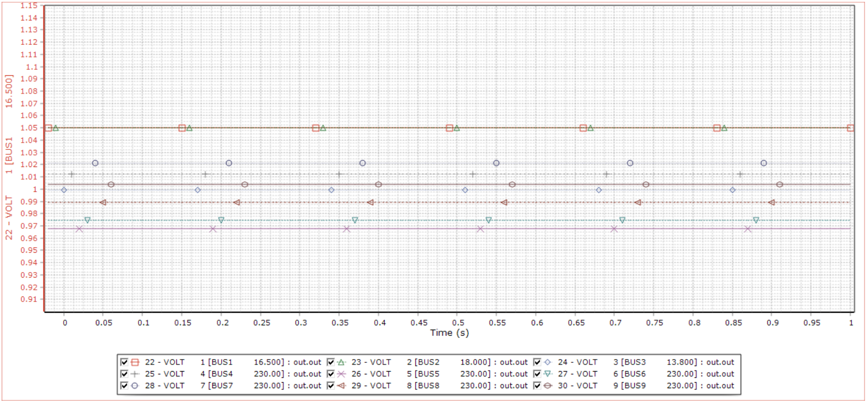

Slide 12
Event: Trip line 5-7

Slide 13
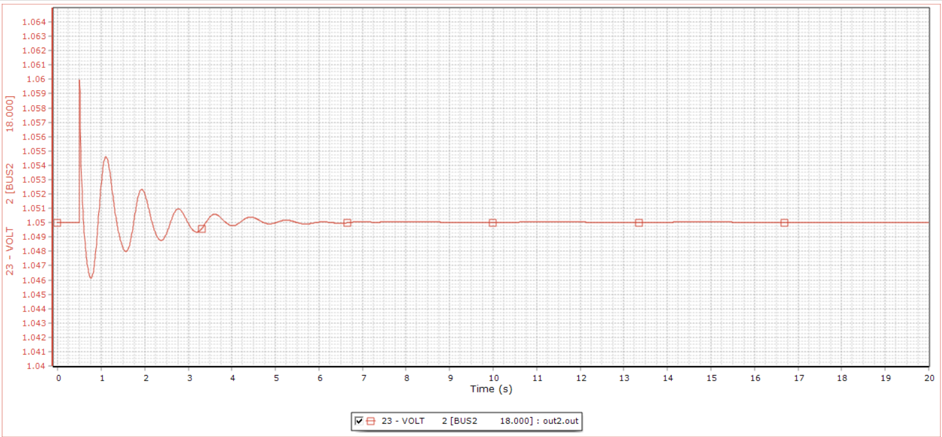
BUS2 voltage (p.u.)

