Slide 1
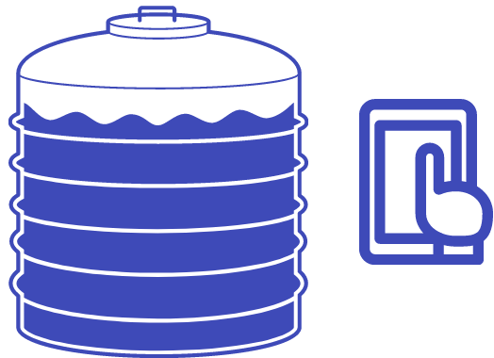
Water Quality Monitoring and usage monitoring System
Milestone 5 (Group 13)
E/16/049 Harshana Bandara
E/16/134 Yasitha Herath
E/16/388 Thushara Weerasundara
1

Slide 2






Review
Mointor the water level of water tanks
Monitor the water quality of the filling water of the tanks.
The required notifications are generated.
Consists of,
Sensor devices
Database
Server
2

Slide 3
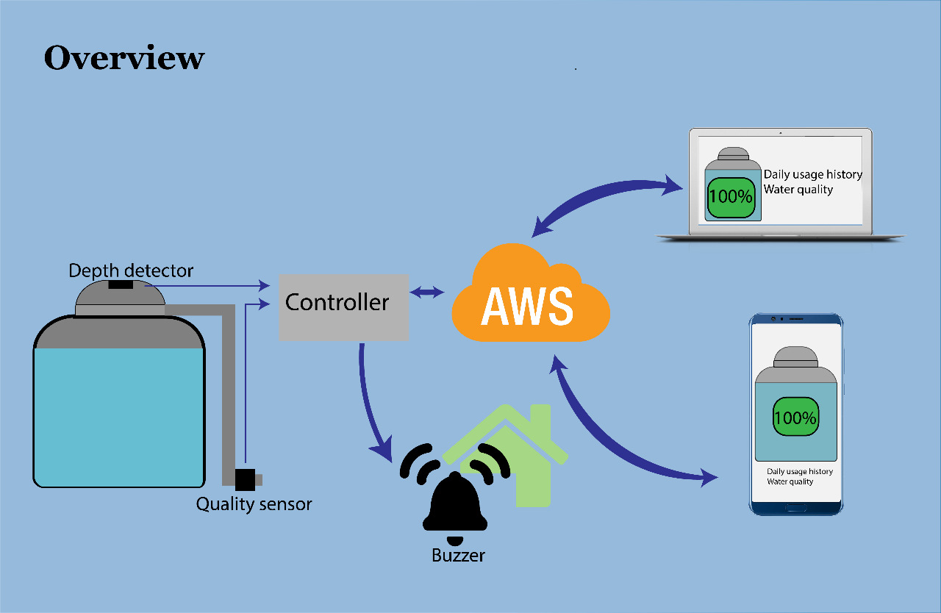
3

Slide 4
Roles of the system
User
Admin
Super Admin
Monitor Devices and Receive notifications
Monitor the system
Customer management and support
Manage Admins
4

Slide 5
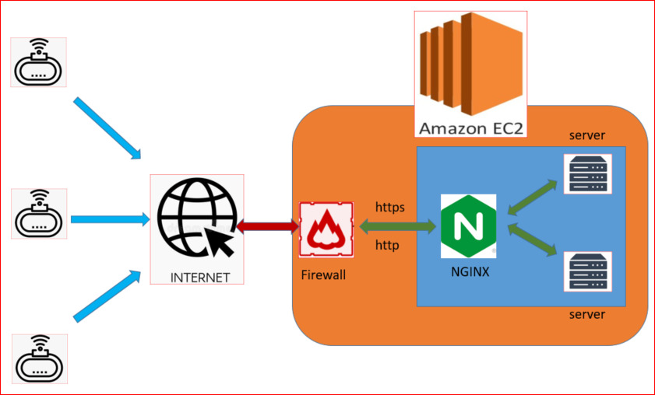

Cloud Deployment
Node js server -
EC2 instance
NGINX reverse proxy
Firewall protection
Mongodb database
Keeping snapshots for
backup data
5

Slide 6
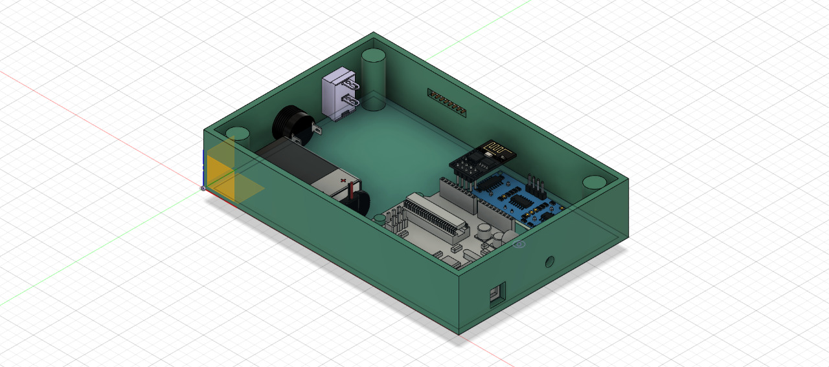
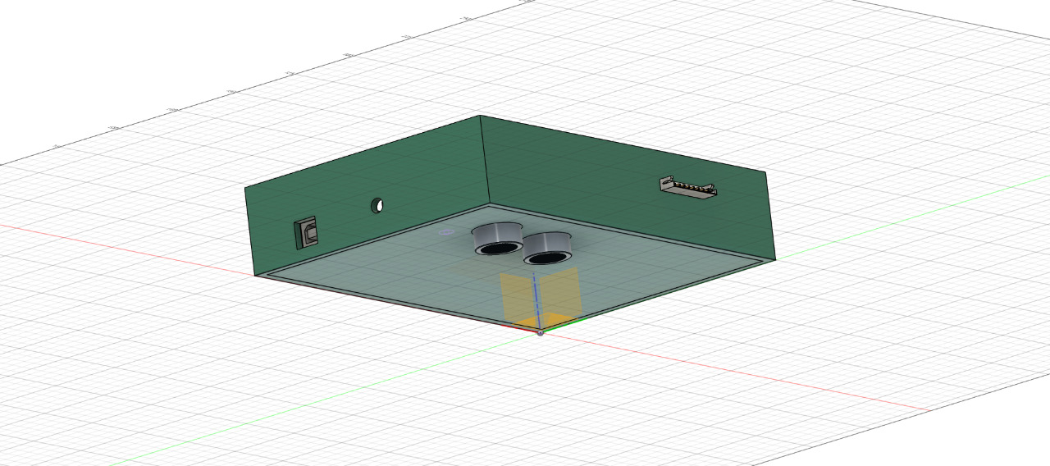
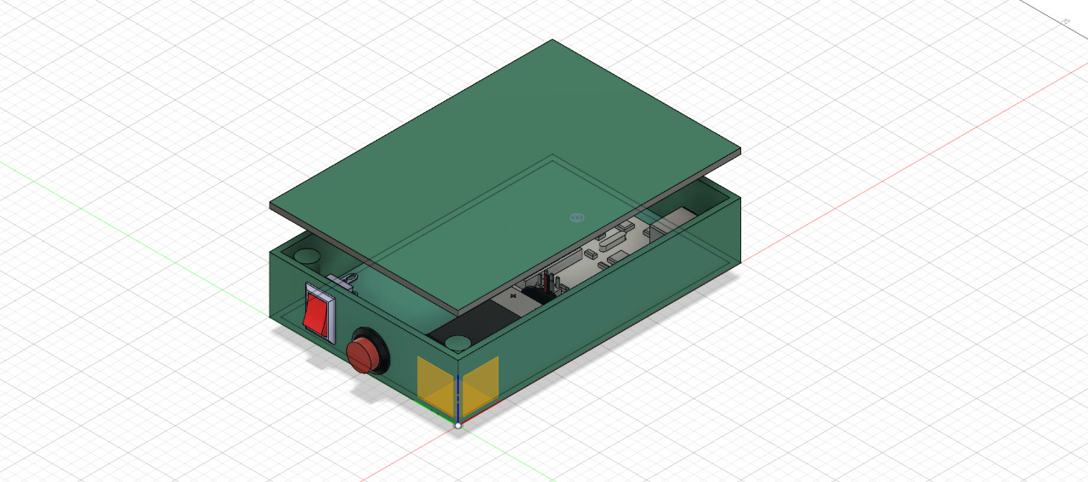
Hardware Designs
6

Slide 7
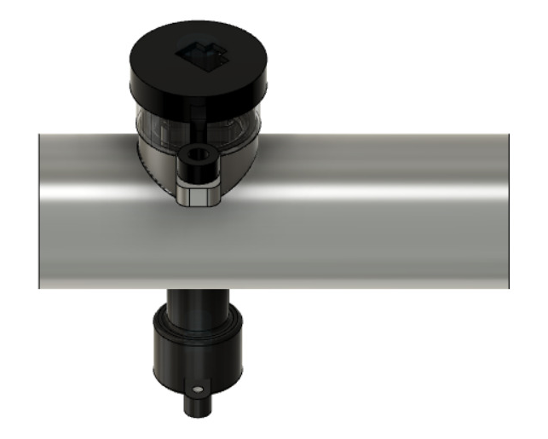
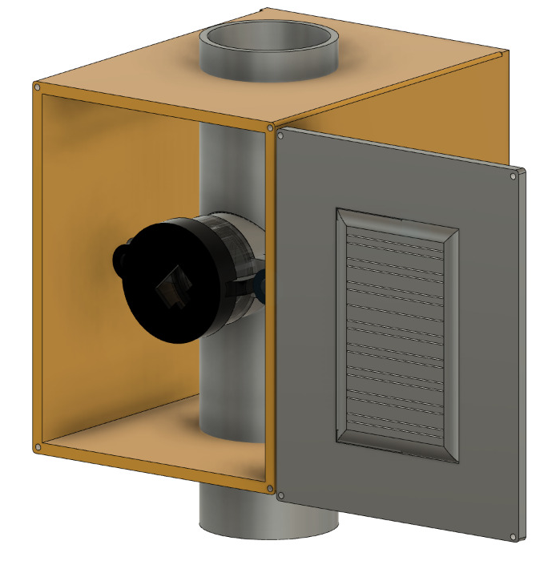
Hardware Designs(Continue..)
7

Slide 8
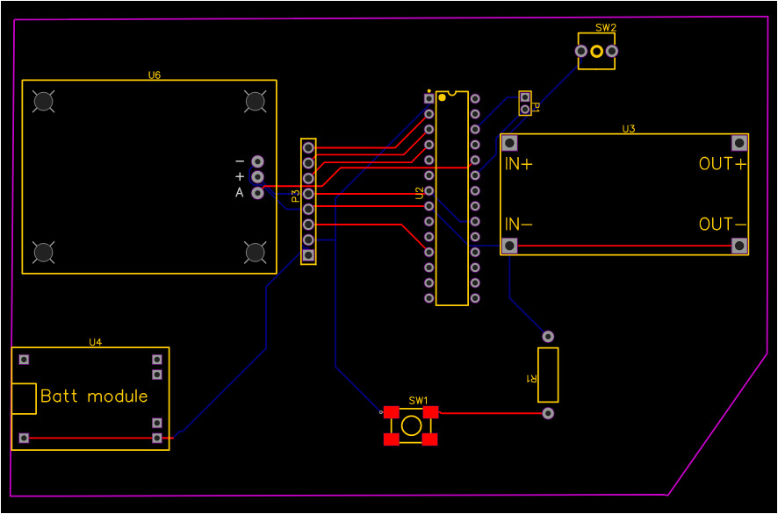
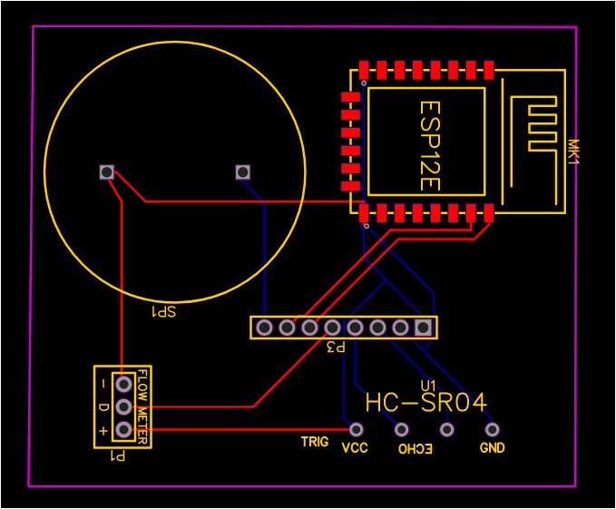
PCB Design
8

Slide 9
Embedded Software
NodeMcu
ATMEGA328P
Inter Communication
Store Device Id and WiFi information on EEPROM
Communication with the server
Readings are taken by analog inputs and external inturrupts
Setting off alarams when needed
Serial communication pins of ATMEGA328P and Software serial pins of NodeMCU
9

Slide 10

User Experience
System admins can assist the customers via website.
Automatically notifying authorities on issues.
Users can receive notice on upcoming water cuts.
Device automatically get configured after installation(no tank parameters needed)
10

Slide 11

Security
Hardware Aspects
Water tight design
Non toxic material for fabrication
Data validation
Software Aspects
Email verification on signup
Hashing passwords using blowfish cipher
Authorization middleware
Setting the request rate limits
11

Slide 12


Reliability
Scalability
Single app can monitor multiple tanks
Easy to add new devices
Can set up on any type of tank
Solar powered rechargable battery
Ability to alert the user by using a buzzer even with no wifi
Can work under extreme weather conditions
Accurate sensor readings
12

Slide 13

Future Plans
Water leakage detection functionalities
Extend the comaptibility to other chemical types to install with chemical tanks
Improve the app and server architecture
13

Slide 14
Demonstration
14

Slide 15
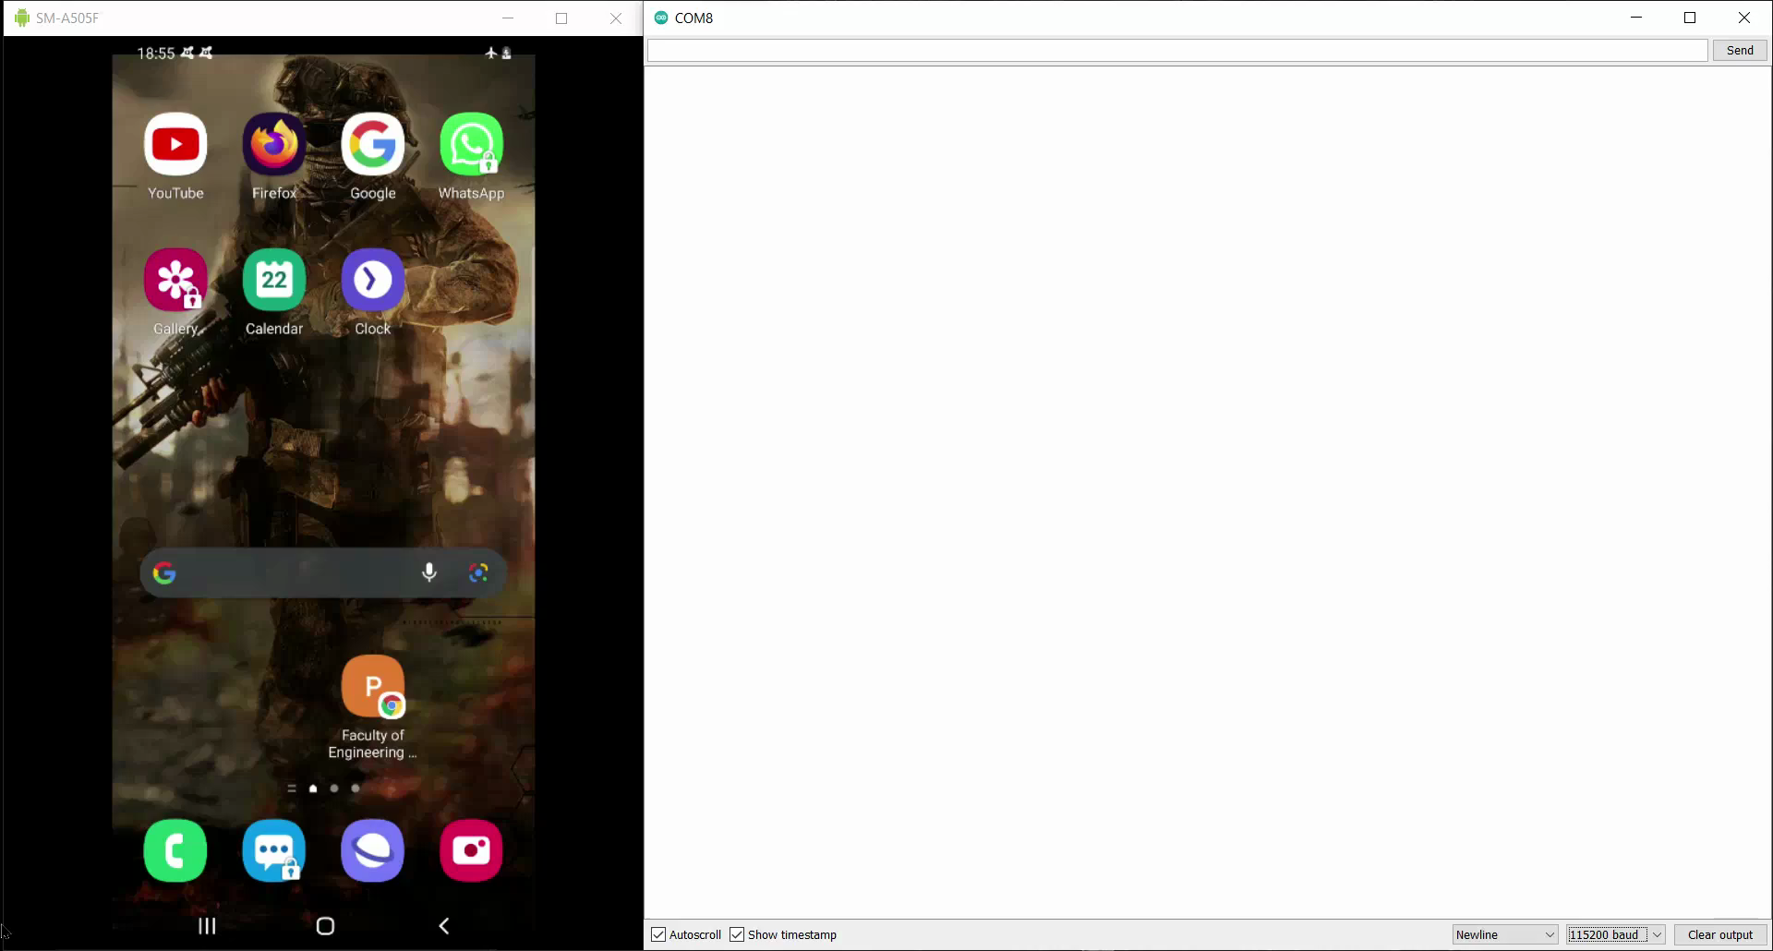
15

Slide 16
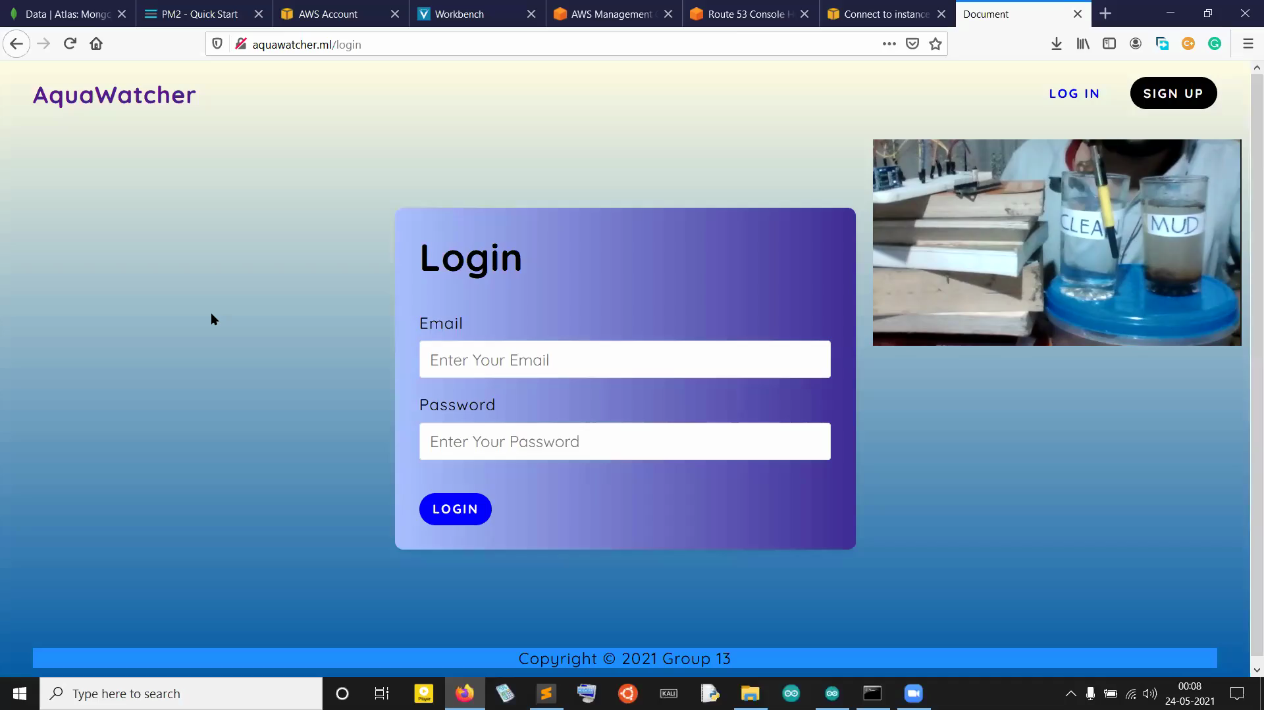

Slide 17
Q & A
17

