Slide 1


Introduction to
Golang
Advanced Web Topics | WMAD Sr. B Eduardo Pohl & Yasmin Kobayachi

Slide 2
History of Go
How Go works
Today’s agenda
Libraries & Packages
What we will cover
Variables
Arrays & Slices
Functions
Demo

Slide 3
Brief History of Go
Go was developed by Google developers
2009
2012
Initial version was released
Current version is go1.20 released on Feb 14th, 2023
2023

Slide 4

How Go works
Syntax
Inspired by several other programming languages
Similar to C in its syntax with a few key differences
Around 25 keywords
Designed to be simple and easy to use, with a focus on developer productivity
Compilation
Compiled into executables that can run anywhere, even if the machine doesn’t have Go installed
Concurrency
Go’s concurrency model is based on lightweight threads called goroutines and they can execute independently of each other

Slide 5

How Go works
bin
It holds all compiled code, the executable files (binary files)
Folders in Go needs to follow specific names
pkg
directory/
└── go
├── bin
├── pkg
└── src
It holds all shared packages of the applications
src
Where we write our code for each application
Hold the third-party packages

Slide 6

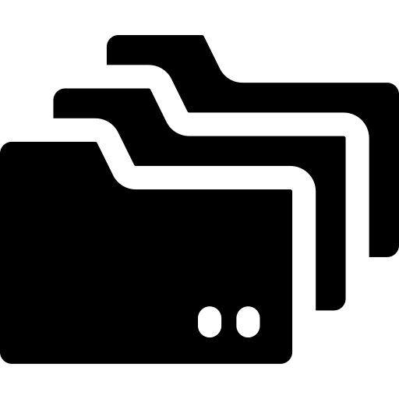
Libraries & Packages
Standard Library
Third-Party Packages
Go already comes with a rich standard library, providing a wide range of functionality
External packages and libraries can be easily installed and used

Slide 7
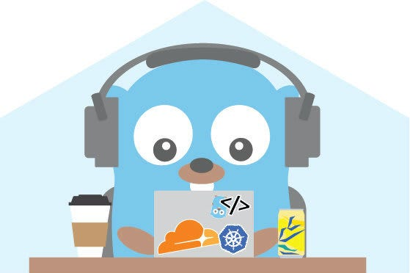
Variables
There are only 5 types of variables
We can’t declare a variable and not use it – that will cause a compilation error!
We don’t need to explicitly declare the variable type
TYPE | DEFAULT VALUE
string | “”
int | 0
float32 or float64 | 0
bool | false
* | nil

Slide 8
Variables
Declaring variables
var variableName string = “Golang”
var variableName = “Golang”
variableName := “Golang”
var example float32 = 2.023
var example = 2.023
example := 2023
const year = 2023
// explicitly declaring a string
// Go already understands this is a string
// short declaration syntax
// explicitly declaring a float32
// Go is the one who decides which float it should be

Slide 9
Variables
Declaring variables
var firstName, lastName string
var (
weight = 10.85
name = “Golang”
quantity := 3
)
// we can declare many variables at the same time

Slide 10
Variables
To know the variable type, we need to use the function TypeOf inside the reflect package
example := 2023
typeOfExample := reflect.TypeOf(example)
fmt.Println(typeOfExample)
// fmt is another package
// this will print float32 or float64

Slide 11
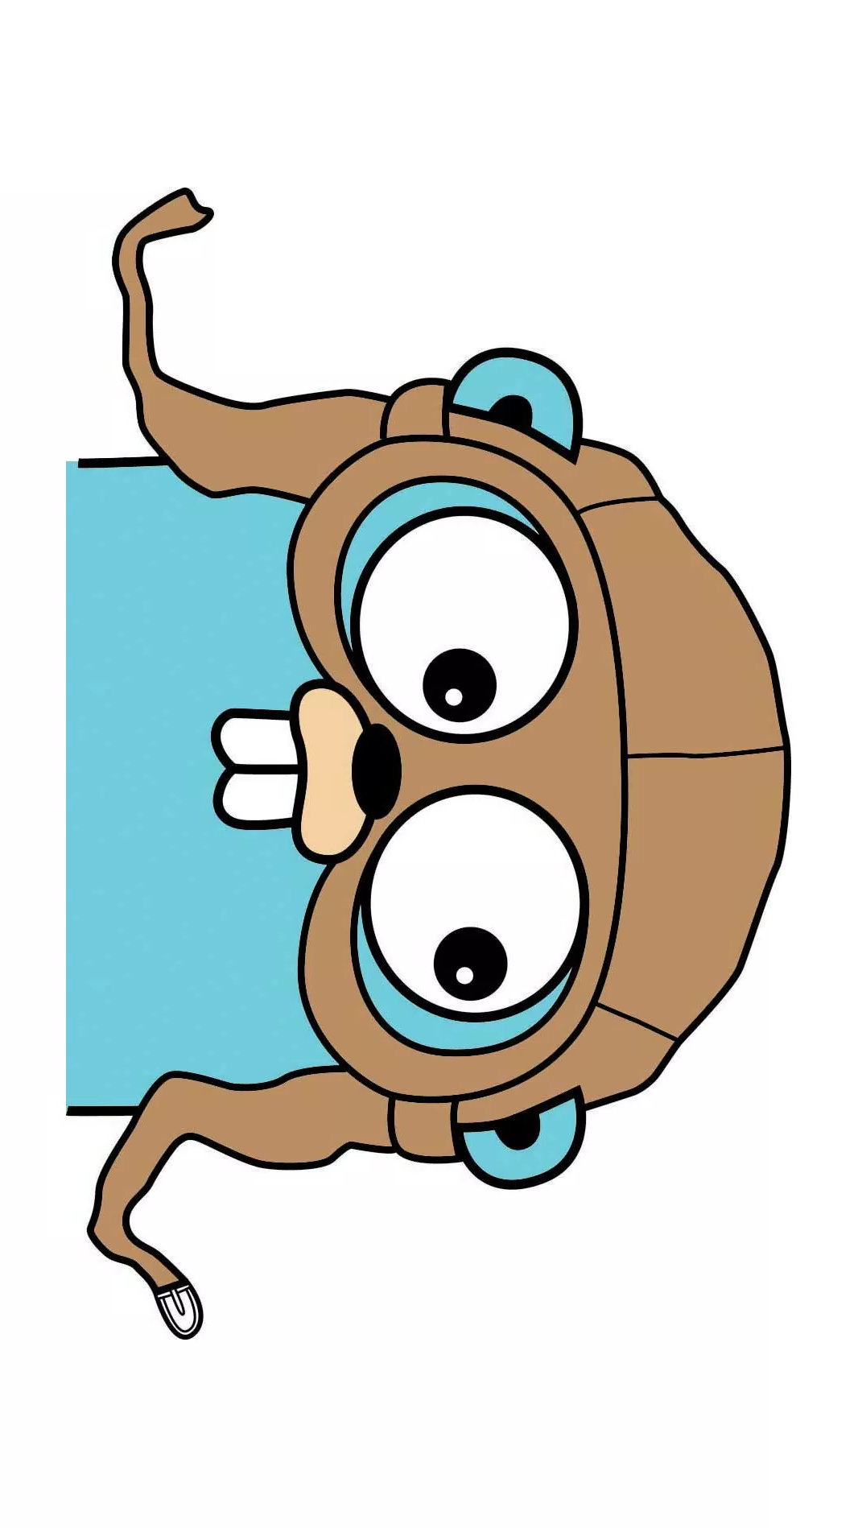
Arrays & Slices
Slices are a type of an array
The difference between arrays and slices is that arrays have a pre-determined size, while slices don’t
When declared, arrays give the default value for its elements – that means that if you don’t initialize one of the elements, it will have an initial value based on its type

Slide 12
Arrays
Declaring an array and changing the value for its elements
var arrayName [3]int
arrayName[0] = 10
arrayName[2] = 30
fmt.Println(arrayName)
// output:
// [10 0 30]

Slide 13
Slices
Declaring and initializing a slice
sliceName := []string{“Red”, “Blue”}
fmt.Println(sliceName)
// output:
// [Red Blue]

Slide 14
Slices
Slices have lengths and capacities:
Length is the number of items inside a slice – we can check it using len(slice)
Capacity is how many elements a slice can hold – we can check it using cap(slice)
colors := []string{“Red”, “Blue”, “Yellow”}
fmt.Println(len(colors))
fmt.Println(cap(colors))
// output: 3
// output: 3

Slide 15
Slices
To add a new element to a slice, we use append(slice, element)
In this case, the capacity will double from its original capacity automatically
colors = append(colors, “Black”)
fmt.Println(colors)
fmt.Println(len(colors))
fmt.Println(cap(colors))
// output: [Red Blue Yellow Black]
// output: 4
// output: 6

Slide 16

Functions
We use the keyword func to declare a function
func main() is the primary function
It doesn’t return anything and doesn’t receive any parameters
When it ends, the application stops running
A function can return one or more parameters
Go doesn’t have access modifiers. What will define the access control is the first letter case of a field , function or method name
camelCase | Private (unexported)
PascalCase | Public (exported)

Slide 17
Functions
Declaring a function
func funcName(parameters) <return type> {
// code
}
func sum(num1, num2 int) int {
return num1 + num2
}
// Function to sum up 2 numbers
// This will return an integer

Slide 18
Functions
Variadic function
Receives an undetermined number of parameters
We use … to indicate it is a variadic function
func sum(numbers …int) int {
total := 0
for _, num := range numbers {
total += num
}
return total
}
// Range returns two values:
the index and the value for each iteration
// We won’t need the index, so we name it _
// This way, Go won’t complain we are not using this value

Slide 19
Functions
Considering the previous variadic function
fmt.Println(sum())
fmt.Println(sum(1, 2, 3))
fmt.Println(sum(10, 20, 30, 40, 50))
// output: 0
// output: 6
// output: 150

Slide 20
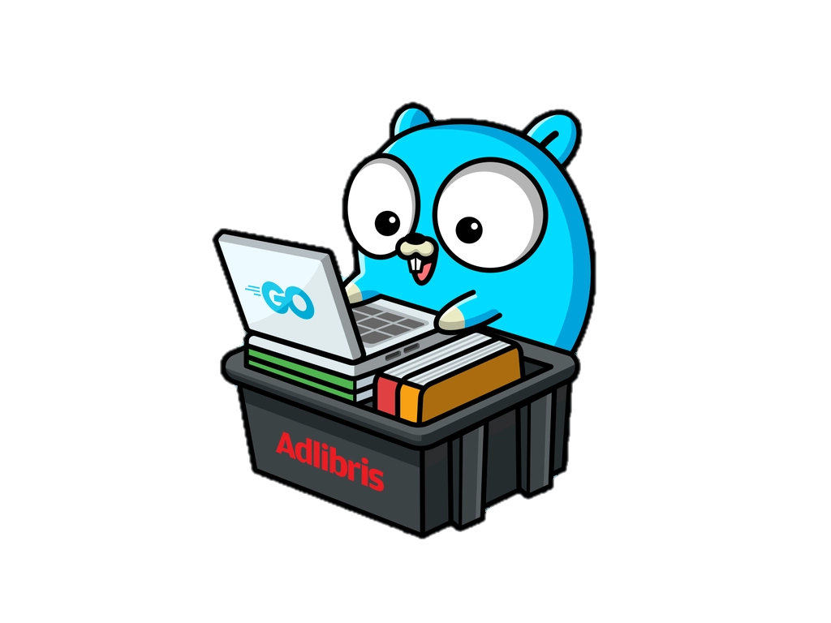
Let’s code!

Slide 21
Documentation
Documentation - The Go Programming Language. (n.d.). https://go.dev/doc/
Wikipedia contributors. (2023, March 3). Go (programming language). Wikipedia. https://en.wikipedia.org/wiki/Go_(programming_language)
References
Courses
Cursos da Formação Linguagem Go. (n.d.). Alura. https://cursos.alura.com.br/formacao-go
The Net Ninja. (2021, May 19). Go (Golang) Tutorial #1 - Introduction & Setup [Video]. YouTube. https://www.youtube.com/watch?v=etSN4X_fCnM
freeCodeCamp.org. (2019, June 20). Learn Go Programming - Golang Tutorial for Beginners [Video]. YouTube. https://www.youtube.com/watch?v=YS4e4q9oBaU

Slide 22
Images and others
Presentation template. (n.d.). Canva. Retrieved March 1, 2023, from https://www.canva.com/
Flaticon. (2019, July 15). Folder Icon - 1975660. https://www.flaticon.com/free-icon/folder_1975660?term=file&related_id=1975660
File:Go gopher favicon.svg - Wikimedia Commons. (n.d.). https://commons.wikimedia.org/wiki/File:Go_gopher_favicon.svg
Gopher. (n.d.). Retrieved March 6, 2023, from https://golangforall.com/en/
Go Gopher coding it up Cloudflare and Kubernetes. (n.d.). Dribbble. https://dribbble.com/shots/3878129-Go-Gopher-coding-it-up-Cloudflare-and-Kubernetes
Gopher with Laptop. (n.d.). Dribbble. https://dribbble.com/shots/18090283-Gopher-with-Laptop
C. (n.d.). GitHub - cilium/pwru: Packet, where are you? -- eBPF-based Linux kernel networking debugger. GitHub. https://github.com/cilium/pwru
Datei Anzeigen - Golang Gopher China Transparent PNG - 2838x2716 - Free Download on NicePNG. (n.d.). NicePNG.com. https://www.nicepng.com/ourpic/u2e6t4e6t4a9u2e6_datei-anzeigen-golang-gopher-china/
Cardoza, C. (2021, March 9). Why developers love Go. SD Times. https://sdtimes.com/softwaredev/why-developers-love-go/
CodePen Home Bootstrap Crud Data Table For Database with Modal Form. (n.d.). Codepen. Retrieved March 7, 2023, from https://codepen.io/naikjavaid/pen/XPrpjr
References

