Slide 1
Paper Presentation C3KG: A Chinese Commonsense Conversation Knowledge Graph
Reporter: Xuan Chen
Student #82286956

Slide 2
Related work
Contributions
Model Construction
Evaluations
Introduction
Problems being solved

Slide 3
Introduction
ATOMIC: a large-scale commonsense knowledge base, which covers event-centered social aspects of inferential knowledge tuples.
Relations: xNeed, xIntent, xAttr, xEffect, xReact, xWant, xForn, xNeed/Hope, xSee.
{PersonX adopts a cat, xEffect, feels happy}
{PersonX adopts a cat, xWant, company}

Slide 4
Problems being solved
{PersonX adopts a cat, xEffect, ___}
{finds out he has allergies}
{becomes less lonely}.
Multiple tails, which will confuse the chatbots when inferring the cause behind the negative emotion.

Slide 5
Problems being solved
{PersonX adopts a cat, isAfter, finds a cat at the animal shelter} {PersonX adopts a cat, xNeed, go to an animal rescue center}
Conversational agents need not only know the current state but also plan the future dialog flow.

Slide 6
Related work
Commonsense Knowledge Bases(CKB): ConceptNet, TransOMCS
Connecting Knowledge and Conversation:
- extract structured knowledge from conversations.
- adopt automatic extraction tools to construct conversational knowledge bases of certain domains.

Slide 7
Contributions
Curate a new Chinese corpus, containing multi-turn human-written conversations on daily life topics and rich, high-quality annotations on the level of sub-utterance;
Create and will release the first large-scale Chinese commonsense conversation knowledge graph, C3KG, which contain 4 types of unique dialog-flow edges to store the distilled conversation knowledge from the multi-turn conversation corpus;
Devise a graph-conversation matching approach, and benchmark 2 typical tasks grounded on commonsense conversation graph.

Slide 8
A Scenario-based Multi-turn Conversation Corpus
CConv: collects a multi-turn human-written Chinese conversation corpus based on crowdsourcing.
5 general emotion types: {joy, angry, sad, surprising, other}
6 commonly-adopted intent classes: {ask, advise, describe, opinion, console, other}

Slide 9
Brief Introduction of ATOMIC
ATOMIC: <head, relation, tail>
ATOMIC-zh: Regular Replacement and Joint Translation
2 properties:
It collects knowledge about how people will react to a given event.
It organizes knowledge using several inferential relations and naturally supports if-then reasoning.
Notes:
P9- ATOMIC Based on ATOMIC, the authors design a pipeline method to translate it into Chinese,
meanwhile ensuring the resulted knowledge graph is reliable and suitable for conversation grounding.
ATOMIC organizes commonsense knowledge in the form of triplet <head, relation, tail>,
where head often describes a daily event.
It collects knowledge about how people will react to a given event.
It also organizes knowledge using several inferential relations
and naturally supports if-then reasoning,
which I have mentioned initially.
在将ATOMIC翻译成中文方面，作者采用Regular Replacement和Joint Translation 的方法来提高翻译的质量，翻译后的ATOMIC表示为ATOMIC-zh。

Slide 10
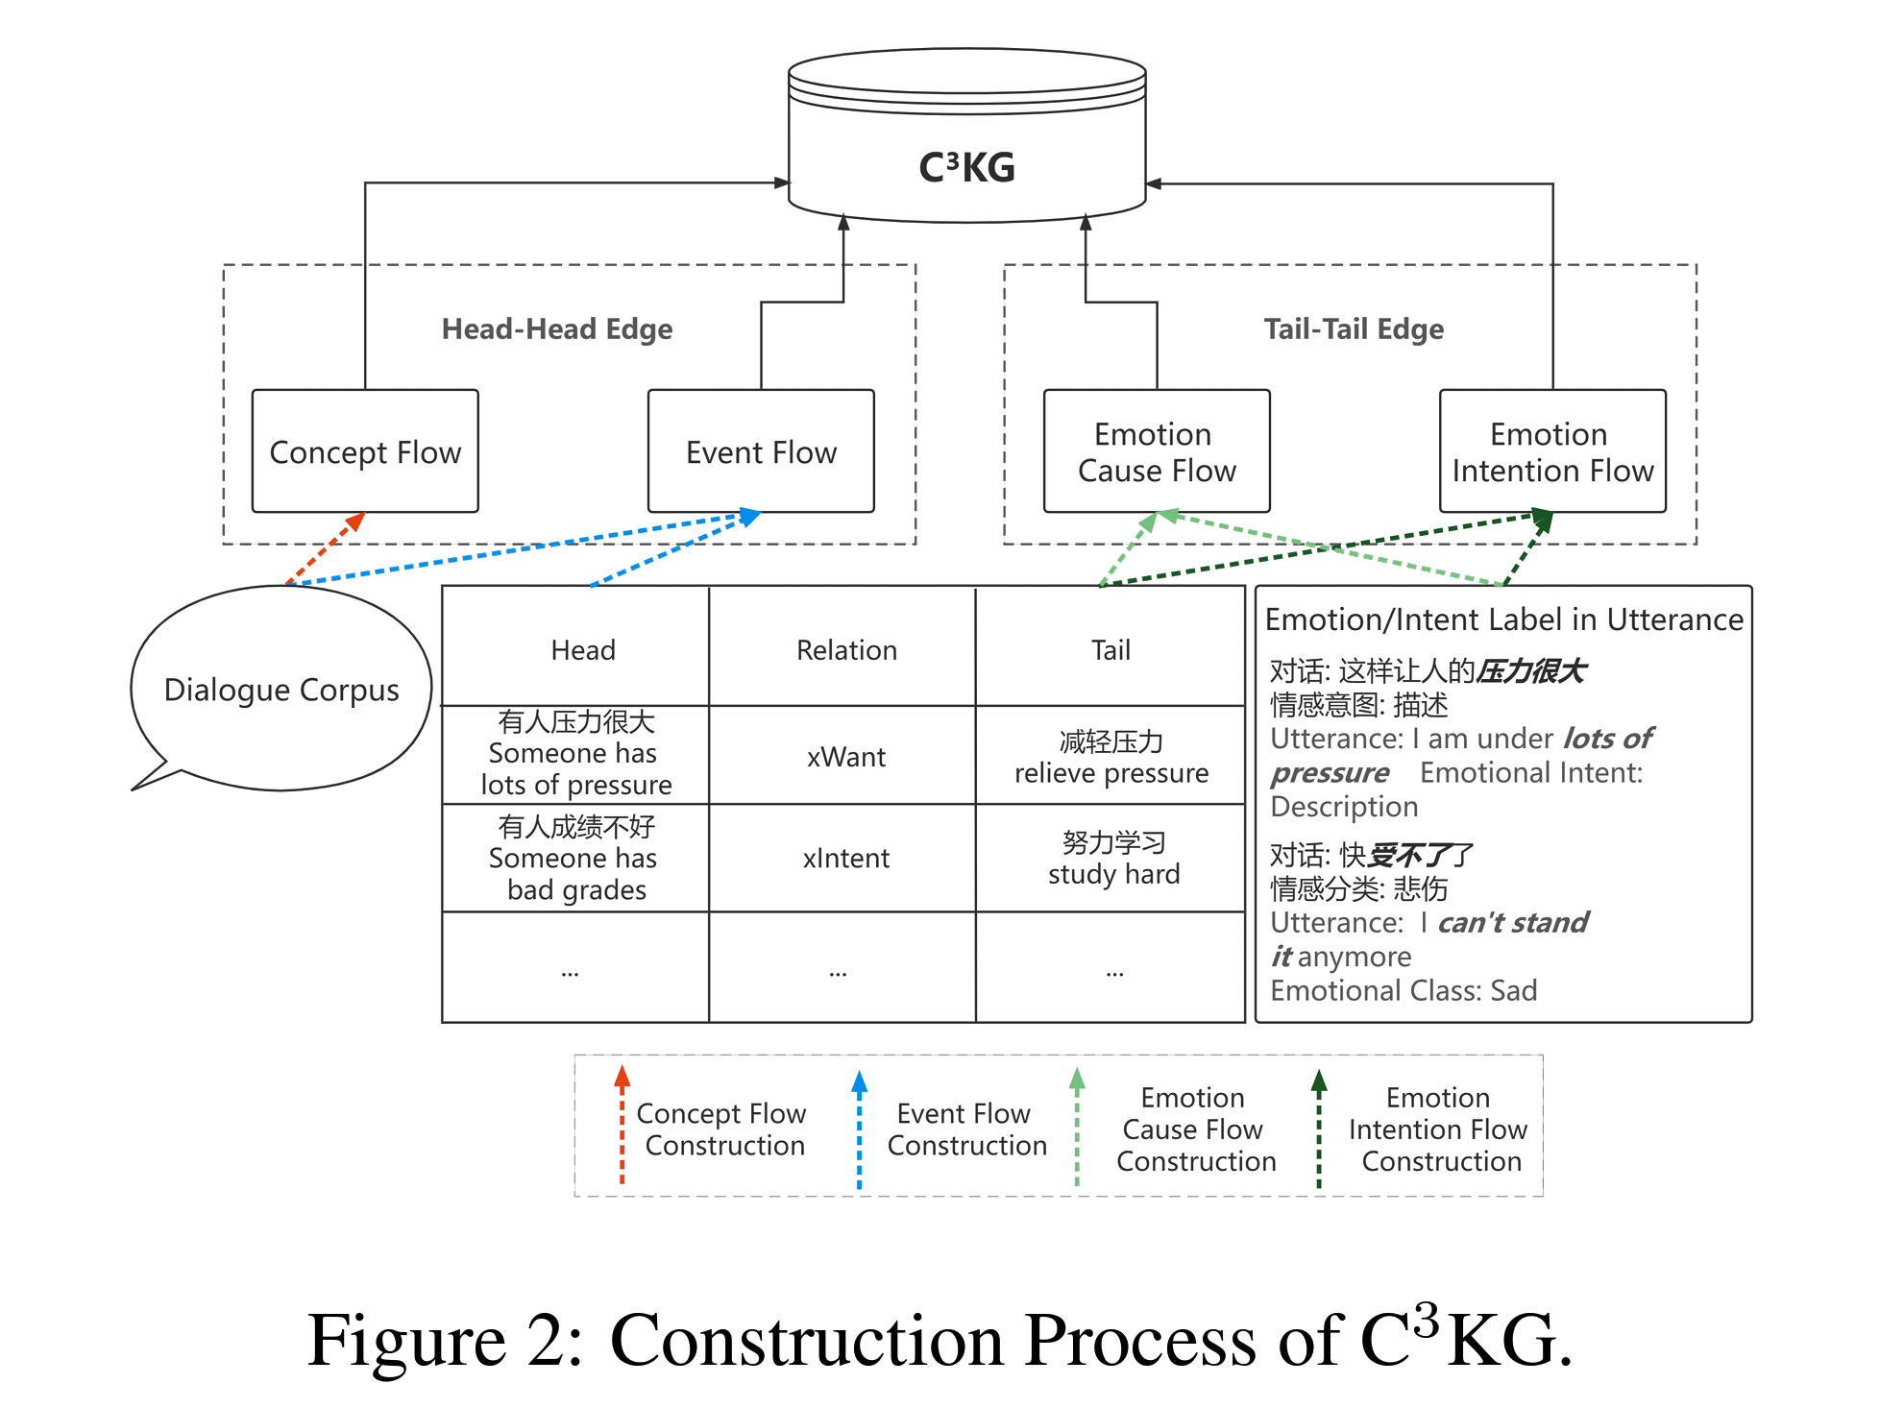
Conversation Knowledge Graph Construction (C3KG)

Slide 11
Conversation Knowledge Graph Construction (C3KG)
Event Extraction
Event Linking as Matching:
Sentence-BERT: It encodes two given sentences separately and calculates the similarity between their representations.
Edge Construction:
Head-Head Edge Construction
Tail-Tail Edge Construction

Slide 12
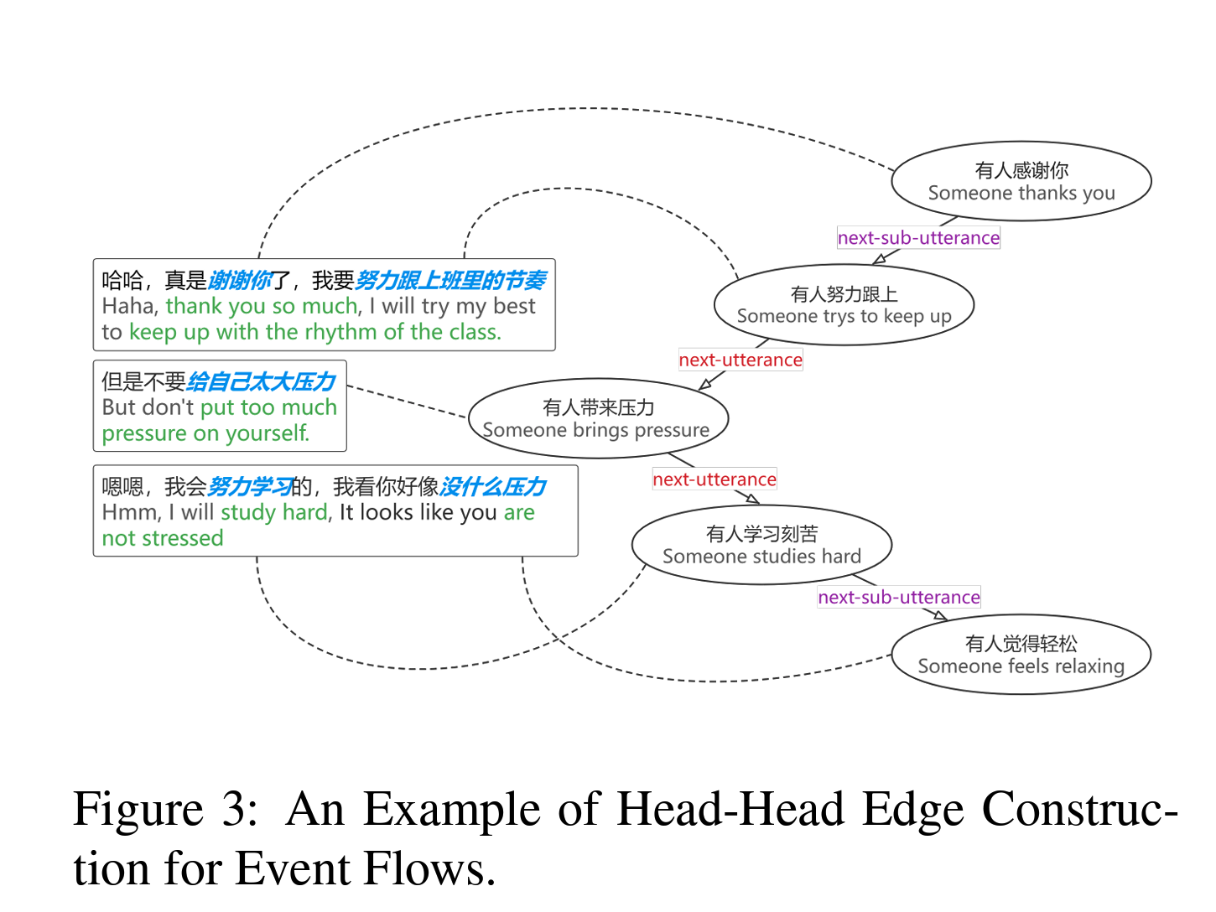
Head-Head Edge Construction
Event Flow
Concept Flow

Slide 13
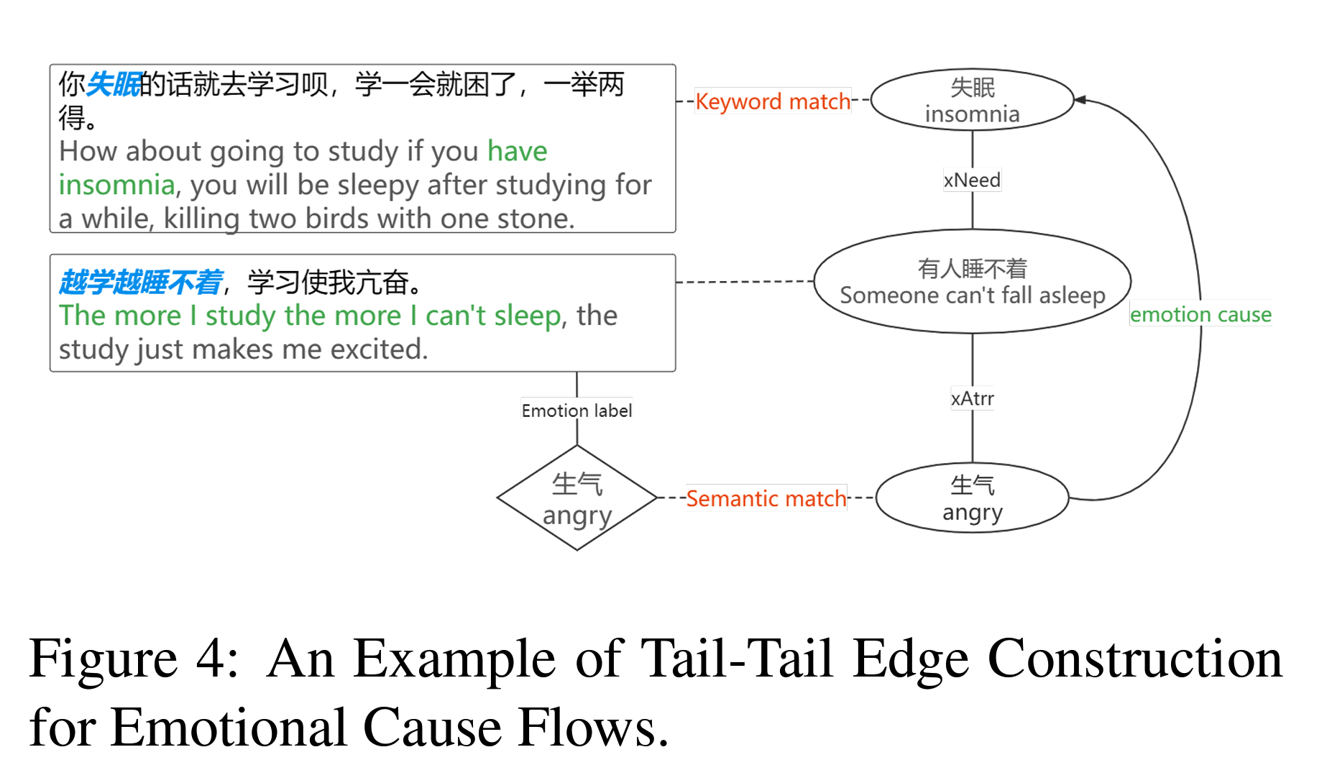
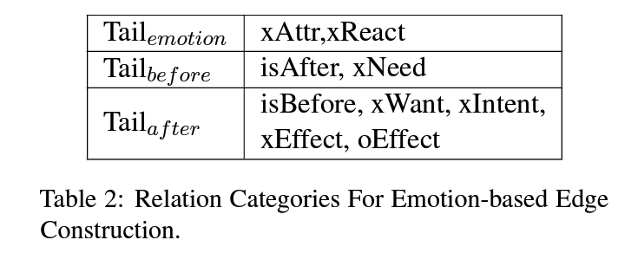
Tail-Tail Edge Construction

Slide 14
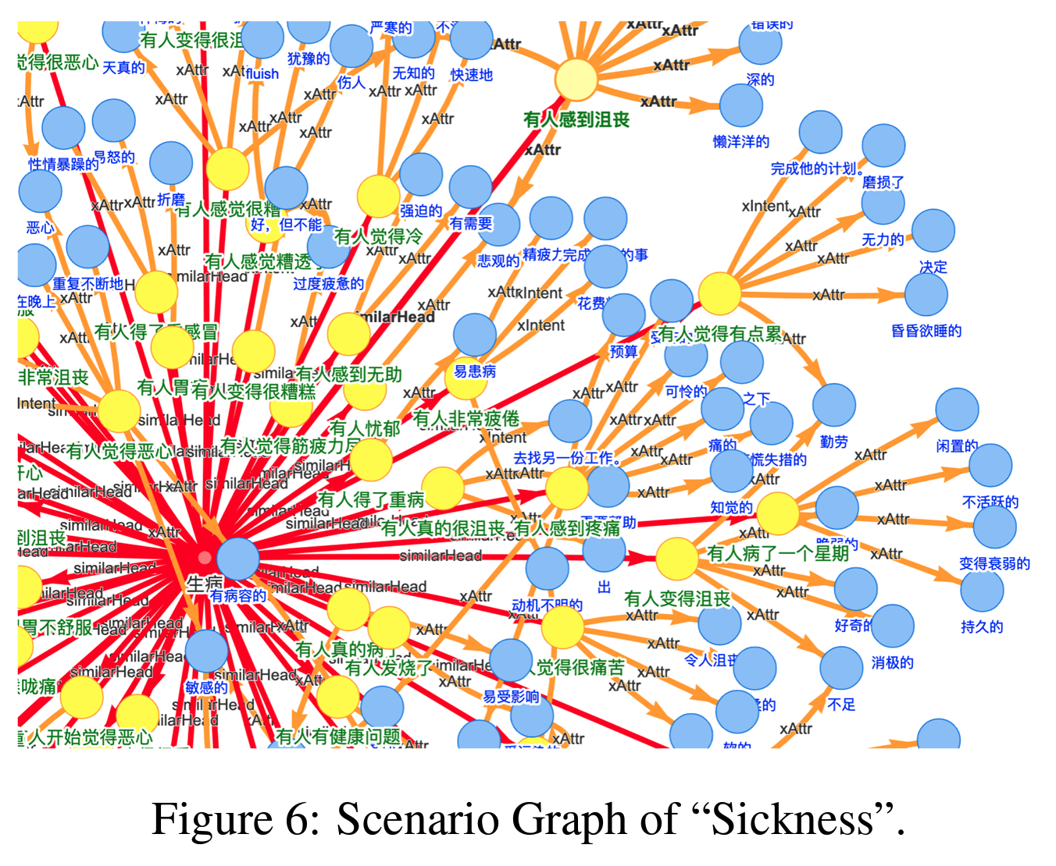
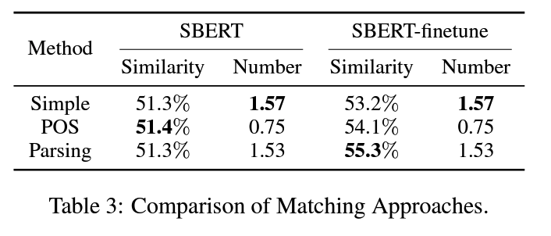
Evaluation – Matching Evaluation
Manual Assessment
Scenario Graph Visualization

Slide 15
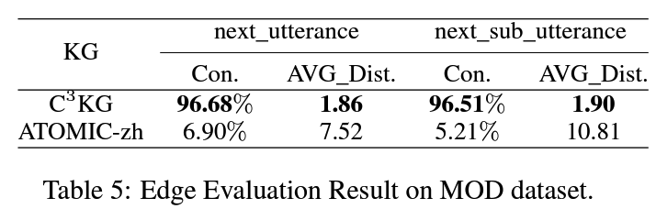
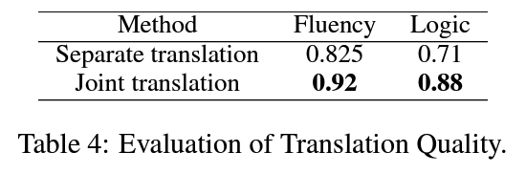
Evaluation – Graph Evaluation
Node Evaluation
Edge Evalutation

Slide 16
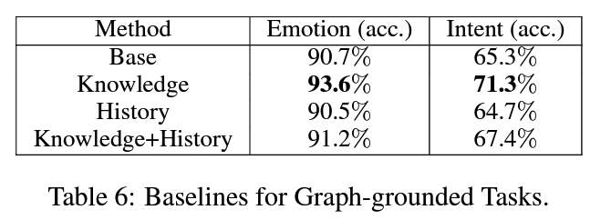
Graph-based conversation tasks
Task 1: Emotion Classification
requires to produce an emotion label conditions on the conversations.
Task 2: Intent Prediction
requires to predict a proper type of response intent for the conversations.

