Slide 1
Ansible
From
Yasmeen

Slide 2
CONTENTS
Ansible
Why ANSIBLE
Ansible Architecture
Ansible main components(playbooks,roles ets)
Ansible in CI/CD

Slide 3
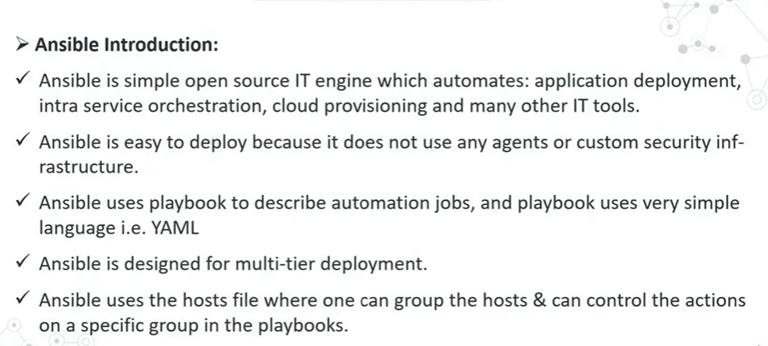
Ansible

Slide 4
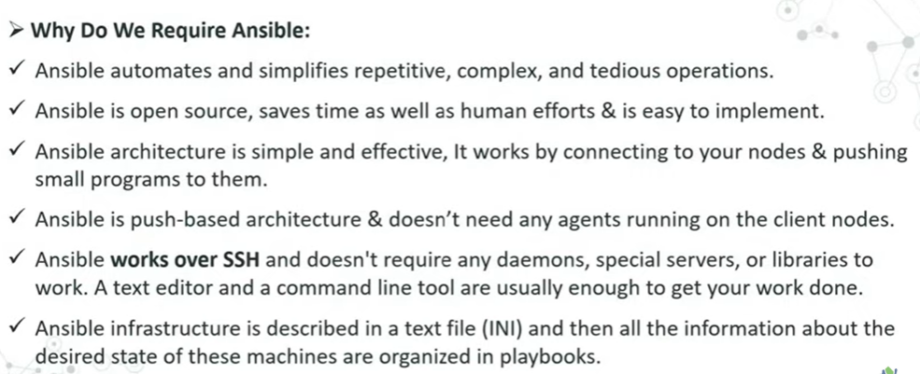
Why ANSIBLE

Slide 5
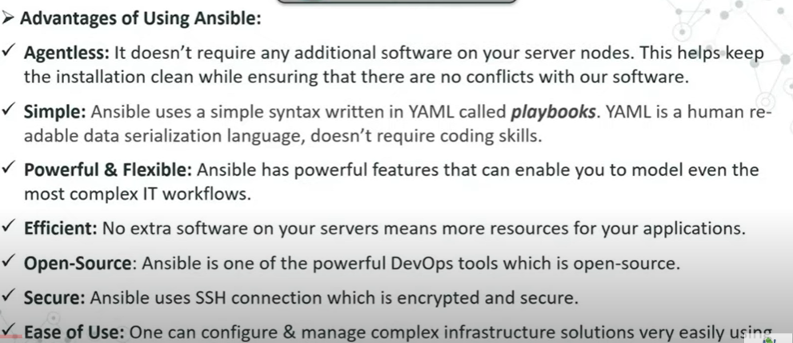
Advantages

Slide 6
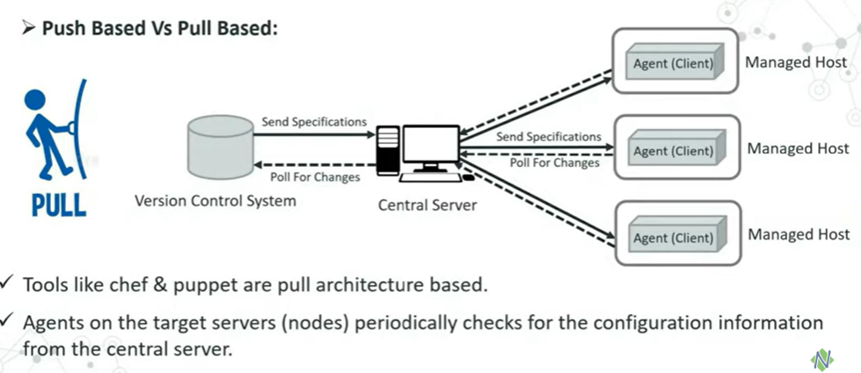
Push Based Vs Pull Based

Slide 7
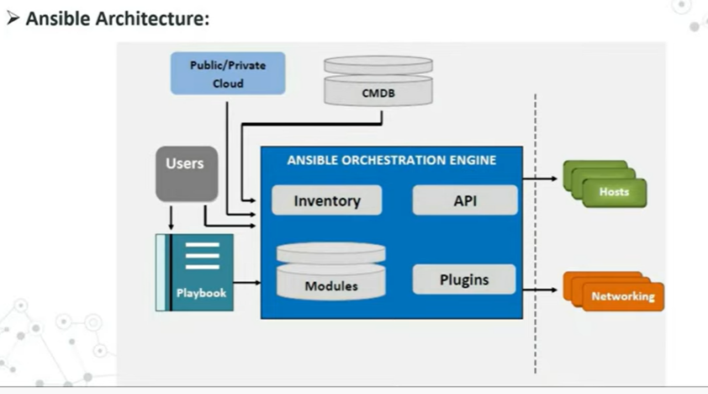
Ansible Architecture

Slide 8
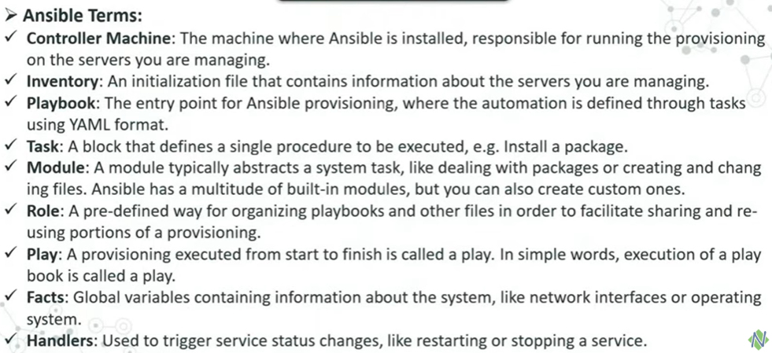

Slide 9
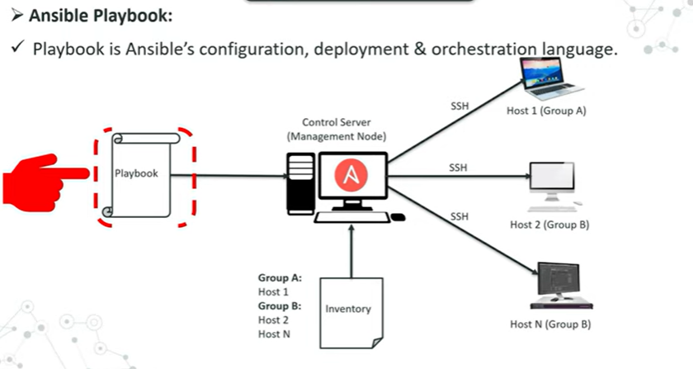

Slide 10
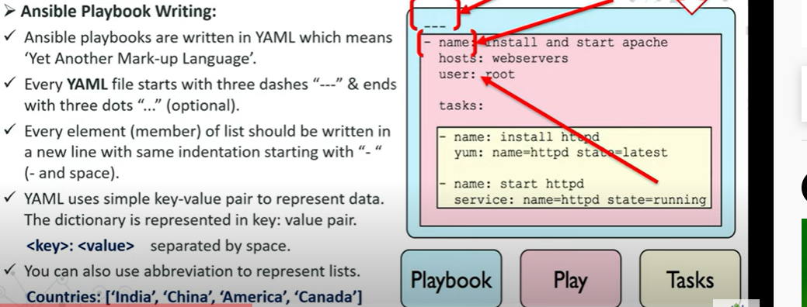
Ansible Playbook

Slide 11
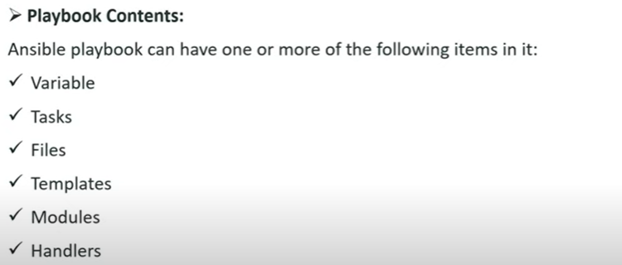
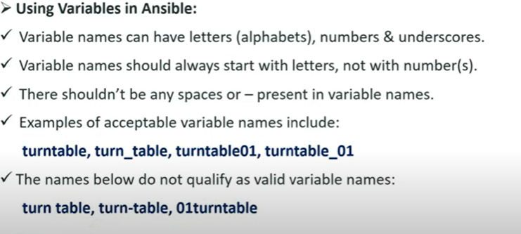
Playbook

Slide 12
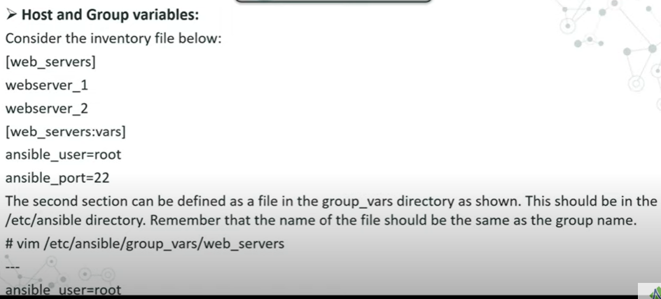

Slide 13
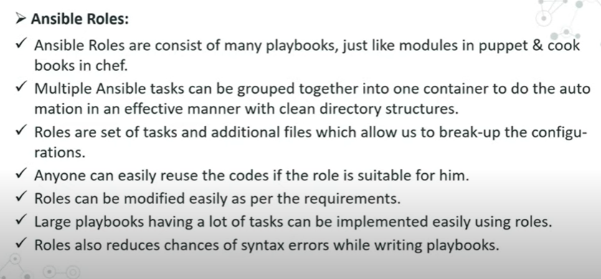
Ansible Roles

Slide 14
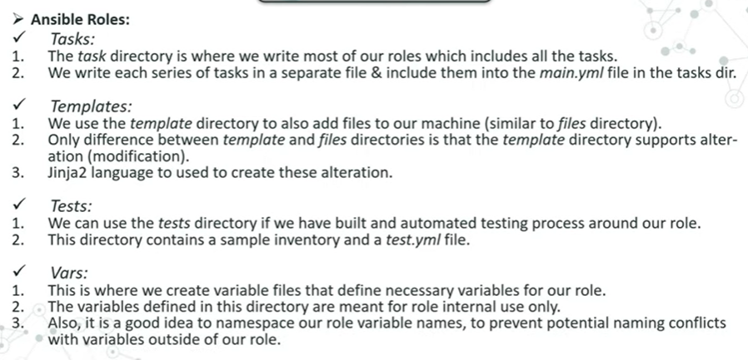

Slide 15
THANKYOU

