Slide 1
Where Are We Losing Orders?
An Order Fulfillment Analysis of 1,200 Transactions
DecodeLabs Data Analytics Internship — Project 4 | Prepared by Yasu

Slide 2
Order Volume Has Been Steady — On the Surface, Business Looks Healthy
1,200
5
5
100%
Total Orders Analyzed
Products in Catalog
Payment Methods Offered
Data Quality After Cleaning
The dataset passed every structural check: no duplicate IDs, no formatting errors, no calculation mismatches. Revenue is evenly distributed across the catalog — no single product carries disproportionate risk.
Situation

Slide 3
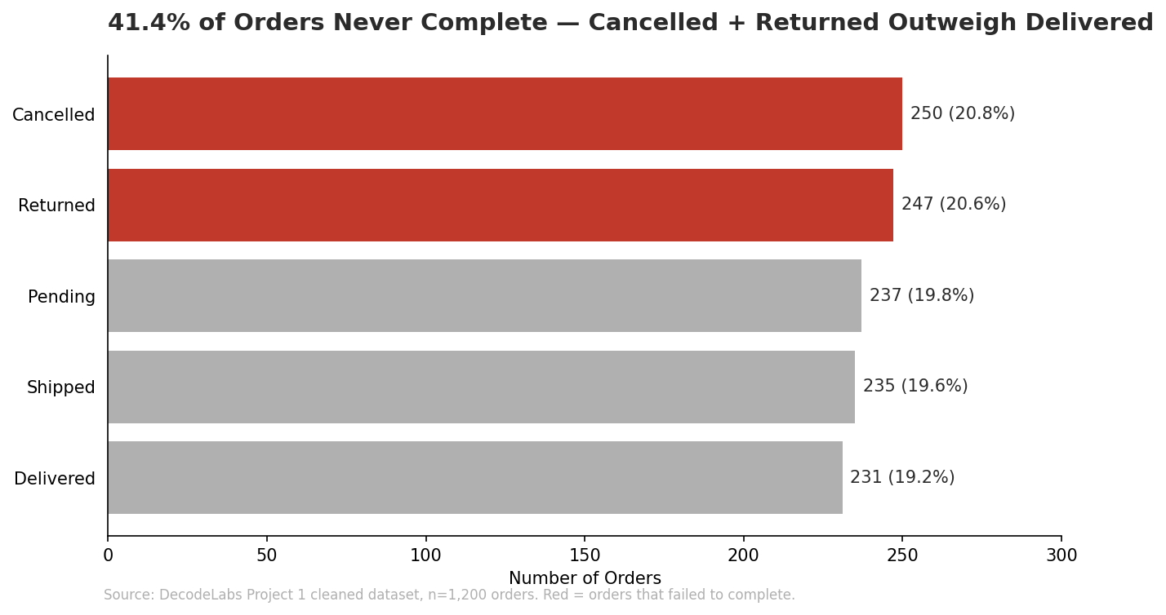
But 41.4% of Orders Never Complete
Cancelled and Returned orders combined outnumber Delivered orders outright.
Complication

Slide 4
Recommendation: Investigate the Cancel/Return Funnel Before Scaling Spend
1. Root-cause the 41.4%
Pull a sample of Cancelled and Returned orders and map them by stage — checkout, payment, fulfillment, or post-delivery — before assuming a single cause.
2. Protect the high-value losses
Cancelled orders priced above the dataset average represent the most expensive failures. Query 6 in Project 3 isolates these — that's the starting list.
3. Report typical order value using the median
Order value is right-skewed (mean ₹1,054 vs. median ₹824). Leading with the median avoids overstating what a normal customer actually spends.
Resolution | Source: DecodeLabs Project 1–3 cleaned dataset, n=1,200 orders

