Slide 1
E-Scooter System
Outline Presentation
SIE 457
Group #40
Yasmin Kullab
Notes:
My presentation is about an E-Scooter system that focuses on people who uses E-Scooter in their daily life and wants to rent an E-Scooter through an application, with full safety and successful services.The main goal of this project is that the user can purchase it quickly, also we need to make sure that all of user’s information are securely locked so that no one can access their information.

Slide 2
Agenda
Executive Summary
Background
Project Objective/Requirements
Deliverables/Milestones
WBS Overview
Project Network/Schedule
Project Costs
Stakeholder Analysis
Project Team
Project Risks
Success Criteria
Summary
Notes:
Before I started, I will go through the contents that the presentation will cover. I will start with Executive Summary which gives an idea of what the project about. Then I will go through the background and how it works, then I will include the project objective which explains the main idea of the project and how the system is going to be. Then I will show the requirements, deliverables, milestones and then I will display the work breakdown structure. After that I will show the project network, Stakeholders, and the project team. Then I will talk about the project risks, and the success criteria. Finally, I will go through the summary to conclude the presentation.

Slide 3
Executive Summary
This project is mainly directed to people who wants to ride an E-Scooter, it focuses on people who uses E-Scooter in their daily life and wants to rent an E-Scooter through an application, with full safety and successful services. The main goal of this project is that the user can purchase it quickly, also we need to make sure that all of user’s information are securely locked so that no one can access their information.
Project is expected to be completed on Nov 22 2021
Notes:
This project is mainly designed to people who wants to rent an E-Scooter through an application, with full safety and successful services.

Slide 4
Background
The mobile application will exist on an iOS and Android smartphone. The user will user will interact will the application through a touch interface, and will use the system camera to scan QR code. Through the app, the user will be able to create an account, enter their payment information, start ride.
Notes:
This project allows the user to register their E-Scooter through the mobile application, the system asks the user to scan the QR code, after that they can start the ride safely.

Slide 5
Project Objectives/Requirements
Project Objective:
The purpose of this project is to create an E-Scooter system that focuses on people who uses E-Scooter in their daily life and wants to rent an E-Scooter through an application, with full safety and successful services. Design an easy transformation system with an NTE of $100,000.
Requirements:
The system shall provide the capability for the users to create an account including email and password through the application.
The system shall Track Usage and data of the bike.
The system shall Auto Lock the scooter once the user ends the ride.
The application shall work on iOS (iPhone), and Android that is connected to the internet.
The application shall allow the users to scan QR codes.
The user Shall have an existing bank account to be able to do the payment.
Notes:
The project objective which explains the idea of the project and how the system will be used. The idea of this project is to create an E-Scooter system that focuses on people who uses E-Scooter in their daily life and wants to rent an E-Scooter through an application, with full safety and successful services. Also I will go through the system requirements.

Slide 6
Deliverables
An E-Scooter that will provide a fast and convenient mode of transport for users.
Smartphone with a camera to scan QR code.
Logo.
Customer service.
Design documents and guidelines.
Notes:
This slide shows my deliverables which focuses one each of :
- An E-Scooter that will provide a fast and convenient mode of transport for users.
- Smartphone with a camera to scan QR code.
- Logo.
- Customer service.
- Design documents and guidelines.

Slide 7
Milestones
Application will be available on May 22 2021. The application should be available on iOS and Android, including maps so you can know where to ride and where to park.
Parking spots will be available on 4th of June 2021. The E-scooters will be parked close to the curb, near designated parking areas, trees or street signs.
Security system will be available on May 24th 2021. The safety for riders is our obsession, all the information will be secured from our application including payment system.
Logo delivered on July 12th 2021.
Help Center will be available on July 15th 2021. Customer service will be available 24/7 for users.
Testing the application will be on June 30 2021.
Design documents and guidelines delivered on Nov 22 2021 .
Notes:
Here is the detailed milestone for the project. It does show the things that need to be done by a specific time.
- Application will be available on May 22 2021. The application should be available on iOS and Android, including maps so you can know where to ride and where to park.
- Parking spots will be available on 4th of June 2021. The E-scooters will be parked close to the curb, near designated parking areas, trees or street signs.
- Security system will be available on May 24th 2021. The safety for riders is our obsession, all the information will be secured from our application including payment system.
- Logo delivered on July 12th 2021.
- Help Center will be available on July 15th 2021. Customer service will be available 24/7 for users.
- Testing the application will be on June 30 2021.
- Design documents and guidelines delivered on Nov 22 2021

Slide 8
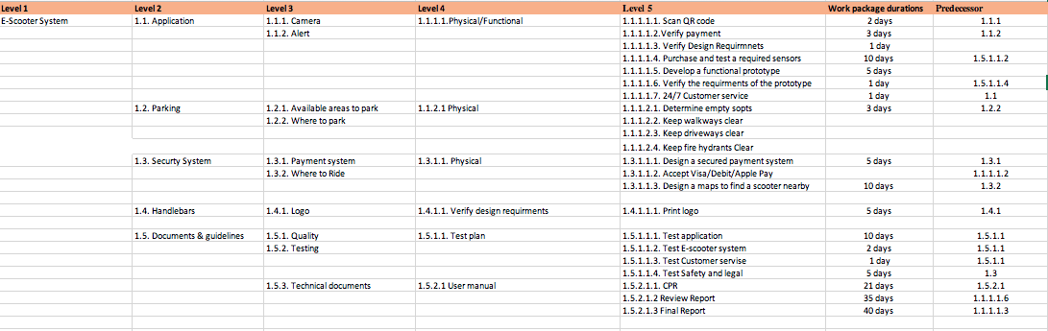
WBS Overview
Notes:
Here is the Work Breakdown Structure which I will explain it in details.
It based on 5 levels, and then the work package schedule and the predecessors.
Starting at level one it has my tile of my project which is the E-Scooter system.
And level two includes each of the application, parking, security system, handbrakes, and Documents and guidelines.
Next level three includes the alert, payment system, and quality.
Level four will include test plan, and user manual.
For level five it will include the scan QR code and print logo.
The predecessors were updated according to the MS project as the project plan changed.

Slide 9
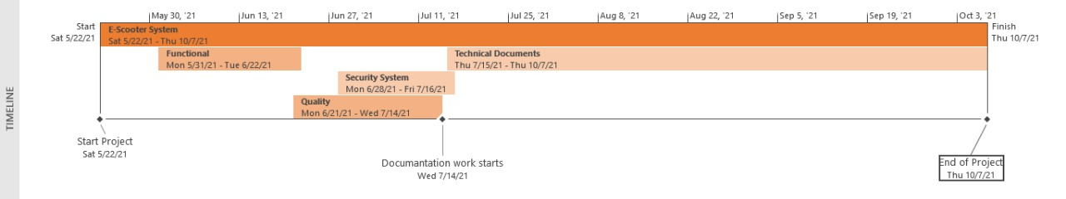
Project Schedule (Timeline)
Notes:
Here is the timeline of the project which displays the milestones tasks. Also, it shows how long it takes to get the project done from day one till the end. It shows the start date of the project which is 5/22/21 and end date of the project will be on 10/7/21. The documentation work starts on 7/14/21.

Slide 10
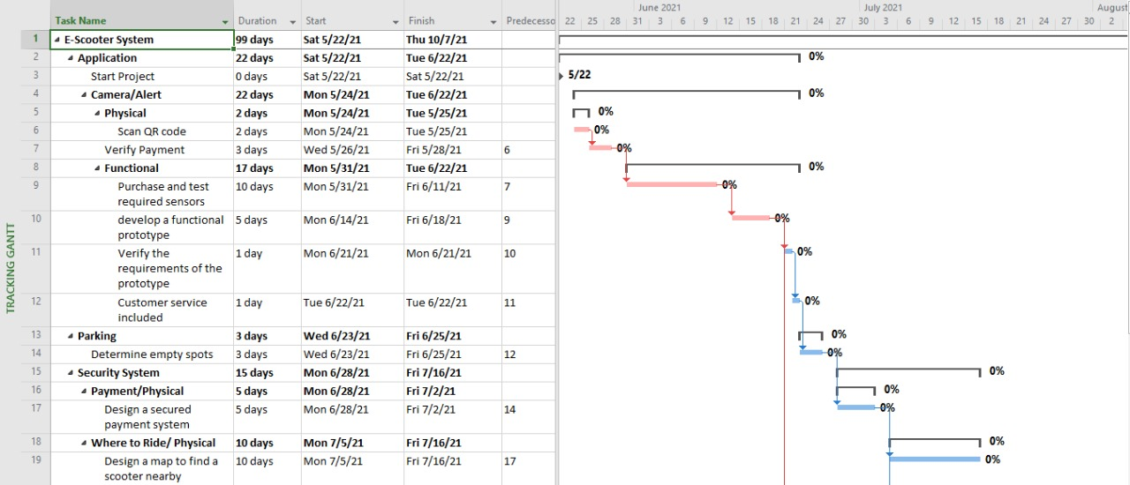
Critical Path and Total Project Time
Notes:
Here is the critical path and total project time before the reduction.
The project will start on 5/22/21 till 10/7/21 which contains 99 days in total.
My critical path will be into 2 slides, the first one shows the system of the project and how it will works.

Slide 11
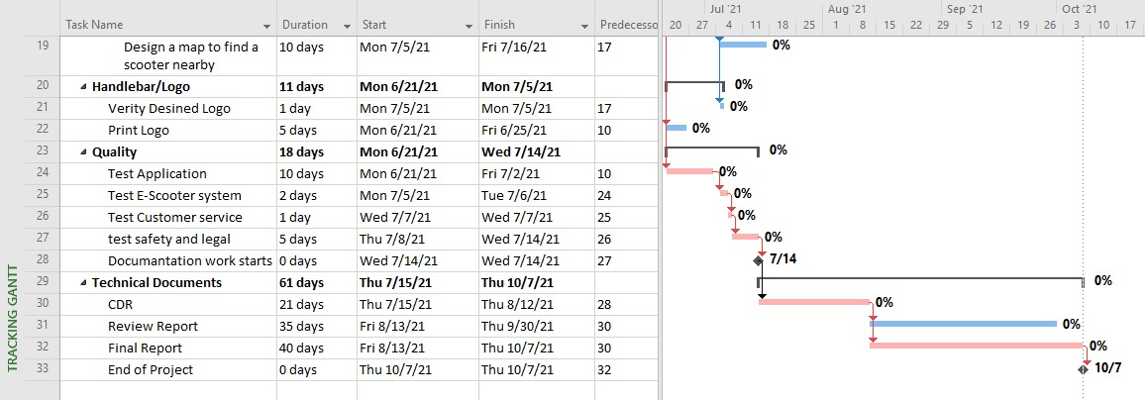
Critical Path and Total Project Time (Cont.)
Notes:
Here is continuing process of the the critical path and total project time before the reduction.
In this slide it shows the logo, quality, and technical documents.

Slide 12
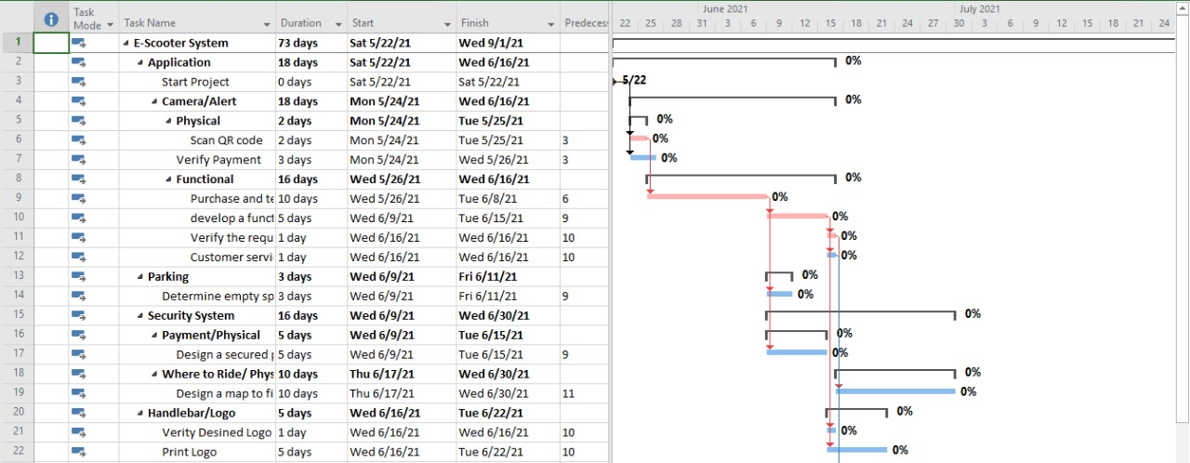
Reduced Duration Schedule
Notes:
Here is the reduced critical path and project time slide. I have changed some tasks to start at the same time with other tasks which can put tasks in parallel position.

Slide 13
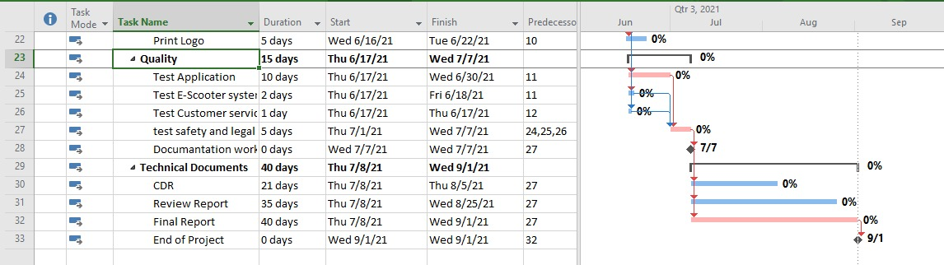
Reduced Duration Schedule (Cont.)
Notes:
Here is the continuing slide of the reduced critical path and project time slide where I have changed some tasks to start at the same time which can put tasks in parallel position.

Slide 14
The Duration Description
The duration has been reduced by %26. The method that I have used to reduce the duration is to change some tasks time to make them starting at the same time. I have changed some tasks to start at the same time with other tasks which can put tasks in parallel position.
Notes:
Here is showing the method that I have used to reduce the duration by changing the starting date of some tasks. The duration has been reduced by 26%. The method that I have used to reduce the duration is to change some tasks time to make them starting at the same time. I have changed some tasks to start at the same time with other tasks which can put tasks in parallel position.

Slide 15
Stakeholder Analysis
Key Stakeholder:
Engineering Team – The team is responsible for the development and implementation of the project.
Project Sponsors – The owners of the application
Logo maker
External – Bank /A middle system which takes care of the payment transactions.
Database storage provider / A third party solution provider for the project.
Project Communication Plan:
Email: Email is used to verify any detailed information.
Google Drive: Drive is the cloud location that will be used for sharing all documents related to the project.
Customer Service: Will be available 24/7 to help users.
Notes:
The major stakeholder of the project are component manufactures, sponsors, users, logo maker. and external. The application will be supported by iOS and Android, also the engineering team will be responsible to build the E-scooter. A logo maker will also be contracted to design a logo for the E-scooter. For External stakeholders their needs is to be connected to a network system.
The communication plan meetings will be organized each week to discuss the progress made in the development of the E-scooter. The customer service will also consult the users through the application and solve any issues and updates

Slide 16
Project Team
The project team that will be working the actual project is some experienced software engineers, mechanical engineers, and a documentation team to manage the project schedule and cost.
Software and Mechanical Engineers both are responsible for the development and repairing and updating any issues.
The documentation team will focus on documentations, and their job is to organize the cost and all the updates and the repairs made.
Notes:
This slide shows the project team that will take care of the project, There will be software engineers and mechanical engineers as well to build the E-scooter system. Software team are only concerned with app problems such as crashing and waiting time. The manager will take care of documents and all the updates and the repairs made.

Slide 17
Responsibility Matrix
Tasks | Software engineer | Mechanical engineer | Documentation team
Developing | A | R | A,R,Q
Testing | R | A | A
Repairing | R | R | Q
A - Accountable
R - Responsible
Q – Quality
Notes:
Here is the responsibility matrix slide based on different tasks such as developing, testing, and repairing. Also, it shows how the software and mechanical engineers, and the documentation team either responsible, accountable, or quality.

Slide 18
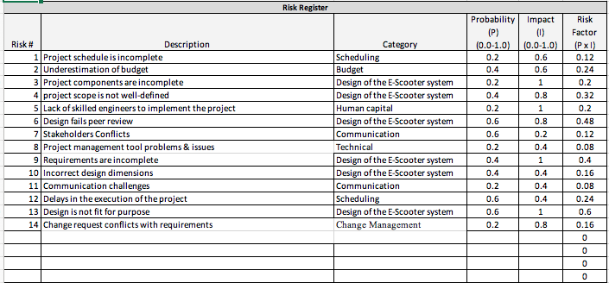
Project Risks
Notes:
Here is the project risks that we have concerned during doing the project. We have 14 different risk and you can see which already show their categories and probabilities.
Project schedule is incomplete
Underestimation of budget
Project components are incomplete
Project scope is not well-defined
Design fails peer review

Slide 19
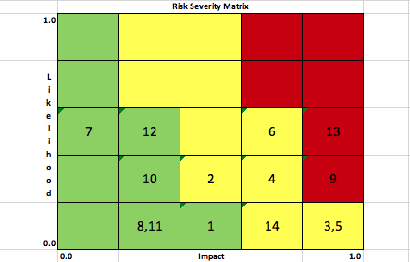
Project Risks (Risk Matrix)
Notes:
This slide shows the risk matrix which show how many risks mitigations that we have and how many low and high risks.

Slide 20
Success Criteria
Survey - we will ask the users when the ride ends to rate the ride and submit their feedback to us.
24/7 customer service – we will ask the users if that was helpful if yes we will call that a success rate.
Notes:
For the success criteria for this project we will create a friendly survey to take the feedbacks from the users.
Survey - we will ask the users when the ride ends to rate the ride and submit their feedback to us.
24/7 customer service – we will ask the users if that was helpful if yes we will call that a success rate.

Slide 21
Summary
In conclusion, with the fast development of technology, we chose to design, develop and create a new an E-Scooter system that​ ​focuses on people who want to ride an E-Scooter with full safety measures, security system, and outstanding feature services. This system allows users to register their E-Scooter through a mobile application. All in all, our E-Scooter system makes it easier for those who wants to ride an E-Scooter with successful services.
Notes:
E-scooter system is directed to people who wants to ride an E-Scooter, it focuses on people who uses E-Scooter in their daily life and wants to rent an E-Scooter through an application, with full safety and successful services. The main goal of this project is that the user can purchase it quickly, also we need to make sure that all of user’s information are securely locked so that no one can access their information.

Slide 22
Any Questions!
Notes:
Thank you!

