Slide 1

E-Commerce Customer
E-Commerce Project
Team Leader: Eman Mansour Abdel Halim Barrin
44,650 Customers
26 Features
Members: Yasmeen Ayman | Walaa Emad | Huda Mohamed

Slide 2
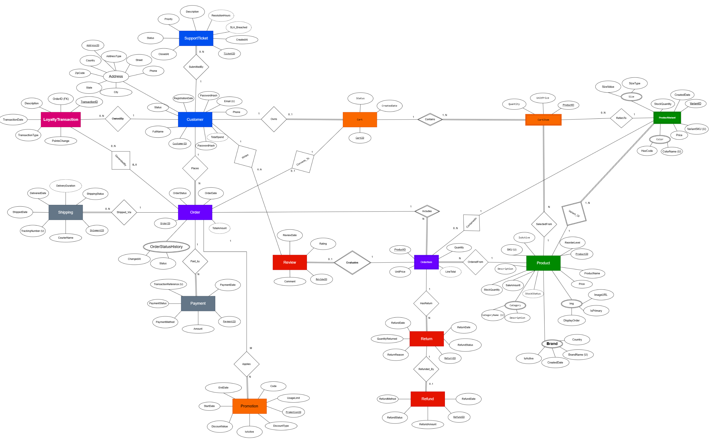
ERD

Slide 3
Database Design
E-Commerce
✦ 5-Level layered architecture with full referential integrity
✦ Cascade & NO ACTION delete rules protect business-critical records
✦ Unicode support (NVARCHAR) for multilingual data (Arabic & English)
✦ Computed & PERSISTED columns for real-time performance metrics
✦ Built-in fraud prevention via Loyalty Trigger & constraint checks

Slide 4
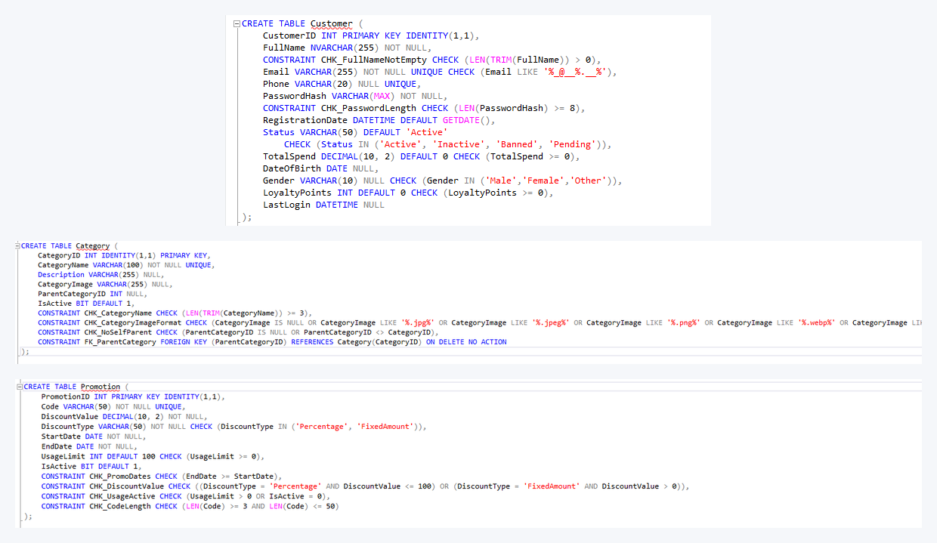
L1
Level 1 — Core / Foundation Tables
Customer · Category · Promotion
KEY HIGHLIGHTS
NVARCHAR for Unicode (Arabic & foreign names)
Email UNIQUE + pattern validation
Self-referencing Category (parent→child)
PasswordHash naming convention (bcrypt)
Cross-column discount CHECK constraints
Promotion dates & usage logic validated

Slide 5
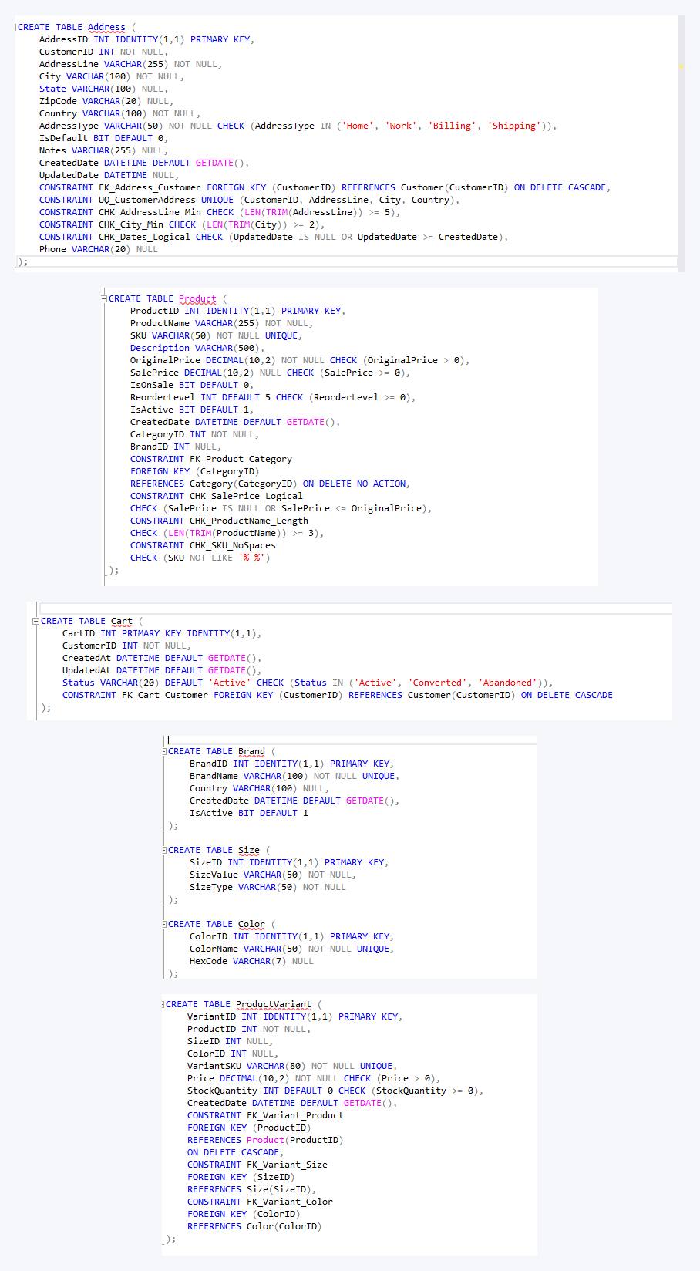
L2
Level 2 — Product & Cart Tables
Address · Product · Cart · Brand · Size · Color · Variant
KEY HIGHLIGHTS
CASCADE delete for addresses & cart items
SKU uniqueness enforced (no spaces allowed)
Sale price never exceeds original price
Soft-delete IsActive flag on Brand
ProductVariant bridges Product/Size/Color
Cart statuses: Active / Converted / Abandoned

Slide 6
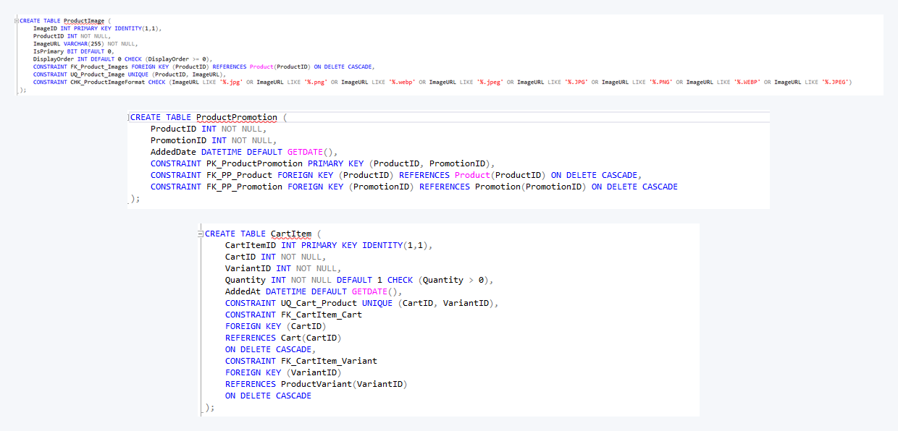
L3
Level 3 — Images, Promotions & Cart Items
ProductImage · ProductPromotion · CartItem
KEY HIGHLIGHTS
IsPrimary flag controls cover image display
Image format limited to jpg/png/webp
Many-to-Many bridge: Product ↔ Promotion
Composite PK prevents duplicate links
CartItem enforces qty > 0 per variant
Dual CASCADE keeps cart clean on deletions

Slide 7
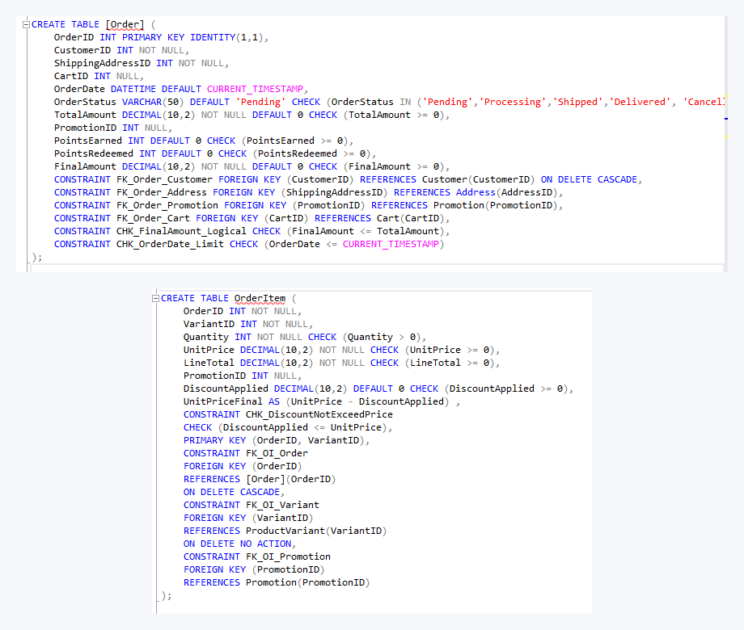
L4
Level 4 — Orders & Order Items
Order · OrderItem
KEY HIGHLIGHTS
Composite PK (OrderID + VariantID)
NO ACTION prevents deleting sold products
Computed column: UnitPriceFinal = Price – Discount
LineTotal stored for fast reporting
Discount check: can't exceed product price
CASCADE deletes orphan items on order removal

Slide 8
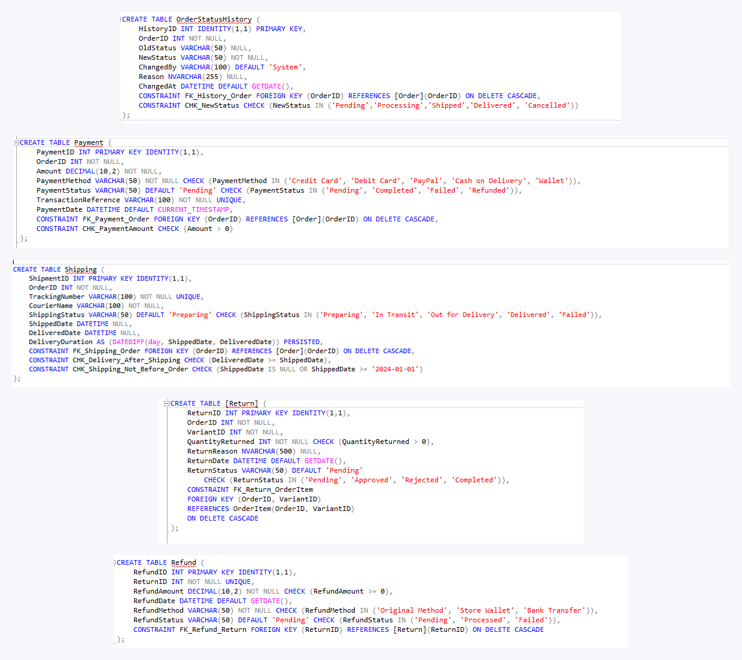
L5a
Level 5 — Fulfilment Tables
OrderStatusHistory · Payment · Shipping · Return · Refund
KEY HIGHLIGHTS
Audit trail: OldStatus → NewStatus + ChangedBy
UNIQUE TransactionReference (no double payment)
PERSISTED DeliveryDuration for fast queries
CHK_Delivery_After_Shipping logic rule
1-to-1 Return ↔ Refund (no double refunds)
RefundStatus: Pending / Processed / Failed

Slide 9
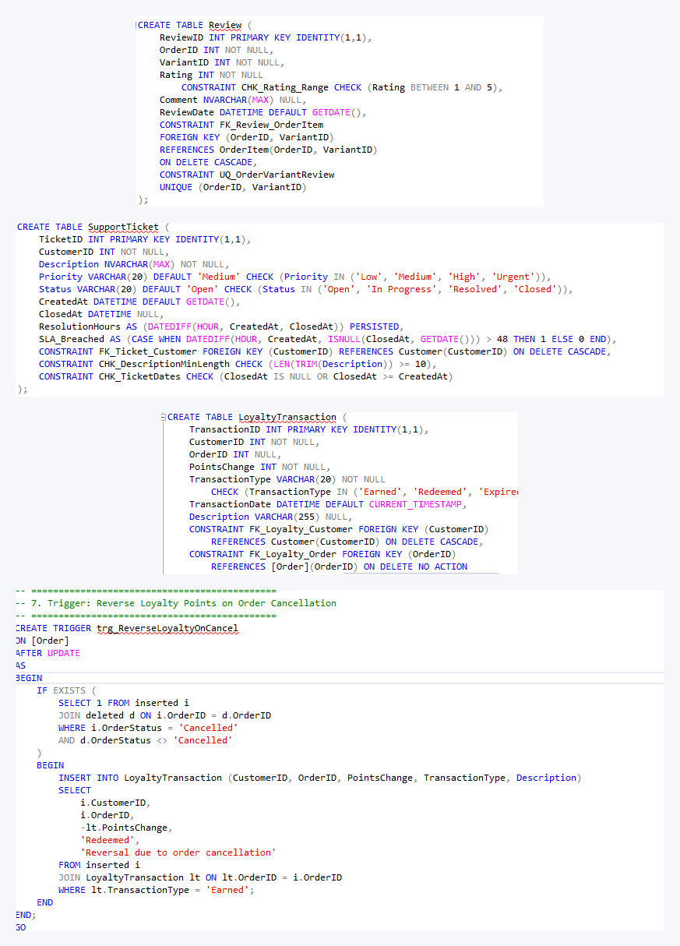
L5b
Level 5 — Post-Order & Automation
Review · SupportTicket · LoyaltyPoints · Trigger
KEY HIGHLIGHTS
UQ_OrderVariantReview prevents review spam
Rating constrained to 1–5 stars only
SLA_Breached auto-flags tickets at 48 hrs
PERSISTED ResolutionHours for SLA tracking
NO ACTION keeps loyalty history on order delete
Trigger reverses points on order cancellation

Slide 10
Database Bulk Insert — Sample Data
LoyaltyTransaction
TxID | CustID | OrderID | Points | Type | Date | Description
1 | 37168 | 1 | 242 | Earned | 54:13.0 | Loyalty points added
2 | 4215 | 2 | 281 | Earned | 29:42.0 | Purchase reward points
3 | 82180 | 3 | 358 | Earned | 56:01.0 | Loyalty points added
4 | 56393 | 4 | 167 | Earned | 23:11.0 | Loyalty points added
5 | 25429 | 5 | 235 | Earned | 20:57.0 | Purchase reward points
Orders
OrdID | CustID | ShipAddrID | Status | Total | PromoID | PtsEarned | Final
1 | 166600 | 591087 | Delivered | 2086.26 |  | 20 | 2086.26
2 | 82863 | 472830 | Processing | 798.18 | 169 | 7 | 777.53
3 | 183477 | 177070 | Delivered | 5852.4 |  | 58 | 5852.4
4 | 7316 | 250959 | Delivered | 1511.02 |  | 15 | 1511.02
5 | 455055 | 629395 | Shipped | 1772.92 | 166 | 17 | 1661.84
OrderItem
OrderID | VariantID | Qty | UnitPrice | LineTotal | PromoID | Discount
1 | 8364 | 2 | 1043.13 | 2086.26 |  | 0
2 | 1377 | 1 | 10037.74 | 10037.74 |  | 0
2 | 1393 | 2 | 4188.9 | 8377.8 |  | 0
2 | 4166 | 3 | 322.67 | 968.01 |  | 0
2 | 7529 | 2 | 309.68 | 619.36 |  | 0
Promotion
PromoID | Code | DiscountVal | Type | StartDate | EndDate | UsageLimit | IsActive
1 | SUMMER2022 | 6.13 | Percentage | 4/05/2022 | 18/05/2022 | 192 | 0
2 | SUMMER2023 | 35.45 | Percentage | 2/09/2023 | 27/09/2023 | 482 | 0
3 | SUMMER2024 | 6.34 | Percentage | 4/04/2024 | 27/04/2024 | 666 | 1
4 | SUMMER2025 | 30.26 | Percentage | 7/09/2025 | 21/09/2025 | 509 | 1
5 | WINTER2022 | 406.62 | FixedAmount | 13/01/2022 | 25/01/2022 | 764 | 0
SupportTicket
TktID | CustID | Description | Priority | Status | CreatedAt | ClosedAt
1 | 68640 | Product stopped working after 2 days | Medium | Open | 44:28.0
2 | 40343 | Cancel order before it is shipped | Medium | Resolved | 37:39.0 | 37:39.0
3 | 18852 | Received damaged product | Medium | Closed | 20:20.0 | 20:20.0
4 | 50979 | Cancel order before it is shipped | Medium | Resolved | 19:29.0 | 19:29.0
5 | 3049 | Product stopped working after 2 days | Medium | Resolved | 46:44.0 | 46:44.0

Slide 11
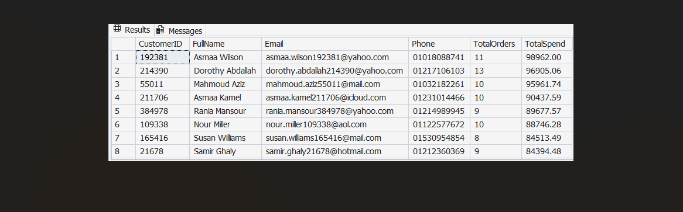
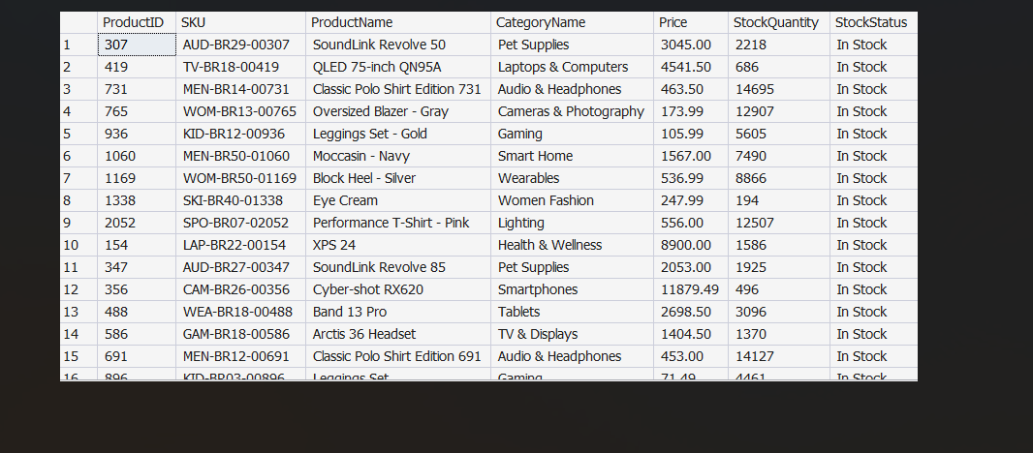
1. vw_CustomerMaster
Objective: Displays customers with total orders and total completed payments amount.
2. vw_ProductCatalog
Objective: Shows products with current price, total stock quantity, and stock status (In Stock / Low Stock / Out of Stock).

Slide 12
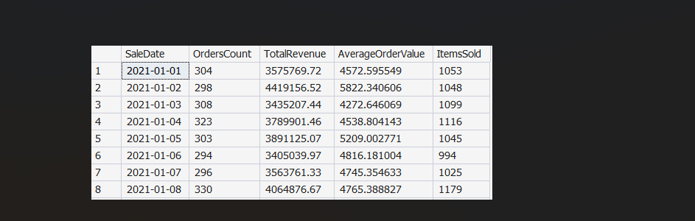
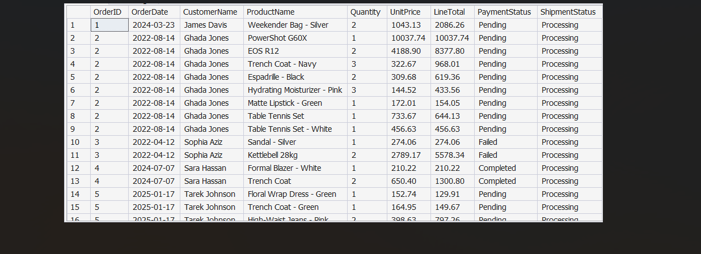
3. Daily Sales Analysis
Objective: Analyzes daily sales performance including orders count, revenue, average order value, and items sold.
4. vw_OrderDetails
Objective: Displays detailed order information including customer name, product, quantities, prices, payment status, and shipment status.

Slide 13
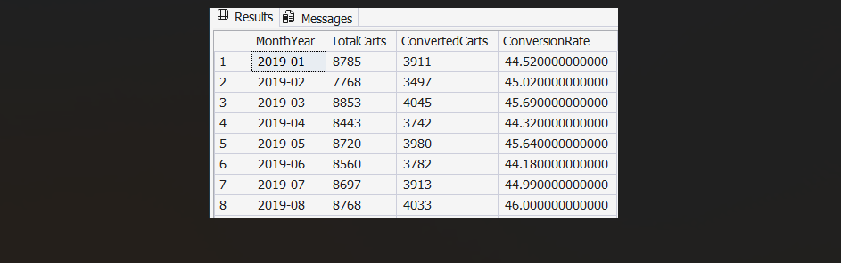
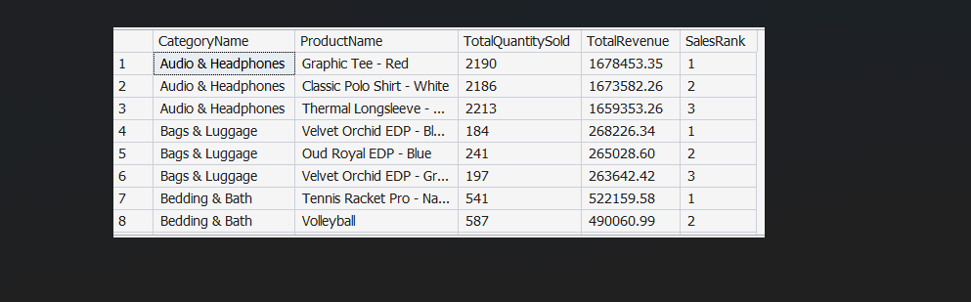
5. Cart Conversion Rate (Monthly)
Objective: Calculates monthly cart-to-order conversion rate to measure shopping cart effectiveness.
6. Top 3 Products per Category
Objective: Identifies the top 3 best-selling products in each category based on revenue.

Slide 14
E-Commerce Customer
E-Commerce Queries & Views
44,650 Customers
26 Features
3 ML Targets

Slide 15
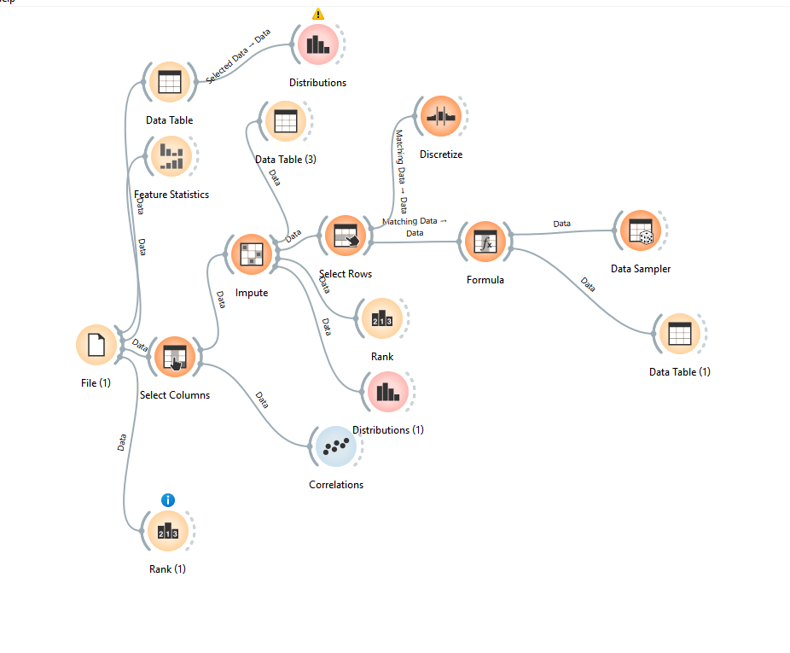
Orange

Slide 16
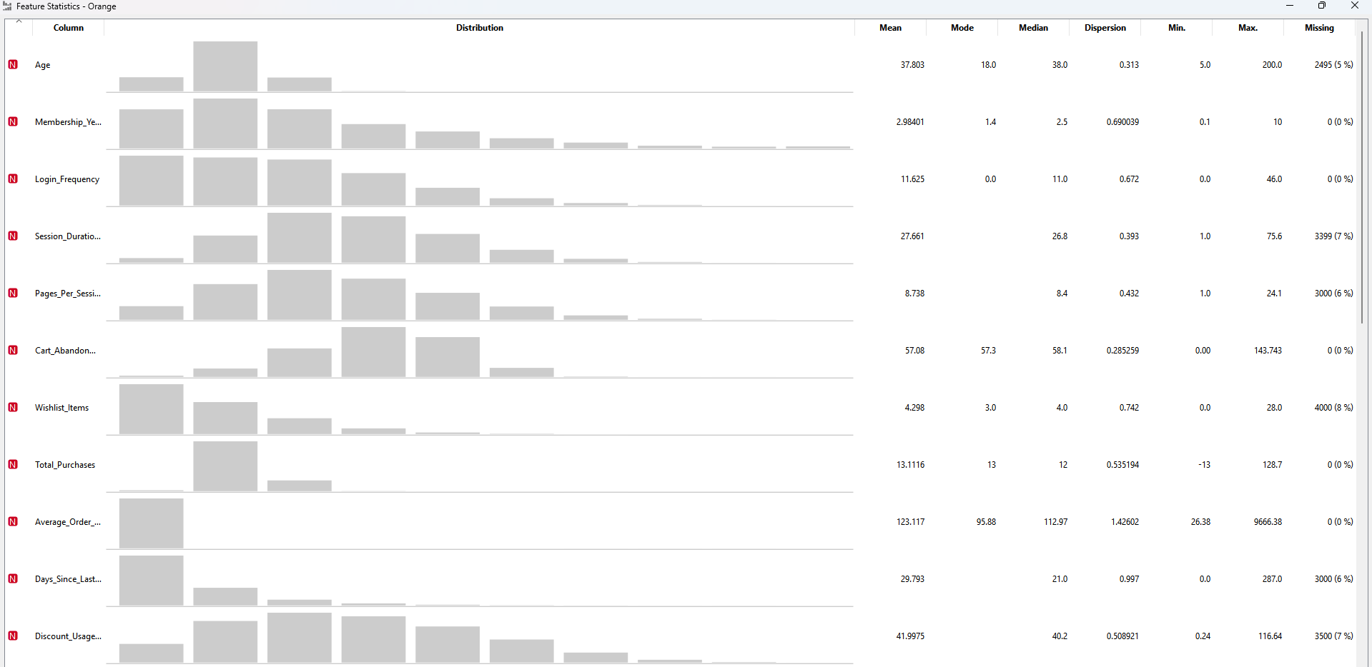
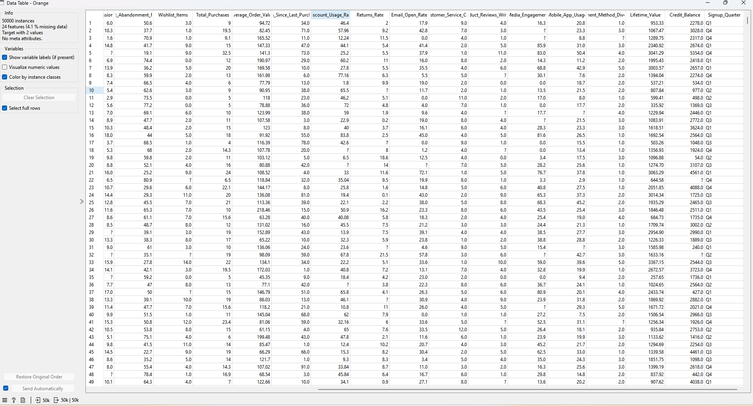
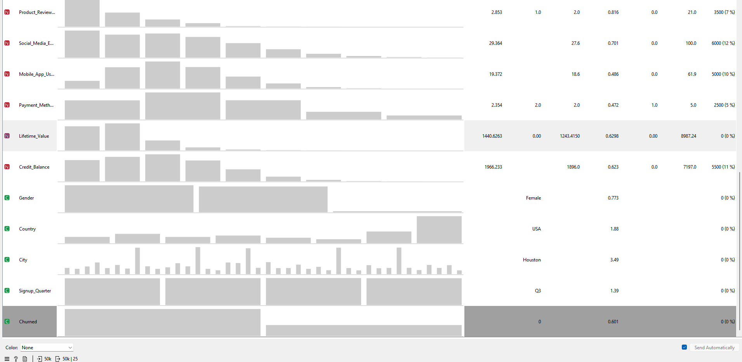

Slide 17
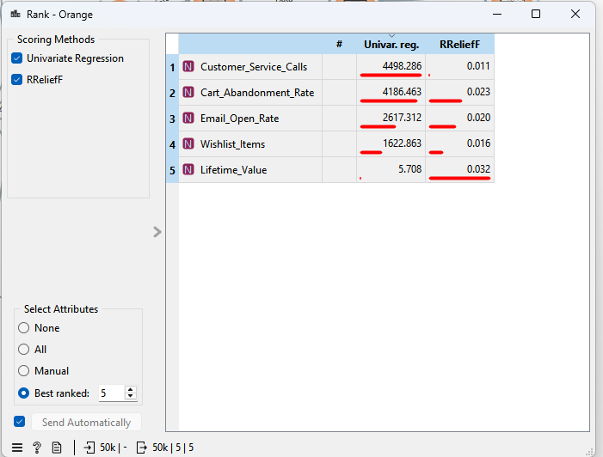
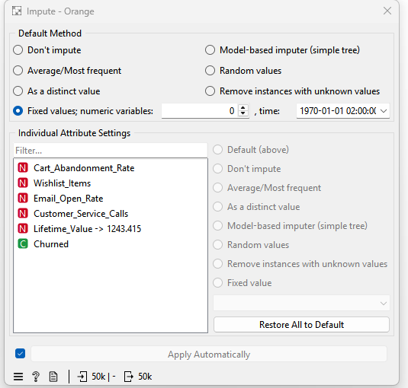
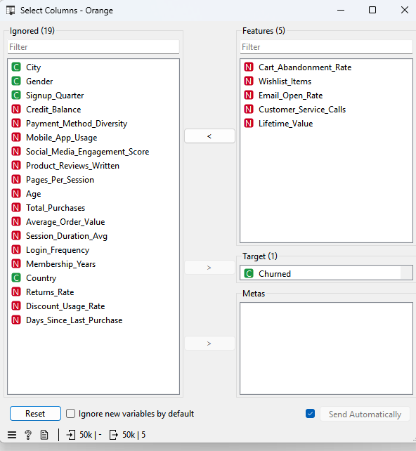

Slide 18



E-Commerce Customer
EDA
Comprehensive Exploratory Data Analysis — 20 Questions, 3 ML Targets
44,650 Customers
26 Features
3 ML Targets

Slide 19



Project Overview
In competitive e-commerce, retaining a customer costs 5× less than acquiring a new one. This EDA decodes the behavioral DNA of 44,650 customers to answer three critical business questions:
Churn Prediction
Lifetime Value
LTV Segmentation
Binary Classification
Regression
Multiclass Classification
Who will leave the platform next month?
How much revenue will each customer generate?
Low / Medium / High value customer tiering
1. Data Loading
2. Data Cleaning
3. Feature Engineering
4. EDA (Q1–Q20)
5. Modeling Roadmap

Slide 20
Dataset at a Glance
44,650
25
14
3
Customer Records
Total Features
Cols w/ Missing
ML Targets
Feature Domains
Prediction Targets
Demographics:
Age, Gender, Country, City
Churned
Binary 0/1
Engagement Behavior:
Login Freq, Session Duration, Pages/Session
Lifetime_Value
Continuous Regression
Transaction History:
Total Purchases, AOV, Cart Abandonment
LTV_Segment
Low / Medium / High
Support & Risk:
Service Calls, Returns Rate, Discount Usage

Slide 21

Data Quality & Cleaning Pipeline
Issues Identified
Imputation Strategy
14 columns with missing values
Drop Rows
Behavioral float columns handled via median/mean imputation
Age, Service Calls, Payment Diversity
→ Critical features — tiny missing %
6 columns wrong data types
Median Fill
Float64 storing integers: Age, Purchases, Reviews, etc.
Days Since Purchase, Returns Rate, Reviews, Wishlist
→ Right-skewed (skew > 0.9) — median is robust
Invalid negative values found
Mean Fill
Impossible values in numeric columns flagged and removed
Session Duration, Pages, Email Open Rate, App Usage
→ Near-normal — mean is appropriate
No duplicate rows found
Dataset integrity fully confirmed
Int64 Convert
Age, Purchases, Reviews, Wishlist, Service Calls
→ Whole-number semantic correction
Final dataset: 44,650 rows × 25 columns — Zero missing values remaining

Slide 22

Key EDA Findings — Feature Correlations
Top Churn Predictors
Top LTV Predictors
Customer Service Calls
28.
Total Purchases
.62
Cart Abandonment Rate
Average Order Value
27.
.58
Pages Per Session
22.
Session Duration Avg
.54
Session Duration Avg
21.
Pages Per Session
.51
Email Open Rate
20.
Mobile App Usage
.50
Mobile App Usage
Login Frequency
.50
18.
Key insight: User-activity features (Login, Session, Pages) form a tightly correlated cluster (r > 0.65) — a single latent construct: platform engagement. This cluster drives both LTV and churn simultaneously.

Slide 23


Who Churns? The Customer Risk Profile
AT-RISK Customer
LOYAL Customer
Cart Abandonment Rate
HIGH
Cart Abandonment Rate
LOW
Customer Service Calls
HIGH
Customer Service Calls
LOW
Login Frequency
LOW
VS
Login Frequency
HIGH
Session Duration
LOW
Session Duration
HIGH
Total Purchases
LOW
Total Purchases
HIGH
Email Open Rate
LOW
Email Open Rate
HIGH

Slide 24
Top 5 Business Insights
01
02
03
Service Calls = Churn Signal #1
Engagement = Retention
LTV and Engagement are Inseparable
Cart_Abandonment_Rate (r=0.289) and Customer_Service_Calls (r=0.278) are the strongest churn predictors. High support volume signals unresolved issues before churn happens.
Churned customers show significantly lower Login_Frequency, shorter Session_Duration, and fewer Pages/Session. Active platform usage is the single best retention signal.
Total_Purchases (r=0.625) and Average_Order_Value (r=0.586) dominate LTV. High-LTV customers also show longer sessions and lower abandonment — loyalty and spend move together.
04
05
Demographics Don't Drive Churn
Engagement Cluster = Dimensionality Opportunity
Gender, Country, City, and Signup_Quarter show near-zero correlation with both Churned and LTV. Behavioral features — not who customers are — determine their value.
Login_Frequency, Session_Duration, and Pages_Per_Session are tightly correlated (r > 0.65). They measure one latent construct — platform engagement — making PCA viable.

Slide 25

Modeling Roadmap
Churned
Lifetime_Value
LTV_Segment
Binary Classification
Regression
Multiclass Classification
Models:
Models:
Models:
XGBoost
Gradient Boosting Regressor
Multiclass Logistic Regression
Next Steps: Apply transformations → Train baseline models → Cross-validate → Compare ROC-AUC & RMSE across model families

Slide 26
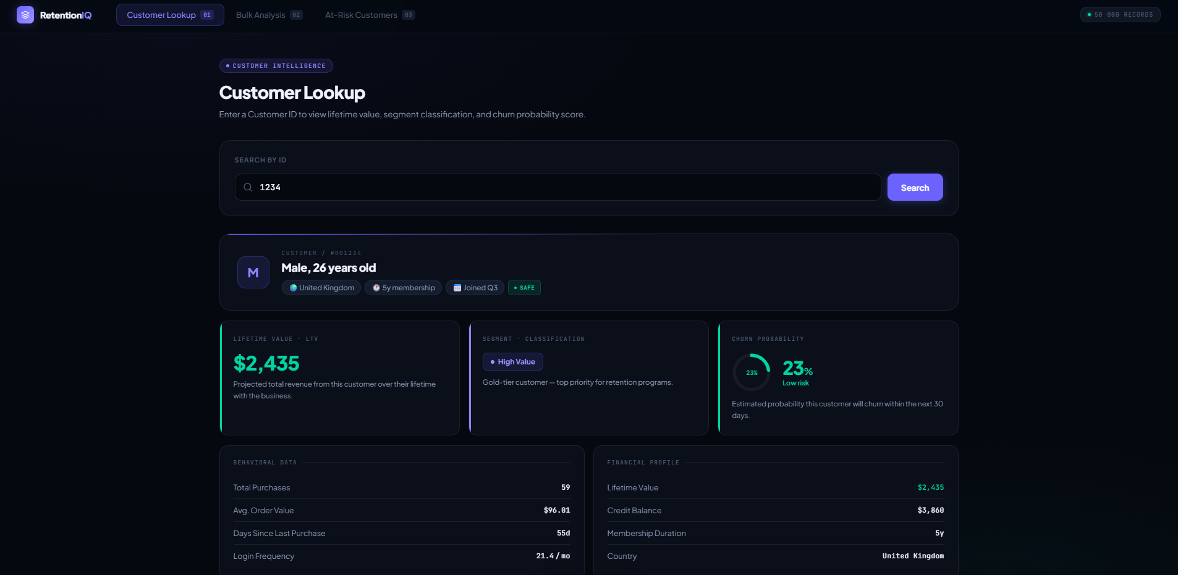

Slide 27
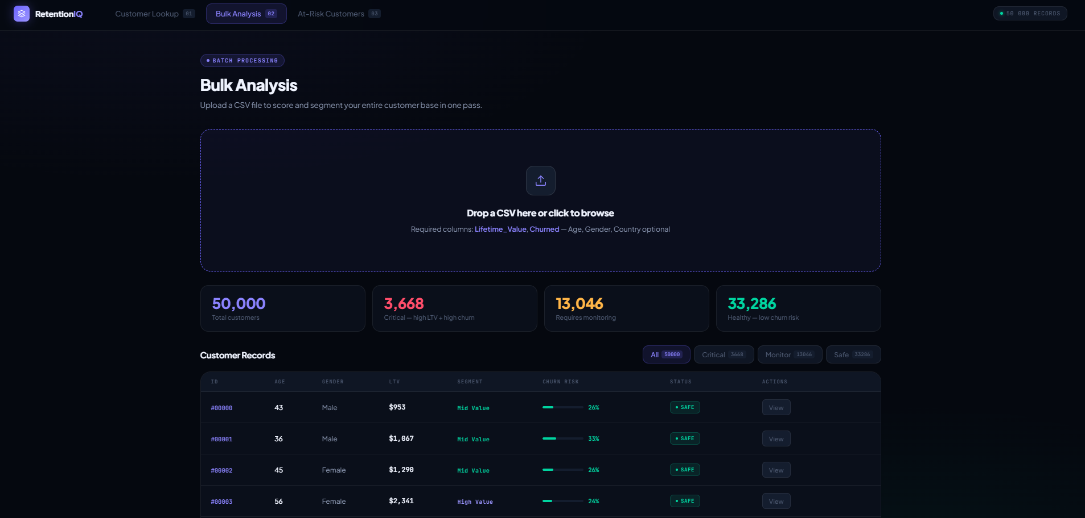

Slide 28
