Slide 1

Job Portal System
Web Application
Yasmin Jamil Al-harasis
2019-2020
Coding Academy by Orange

Slide 2
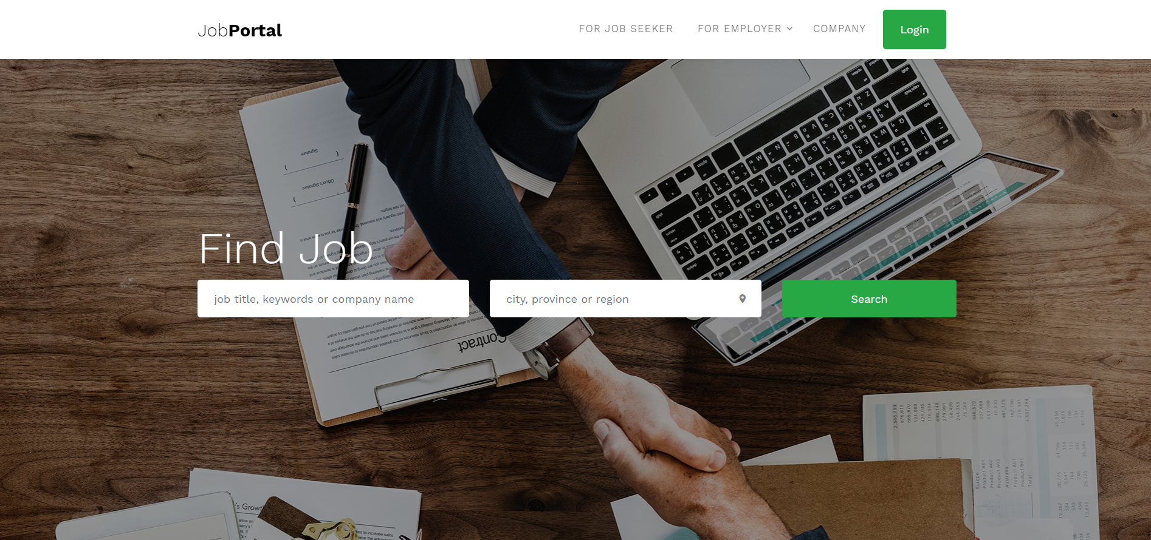
Job Portal

Slide 3
Purpose
Provide online job search

Slide 4
The problem is expected to be solved through this system
reducing work load
secure database
handling company and jobseeker information’s, which reduce the paper work and organized process.

Slide 5
who is stackholders for this website ?
primary stakeholders | secondary stakeholders
administrator, job seeker, and employer | Management

Slide 6
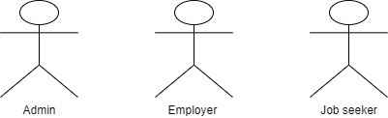
There will be 3 kinds of users:

Slide 7
features

Slide 8
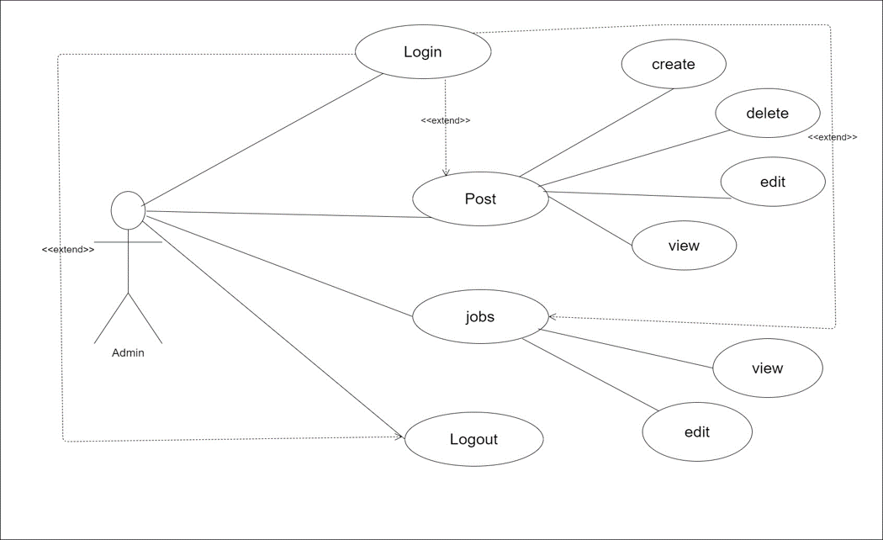
For the admin

Slide 9
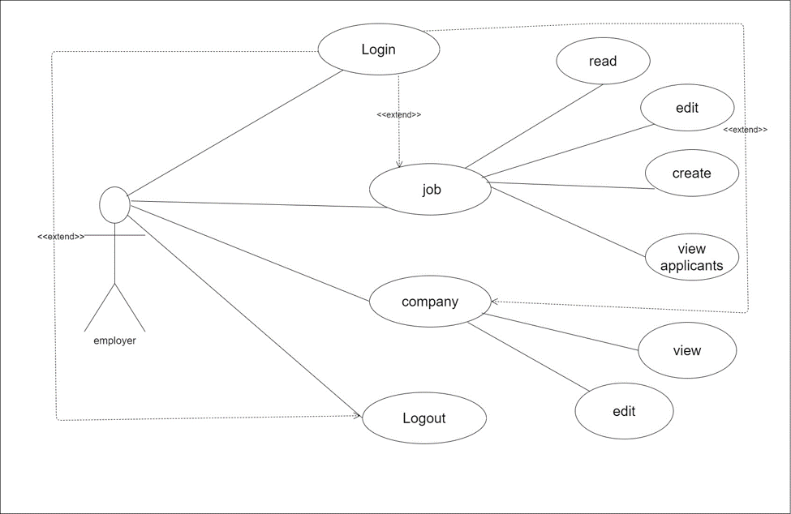
For the employer

Slide 10
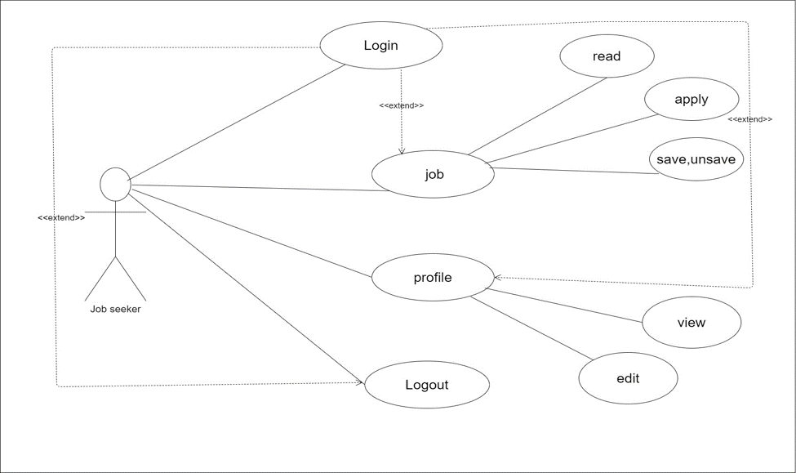
For the job seeker

Slide 11




Technologies:

Slide 12
