Slide 1

Compiler Design Assignment 3
Iran University of Science & Technology
School of Computer Engineering
Spring 2021

Slide 2
Assignment Specifications
Subject: introduction to antlr4 listener and visitor
Deadline: Saturday, , 23:59 (Would not be extended!!)
Where to upload: LMS
Your report should be provided continuing these slides
Full Name: Yasmin Madani
Student ID: 97532265

Slide 3
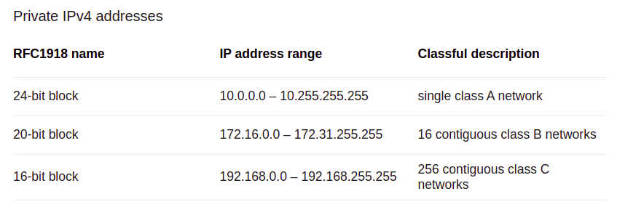
Assignment Details
1- Write a regular expression for a simple network Router: router's in computer network must validate ipv4 and drop all packet with private ipv4 address. Write a anrlr4 grammar to validate IP addresses for a router.
Requirment:
A) An ip address consists of 3 numbers, separated with two dots. The value of each number is 0-255 For example: 255.189.10.37 Correct and 256.189.89.9 is error.
B) private ip address range:

Slide 4
Assignment Details
2- Write a Python program, using ANTLR regular expression, over the alphabet {a, b, c}:
a) length of input is at least 2 and at most 4
b) number of 'a's is a multiple of 3
c) contains at least three consecutive 'b's
3- Depict a DFA to accept all the binary strings, that do not include the substring “1101”. write a lexer function pseudocode to determine these strings. (code implementation in any language is optional and have extra credit)

Slide 5
Assignment Details
4- Write a function with lexical analyzer of anrlr4 that undo comments from a Java program. assume that: a- we previously comment some piece of program and we know that piece of commented code has no error. b- we know in this program all comments are piece of correct Java code. and have not any discretional comment. Use antlr4 lexical analyzer and Java grammar in previous assignment. There is an example in next slide.

Slide 6
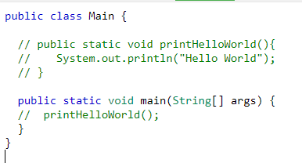
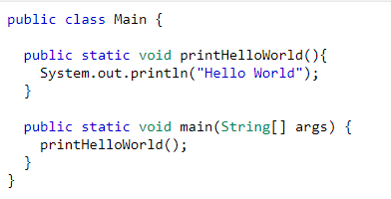
Assignment Details
Input:
Output:
Note that real compiler remove all comment in lexical analyzer step. So that in syntax analyzer step you don't have access to comments. So you must work in lexical analyzer step.

Slide 7
Assignment Details
Write and explain all question completely in your report (use screenshot)
And attach your code please.
Your report must be in end of this slide.
Good Luck!

Slide 8
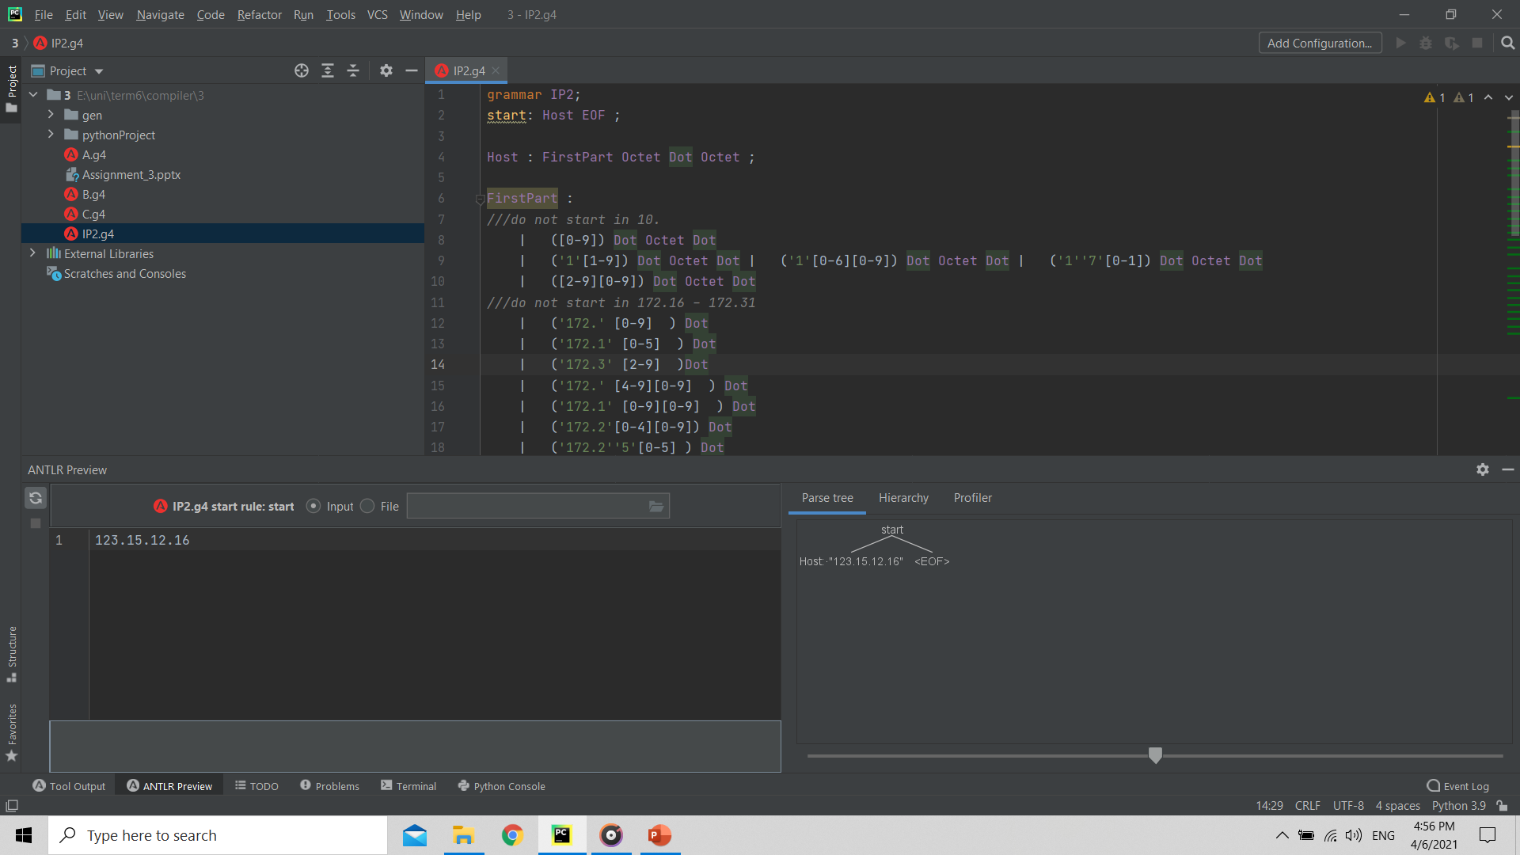
Q1
در این سوال نیاز است بازه routerهای پرایوت را از دامنه قابل قبول حذف کنیم به این منظور چون به دو بخش اول هر Ipنیاز داریم دوبخش اول را به عنوان یک بخش در نظر میگیریم و حالت های استثنا را جدا می کنیم.که درفایلIP2.g4قابل مشاهده است و چند اسکرین شات به عنوان نمونه در صفحه بعد آورده شد.

Slide 9
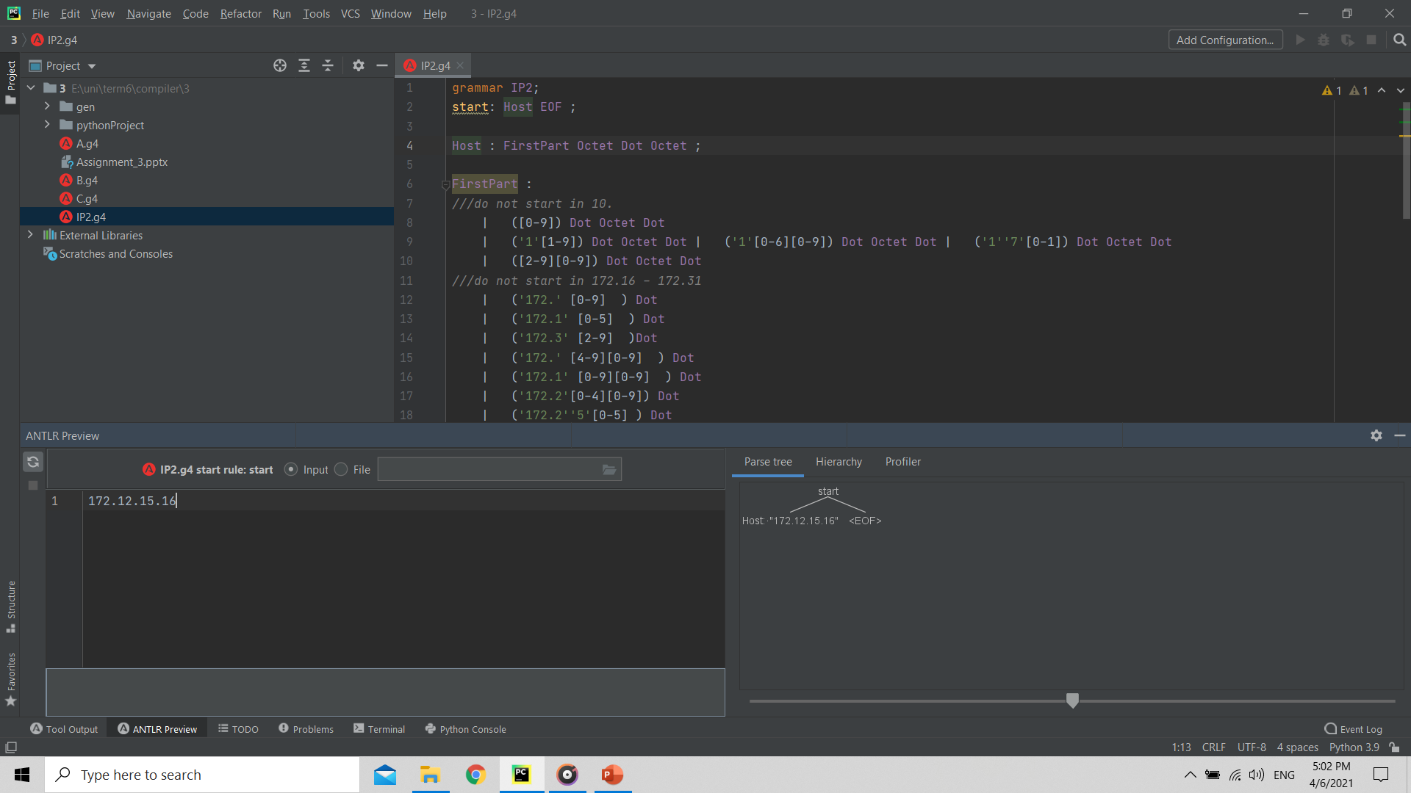
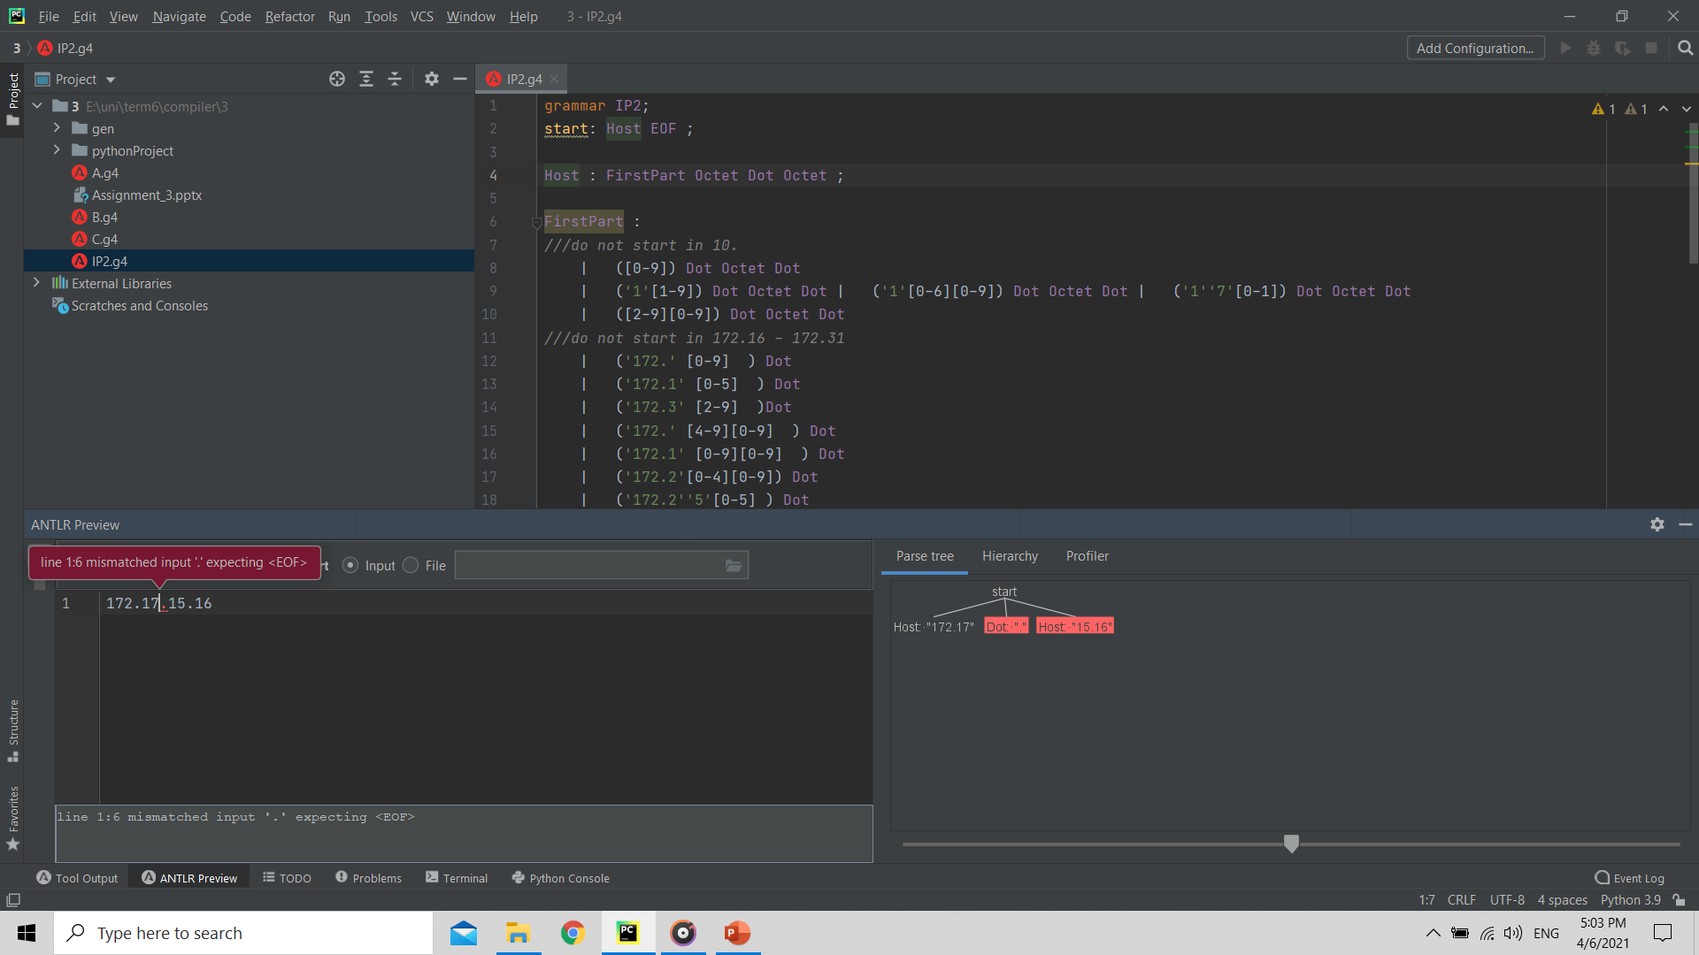
Q1

Slide 10
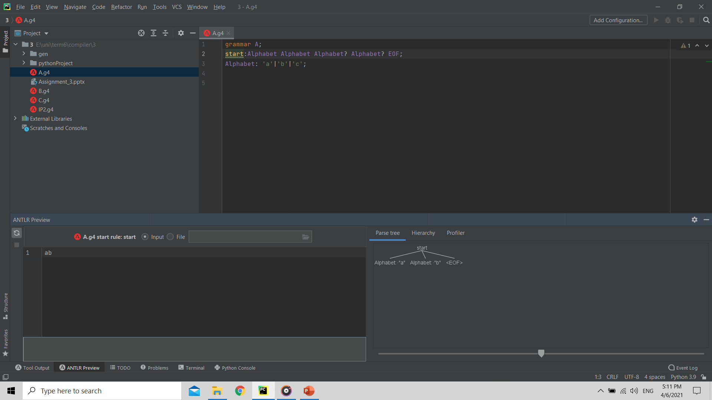
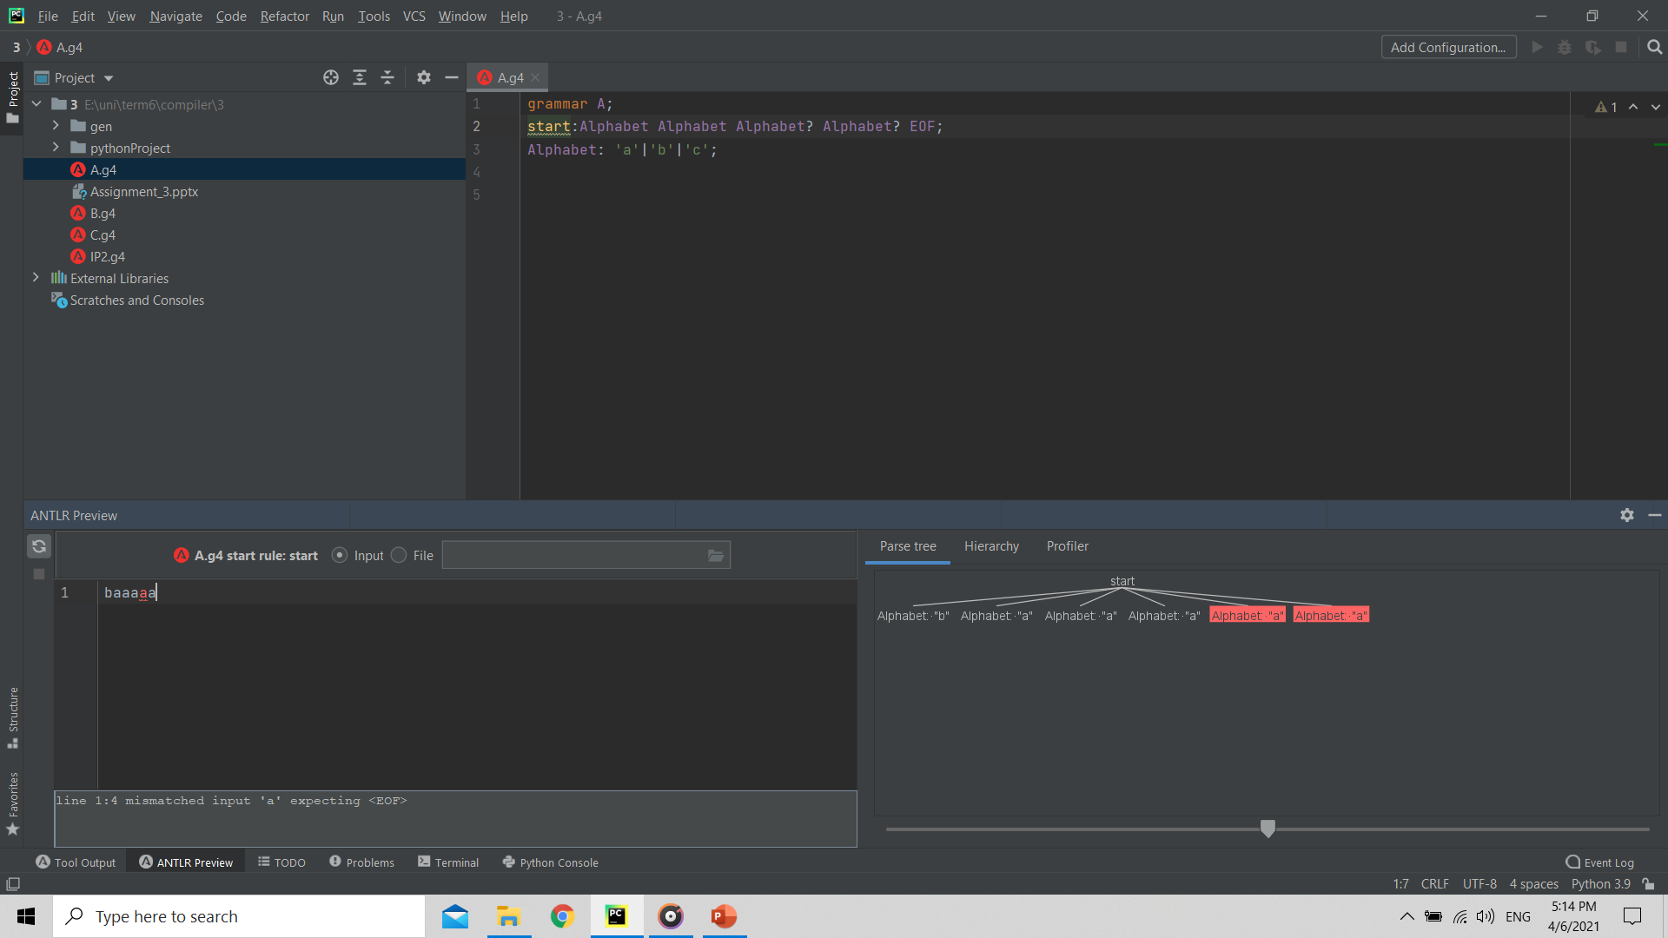
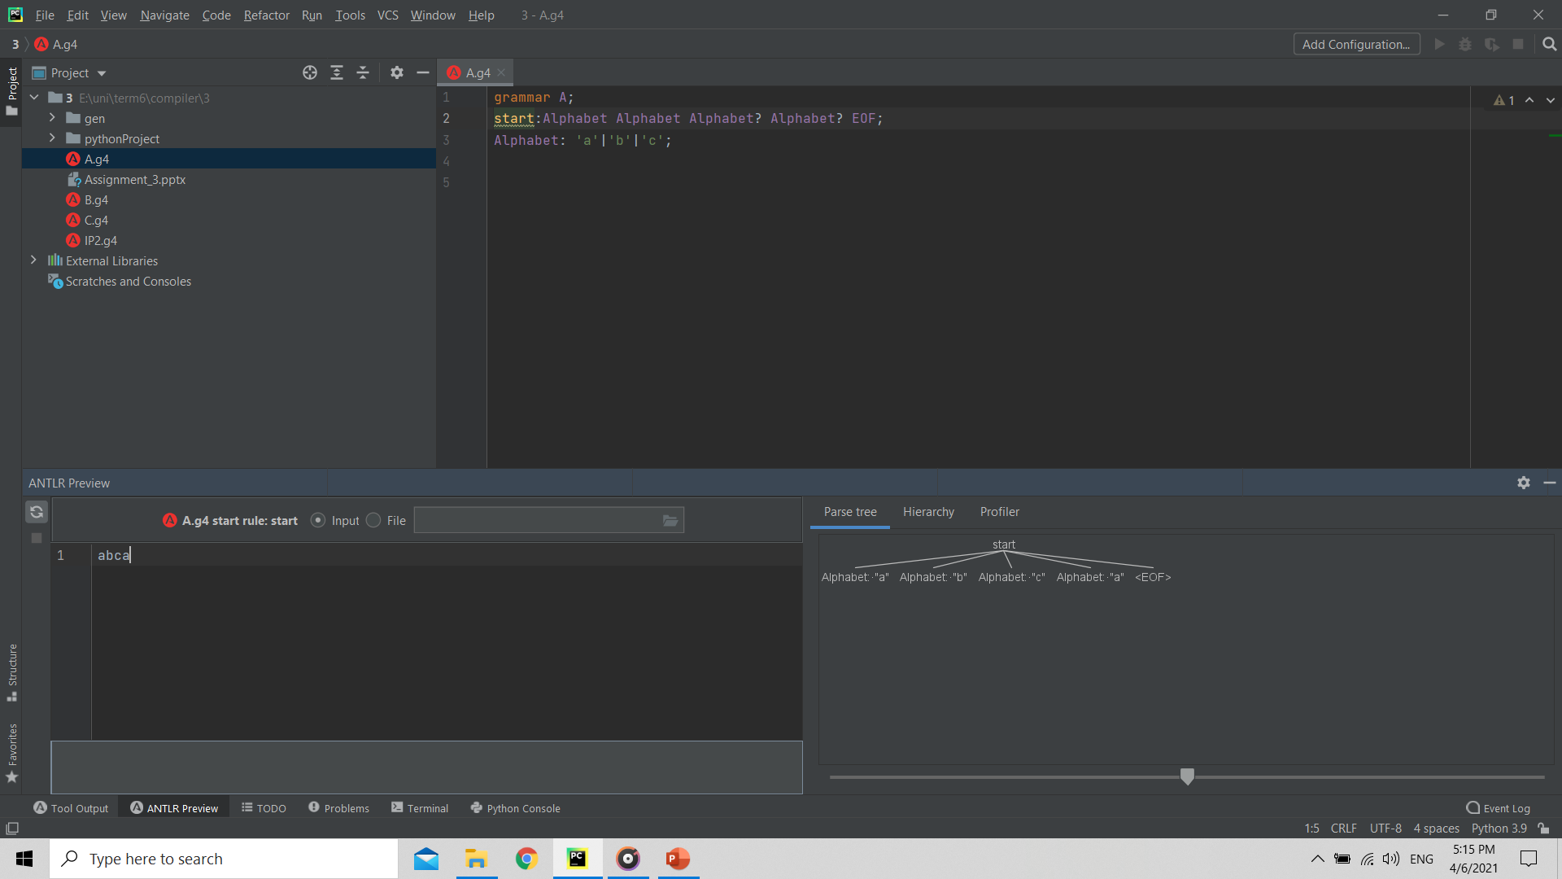
Q2-A
پاسخ این سوال در فایل A.g4آمده و برای مثال تصاویری از اجرای برنامه آورده شده.

Slide 11
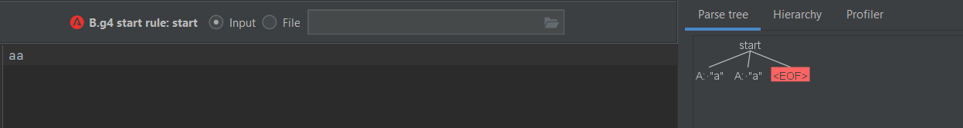
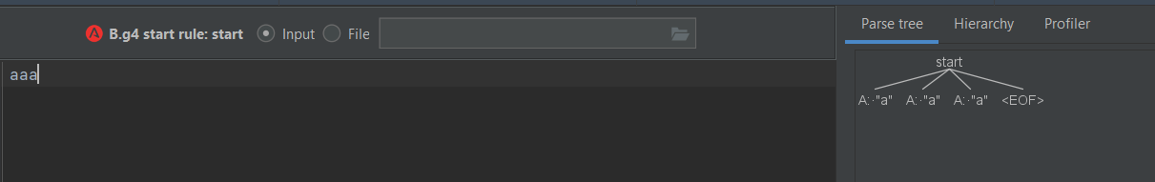
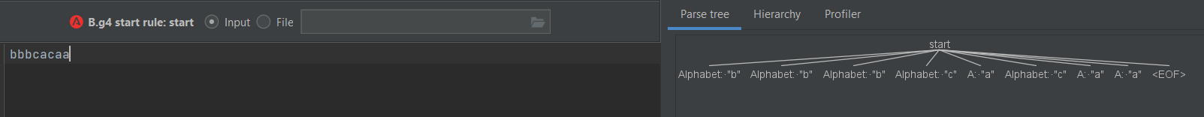
Q2-B
پاسخ این سوال در فایل B.g4آمده و برای مثال تصاویری از اجرای برنامه آورده شده.

Slide 12
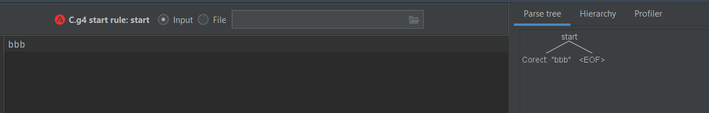
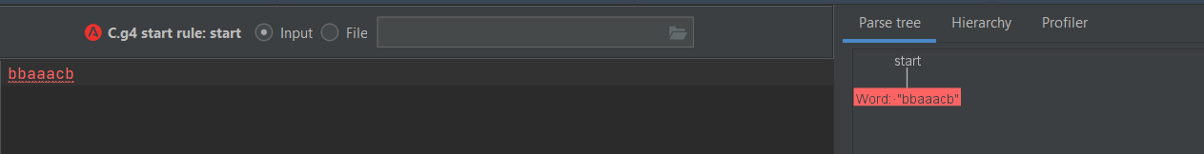

Q2-C
پاسخ این سوال در فایل C.g4آمده و برای مثال تصاویری از اجرای برنامه آورده شده.

Slide 13
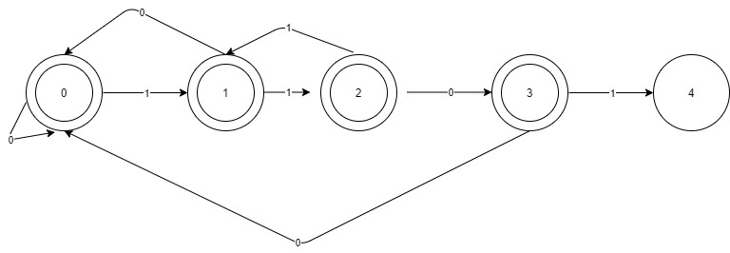
Q3
DFA

Slide 14
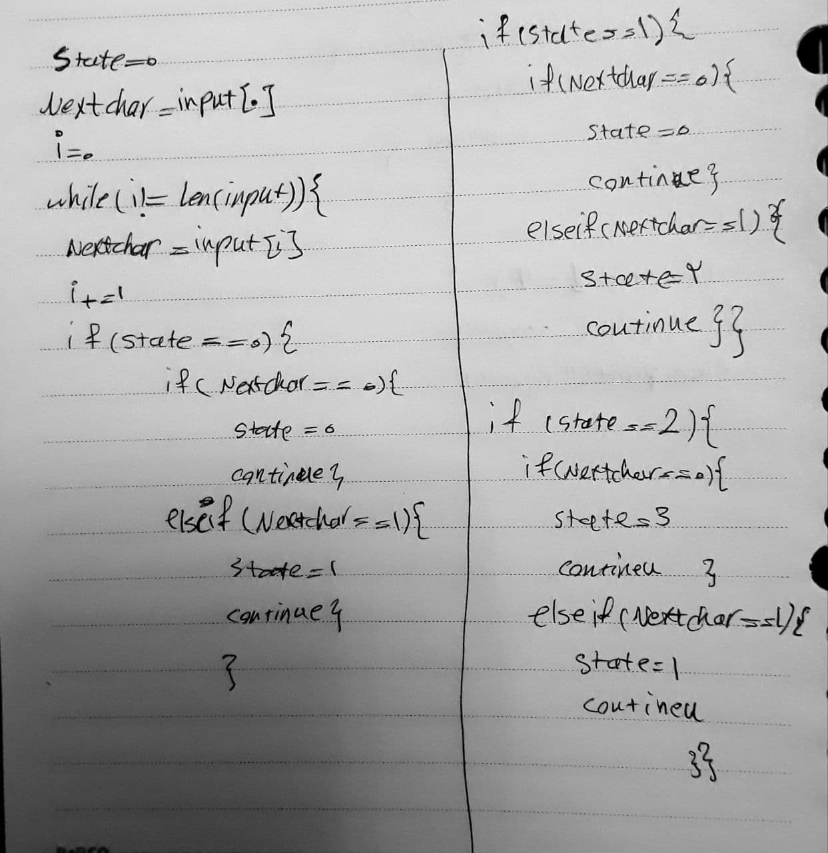
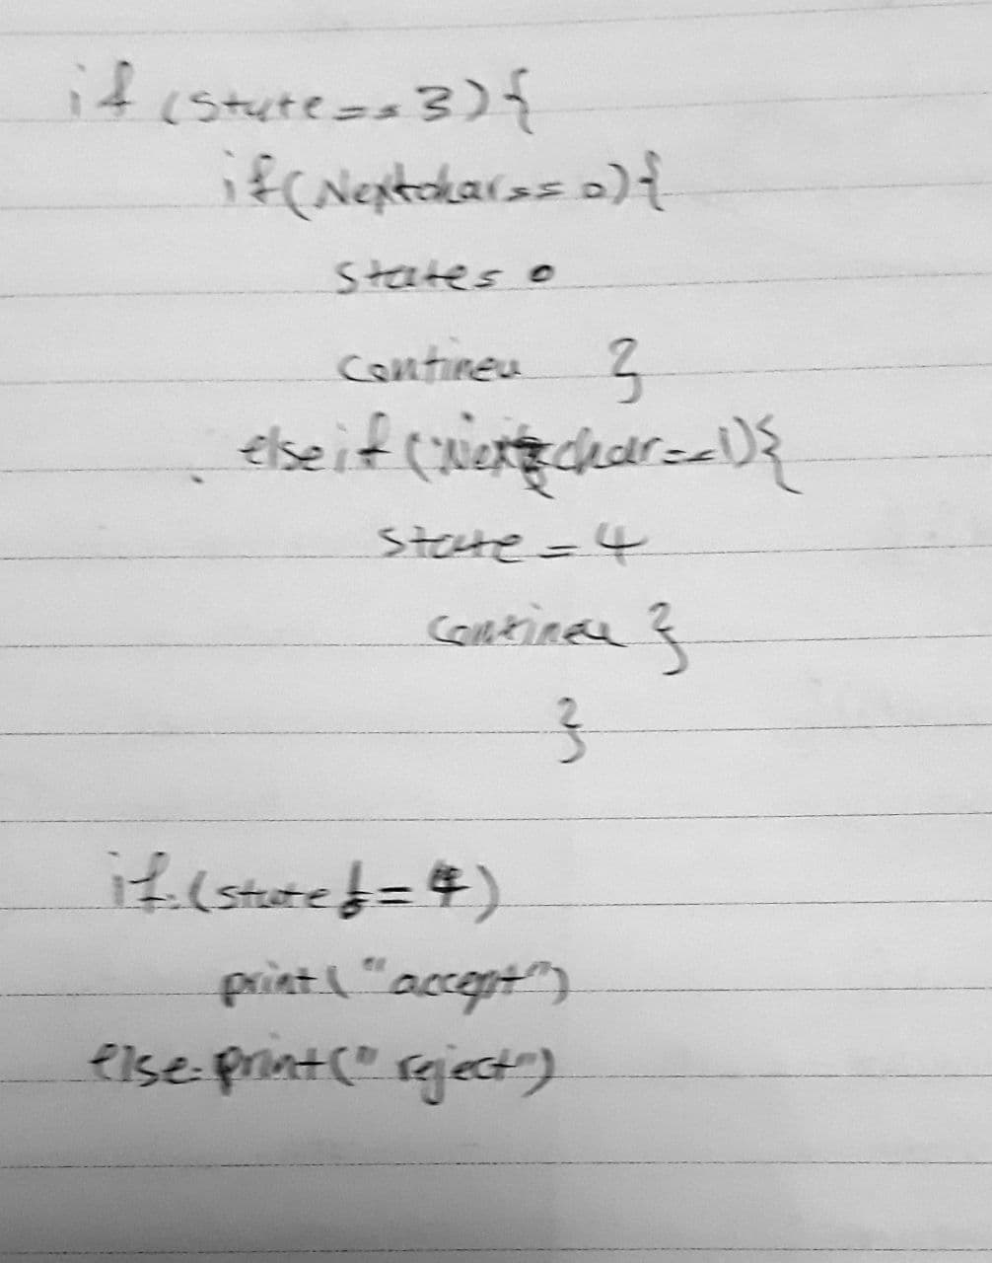
Q3

Slide 15
Q4
پاسخ این سوال در پوشه python project قرار دارد.
برای پیداکردن کامنت مانند آنچه در کد آمده کامنت ها را تشخیص داده از آنجا که کامنت های خطی را تشخیص نداده با چک کردن کاراکتر ها آن ها را می یابیم.
فایل اصلی
فایل بدون کامنت

