Slide 1

Taming AI
Start by Properly
Introducing Yourself
Keynote Address presented at PACTrans Region 10
Student Conference, Anchorage, AK
October 10, 2026
By Eva Lerner-Lam,
NAE, Dist.M.ASCE, F.ITE, M.SAE
President, Palisades Consulting Group, Inc., Tenafly, NJ
Co-Authors: Hannah Chun and Yasmin Korin
01

Slide 2
“AI is not artificial, nor is it intelligent;
it is simply Automated Inference.”
-> AI models infer from learned patterns and the context you supply.
-> The more accurate the source data is, the less hallucination
(and energy use at data centers!) there will be.
02

Slide 3
AI Models are Trained; Teach yours well
Training
Training shapes the model’s learned patterns.
Retrieval
Retrieval-augmented generation (RAG) supplies source
evidence when a user enters a prompt and triggers a
RAG tool into action.
Your contribution
to the AI Ecosystem
Starts with a precise identity record that makes
permissioned information about YOU accessible to AI models.
03

Slide 4
-> Create Your Own "Verified and Validated"
introduction:
A Soulbound Token (SBT)
“An SBT is an identity record bound to its subject, with
structured claims, evidence and permissions."
“Verified" source
Authenticate who created or issued the record.
“Validated" claim
An identified third party checks a claim against
evidence; record “validated” or “not validated.”
04

Slide 5
Same prompt, two sources
“Who has experience with winter road safety modeling?”
PDF RÉSUMÉ
SBT: STRUCTURED RECORD
“…Summer 2025, assisted Prof. R. on
Claim: Built a crash-risk model for icy
DOT project. Ran regression analyses
road segments
in R; cleaned crash data; presented
Topic: Winter road safety; crash modeling
to stakeholders…”
Evidence: Project report (link)
Dates: Jun 2025 - Aug 2025
Validated by: Faculty advisor
“Winter” never appears.
The agency and project are unclear.
No direct link lets someone check the work.
The topic is explicit, the evidence is
linked, and the reviewer is identified.
05

Slide 6
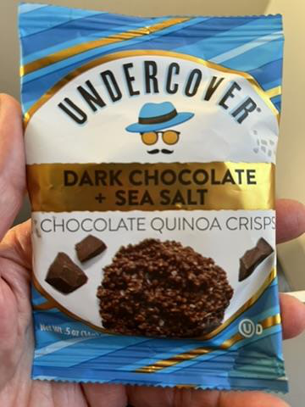
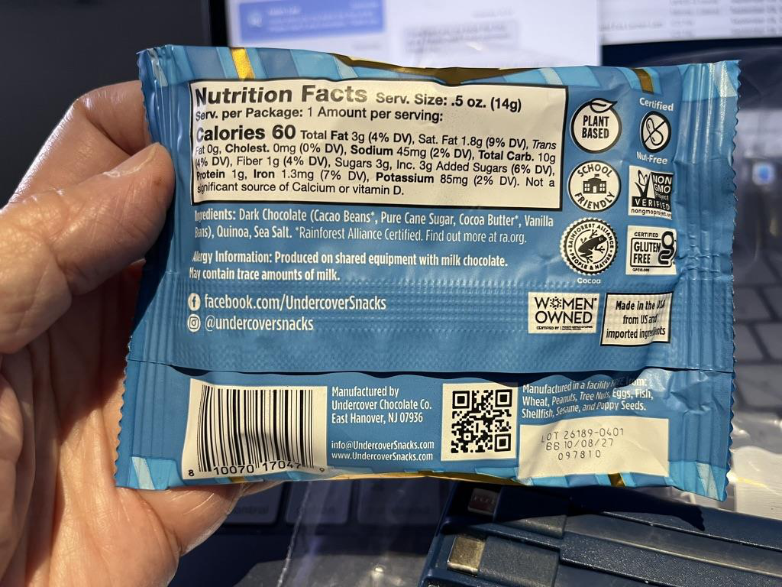
A cookie package label makes the object’s
content identifiable
Product
Ingredients
Allergen notices
Manufacturer
Lot and best-by
Each descriptor
tells a buyer
what this object
is.
06

Slide 7
A machine-readable label travels with the object
ILLUSTRATIVE JSON LABEL
•
Named fields describe the object.
{
"product": "Chocolate quinoa crisps",
•
Semantic embeddings help find it.
"flavor": "Dark chocolate + sea salt",
"manufacturer": "Undercover Chocolate
Co.",
•
Evidence supports checking it.
"lot_id": "26189-0401",
"evidence": "package label photo"
}
Any number of buyers can purchase the cookies and use their own supply
chains.
Buyer A
→
distributor
→
retailer
•
A receipt at every stop references the
Buyer B
→
campus
→
student
label and lot;
easy to accomplish with
blockchains.
07

Slide 8
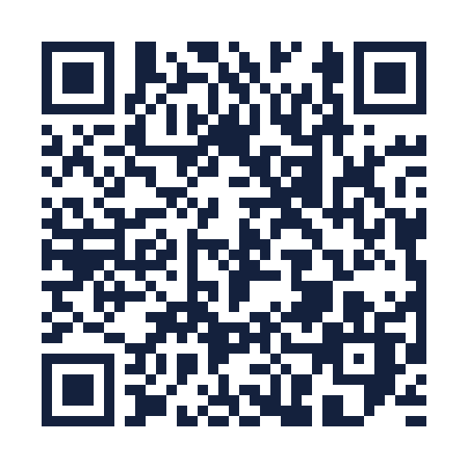
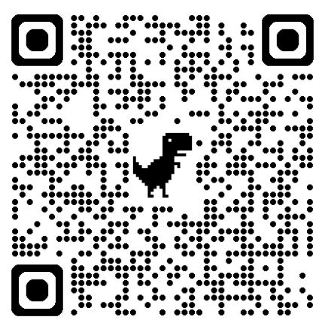
One identity, two readable formats
Machine-readable JSON record
Human-readable form of the ELL SBT
Eva’s machine-readable SBT
Eva’s human-readable SBT
1. Review claims and evidence links
1. Open the human-readable form
2. Inspect validation status and permissions
2. Review Eva’s identity and credentials
3. Check pending approval and signature
3. Compare with the machine-readable
record
08

Slide 9
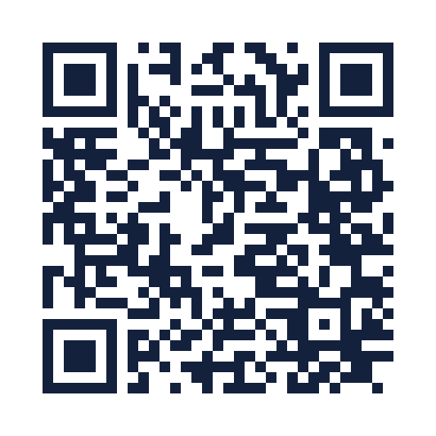
Explore the Registry prototype
Fictional records; simulated retrieval
Registry concept demo
1. Open AI Retrieval Sandbox
2. Run the transportation-planning prompt
3. Inspect the result and retrieval trace
09

Slide 10
One AI agent answers the user’s prompt
“Which registered member has experience with transportation planning?”
USER
AI AGENT
RAG TARGET
AI AGENT
USER
Prompt
→
Plan the
→
Authorize
→
Reason from
→
Answer +
query
Retrieve
evidence
sources
Proposed agent workflow using the demo’s question
Demo result: Priya Shah, Transportation Planner, Demo Mobility Lab.
The demo labels the returned expertise as transportation planning.
10

Slide 11
Three Agentic AI tools use the same source
USER PROMPT: Who has transportation-planning experience?
↓
Permissioned SBT repository
APIs
APIs
APIs
Agentic AI tool A
Agentic AI tool B
Agentic AI tool C
Retrieve, reason and cite
Retrieve, reason and cite
Retrieve, reason and cite
MCP & A2A Interfaces
MCP & A2A Interfaces
Answer A + source
Answer B + source
Answer C + source
references
references
references
11

Slide 12
Your identity needs governance
Your record
Define claims and approve the canonical source.
Correct and version it when your experience changes.
Your permissions
Set access and attribution terms for your original
content. Specify licensing or compensation, where
applicable.
PROPOSAL:
An Engineering School-controlled repository could let
A university pilot
students opt in, create their own SBTs,
validate claims and test retrievals.
12

Slide 13
REMEMBER:
1. There is nothing “Artificial” or “Intelligent” about AI
2. Only YOU can define who you are; and only YOU should be
permitted to set the rules and permissions for AI tools to
access your personal and professional identifiers
3. By understanding how to define who YOU are to the
agentic AI ecosystem, you can better tame broader AI
tools for your use as your trusted assistant.
13

Slide 14
Questions?
Eva Lerner-Lam
elernerlam@palisadesgroup.com

