Slide 1
Lecture № 3.
Kazakhstan during the Mongol conquest (13th century). The Golden Horde (1243 - mid-15th century). Medieval states in the fourteenth and fifteenth centuries.
Plan:
Genghis Khan and the formation of the Mongol Empire
Ulys Dzhuchi and the Golden Horde
Medieval states of XIV-XV centuries.

Slide 2
Genghis Khan (1162 (1155)-1227).
Originated from the kiyat-borzhigin family (blue-eyed kiyats)
There are disputes about the place of birth - Mongolia or Kazakh steppes?
His real name was Temuchin.
In 1206 was proclaimed Genghis Khan, which could mean:Shyn-khas khan - truly a real khan.
He stopped inter-clan strife and united steppe tribes.
Founder of the Great Empire

Slide 3
Genghis Khan's campaigns
1200-1206, united the steppe tribes of Taichiuts, Tatars, Merkits, Oirats, Kereits and others.
Many tribes submitted independently, without coercion.
1207-1211, subjugated Siberia and East Turkestan (Buryats, Yakuts, Kyrgyz, Uigurs)
1211-1215 campaign to China, capture of Peking and subjugation of Northern China
1219 conquest of Korea

Slide 4
Military campaign in Central Asia and Kazakhstan
Pursuing Naimans reached Irgiz steppe, here they met for the first time with the army of Shah Mohammed of Khorezm
1218-1219 conquest of Semirechye. Granted freedom of religion to local population, which was limited by Kidans. All cities of Semirechye surrendered without a fight, accepting them as liberators
1218 trade caravan to Otrar, which was exterminated by Kair khan, accusing them of espionageCairo Khan was the nephew of Khorezm Shah.
Genghis Khan demanded his extradition, having received a refusal started a war.

Slide 5
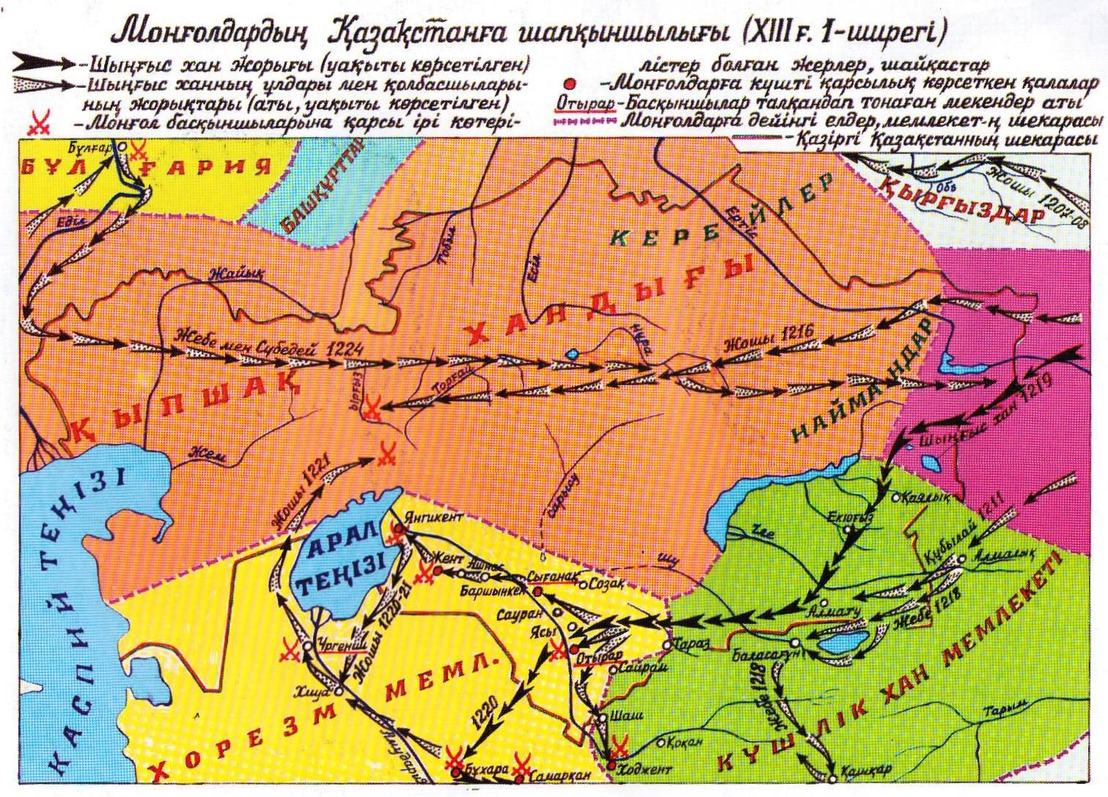

Slide 6
The formation of uluses
Ulus Dzhuchi - from Irtysh to Europe, North-Eastern Khorezm, all of Desht-i Kipchak
Ulus Chagatai - South Kazakhstan, South-East Kazakhstan, Semirechye, Mawrennahr, East Turkestan.
Ulus Ugedei - Western Mongolia, Tarbagatai, Altai, Upper Irtysh and North-Eastern territories.
Tole Ulus - ancestral Mongolian lands, Karakorum - kara shanyrak

Slide 7
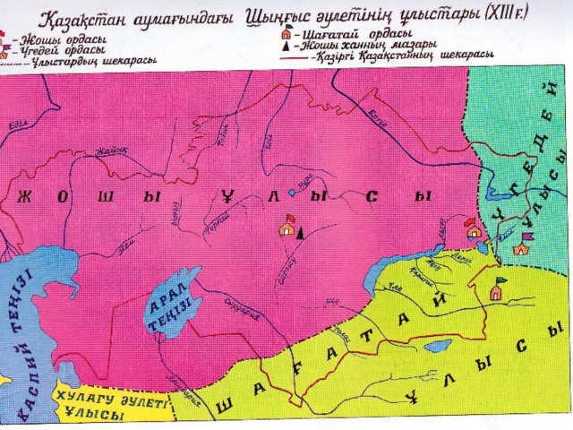

Slide 8
Golden Horde
1237-1240 Batyi's campaign in Europe, up to the Adriatic Sea
1241 has established the capital - Horde on coast of the river Edil (Volga)
The state in history is called Ulug Ulus (Great Ulus), Golden Horde is called only in Russian sources of late time (mistakes of historians).
Palaces in the cities of Sarai-Batu, then Sarai-Berke were covered with gold.
Territory - former Dasht-i-Kypshak
East – Ertis
West - Dniester and Danube
South - lower reaches of Syr Darya, Khorezm, North Caucasus
North - Iber-Siberian forests (Siberia)

Slide 9
The system of governance is Steppe and Turkic
The main population was Kipchaks
The territory consisted of three ulus:
Ak Orda (White) - ulus of Orda Yezhen (Batu's older brother)
Kok Orda (Blue) - ulus of Shaiban (Batu's younger brother).
Ulug Horde (Great, Golden) - Batu's ulus

Slide 10
Main KHANS:
Batu - 1241-1256 founder of the state, known as "Sayin Khan"
Berke - 1257-1266. - Conducted independent economic policy, traded with the Mamluks of Egypt, Caucasus, Ottoman Empire.
Mengu-Temir - 1266-1280 - independent political actions - printed his own money, refused to go to the kurultai at Karakorum
Tudai-Monke - 1280-1287
Tole Buka - 1287-1291
Tokai-Temir - 1291-1312
Uzbek (Giyas-Ad din Muhammed Khan) - 1312-1342 - proclaimed Islam as the state religion
Zhanibek - the heyday of the state - 1343-1357

Slide 11
Golden Horde
From Berdybek to Urus khan, in 1361-1376, 26 khans were replaced
1378-1379 under Tokhtamys khan it split into four possessions.
Collapse in XV century.
Causes:
Internecine struggle for the throne
Separatism
Timur's campaigns
Plague pandemic in Europe (increased migration and weakened trade)

Slide 12
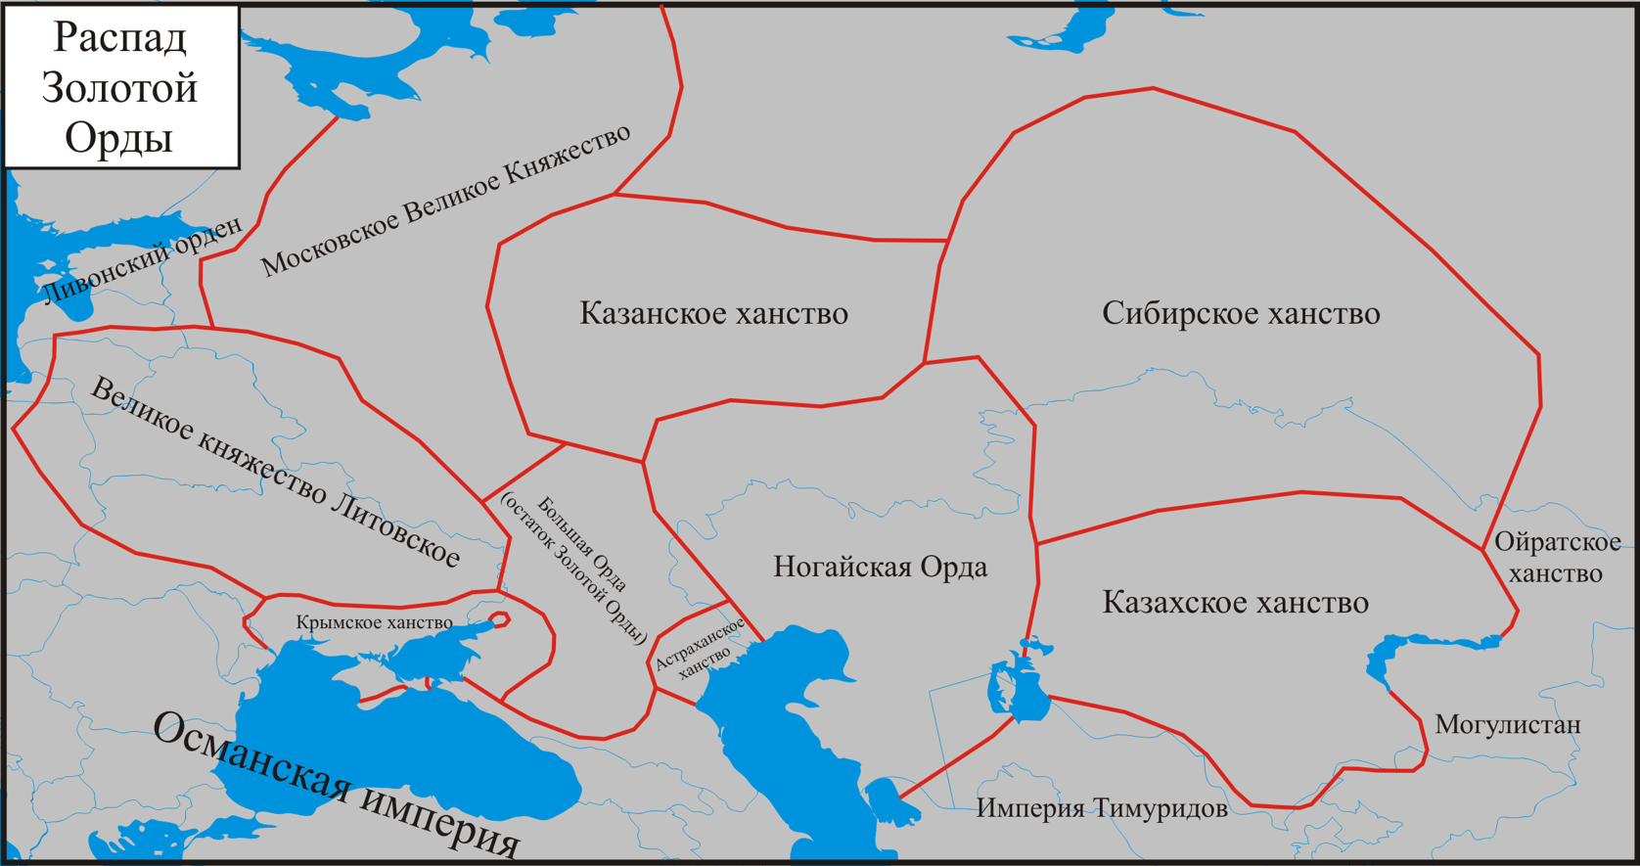
Collapse of the Golden Horde (end of 15 century)

Slide 13

Mongol Successor States (Moghulistan, State of nomadic Uzbeks (Abulkhair Khanate), Nogai Horde, Khanate of Sibir)
Formation | Territory & Rulers | Political History | State Structure | Reasons of Collapse

Slide 14
Ak Horde (XIII - early XV)
The eastern part of the ulus of Djuchi - the eldest son - Yezhen's Horde
Territory - from Zhaik to Irtysh, Syr Darya, Aral, to Siberian forests.
Capital – Syganak
Stages of development:
Struggle for independence from Ulug Ulus (Altyn Horde) (1242-1361) - khans Erzen, Mүbarak Қожа.
Management of affairs of Ulug Ulus (Altyn Horde) (1361-1377) - Shymtai, Urus khans.
Punishment by Urus khan of the emir of Mangistau - Toy-Khoja for refusal to participate in the campaign to Sarai Batu
Toy-Khoja's son Toktamys fled to Timur and received help from him for possession of the throne of the Great Horde, in 1379 they captured the Ak Horde, and in 1380. Golden Horde.
3The period of struggle with Temir and his descendants (1377-1428).During the reign of Urus' grandson Barak Khan the state was strengthened again, but after his death, in 1428, the power passed into the hands of Shiban's descendants

Slide 15
Moghulistan (1318-1514).
In the 15th century, the Ulus Chagatai disintegrated, in the eastern territory under the influence of Emir Bolatchi, Togluk Timur was elected khan in 1348.
In 1358 he killed Kazagan Khan and subjugated the territories of Mawrennahr (between the Syr Darya and Amu Darya rivers)
Kazagan's son-in-law Timur first served Togluk Temir, then separated from him and created his own state.
Territory - Manglai-Sube - from East Turkestan to Fergana, Balkhash, TurkestanIliyas Khozha - defeated Timur in all battles. In 1365 "Battle of Batpak".
But after Iliyas Khoja died in 1390, Moghlistan became dependent on Timur. Gradually gets independence, but in 1462 after the death of Esen Bugi the state broke up, most of it became part of the Kazakh Khanate.

Slide 16
Nogai Horde
It emerged during the collapse of the Golden HordeAfter death of Berke, territories from Don to Danube have passed under authority of Nogai (grandson of Djuchi from the younger wife) The territory was united by Emir Yedige of the Mangyt family (1395-1419). He about 15 years ruled Ulug Ulus, became "great emir" and appointed khans from Chingizids (1396-1411).
Gradually the Nogai Horde began to separate from the Horde, completed under Nuraddin (son of Yedige), in the ÕY century. It became an independent state. Territory: interfluve of Edil and Zhaik.
The capital is the town of Saraychik on the bank of the Zhaik River
Population: Mangyts, Kipchaks, Konrats, Alshyns, Argyns and others.

Slide 17
Territory: from Syr Darya to Emba, in the west the interfluve of Yedil and Zhaik
Under Musa Myrza, the Zhanburchi were in close relations with Uzbeks and Kazakhs.
In the second half of the ХYYI century it split into the Big and Small Nogai Horde. The border is the Yedil River)
During the period of disintegration, most of the population became part of the Kazakh Khanate, under Haknazar.
Played an important role in the formation of the Kazakh Khanate

Slide 18
State of nomadic Uzbeks (Abulkhair Khanate)
The last khan of the Ak Horde, Barak Khan, died in the struggle with the Golden HordeInstead of Barak's successor - Kerey, a descendant of Shiban - 18 years old Abulkhair, was elected khan in the town of Tura
For 40 years of power he subjugated the whole territory of the Great Steppe up to Syr Darya
.Capitals: Chingi-Tura, Orda-bazar, Syganak, Haji-Tarkhan.1446 annexed Sozak, Syganak, Uzkent
1456-1457 was defeated by the Oirats and lost his authority.Kerey and Zhanibek retreated with their tribes to Semirechye.
After Abulkhair's death in 1468 the state disintegrated.

Slide 19
Culture
Cities: Saray, Saray әl-Zhәdid, Gүlstan, Bolgar, Bilar, Azak (Azauly), Kyrym, Kafa, Kazhy-Tarkhan, Orda-Bazar, Bek-Bazar, Үkek, Saraishyk, Tүmen, Akkermen, Shahar әl-Zhәdid, Mazhar, Mamai-Saray, Bel-Zhәmen, Kopa, Khorezm, t. s.s.
In 38 cities gold and silver coins were minted, in each city there were quarters (mahallas) of gunsmiths, blacksmiths, jewelers, masons, weavers and others.
Literary monuments - Әl-Binai "Shaybaninama", M.Khorezmi "Makhabbatnama", Burhanetdin Rabghuzi "Kissa-su-l Anbiya", Ұsman Kukhastani "Tarikhi Bilhayyr-khani", Kuteiba "Khusrau ua Shyrin".

