Slide 1


Lecture 8

Slide 2
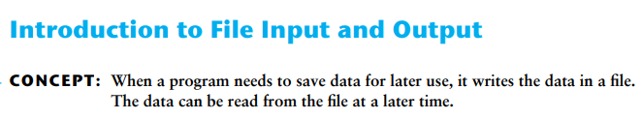
If a program is to retain data between the times it runs, it must have a way of saving it. Data is saved in a file, which is usually stored on a computer’s disk. Once the data is saved in a file, it will remain there after the program stops running. Data stored in a file can be retrieved and used at a later time.
Types of Files
A text file contains data that has been encoded as text, using a scheme such as ASCII or Unicode.
A binary file contains data that has not been converted to text.

Slide 3
File Access Methods
Most programming languages provide two different ways to access data stored in a file: sequential access and direct access.
A sequential access file: you access data from the beginning of the file to the end of the file. If you want to read a piece of data that is stored at the very end of the file, you have to read all of the data that comes before it—you cannot jump directly to the desired data.
A direct access file (which is also known as a random access file): you can jump directly to any piece of data in the file without reading the data that comes before it.
We will use sequential access files. Sequential access files are easy to work with, and you can use them to gain an understanding of basic file operations.

Slide 4
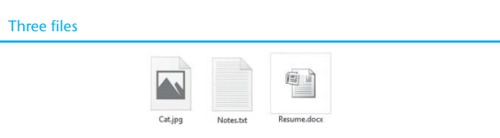
File names and File Objects
Figure 1
In order for a program to work with a file on the computer’s disk, the program must create a file object in memory. A file object is an object that is associated with a specific file and provides a way for the program to work with that file. In the program, a variable references the file object. This variable is used to carry out any operations that are performed on the file. This concept is shown in Figure 2.

Slide 5
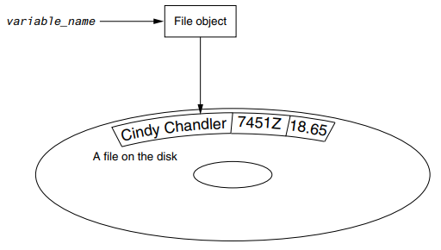
Figure 2

Slide 6
Opening a File
You use the open function in Python to open a file. The open function creates a file object and associates it with a file on the disk. Here is the general format of how the open function is used:
file_variable = open(filename, mode)
In the general format:
• file_variable is the name of the variable that will reference the file object.
• filename is a string specifying the name of the file.
• mode is a string specifying the mode (reading, writing, etc.) in which the file will be opened. Table 1 shows three of the strings that you can use to specify a mode.

Slide 7
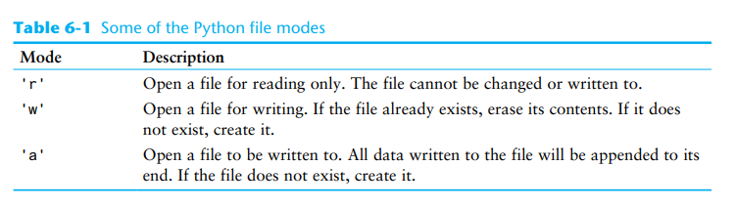
For example, suppose the file customers.txt contains customer data, and we want to open it for reading. Here is an example of how we would call the open function:
customer_file = open('customers.txt', 'r')

Slide 8

After this statement executes, the file named customers.txt will be opened, and the variable customer_file will reference a file object that we can use to read data from the file.
Suppose we want to create a file named sales.txt and write data to it. Here is an example of how we would call the open function:
sales_file = open('sales.txt', 'w')
After this statement executes, the file named sales.txt will be created, and the variable sales_file will reference a file object that we can use to write data to the file.

Slide 9
Specifying the Location of a File
When you pass a file name that does not contain a path as an argument to the open function, the Python interpreter assumes the file’s location is the same as that of the program. For example, suppose a program is located in the following folder on a Windows computer:
C:\Users\Blake\Documents\Python
If the program is running and it executes the following statement, the file test.txt is created in the same folder:
test_file = open('test.txt', 'w')
If you want to open a file in a different location, you can specify a path as well as a filename in the argument that you pass to the open function. If you specify a path in a string literal (particularly on a Windows computer), be sure to prefix the string with the letter r. Here is an example:
test_file = open(r'C:\Users\Blake\temp\test.txt', 'w')
This statement creates the file test.txt in the folder C:\Users\Blake\temp. The r prefix specifies that the string is a raw string. This causes the Python interpreter to read the backslash characters as literal backslashes. Without the r prefix, the interpreter would assume that the backslash characters were part of escape sequences, and an error would occur.

Slide 10
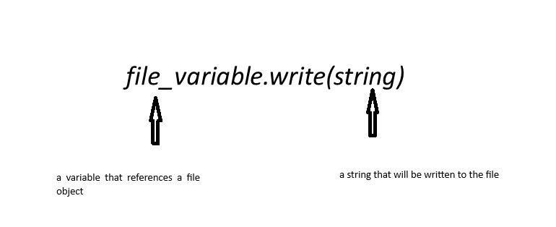
Writing Data to a File
A method is a function that belongs to an object and performs some operation using that object. Once you have opened a file, you use the file object’s methods to perform operations on the file.
For example, file objects have a method named write that can be used to write data to a file. Here is the general format of how you call the write method:
Let’s assume customer_file references a file object, and the file was opened for writing with the 'w' mode. Here is an example of how we would write the string ‘Charles Pace’ to the file:
customer_file.write('Charles Pace')
The following code shows another example:
name = 'Charles Pace‘
customer_file.write(name)

Slide 11
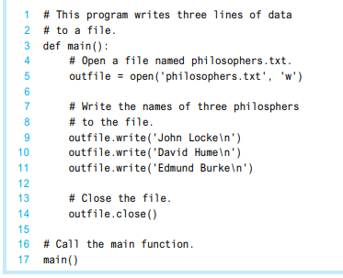

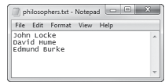
Python program that opens an output file, writes data to it, then closes it.

Slide 12
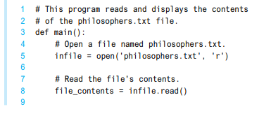
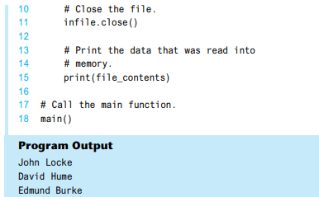
Reading Data From a File

Slide 13
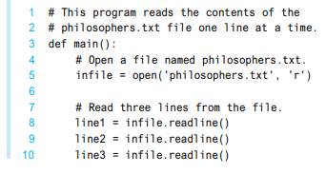


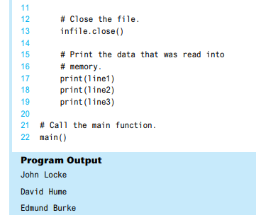


Figure 3
Figure 4
Figure 5
Figure 6

Slide 14


Slide 15
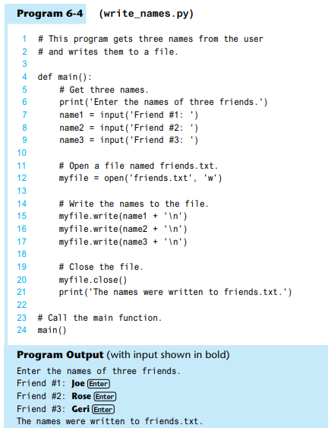
Concatenating a Newline to a String
Lines 7 through 9 prompt the user to enter three names, and those names are assigned to the variables name1, name2, and name3.
Line 12 opens a file named friends.txt for writing. Then, lines 15 through 17 write the names entered by the user, each with '\n' concatenated to it.
As a result, each name will have the \n escape sequence added to it when written to the file.
Figure shows the contents of the file with the names entered by the user in the sample run

Slide 16
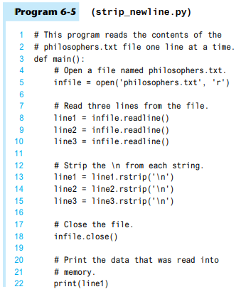
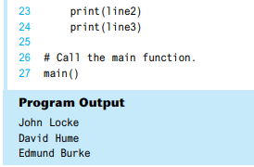
Reading a String and Stripping the Newline from It
The \n serves a necessary purpose inside a file: it separates the items that are stored in the file. However, in many cases, you want to remove the \n from a string after it is read from a file. Each string in Python has a method named rstrip that removes, or “strips,” specific characters from the end of a string. (It is named rstrip because it strips characters from the right side of a string.) The following code shows an example of how the rstrip method can be used.
name = 'Joanne Manchester\n'
name = name.rstrip('\n')

