Slide 1
Statements and predicates
The basic concepts and information of the algebra of propositions and predicates, namely propositions, predicates, axioms, logical expressions and functions, equivalent expressions and reduction to an equivalent expression, other related concepts and facts of logic, as well as infological tasks.

Slide 2
A statement, in logical terms, is a declarative sentence that is either true or false, but not both.
For example:
“The sky is blue.” (This can be evaluated as true or false.)
“2 + 2 = 5.” (This is false.)
Key points to remember about statements:
They must have a definite truth value.
They cannot be ambiguous or opinion-based.

Slide 3
Examples
The following are statements:
Zero times any real number is zero.
1+1=2.
All birds can fly. (This is a false statement. How can you establish that?)
The following are not statements:
Come here.
Who are you?
I am lying right now. (This is a paradox. If I'm lying I'm telling the truth and if I'm telling the truth I'm lying.)

Slide 4
A proposition is a statement that is either true or false, but not both, neither, or sometimes one and sometimes the other.
For example:
(1) «Williams College is located in Williamstown.» is a proposition (because it’s true).
(2) «Leo is a frog.» is a propositions (because it’s false).
(3) «You are located in Williamstown.» is not a proposition, because it’s sometimes true and sometimes false.
(4) «This statement is false.» is not a proposition, because it is neither true nor false.

Slide 5
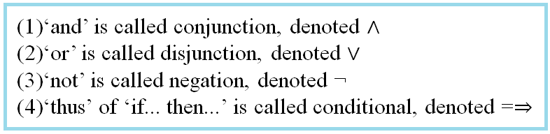
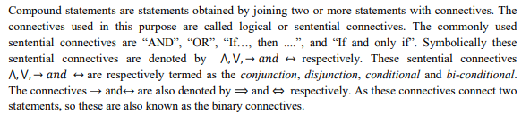
Compound statements: Sentential or binary Connectives

Slide 6
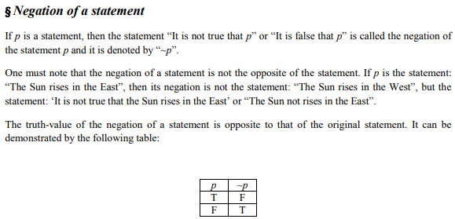

Slide 7
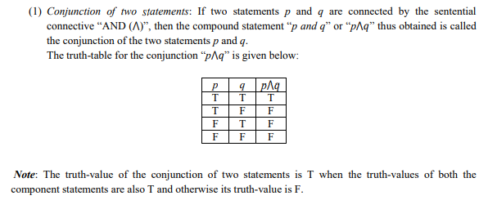

Slide 8
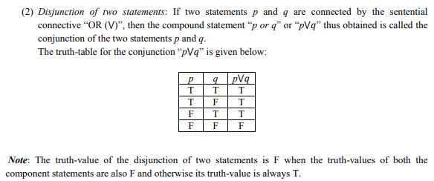

Slide 9
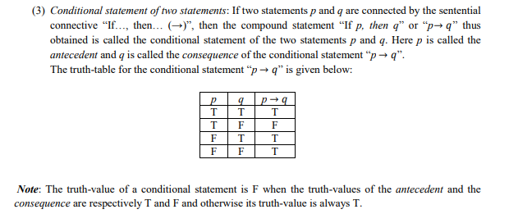

Slide 10
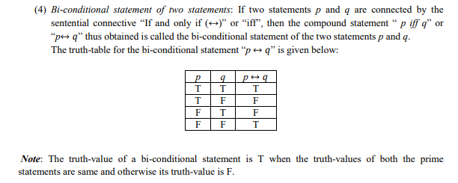

Slide 11
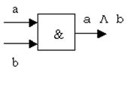
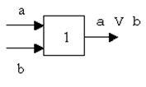


Formulas can also be represented using the logic circuit language. In particular, the operations of conjunction, disjunction, negation are represented by corresponding logical circuits (functional elements):
or

Slide 12

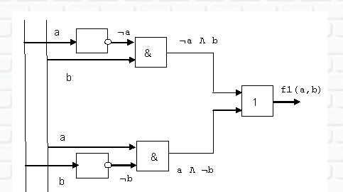
There are standard technical schemes for these logic circuits. Using these functional elements, you can create computational schemes, for example, for formulas

Slide 13
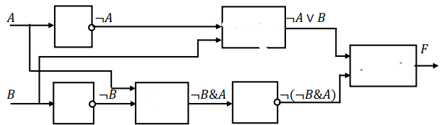
Build a logical scheme of the function
Number of logical variables –
Number of operations-
Inversion is performed first, then conjunction, then disjunction
The circuit consists of 3 inverters, 1 conjuncture, 2 disjunctors

Slide 14
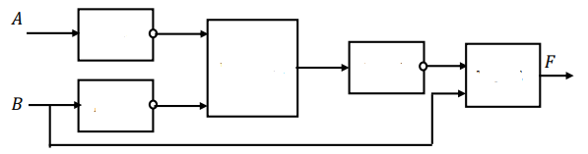
According to the given logical scheme
1) write the formula of the logical function
2) Construct a truth table
V
&

Slide 15
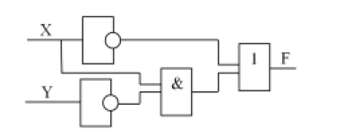
According to the given logical scheme
write the formula of the logical function
build a truth table

Slide 16
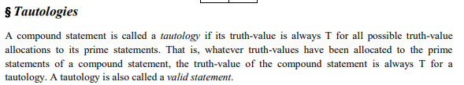
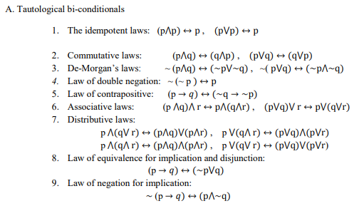

Slide 17
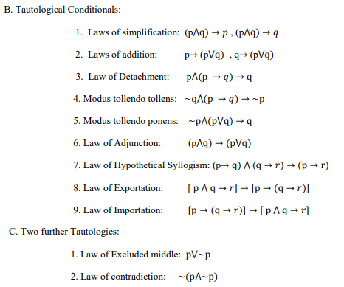

Slide 18
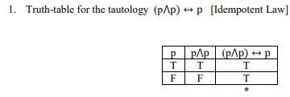
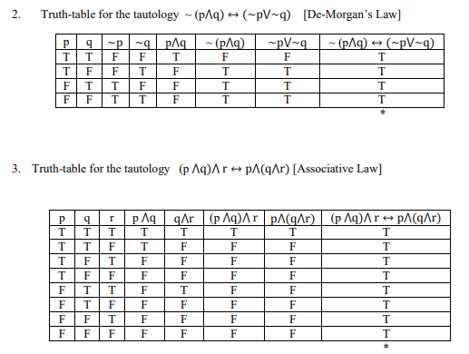

Slide 19


Slide 20
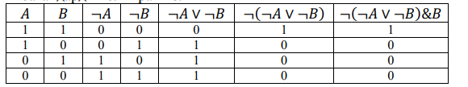
Number of logical variables –
Number of operations-

Slide 21
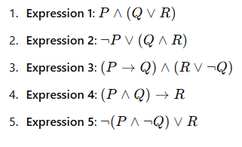
Construct Truth Tables Construct a truth table for the following logical expressions:

Slide 22
Predicate
Definition 1: A sentence containing variables that, when replaced with possible values, become statements, is called a predicate or an utterance form.
Definition 2: A predicate is a logical function of a certain number of subject elements that defines the properties of an object or the relationship between objects.
Definition: A predicate that depends on a single variable is called a one-place predicate. A predicate that depends on n variables is called an n local predicate.
Thus, there are double, triple, etc. predicates. Any statement is a null-local predicate.

Slide 23
Example 1. The sentence A(x): "|x|=x" is a predicate of one variable (single).
Example 2. The sentence "River x flows into Lake Baikal" is a single predicate defined over the set of all river names. Substituting the name "Barguzin" instead of the subject variable x, we get the statement "The Barguzin River flows into Lake Baikal." This statement is true. Substituting the name " Dnieper " instead of the subject variable x, we get a false statement "The Dnieper River flows into Lake Baikal."
Example 3. The sentence (expression) "x2+y2≤9" is a double predicate given over the sets R, R. The sets on which the double predicate is given coincide (they say that this is "the double predicate is given on the set R² "). A pair of real numbers 2, 2 turns this predicate into a true statement: "22+22≤9", and a pair of numbers 2, 3 — into a false one: "22+32≤9".

Slide 24
Definition: A predicate given on the set A1, A2, ..., Ap is called:
Identically true if, with any substitution instead of variables x1 , x2 , ... , xn of any specific objects a1 , a2 , ..., ap from the sets A1, A2, ..., Ap, it turns into a true statement;
Identically false if, with any substitution instead of variables x1, x2 , ... , for any specific objects a1 , a2 , ..., ap from the sets A1 , A2 , ... , Ap, it turns into a false statement;
Feasible (refutable) if there is at least one set of subjects a1 , a2 , ..., ap from the sets A1 , A2 , ... , Ap, when substituting which instead of the corresponding subject variables in the predicate, the latter turns into a true (false) statement.

Slide 25
Example 4. The predicate "x² -1=(x-1)(x+1)" is one-place identically true on the set of real x, and the predicate "x⁴+1" is one-place identically false for all real x.
Example 5. The single predicate "City x is located on the banks of Volga River", defined on a variety of city names. There are cities whose names turn this predicate into a true statement, or, otherwise, satisfy this predicate (for example, Ulyanovsk, Saratov, etc.). But there are cities whose names turn it into a false statement, or, otherwise, do not satisfy this predicate (for example, Prague, Yakutsk, etc.). This predicate is feasible.

Slide 26
Example 6. The single predicate "sin²x+cos²x=1", defined on the set of real numbers, is identically true.
Practice: Independently prove why the predicate in Example 6 is identically true?
Example 7. Double predicate "x²+y² ", given on a set of real numbers, is an identically false predicate.
Practice: Independently prove why the predicate in Example 7 is identically false?

