Slide 1
SOLVING SYSTEMS OF LINEAR ALGEBRAIC EQUATIONS

Slide 2
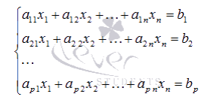
A system of linear algebraic equations is called a union of p linear equations, each of which contains n variables:

Slide 3



- unknown variables
- coefficients (some real and complex numbers)
- free terms (also real and complex numbers)
This form of writing a system of linear algebraic equations is called coordinate.
In the matrix form of the record, this system of equations has the form

Slide 4
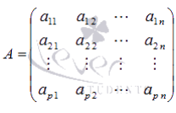


where
- the main matrix of the system,
- the matrix is a column of unknown variables
- the matrix is a column of free members

Slide 5
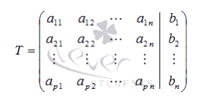
If we add a matrix column of free terms to matrix A as the (n-1)th column, we get the so-called extended matrix of a system of linear equations. Usually, the extended matrix is denoted by T, and the column of free members is separated by a vertical line from the rest of the columns, that is
The solution of a system of linear algebraic equations is called a set of values of unknown variables that convert all the equations of the system into identities. Matrix equation A*X=B with these values of unknown variables, it also turns into an identity A*X≡B.

Slide 6
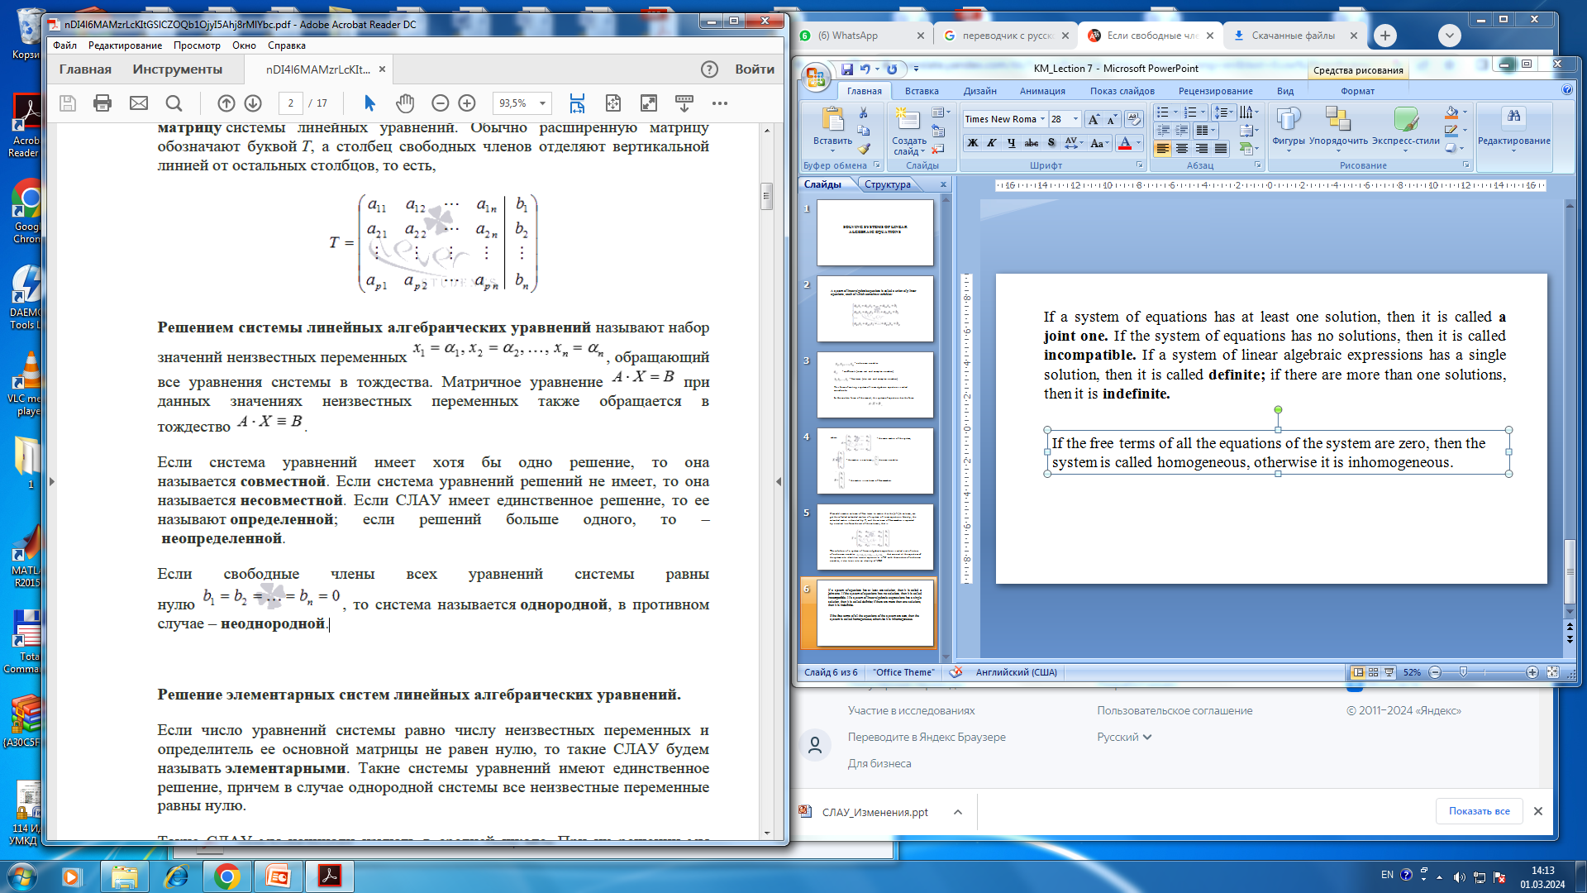
If a system of equations has at least one solution, then it is called a joint one. If the system of equations has no solutions, then it is called incompatible. If a system of linear algebraic expressions has a single solution, then it is called definite; if there are more than one solutions, then it is indefinite.
If the free terms of all the equations of the system are zero
, then the system is called homogeneous, otherwise it is inhomogeneous.

Slide 7
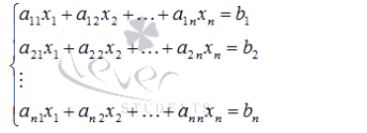
Solving elementary systems of linear algebraic equations.
Solving systems of linear equations by Cramer’s method.
Suppose we need to solve a system of linear algebraic equations
in which the number of equations is equal to the number of unknown variables and the determinant of the main matrix of the system is nonzero, that is, |A |≠0

Slide 8

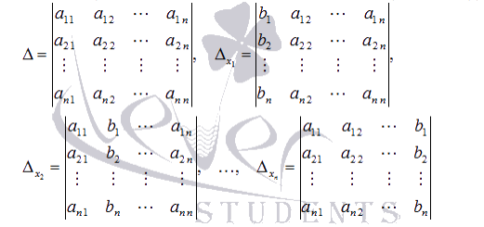
Let be the determinant of the main matrix of the system, and let
be the determinants of the matrices, that are obtained from A by replacing the 1st, 2nd, ..., nth column, respectively, with a column of free terms:

Slide 9

With such notation, unknown variables are calculated using the formulas of Cramer’s method as
This is how the solution of a system of linear algebraic equations by Cramer’s method is found.

Slide 10
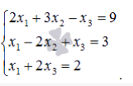
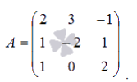
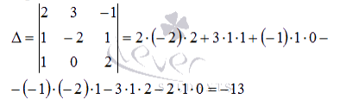
Example.
Solve a system of linear equations using Cramer’s method
Solution.
The main matrix of the system has the form
Let's calculate its determinant:

Slide 11





Since the determinant of the main matrix of the system is nonzero, the system has a single solution that can be found by Cramer’s method.
Let's make up and calculate the necessary determinants
(we get the determinant by replacing the first column in matrix A with a column of free members
the determinant by replacing the second column with a column of free members, by replacing the third column of matrix A with a column of free members):

Slide 12
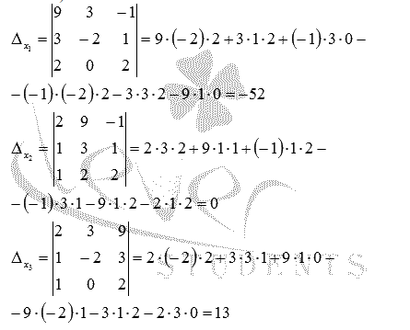

Slide 13

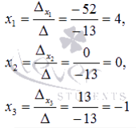

Find unknown variables using formulas
Answer:

Slide 14
The main disadvantage of Cramer’s method (if it can be called a disadvantage) is the complexity of calculating determinants when the number of equations of the system is more than three.

Slide 15
Solving systems of linear algebraic equations by Matrix method (using the inverse matrix).
Let the system of linear algebraic equations be given in matrix form
where the matrix A has dimension n by n and its determinant is nonzero.

Slide 16



Since , the matrix A is invertible, that is, there is an inverse matrix
If we multiply both parts of the equality times on the left, we get a formula for finding the matrix column of unknown variables
This is how we obtained the solution of a system of linear algebraic equations using Matrix method.

Slide 17
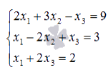

Example.
Solve a system of linear equations using the matrix method.
Solution.
Rewrite the system of equations in matrix form:

Slide 18
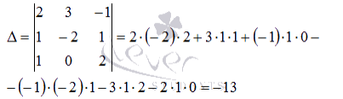
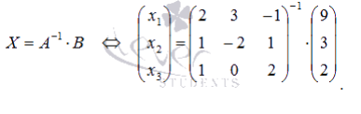
As
so the system of linear algebraic equations can be solved using the matrix method. Using the inverse matrix, the solution to this system can be found as

Slide 19

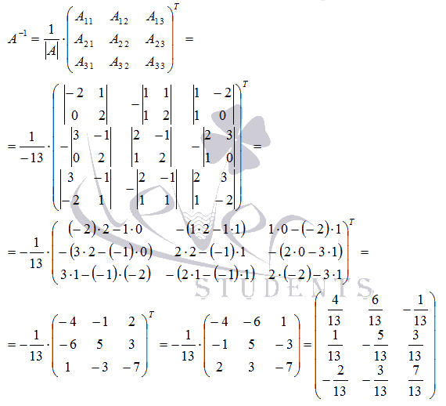
Construct the inverse matrix using a matrix of algebraic additions of the elements of matrix A:

Slide 20

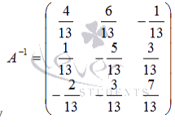

It remains to calculate - the matrix of unknown variables
by multiplying the inverse matrix by the matrix
column of free terms

Slide 21
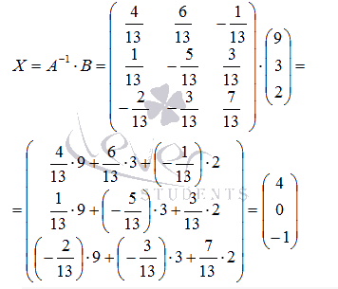
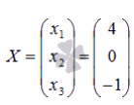
Answer:
or in another entry
The main problem in finding solutions to systems of linear algebraic equations using the matrix method is the complexity of finding the inverse matrix, especially for square matrices of the order above the third.

