Slide 1
Lectures 4-5 Kazakh Khanate

Slide 2
Plan
Kazakh Khanate
2. Ethnogenesis of Kazakh people

Slide 3
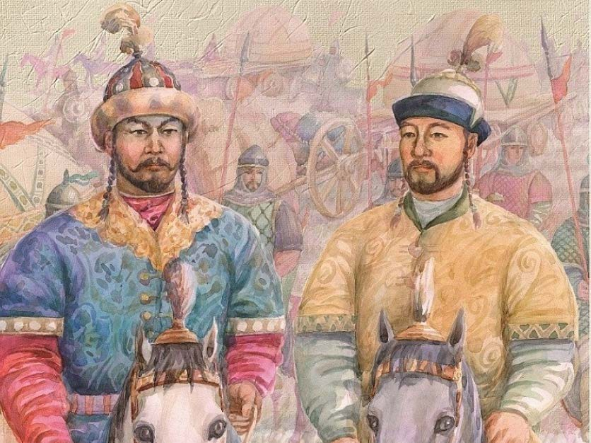
1. Emergence of Kazakh Khanate
Abu-l-Khair’s actions were of an aggressively armed nature, which required incalculable human and material costs and losses.
A significant part of the population rallied around the sultans of Giray and Janibek back in the 1440s-1450s. In the hands of the sultans were urban centers and fortresses in the foothills of Karatau and on the Syr Darya: Suzak, Sygnak, Sauran, etc.
Janibek and Girey headed the clans and tribes that went beyond the Khanate of Abu-l-Khair.

Slide 4
1. Emergence of Kazakh Khanate
The ruler of Mogolistan, Yesen-Buga, entered into an alliance with Kazakh leaders, providing them with the territories of the Western Semirechye
This was the beginning of the emergence of Kazakh Khanate (“Kazak” means “unrestricted”, “free”, “separated from something”).
Mohammed Khaidar Dulati refers the time of the formation of Kazakh Khanate to 1465-1466.

Slide 5
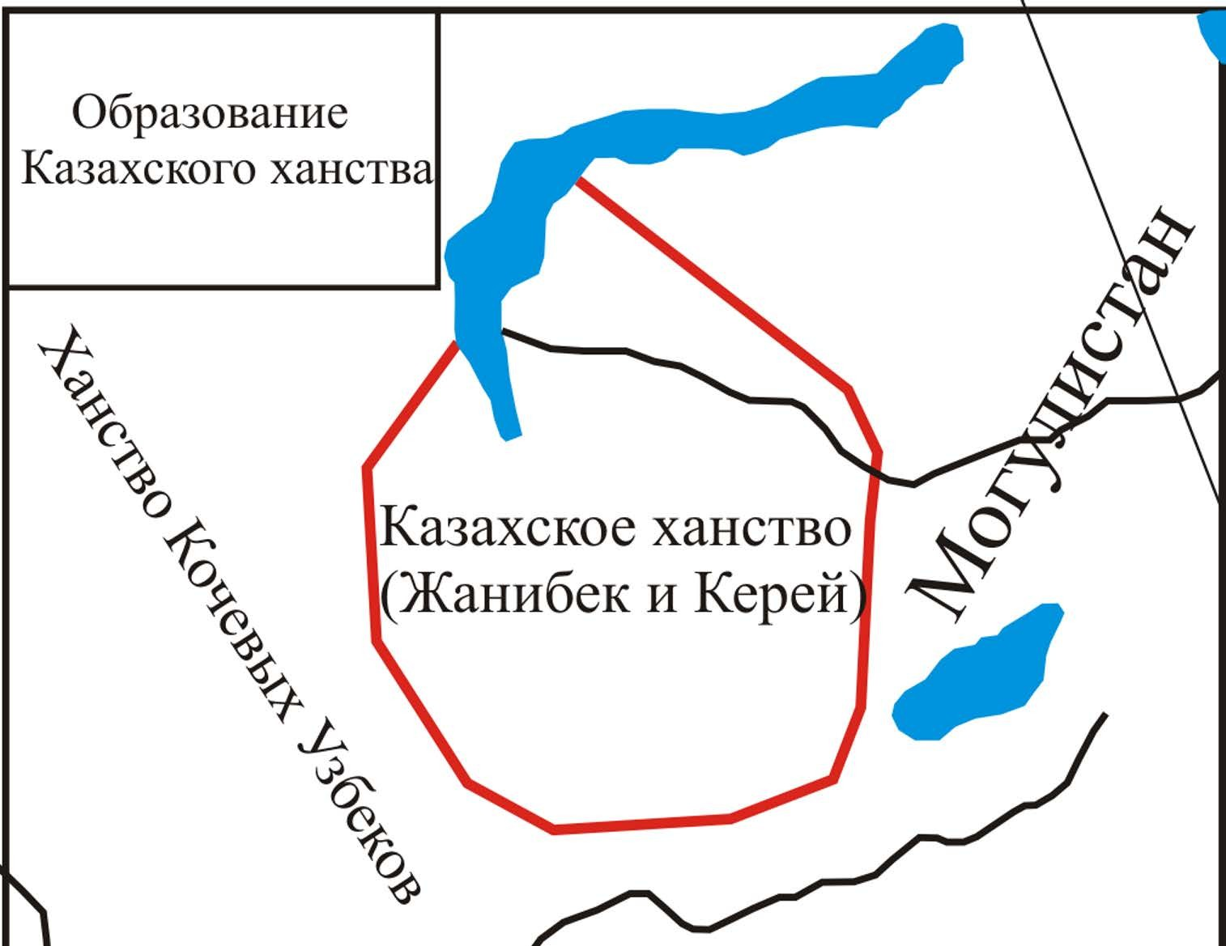
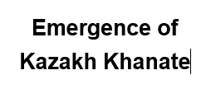
из 36
5

Slide 6
Kazakh Khanate in the XV century
Kazakh khans immediately after the death of Abu-l-khair (died in 1468), entered into a struggle for power in the steppe and in the southern regions.
Their main opponents were the Shaibanids (descendants of Abu-l-Khair).
The main struggle unfolded in Turkestan (the economic and strategic importance of this region was great). The struggle dragged on for 3 decades.
One of the prominent leaders of the Kazakh troops in this period was Giray's son Burundyk (khan since 1480).

Slide 7
Kazakh Khans
Name | Ruling period
Kerei | 1456–1473
Janibek | 1473–1480
Burundyk | 1480–1511
Kasym | 1511–1518
Muhammed | 1518–1523
Tahir | 1523–1533
Buidash | 1533–1538
Ahmed | 1533–1535
Toghym | 1535–1537
Haqnazar | 1538–1580
Shygai | 1580–1582
Tauekel | 1582–1598
Esim | 1598–1628
Jangir | 1628–1652
Batyr Khan | 1652-1680
Tauke | 1680–1715
Qaiyp | 1715–1718
Bolat | 1718–1729
Abulmambet Khan | 1729–1771
Ablai Khan | 1771–1781
Kenesary Khan | 1841–1847

Slide 8
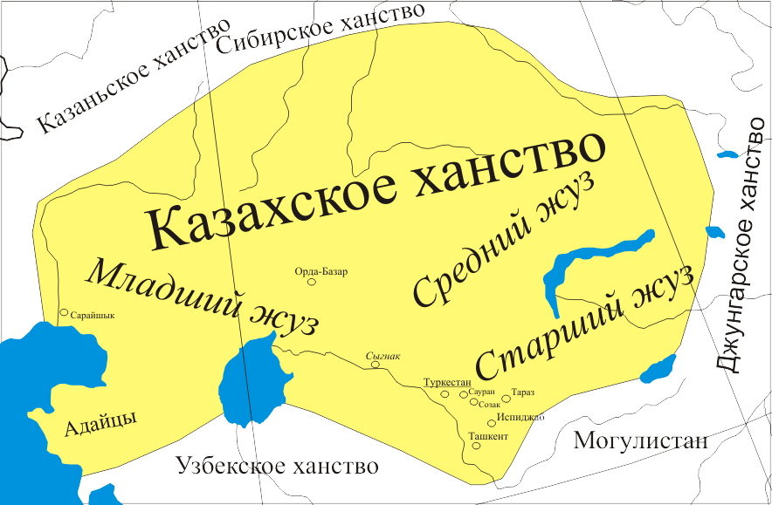
из 36
8

Slide 9
Socio-economic development of Kazakh Khanate
The increasing share of the nomadic pastoral economy has changed social relations in the direction of patriarchy.
The communal form of land tenure dominated.
Livestock is the main measure of the wealth of nomads.
The entire territory of the khanate belonged to the ruling family of Genghisides.
The khan was the supreme manager of the lands, dividing them among the sultans.

Slide 10
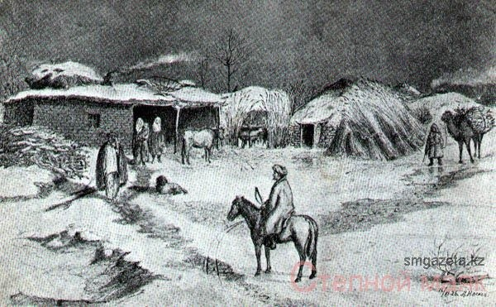
из 36
18

Slide 11
Social Structure
To the upper aristocratic class−ak suyek (white bone)−Genghisides included: khans, sultans, oglans and tore.
Each sultan could claim a khan's title, an ulus with a certain number of clans and tribes.
In the uluses, the sultans owned all the administrative and judicial power, they were exempted from performing duties in favor of the khan

Slide 12
Socio-economic development of Kazakh Khanate
ushur - soul tax;
tagar - a tax to provide troops with food;
budge - tax on cultivated land;
kharaj−state land tax.
Taxes were not fixed and were collected depending on the crop or the number of livestock received.

Slide 13
2. Ethnogenesis of the Kazakh people
1 period-the Bronze age The ancient tribes of the Bronze Age with the Andron ethnocultural appearances with Indo-European language, with European features factually were one of the far physical forbear forms of the Kazakh people.
2 period – The Iron age In this period ancient Kazakhstan by its existence became the center of dissemination of the so called «nomadic tribes » characteristic of all Eurasian steppes, i. e. –saks, looking like European shape.
3 period – Huns period As a result of “the Great resettlement of people” which hunnu begun the Ethnic map of Eurasia changed. Hunny have for the first tribes who brought Mongol type to the territory of Kazakhstan. After huns invasion local European tribes revealed 50% of Mongol type.

Slide 14
2. Ethnogenesis of the Kazakh people
4 period -Turk period (VI-XII cc.) In the Turkic period vast territory of Kazakhstan for thousands years became bridge between East and West. Since that time vast territory of the Great Steppe became Turkestan, i. e. the country of the Turkic. Among the numerous Turkic tribes, such tribes as Ogyzes and Kypchaks played the most important role in ethno geneses.
5 period – Mongol period (XIII-XIV cc.) The Mongol conquests have definitively bolted Mongolian types in the external look of Turkic tribes. However, Mongols themselves disappeared among numerous Turkic tribes, have taken their language, customs.
6 period - Kazakh Khanate – final stage of formation

Slide 15
2. Ethnogenesis of the Kazakh people
Kazakhstan has an extremely complex ethnic history.
Due to the natural geographical and economic conditions of the habitat, the entry of various tribes into different tribal unions and early feudal states, three ethno-cultural groups are formed−zhuzes.

Slide 16
2. Ethnogenesis of the Kazakh people
Senior Zhuz: Zhetysu, Turkestan;
Tribes: Dulats (4 generic groups: Boptai, Shymyr, Seykym, Zhanys), Uysun, Zhalair, Kangly, Suans, Albans, Shaprppshty, Sirgels, Zhalairs, Shakty.
Middle zhuz: Central, Northern and Eastern Kazakhstan;
Tribes: Argyns, Naimans, Kypchaks, Kereis, Uaks, Konrats.
Junior zhuz: Western Kazakhstan, between the Urals and the Volga.
Tribes: 3 tribal associations − Alimuly (Shekty, Tortkara, Karakesek, Karasakal, Kete, Shomekey), Baiuls (Aday, Jappas, Alash, Baybakty, Maskar, Bersh, Tazlar, Esentemir, Serkesh, Tana, Kyzylkurt, Shihlar, Altyn, Isyk ), zhetyru (tabyn, tama, kerderi, kereit, toleu, ramadan, zhagalbayly).

Slide 17
Assignment
Name | Years of reign | Internal Policy | External Policy | Evaluation (role in KH)
Kasym
Tahir
Haqnazar
Tauekel
Esim
Tauke

