Slide 1
Lecture 1
Programming paradigms.
The concept of a programming language.

Slide 2
A program is a set of instructions for a specific performer.
A programming language is a formal language designed for writing programs (usually for computers).

Slide 3
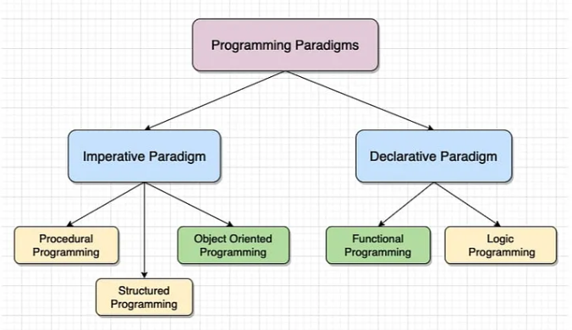
The programming paradigm is a set of ideas and concepts that define the style of writing computer programs (approach to programming).

Slide 4
Areas of programming languages application
System programming
Programming of embedded devices
Video card programming
Programming high-load servers
Programs for working with databases
System Administration
Writing graphical user interfaces
Web programming
Computer games
Scientific programming

Slide 5
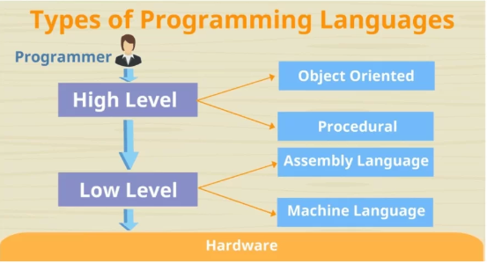

Slide 6
High level languages are written in a form that is close to our human language, enabling to programmer to just focus on the problem being solved.
Examples include: C++, Java, Pascal, Python, Visual Basic.
Advantages
Easier to modify as it uses English like statements
Easier/faster to write code as it uses English like statements
Easier to debug during development due to English like statements
Portable code – not designed to run on just one type of machine

Slide 7
Low Level Languages
Low level languages are used to write programs that relate to the specific architecture and hardware of a particular type of computer.
Examples of low level language:
Assembly Language
Machine Code
Assembly Language
Few programmers write programs in low level assembly language, but it is still used for developing code for specialist hardware, such as device drivers.
It is easy distinguishable from a high level language as it contains few recognisable human words but plenty of mnemonic code.
Advantages
Can make use of special hardware or special machine-dependent instructions (e.g. on the specific chip)
Translated program requires less memory
Write code that can be executed faster
Total control over the code
Can work directly on memory locations
Machine Code
Programmers rarely write in machine code (binary) as it is difficult to understand.

Slide 8
Compilers and interpreters
Translator is a special program that converts program code from a particular programming language into machine code
Compiler
Immediately translates all program code into machine language. Creates an executable file.
Interpreter
Translates the program code line by line. It interacts directly with the operating system.

Slide 9
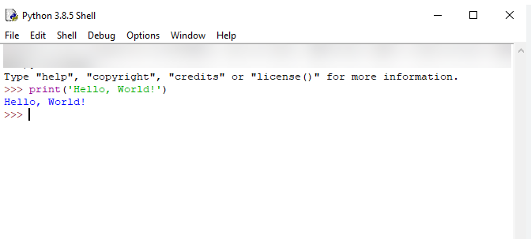
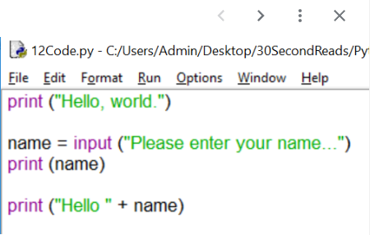

Slide 10
Task 1
(Data input/output)
Tasks must be performed in interactive and scripting modes. Everything should be done in order.
Write a program:
sequentially requesting your last name, first name, patronymic and displaying them in one line in the sequence: last name = first name = patronymic;
sequentially requesting your last name, first name, patronymic and displaying them in one line in the sequence: first name → patronymic → last name (you can combine the first and second points in one program by requesting data once, but providing output in both ways);
converting a simple Russian surname in the masculine gender into the feminine gender (Petrov → Petrova);
Sequentially enter the date, month, year of birth; enter your date of birth separated by dots (01.01.2024), slashes (01/01/2024), spaces (01 01 2024), dashes (01-01-2024).

