Slide 1
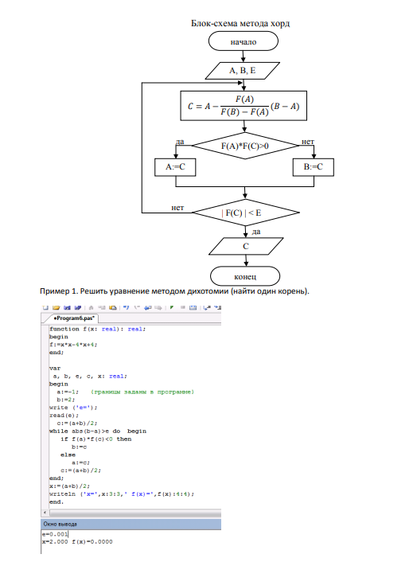
Chord method

Slide 2
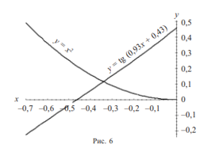
1. Separate the roots of the equation graphically and refine one of them using the chord method with an accuracy of 0.0001.
Solution: We separate the roots of the equation graphically, for which we plot a graph of functions

Slide 3
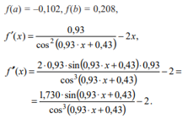
Thus, the desired root of the equation is located on the segment .
Define the sign of the function at the ends of the segment and the sign of its second derivative on this segment
where
(it can be checked graphically).
Since , let's use the formula (Slide 5 lecture 4), take . The calculations are given in the table (look the next slide)

Slide 4
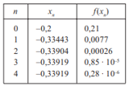
Since , then we assume I.e., we found the root of the equation with an accuracy of 0.0001 in four steps.
Answer:

Slide 5
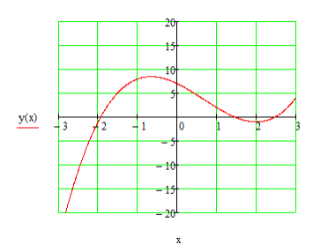
2. Using the chord method, find the negative root of the equation
with an accuracy of 0.0001.
A preliminary plotting of the function and separation of the roots is required.
Solution. Separate the roots graphically:

Slide 6
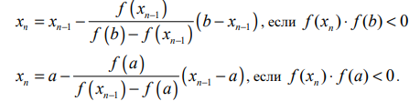



The first negative root is in the range [-2; -1]. Refine the root of the equation by the chord method.
Convergence criterion:
So, let's choose
1 iteration:
then

Slide 7





2 iteration:
then
3 iteration:
then
4 iteration:
then
Answer:

