Slide 1

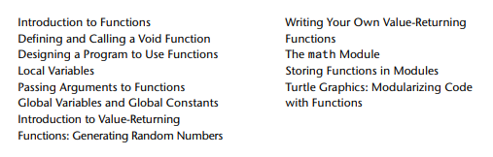
Lecture 5
Agenda

Slide 2

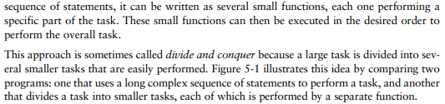

Slide 3
A program benefits in the following ways when it is broken down into functions:
Simpler Code
Code Reuse
Better Testing
Faster Development
Easier Facilitation of Teamwork
We will learn to write two types of functions: void functions and value returning functions. When you call a void function, it simply executes the statements it contains and then terminates. When you call a value-returning function, it executes the statements that it contains, then returns a value back to the statement that called it.

Slide 4

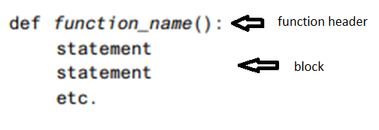
To create a function, you write its definition. Here is the general format of a function definition in Python:

Slide 5
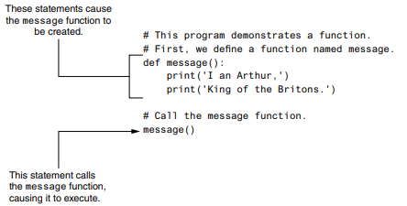
The function definition and the function call
function call

Slide 6
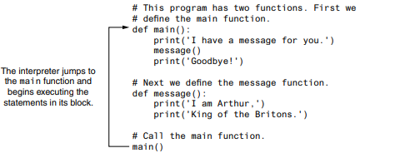
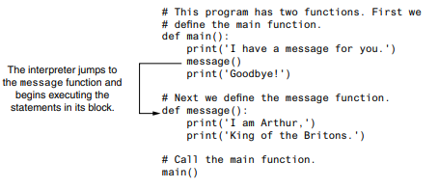
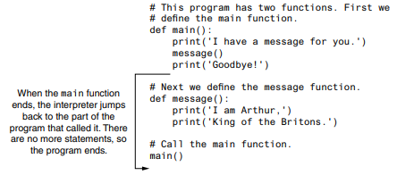
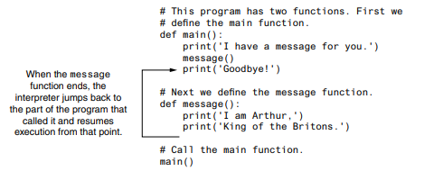
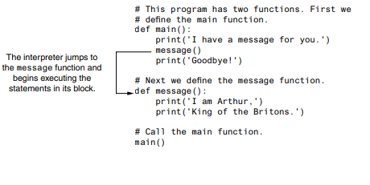
Calling the main function
Calling the message function
The main function returns
The message function returns
Calling the message function

Slide 7


Slide 8

Just as important as understanding how functions work is understanding how to design a program that uses functions. Programmers commonly use a technique known as top-down design to break down an algorithm into functions. The process of top-down design is performed in the following manner:
The overall task that the program is to perform is broken down into a series of subtasks.
Each of the subtasks is examined to determine whether it can be further broken down into more subtasks. This step is repeated until no more subtasks can be identified.
Once all of the subtasks have been identified, they are written in code.
This process is called top-down design because the programmer begins by looking at the topmost level of tasks that must be performed and then breaks down those tasks into lower levels of subtasks.

Slide 9
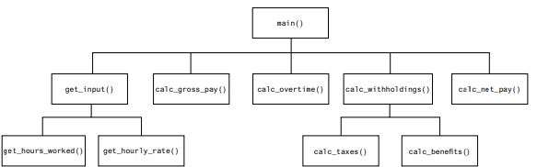
Figure 2 - A hierarchy chart
The chart shown in Figure 2 shows the main function as the topmost function in the hierarchy. The main function calls five other functions: get_input, calc_gross_pay, calc_overtime, calc_withholdings, and calc_net_pay. The get_input function calls two additional functions: get_hours_worked and get_hourly_rate. The calc_withholdings function also calls two functions: calc_taxes and calc_benefits.

Slide 10
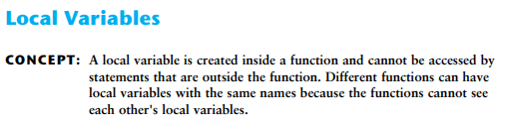
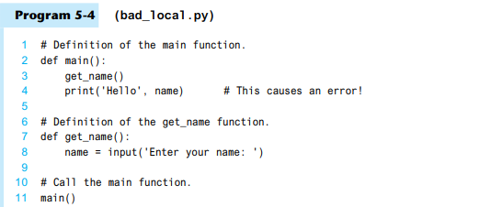
Anytime you assign a value to a variable inside a function, you create a local variable. A local variable belongs to the function in which it is created, and only statements inside that function can access the variable. (The term local is meant to indicate that the variable can be used only locally, within the function in which it is created.)
An error will occur if a statement in one function tries to access a local variable that belongs to another function. For example, look at Program 5-4.

Slide 11

A variable’s scope is the part of a program in which the variable may be accessed. A variable is visible only to statements in the variable’s scope. A local variable’s scope is the function in which the variable is created.
In addition, a local variable cannot be accessed by code that appears inside the function at a point before the variable has been created. For example, look at the following function. It will cause an error because the print function tries to access the val variable, but this statement appears before the val variable has been created. Moving the assignment statement to a line before the print statement will fix this error.
Because a function’s local variables are hidden from other functions, the other functions may have their own local variables with the same name. For example, look at Program 5-5. In addition to the main function, this program has two other functions: texas and california. These two functions each have a local variable named birds.

Slide 12
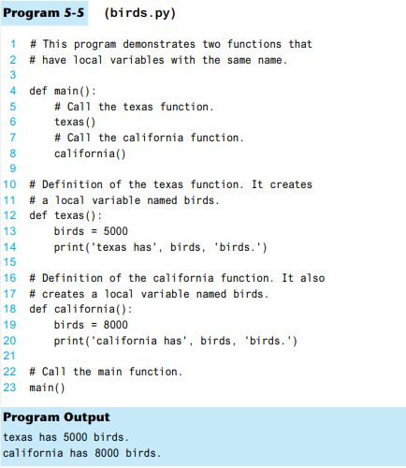
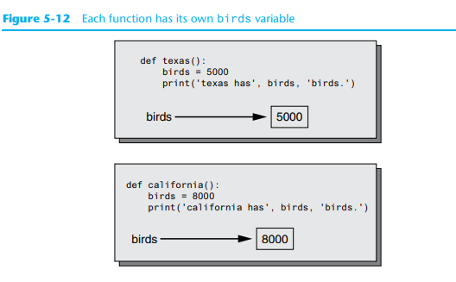
Although there are two separate variables named birds in this program, only one of them is visible at a time because they are in different functions. This is illustrated in Figure 5-12. When the texas function is executing, the birds variable that is created in line 13 is visible. When the california function is executing, the birds variable that is created in line 19 is visible.

Slide 13
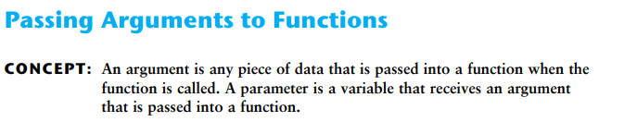

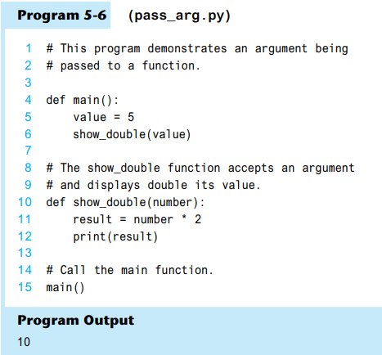
Pieces of data that are sent into a function are known as arguments. The function can use its arguments in calculations or other operations.
A parameter variable, often simply called a parameter, is a special variable that is assigned the value of an argument when a function is called.
Example:
The function in a complete program:

Slide 14
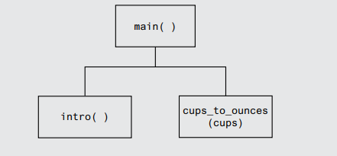
TASK: Passing an Argument to a Function
Your friend Michael runs a catering company. Some of the ingredients that his recipes require are measured in cups. When he goes to the grocery store to buy those ingredients, however, they are sold only by the fluid ounce. He has asked you to write a simple program that converts cups to fluid ounces. You design the following algorithm:
Display an introductory screen that explains what the program does.
Get the number of cups.
Convert the number of cups to fluid ounces and display the result. This algorithm lists the top level of tasks that the program needs to perform and becomes the basis of the program’s main function. Figure 1 shows the program’s structure in a hierarchy chart.
Hierarchy chart for the program

Slide 15

When a variable is created by an assignment statement that is written outside all the functions in a program file, the variable is global. A global variable can be accessed by any statement in the program file, including the statements in any function.

Slide 16
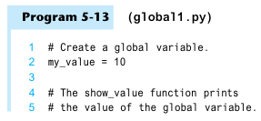
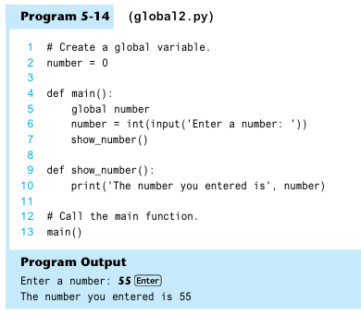
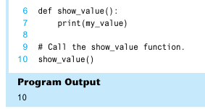

Slide 17
Most programmers agree that you should restrict the use of global variables, or not use them at all. The reasons are as follows:
• Global variables make debugging difficult. Any statement in a program file can change the value of a global variable. If you find that the wrong value is being stored in a global variable, you have to track down every statement that accesses it to determine where the bad value is coming from. In a program with thousands of lines of code, this can be difficult.
• Functions that use global variables are usually dependent on those variables. If you want to use such a function in a different program, most likely you will have to redesign it so it does not rely on the global variable.
• Global variables make a program hard to understand. A global variable can be modified by any statement in the program. If you are to understand any part of the pro gram that uses a global variable, you have to be aware of all the other parts of the program that access the global variable

Slide 18

A global constant is a global name that references a value that can not be changed. Because a global constant’s value cannot be changed during the program’s execution, you do not have to worry about many of the potential hazards that are associated with the use of global variables.

Slide 19
Example
Marilyn works for Integrated Systems, Inc., a software company that has a reputation for providing excellent fringe benefits. One of their benefits is a quarterly bonus that is paid to all employees. Another benefit is a retirement plan for each employee. The company contributes 5 percent of each employee’s gross pay and bonuses to their retirement plans. Marilyn wants to write a program that will calculate the company’s contribution to an employee’s retirement account for a year. She wants the program to show the amount of contribution for the employee’s gross pay and for the bonuses separately.
An algorithm for the program:
Get the employee's annual gross pay.
Get the amount of bonuses paid to the employee.
Calculate and display the contribution for the gross pay.
Calculate and display the contribution for the bonuses.

Slide 20
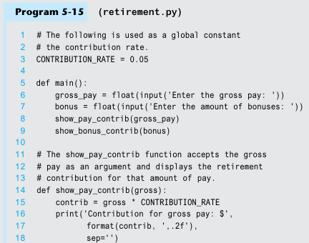
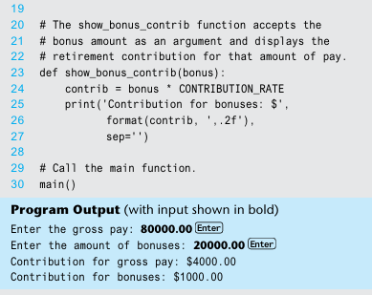

Slide 21
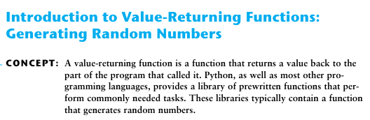
A value-returning function is a special type of function. It is like a void function in the following ways.
• It is a group of statements that perform a specific task.
• When you want to execute the function, you call it.

Slide 22
Many of the functions in the standard library, however, are stored in files that are known as modules. These modules, which are copied to your computer when you install Python, help organize the standard library functions.
For example, functions for performing math operations are stored together in a module, functions for working with files are stored together in another module, and so on. In order to call a function that is stored in a module, you have to write an import statement at the top of your program. An import statement tells the interpreter the name of the module that contains the function. For example, one of the Python standard modules is named math. The math module contains various mathematical functions that work with floating-point numbers. If you want to use any of the math module’s functions in a program, you should write the following import statement at the top of the program:
import math
This statement causes the interpreter to load the contents of the math module into memory and makes all the functions in the math module available to the program.

Slide 23
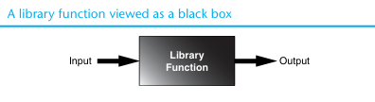

Slide 24
Python provides several library functions for working with random numbers. These functions are stored in a module named random in the standard library. To use any of these functions, you first need to write this import statement at the top of your program:
import random
This statement causes the interpreter to load the contents of the random module into memory. This makes all of the functions in the random module available to your program.
RANDINT
- the random module
In dot notation, the function’s name is random.randint

Slide 25
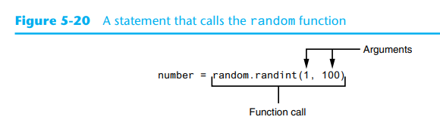
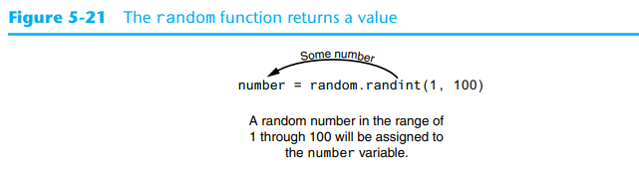

Slide 26
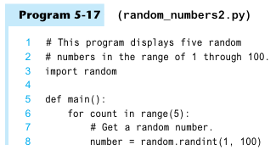
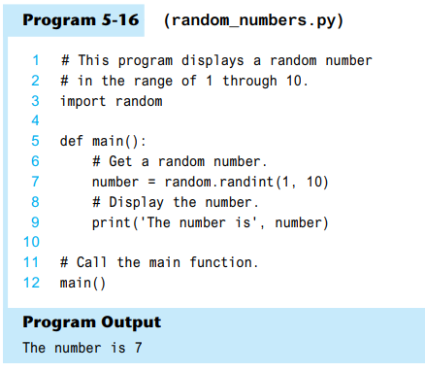
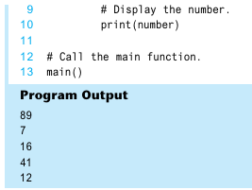

Slide 27
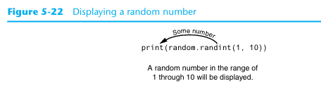
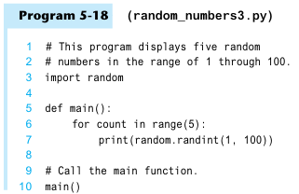
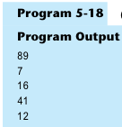

Slide 28
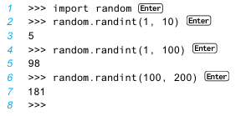

Slide 29
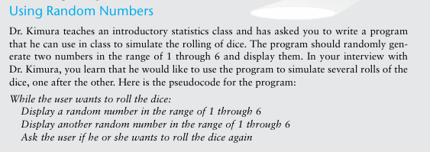
Tasks for self work
P.S. You will write a while loop that simulates one roll of the dice and then asks the user if another roll should be performed. As long as the user answers “y” for yes, the loop will repeat.

Slide 30

P.S. You decide that you can simulate the tossing of a coin by randomly generating a number in the range of 1 through 2. You will write an if statement that displays “Heads” if the random number is 1, or “Tails” otherwise. Here is the pseudocode:
Repeat 10 times:
If a random number in the range of 1 through 2 equals 1 then:
Display ‘Heads’
Else:
Display ‘Tails’
Because the program should simulate 10 tosses of a coin you decide to use a for loop.

Slide 31



The randrange function takes the same arguments as the range function. The difference is that the randrange function does not return a list of values. Instead, it returns a randomly selected value from a sequence of values.

Slide 32
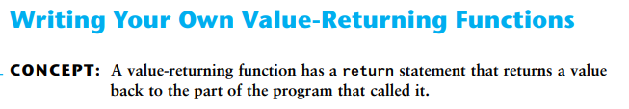
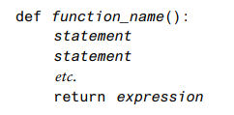

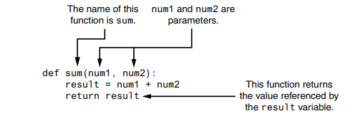

Slide 33
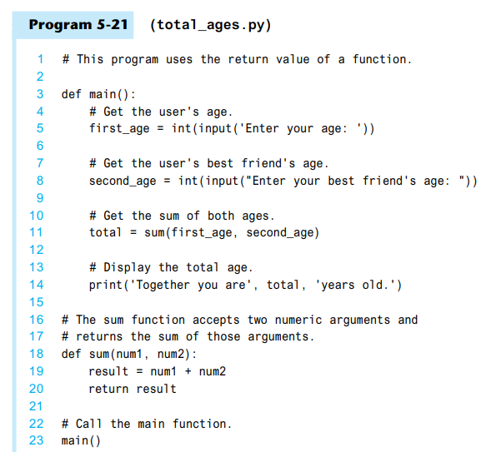
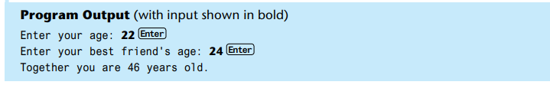

Slide 34
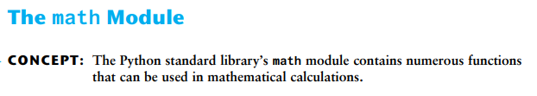
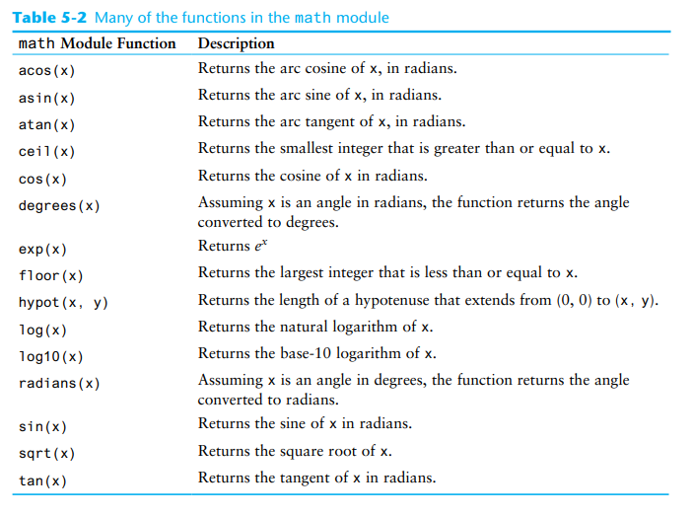


Slide 35
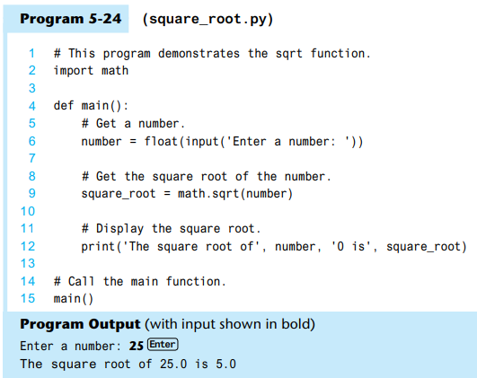
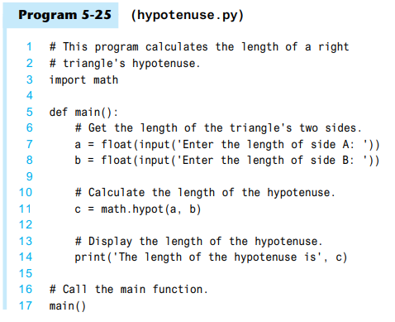


Slide 36
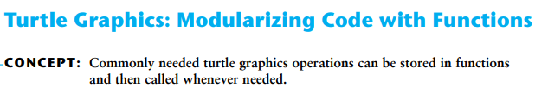
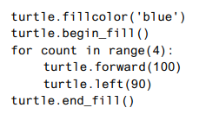
Using the turtle to draw a shape usually requires several steps. For example, suppose you want to draw a 100-pixel wide square that is filled with the color blue. These are the steps that you would take:

Slide 37
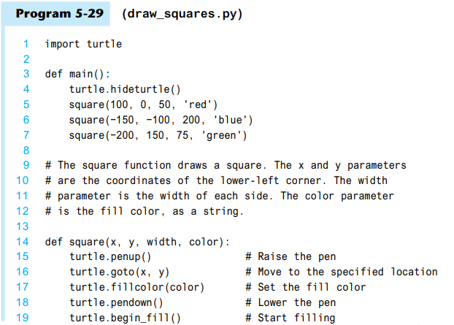
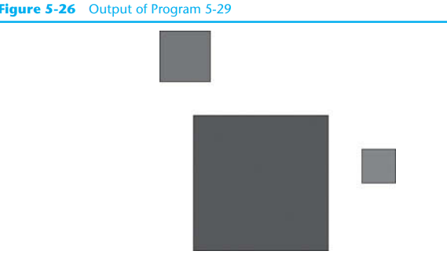
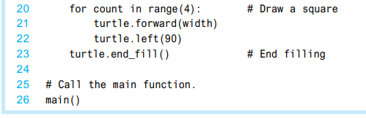

Slide 38
