Slide 1
Solving systems of linear equations by Gauss’s method.

Slide 2
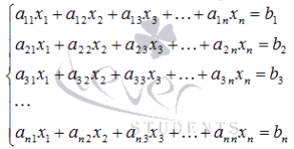
Suppose we need to find a solution to a system of n linear equations
with n unknown variables whose determinant of the main matrix is nonzero

Slide 3
The essence of Gauss’s method is the sequential exclusion of unknown variables: first, x1 is excluded from all equations of the system, starting with the second, then x2 is excluded from all equations, starting with the third, and so on, until only the unknown variable xn remains in the last equation. This process of converting the equations of the system to sequentially exclude unknown variables is called the direct course of Gauss’s method. After completing the forward stroke of Gauss’s method, xn is found from the last equation, using this value, xn-1 is calculated from the penultimate equation, and so on, x1 is found from the first equation. The process of calculating unknown variables when moving from the last equation of the system to the first is called the reverse course of Gauss’s method.

Slide 4



Briefly describe the algorithm for excluding unknown variables.
We will assume that , since we can always achieve this by rearranging the equations of the system. Let's exclude the unknown variable x1 from all the equations of the system, starting with the second one. To do this, add the first equation of the system multiplied by to the second one, add the first equation multiplied by to the third one, and so on, add the first equation multiplied by to n-th equation. The system of equations after such transformations will take the form:

Slide 5
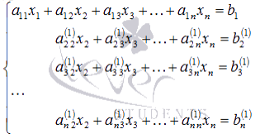


where

Slide 6
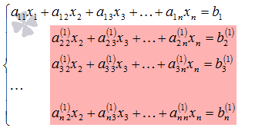
The same result would have been if we had expressed x1 through other unknown variables in the first equation of the system and substituted the resulting expression into all other equations. Thus, the variable x1 is excluded from all equations, starting with the second one.
Next, we act similarly, but only with a part of the resulting system, which is marked in the figure

Slide 7





Assume that (otherwise we will rearrange the second row with the kth, where ). Proceed to exclude the unknown variable x2 from all equations, starting with the third one. To do this, add the second equation multiplied by to the third one of the system , add the second equation multiplied by to the fourth one equation , and so on, add the second equation multiplied by to the n-th one. The system of equations after such transformations will take the form:

Slide 8
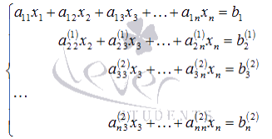


where
Thus, the variable x2 is excluded from all equations, starting with the third one.

Slide 9
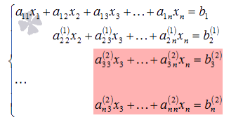
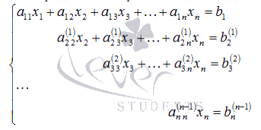
Next, we proceed to exclude the unknown x3, while acting similarly with the part of the system marked in the figure
Continue the direct course of Gauss’s method until the system takes the form

Slide 10

From this point on, we begin the reverse course of Gauss’s method: calculate xn using the last equation as . Using the obtained value of xn, we find xn-1 from the penultimate equation, and so on, we find x1 from the first equation.

Slide 11



Example:
Solve a system of linear equations
using Gauss’s method.
Solution:
Exclude the unknown variable x1 from the second and third equations of the system. To do this, add the corresponding parts of the first equation to both parts of the second and third equations, multiplied by and by
respectively:

Slide 12
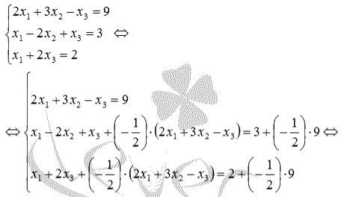
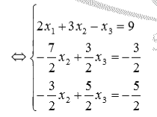

Slide 13
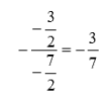
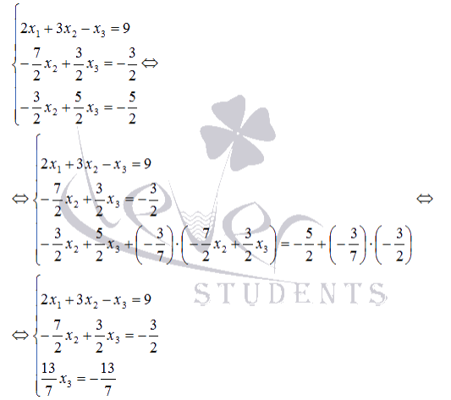
Next exclude x2 from the third equation by adding to its left and right sides the left and right sides of the second equation multiplied by :

Slide 14
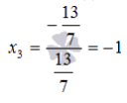



At this point the direct course of Gauss’s method is completed, and begin the reverse course. From the last equation of the resulting system of equations find x3:
From the second equation we get
From the first equation, we find the remaining unknown variable and this completes the reverse course of Gauss’s method
Answer:

