Slide 1
Lecture 4
Solving nonlinear equations with one variable

Slide 2


Chord method (proportional parts method)
The points of the curve at and are connected by a straight line (chord). The intersection point of this chord with the abscissa axis determines the first approximation for the root value. In this case, the interval turns out to be divided into two parts
and . Select the part of the interval where the function values at the ends have different signs. Connect the ends of this interval with a chord and repeat the steps described above.
There are two possible cases when the end of a chorus turns out to be stationary or when the end of b chords turns out to be stationary.

Slide 3
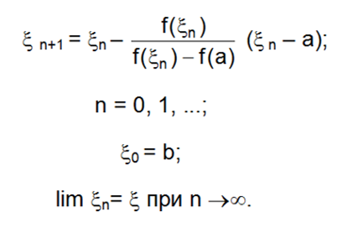
If the end of a chord turns out to be stationary, then we get the following iterative process:

Slide 4
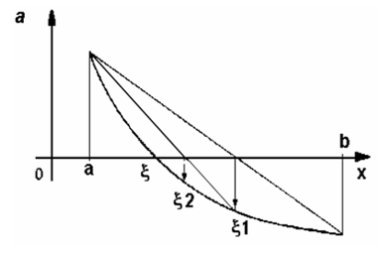
A scheme for clarifying the roots of the equation by the chord method (the left end is fixed)

Slide 5
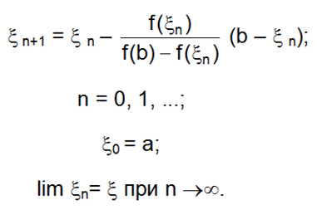
If the end of the b chords turns out to be stationary, then we get the following iterative process:

Slide 6
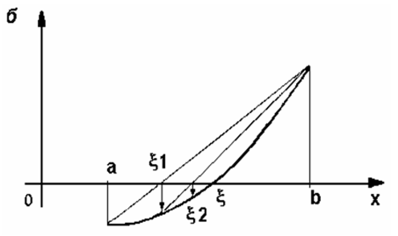
A scheme for clarifying the roots of the equation by the chord method (the right end is fixed)

Slide 7



Error estimation
Where and are the largest and smallest values of the modulus of the derivative on the segment .
For a narrow segment

Slide 8



Tangent method (Newton's method)
Theorem: If the inequality , and the derivatives
are nonzero and retain certain signs , then, based on the initial approximation satisfying the inequality , it is possible to calculate by Newton's method the only root of the equation
with any degree of accuracy.

Slide 9




Let the root of the equation be rejected on the segment and the derivatives and are continuous and retain certain signs inside this segment.
Then
The end of the interval that corresponds to the ordinate of the same sign as the sign is chosen as the starting point
Error estimation

Slide 10
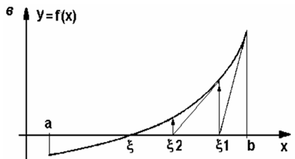
Scheme refinement of the roots of the equation by tangent method

Slide 11
Example 1. Calculate the negative root of an equation with five correct signs using Newton's method.
Decision. Assuming x=0, -10, -100, … on the left side of the equation we get
f(0)= -10000, f(-10)=-1050,
Therefore, the desired root is in the interval . Let's narrow down the found interval. Since f(-11)=3453, then
In the last interval and
Since , we can take as an initial approximation. The successive approximations are calculated according to the following scheme:

Slide 12
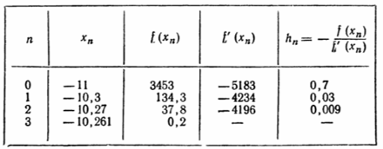
Stopping at n= 3, we check the sign of the value Since then and any of these numbers gives the desired approximation

Slide 13

The iteration method (the method of successive approximations)
Replaces the given equation with an equation equivalent to it
.Let's choose an approximate value of the root in some way and substitute it in the right part (a). We get
Now put another number in the right part (b) instead of , we get a new number , etc. Repeating this process, we find a sequence of numbers
If the sequence converges, then when

Slide 14
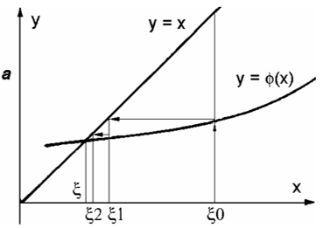
When the iteration method is geometrically displayed, the resulting shapes look like stairs when

Slide 15

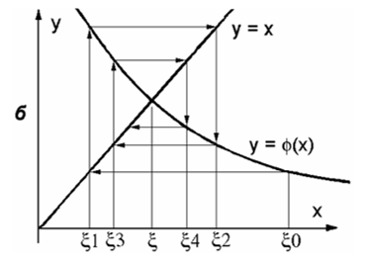
The resulting shapes have the appearance of a spiral when
Note the self-correction property of the calculation algorithm - a separate calculation error does not affect the result.

Slide 16
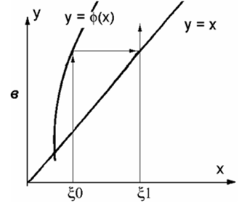

The iteration process can be divergent
A sufficient condition for the convergence of the process has the form

Slide 17



The number q can be taken as the smallest value or the lower face of the modulus of the derivative on the segment
Approximation error
The process should be continued until the inequality is satisfied
where is the specified absolute margin of error.

Slide 18
Remarks on algebraic equations
The algebraic equation has the form
The main theorem of algebra: equation (c) has exactly n roots, real and complex. Each root is counted as many times as its multiplicity. The root has a multiplicity of s if
Complex roots have paired conjugacy.
If , then there is an odd number of roots in the interval . If
, then this interval either has no roots, or there is an even number of roots.

