Slide 1
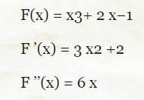
Tangent method (Newton's method)
Advantages of the method: high convergence rate; generalized to systems of equations.
Disadvantages: difficult, because calculation of derivatives is required; strong dependence of convergence on the type of function and the choice of the initial approximation.
Example 1: Using Newton's method, refine the roots of the equation x3 = 1− 2x with an accuracy of ε=0.001. The root is refined on the segment [0;1]
First you need to choose the initial approximation.
The derivatives have a constant sign on the segment [0,1], so it is sufficient to use the condition to select the initial approximation (look the lection 4 slide 8)

Slide 2
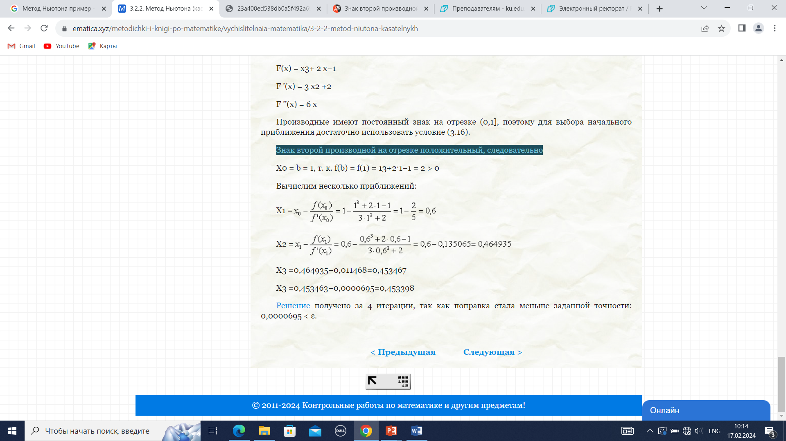
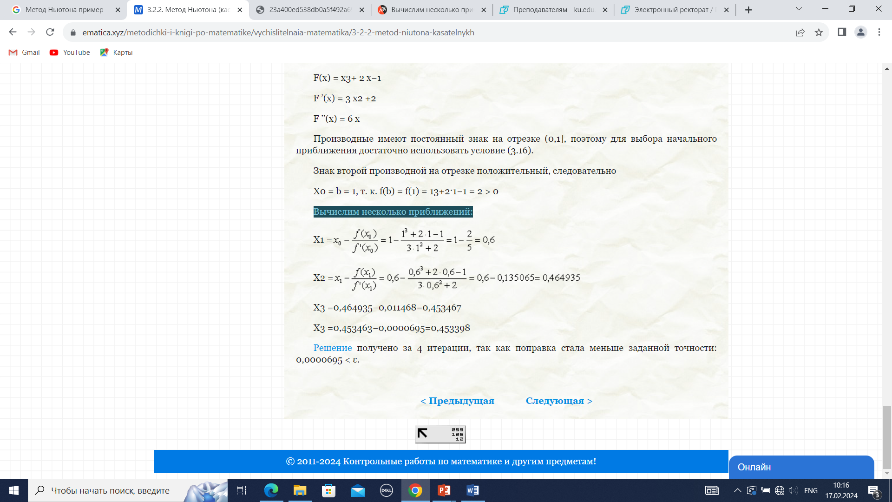
The sign of the second derivative on the segment is positive, therefore
Let's calculate a few approximations:
The solution was obtained in 4 iterations, since the correction became less than the specified accuracy: 0.0000695 < ε.

Slide 3
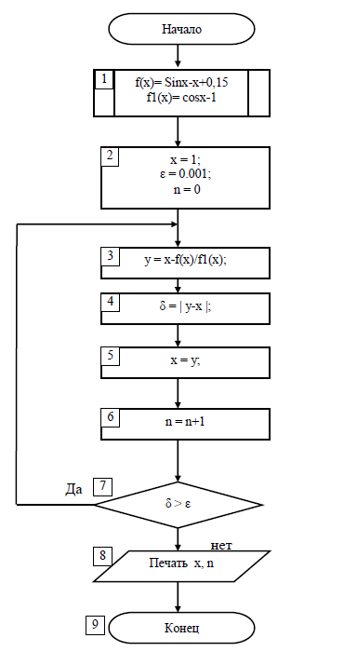
Example 2. Using Newton's method, find the root of the equation f (x) = sin x—x + 0.15 = 0 on the segment [0.5; 1], with an absolute error ε = 10-4.

Slide 4
Practical work
Using Newton's method, refine the roots of the equation with an accuracy of ε=0.0001.
The root is refined on the segment [0;1].
f(x)=x5+2x-+1

