Slide 1
Functions approximation

Slide 2
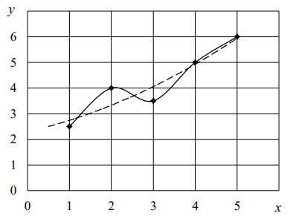

Approximation is an approximation method in which, in order to find additional values other than tabular data, the approximate function passes not through the interpolation nodes, but between them (Fig. 4).
– the interpolating function
– the approximating function
Fig. 4. Type of interpolating and approximating functions

Slide 3

If the analytical expression of the function describing the law of change
is unknown or very difficult, then the task arises to find such an empirical formula
the values of which at would differ little from the experimental data.
Geometrically, the task of constructing the function f(x) according to an empirical formula consists in drawing an averaged curve – a curve passing through the middle of the value range (Table. 8) (fig. 5).

Slide 4

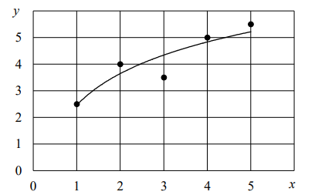
Table 8
Experimental data
Fig. 5. An example of an approximating function

Slide 5
Data is described more accurately by interpolation than by approximation, but in some cases the use of approximation is justified:
with a significant amount of tabular data (the interpolating function becomes cumbersome);
it is impossible to describe the data with an interpolating function when repeating the experiment under the same initial conditions (statistical processing is required);
to smooth out the errors of the experiment. The xi and yi data usually contain errors, so the interpolation formula repeats these errors. It can be seen from the figure (Fig. 6) that the values of y constantly and uniformly increase with increasing x, and the spread of data relative to the approximating function can be explained by the experimental error.

Slide 6
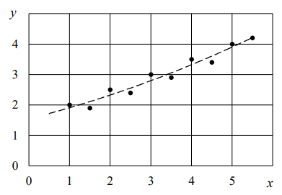
Fig. 6. An example of the construction of an approximating function

Slide 7
When constructing an approximating dependence, it is determined:
the analytical nature of the empirical formula. Preference is given to simple formulas with good accuracy;
the best parameters of empirical dependence.

Slide 8


The least squares method
The essence of the least squares method is to find such values of , at which the sum of the squares of deviations (errors) will tend to a minimum
Since each value of is generally "accompanied" by the corresponding coefficient (i = 0, 1, 2, ..., n), the task is reduced to finding these coefficients. Introduce the function designation

Slide 9

Then, based on the acssess of its derivatives at the minimum point of the function F to zero, a normal system is compiled to determine the above-mentioned coefficients:

Slide 10


Linear approximation
In a number of experiments, the data are distributed in such a way that it is possible to describe their change by a linear dependence (linear equation) (Fig. 7)
The formulas for calculating the coefficients a and b are determined by the least squares method (9), substituting (11) into (10)

Slide 11
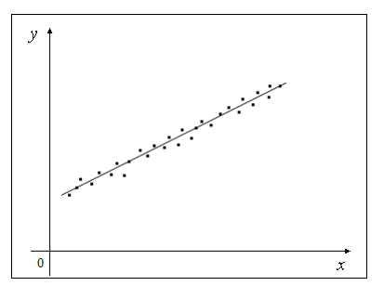
Fig. 7. Linear approximation

Slide 12
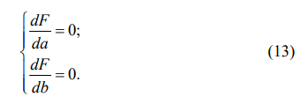
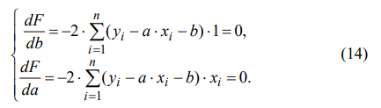
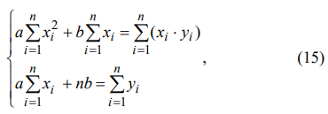
To solve (12), a system of two equations with two unknowns is compiled
Substituting formula (12) in (13), we obtain
and

Slide 13
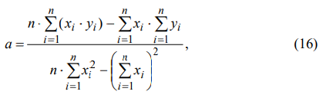
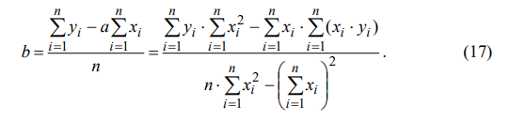
Solving the resulting system (15) by substitution method, we obtain formulas for finding the coefficients a and b:

Slide 14

Example
A tabular dependence of the power of N turning and screw-cutting machines on the maximum diameter of the d workpiece, installed above the bed, for ten models is given (Table 9).
Table 9
The values of the maximum diameter of the workpiece installed above the bed and the power of turning and screw-cutting machines
Machine
model
It is required to find the capacity of the projected turning and screw-cutting machine for processing a workpiece with a maximum diameter of 700 mm.

Slide 15
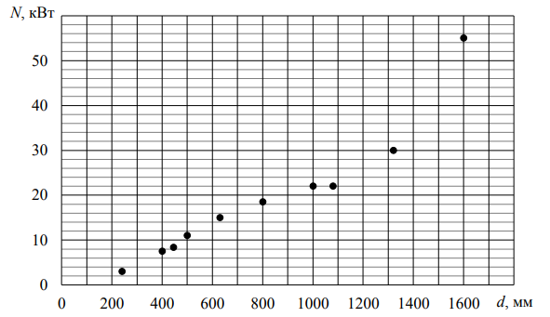
Figure 8. The distribution area of tabular data (Table 9)
The analysis of the diagram (Figure 8) allows us to conclude that the change in tabular data can be described with a sufficient degree of accuracy by the equation of the line (11). In this regard, to find an empirical dependence describing the change in data, you can use the linear approximation method.

Slide 16
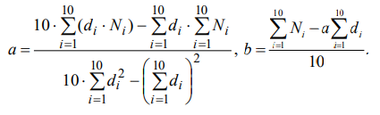

For convenience, we will rewrite the above formulas (16, 17):
Make calculations and solve the problem, illustrate the solution graphically.
Coefficient values:
The equation of the line for this example will take the form

Slide 17
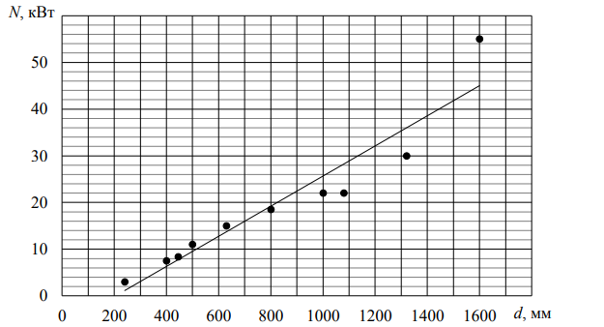
Substituting the value of the diameter of 700 mm into the last expression, we get the power value of the designed machine –N = 15.78 kW.
By performing an approximating function (direct), you can verify the correctness of the solution (Fig. 9).
Fig. 9. Diagram constructed using Microsoft Office Excel tools
It can be seen from the diagram that with a workpiece diameter of 700 mm, the machine power will approximately be 16 kW.

