Slide 1
Lecture 4
Repetition Structures

Slide 2

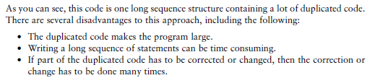


Slide 3
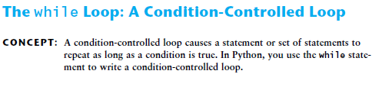
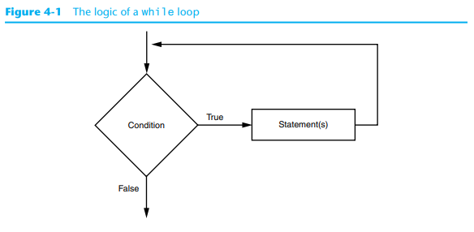
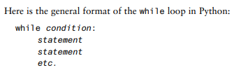

Slide 4
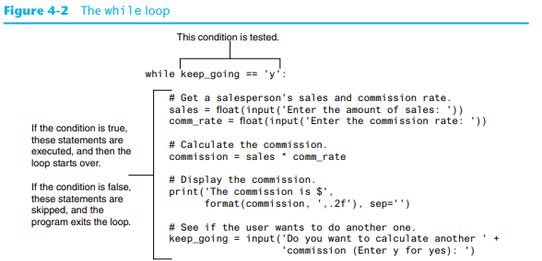
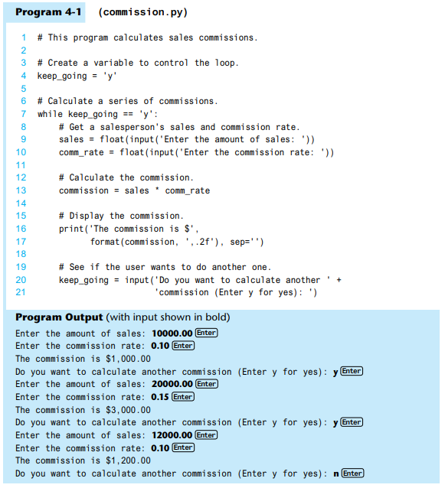

Slide 5
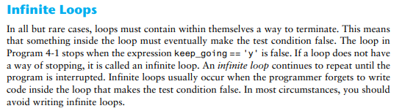
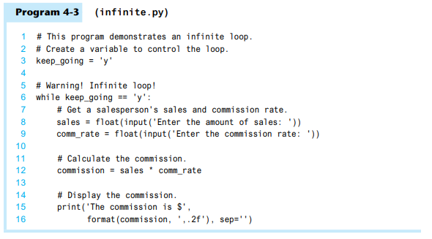

Slide 6
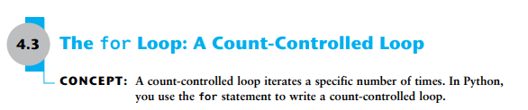
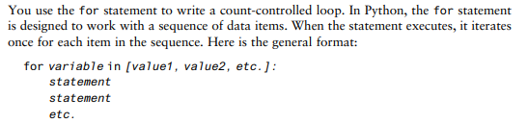

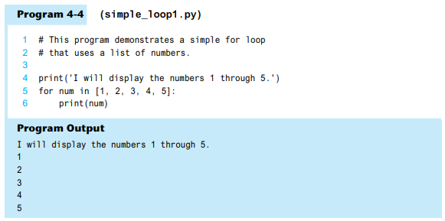

Slide 7


Python provides a built-in function named range that simplifies the process of writing a count-controlled for loop. The range function creates a type of object known as an iterable. An iterable is an object that is similar to a list. It contains a sequence of values that can be iterated over with something like a loop. Here is an example of a for loop that uses the range function:
Instead of using a list of values, we call to the range function passing 5 as an argument. In this statement, the range function will generate an iterable sequence of integers in the range of 0 up to (but not including) 5. This code works the same as the following:

Slide 8
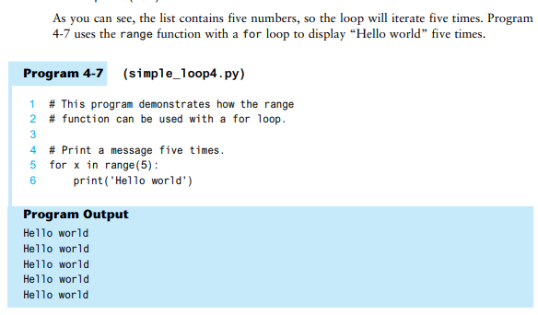

Slide 9
By default, the range function produces a sequence of numbers that increase by 1 for each successive number in the list. If you pass a third argument to the range function, that argument is used as step value. Instead of increasing by 1, each successive number in the sequence will increase by the step value. Here is an example:
for num in range(1, 10, 2):
print(num)

Slide 10
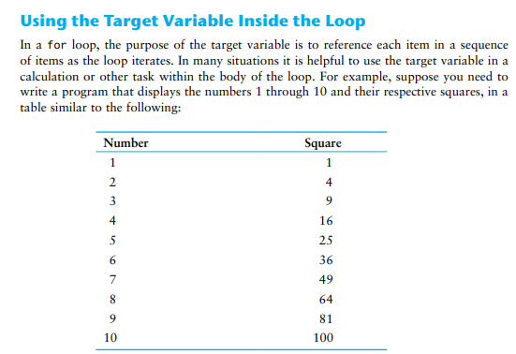
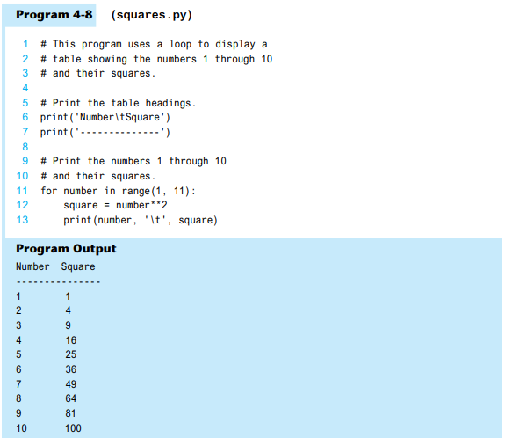

Slide 11
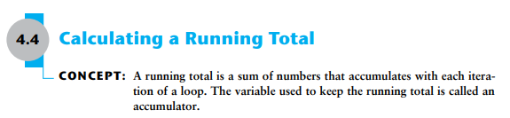
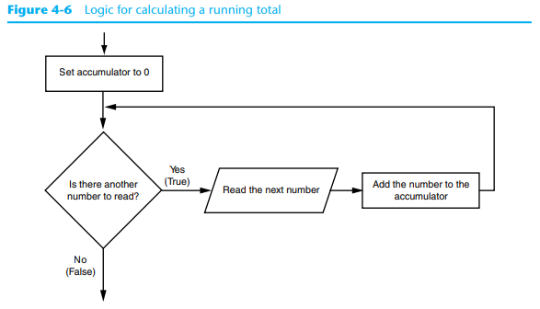
Programs that calculate the total of a series of numbers typically use two elements:
• A loop that reads each number in the series.
• A variable that accumulates the total of the numbers as they are read.
The variable that is used to accumulate the total of the numbers is called an accumulator. It is often said that the loop keeps a running total because it accumulates the total as it reads each number in the series. Figure 4-6 shows the general logic of a loop that calculates a running total.

Slide 12
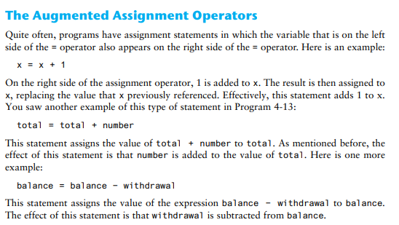
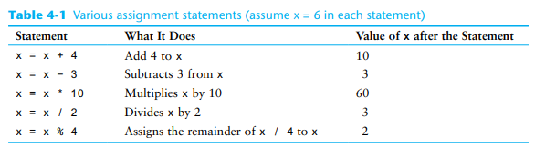
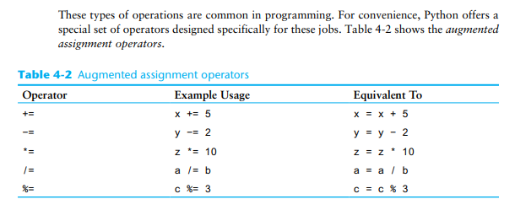

Slide 13


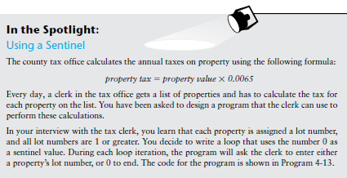
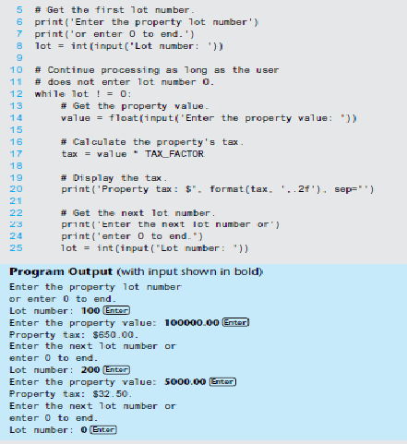
When processing a long sequence of values with a loop, perhaps a better technique is to
use a sentinel. A sentinel is a special value that marks the end of a sequence of items. When
a program reads the sentinel value, it knows it has reached the end of the sequence, so the
loop terminates.

Slide 14



A nested loop is a loop that is inside another loop. A clock is a good example of something that works like a nested loop. The second hand, minute hand, and hour hand all spin around the face of the clock. The hour hand, however, only makes 1 revolution for every 12 of the minute hand’s revolutions. And it takes 60 revolutions of the second hand for the minute hand to make 1 revolution. This means that for every complete revolution of the hour hand, the second hand has revolved 720 times. Here is a loop that partially simulates a digital clock. It displays the seconds from 0 to 59:
We can add a minutes variable and nest the loop above inside another loop that cycles through 60 minutes:
To make the simulated clock complete, another variable and loop can be added to count the hours:
for hours in range(24):
for minutes in range(60):
for seconds in range(60):
print(hours, ':', minutes, ':', seconds)
This code’s output would be:
0 : 0 : 0
0 : 0 : 1
0 : 0 : 2
(The program will count through each second of 24 hours.)
23 : 59 : 59

Slide 15
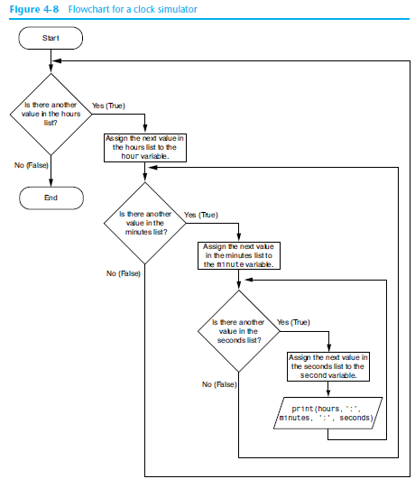
The innermost loop will iterate 60 times for each iteration of the middle loop. The middle loop will iterate 60 times for each iteration of the outermost loop. When the outermost loop has iterated 24 times, the middle loop will have iterated 1,440 times and the innermost loop will have iterated 86,400 times! Figure 4-8 shows a flowchart for the complete clock simulation program previously shown.

Slide 16
The simulated clock example brings up a few points about nested loops:
• An inner loop goes through all of its iterations for every single iteration of an outer
loop.
• Inner loops complete their iterations faster than outer loops.
• To get the total number of iterations of a nested loop, multiply the number of iterations of all the loops.

