Slide 1
Lecture 5
Number systems and actions in them. Basic concepts of number systems, rules of their construction, performing actions in them.

Slide 2
Objective: To explore the basic concepts of number systems, the rules governing their construction, and the actions performed within these systems.
Definition of Number Systems
A number system is a writing system for expressing numbers; it consists of a set of symbols and rules for their manipulation.
Importance
Number systems are foundational for mathematics, science, and everyday applications.

Slide 3
What is a Number?
A number is a mathematical value used for counting or measuring or labelling objects. Numbers are used to performing arithmetic calculations. Examples of numbers are natural numbers, whole numbers, rational and irrational numbers, etc. 0 is also a number that represents a null value.
A number has many other variations such as even and odd numbers, prime and composite numbers. Even and odd terms are used when a number is divisible by 2 or not, whereas prime and composite differentiate between the numbers that have only two factors and more than two factors, respectively.

Slide 4
Types of Number
Natural Numbers: The set of positive integers starting from 1 (1, 2, 3, ...).
Whole Numbers: The set of natural numbers including zero (0, 1, 2, ...).
Integers: All whole numbers and their negatives (..., -3, -2, -1, 0, 1, 2, 3, ...).
Rational Numbers: Rational number, in arithmetic, a number that can be represented as the quotient p/q of two integers such that q ≠ 0.
Irrational Numbers: Numbers that cannot be expressed as a fraction (e.g., 2,π\sqrt{2}, \pi2​,π).
Real Numbers: All rational and irrational numbers.
Complex Numbers: Complex numbers are the numbers that are expressed in the form of a+ib where, a,b are real numbers and ‘i’ is an imaginary number

Slide 5
A number system is defined as a system of writing to express numbers. It is the mathematical notation for representing numbers of a given set by using digits or other symbols in a consistent manner. It provides a unique representation of every number and represents the arithmetic and algebraic structure of the figures. It also allows us to operate arithmetic operations like addition, subtraction, multiplication and division.
The value of any digit in a number can be determined by:
The digit
Its position in the number
The base of the number system

Slide 6
In a number system, numbers are used as digits. 0 and 1 are the most common digits in the number system, that are used to represent binary numbers. On the other hand, 0 to 9 digits are also used for other number systems. Let us learn here the types of number systems.
Each number system has its own structure:
Base: Each number system is based on a specific base.
Place Value: The position of a digit in a number determines its value, influenced by the base.
Digits: Each system has a set of allowed digits (e.g., binary uses 0 and 1; decimal uses 0-9).

Slide 7
Basics of Each Number System
Binary (Base 2)
Digits: 0, 1
Example: 101121011_210112​ (which is 11 in decimal).
Decimal (Base 10)
Digits: 0, 1, 2, 3, 4, 5, 6, 7, 8, 9
Example: 471047_{10}4710​
Octal (Base 8)
Digits: 0, 1, 2, 3, 4, 5, 6, 7
Example: 57857_8578​ (which is 47 in decimal).
Hexadecimal (Base 16)
Digits: 0-9 and A-F (where A=10, B=11, ..., F=15)
Example: 2F162F_{16}2F16​ (which is 47 in decimal).

Slide 8
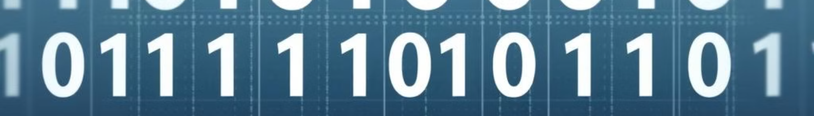
Binary Number System
Base 2
Arithmetic Operations
The binary number system, or base 2, is the fundamental system used in digital electronics and computer science. It employs only two digits, 0 and 1, to represent all numerical quantities.
Performing arithmetic operations in the binary system, such as addition, subtraction, multiplication, and division, follows specific rules and algorithms. These operations are essential for digital circuits and computer programming.
1
2
3
Bit and Byte
In the binary system, the smallest unit of information is called a bit, which can have a value of either 0 or 1. A collection of 8 bits is known as a byte, which is the basic unit of data storage and processing in digital systems.

Slide 9
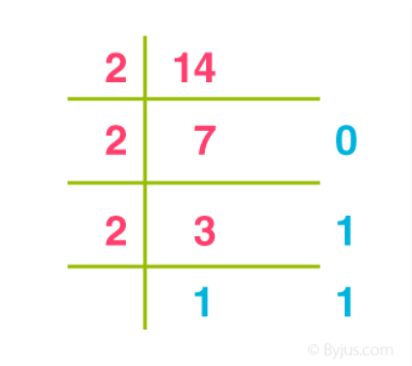
Example
Write (14)₁₀ as a binary number.
Solution:
(14)₁₀ = 1110₂

Slide 10
Octal Number System
Base 8
Compact Representation
The octal number system, or base 8, uses the digits 0 through 7 to represent numerical values. It is a compact way to represent binary data, as each octal digit corresponds to three binary digits (bits).
The octal system is particularly useful in computer science and programming, where it can provide a more concise representation of binary data compared to the decimal system. This can be advantageous in certain applications, such as memory addressing and low-level system programming.
Arithmetic Operations
Conversion to Binary
Performing arithmetic operations in the octal system, such as addition, subtraction, multiplication, and division, follows similar rules to the decimal system, with some minor variations to account for the base-8 nature of the system.
Octal numbers can be easily converted to and from binary, making it a useful intermediate representation for working with digital systems and data structures.

Slide 11
Example: Convert 215₈ into decimal.
Solution:
215₈ = 2 × 8² + 1 × 8¹ + 5 × 8⁰
= 2 × 64 + 1 × 8 + 5 × 1
= 128 + 8 + 5
= 141₁₀

Slide 12




Hexadecimal Number System
Base 16
Computer Applications
Arithmetic Operations
Conversion Capabilities
The hexadecimal number system, or base 16, uses the digits 0 through 9 and the letters A through F to represent numerical values. It is a compact and efficient way to represent binary data, as each hexadecimal digit corresponds to four binary digits (bits).
Performing arithmetic operations in the hexadecimal system, such as addition, subtraction, multiplication, and division, follows similar rules to the decimal system, with some variations to account for the base-16 nature of the system.
Hexadecimal is widely used in computer science and programming, especially in areas like memory addressing, color representation, and low-level system programming. Its compact nature and easy conversion to and from binary make it a valuable tool for working with digital systems.
Hexadecimal numbers can be easily converted to and from binary and decimal, making it a versatile system for working with digital data and performing various computational tasks.

Slide 13
Hexadecimal | 0 | 1 | 2 | 3 | 4 | 5 | 6 | 7 | 8 | 9 | A | B | C | D | E | F
Decimal | 0 | 1 | 2 | 3 | 4 | 5 | 6 | 7 | 8 | 9 | 10 | 11 | 12 | 13 | 14 | 15
Example:
(1056)₁₆
= 1 × 16³ + 0 × 16² + 5 × 16¹ + 6 × 160
= 4096 + 0 + 80 + 6
= (4182)₁₀

Slide 14



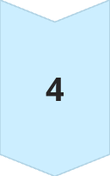
Arithmetic Operations in Number Systems
Addition
Adding numbers within a number system follows specific rules and algorithms, taking into account the base of the system and any necessary carries or borrows.
Subtraction
Subtracting numbers in a number system also has its own set of rules, often involving the concept of borrowing or regrouping to ensure the correct result.
Multiplication
Multiplying numbers within a number system involves a step-by-step process that takes into account the positional notation and the base of the system.
Division
Dividing numbers in a number system follows a systematic approach, often involving the use of long division or other specialized algorithms to arrive at the correct quotient and remainder.

Slide 15
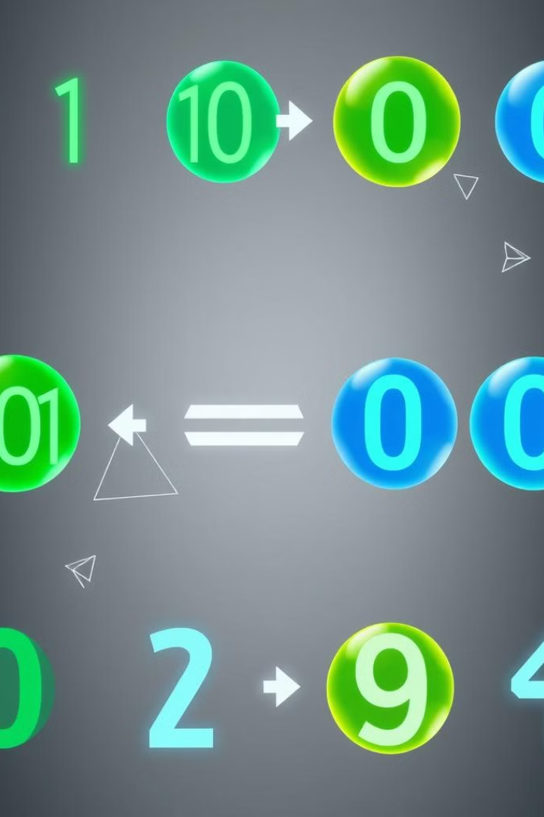
Conversion Between Number Systems
Decimal to Binary
Binary to Decimal
Decimal to Hexadecimal
Hexadecimal to Decimal
Decimal to Octal
Octal to Decimal
Binary to Hexadecimal
Hexadecimal to Binary
Mastering the ability to convert between different number systems is crucial for working with digital systems, programming, and various mathematical and scientific applications. Each conversion process follows specific rules and algorithms that allow for efficient and accurate transitions between the different bases.

Slide 16
Properties of Number Systems
Closure: A system is closed under an operation if applying that operation on numbers in the system produces a number still in the system.
Associativity: The grouping of numbers doesn’t change the result (e.g., (a+b)+c=a+(b+c)(a + b) + c = a + (b + c)(a+b)+c=a+(b+c)).
Commutativity: The order of numbers doesn’t change the result (e.g., a+b=b+aa + b = b + aa+b=b+a).
Identity Element: An element that doesn’t change others (0 for addition, 1 for multiplication).

Slide 17
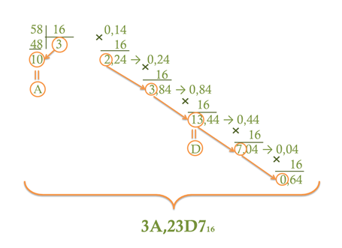
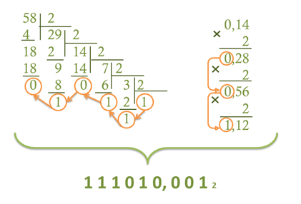
Algorithm for converting a fractional number from a decimal number system to another number system

Slide 18
Assume the number 349. Thus, the number 349 in different number systems is as follows:
The number 349 in the binary number system is 101011101
The number 349 in the decimal number system is 349.
The number 349 in the octal number system is 535.
The number 349 in the hexadecimal number system is 15D

Slide 19
Practical Applications and Considerations
Digital Systems
Programming and Coding
Scientific and Engineering Applications
Understanding number systems is essential for working with digital systems, such as computers, microcontrollers, and digital circuits. These systems rely heavily on the binary number system for data representation, storage, and processing.
Knowledge of number systems is crucial for programming and coding, as many programming languages and techniques involve working with binary, hexadecimal, and other specialized number representations. Familiarity with these systems enables efficient and accurate coding practices.
Number systems play a crucial role in scientific and engineering applications, where they are used for data representation, measurement, and various calculations. Understanding the strengths and limitations of different number systems is essential for accurate and reliable work in these fields.

Slide 20
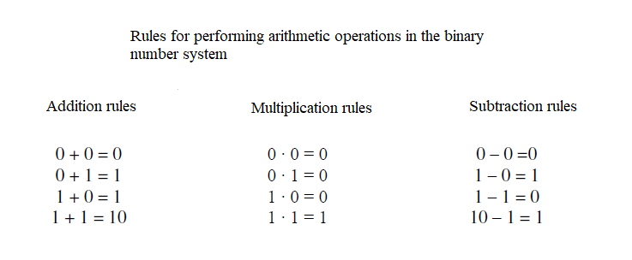
•
•
•
•
•
•
•
0 1 1 10₂
0 10₂
1 0 1 1 0₂
+ 1 1 1 0 1 1₂
1 0 0 0 1 0 1₂
– 1 1 0 1 1₂
1
0
1
0
0
0
1
0
1
0
1
0
1
0
₂
₂

Slide 21
Arithmetic Operations
110101₂
+ 10110₂
10111₂
+ 101110₂
111011₂
+ 11011₂
111011₂
+ 10011₂

Slide 22
Arithmetic Operations
101 1 1₂
– 1101₂
101 1101₂
– 110111₂
10 1101₂
– 11011₂

Slide 23
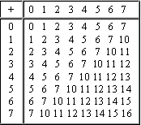
The addition operation in octal number system

Slide 24
Arithmetic Operations
•
•
•
1 is transfered
1 5 6₈
+ 6 6 2₈
1 is transfered
6 + 2 = 8 = 8 + 0
5 + 6 + 1 = 12 = 8 + 4
1 + 6 + 1 = 8 = 8 + 0
1
0
4
0₈
1 is transfered

Slide 25
Arithmetic Operations
•
•
borrowing
4 5 6₈
– 2 7 7₈
(6 + 8) – 7 = 7
(5 – 1 + 8) – 7 = 5
(4 – 1) – 2 = 1
borrowing
1
5
7₈

Slide 26
3472₈
+ 4520₈
₈
7 2 5₈
– 3 7 4₈
3 5 3₈
+ 7 3 6₈
1 1 5 6₈
– 6 6 2₈

Slide 27
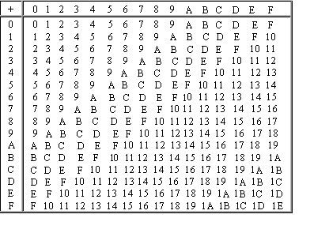
The addition operation in hexadecimal number system

Slide 28
Arithmetic Operations
•
•
A 5 B₁₆
+ C 7 E₁₆
10 5 11
+ 12 7 14
1 6 D 9₁₆
1
6
13
9
1 is transferred
11+14=25=16+9
5+7+1=13=D₁₆
10+12=22=16+6
1 is transferred

Slide 29
С В А₁₆
+ A 5 9₁₆
10 В А₁₆
+ 8 5 6₁₆

Slide 30
Arithmetic Operations
borrowing
•
•
С 5 B₁₆
– A 7 E₁₆
12 5 11
– 10 7 14
1 D D₁₆
1
13
13
borrowing
(11+16)–14=13=D₁₆
(5 – 1)+16 – 7=13=D₁₆
(12 – 1) – 10 = 1

Slide 31
10 В А₁₆
– A 5 9₁₆

Slide 32
Arithmetic Operations
multiplication
1 0 1 0 1₂
× 1 0 1₂
2 0 1 3₄
× 2 1₄
1 0 1 0 1₂
+ 1 0 1 0 1₂
2 0 1 3₄
+ 1 0 0 3 2₄
1 1 0 1 0 0 1₂
1 0 2 3 3 3₄

Slide 33
Arithmetic Operations
multiplication
7 2 5₈
× 1 4₈
3 А 2₁₆
× 3 1₁₆
3 5 2 4₈
+ 7 2 5₈
3 А 2₁₆
+ А Е 6₁₆
1 2 7 7 4₈
В 2 0 2₁₆

Slide 34
