Slide 1
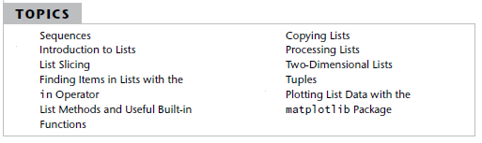
List and Tuples

Slide 2

Sequences
A sequence is an object that contains multiple items of data.
The items that are in a sequence are stored one after the other. Python provides various ways to perform operations on the items that are stored in a sequence.

Slide 3
Sequences
lists
tuples
is mutable, which means that a program can change its contents,
is immutable

Slide 4
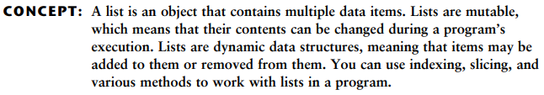

A list
A list is an object that contains multiple data items. Each item that is stored in a list is called an element. Here is a statement that creates a list of integers:

Slide 5


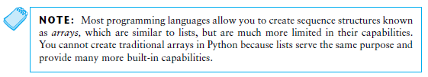
The Repetition Operator

Slide 6



Iterating over a List with the for Loop
Indexing
Another way that you can access the individual elements in a list is with an index. Each element in a list has an index that specifies its position in the list. Indexing starts at 0, so the index of the first element is 0, the index of the second element is 1, and so forth.

Slide 7


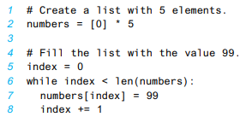
Len function
Lists Are Mutable
If you want to use indexing expressions to fill a list with values:

Slide 8
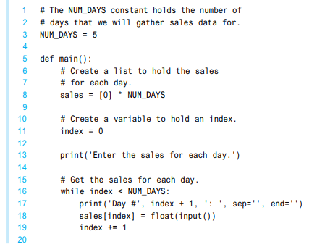
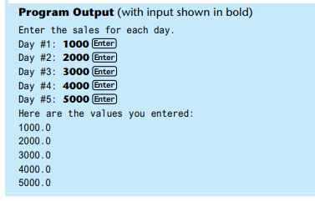
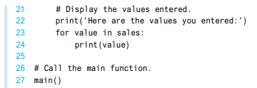

Slide 9


Concatenating Lists

Slide 10
Lists Slicing
A slice is a span of items that are taken from a sequence. When you take a slice from a list, you get a span of elements from within the list. To get a slice of a list, you write an expression in the following general format:
list_name[start : end]
In the general format, start is the index of the first element in the slice, and end is the index marking the end of the slice. The expression returns a list containing a copy of the elements from start up to (but not including) end. For example, suppose we create the following list:
days = ['Sunday', 'Monday', 'Tuesday', 'Wednesday', 'Thursday', 'Friday', 'Saturday'

Slide 11
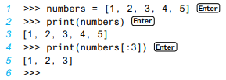
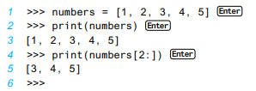
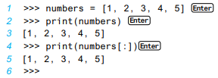
If you leave out the start index in a slicing expression, Python uses 0 as the starting index. The following interactive mode session shows an example:
If you leave out the end index in a slicing expression, Python uses the length of the list as the end index. The following interactive mode session shows an example:
If you leave out both the start and end index in a slicing expression, you get a copy of the entire list. The following interactive mode session shows an example:

Slide 12
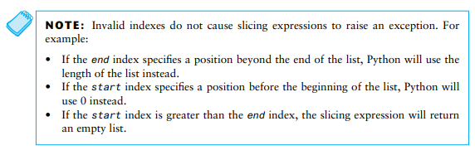

Slide 13
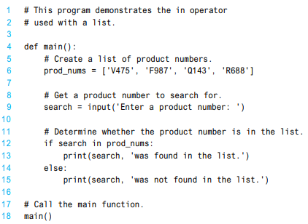
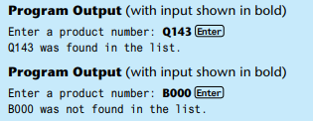

Finding Items in List with IN Operator
item in list

Slide 14

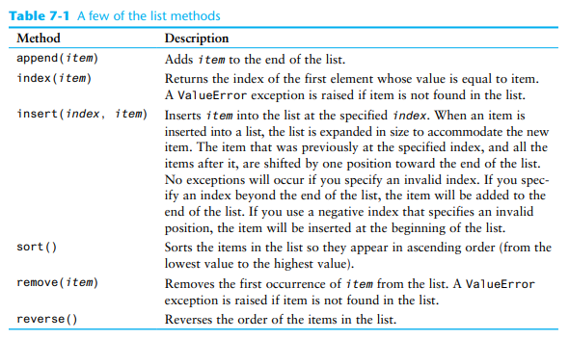
List Methods and useful built-in functions

Slide 15
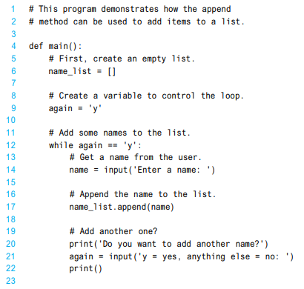
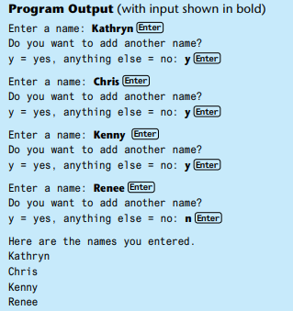
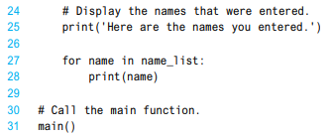
Append Method

Slide 16
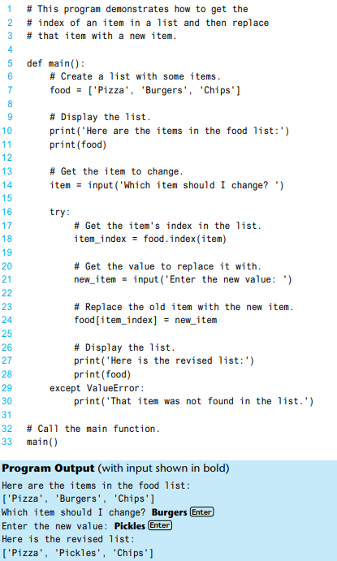
Index Method

Slide 17
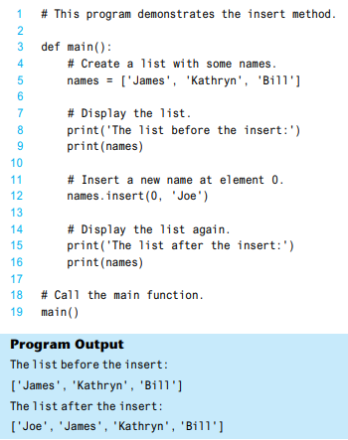
Insert Method

Slide 18
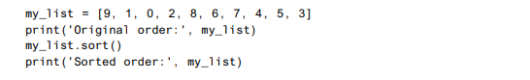
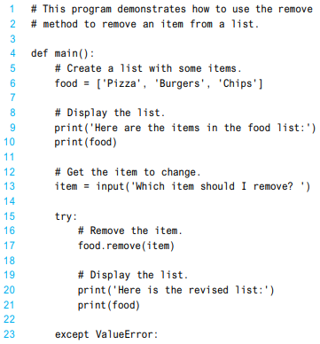

Sort Method
The sort method rearranges the elements of a list so they appear in ascending order (from the lowest value to the highest value). Here is an example:
Remove Method
Remove method removes an item from the list. You pass an item to the method as an argument, and the first element containing that item is removed. This reduces the size of the list by one element. All of the elements after the removed element are shifted one position toward the beginning of the list. A ValueError exception is raised if the item is not found in the list.

Slide 19
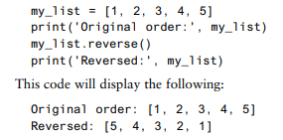
reverse Method
Reverse method simply reverses the order of the items in the list.

Slide 20
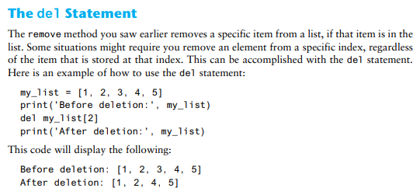
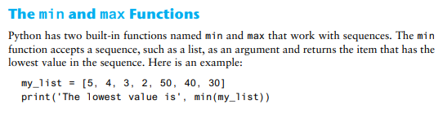
This code will display the following:
The lowest value is 2

Slide 21
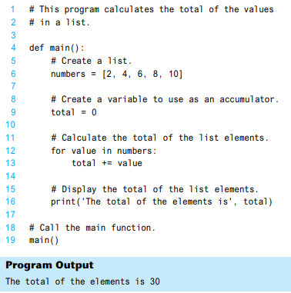
Totaling the Values in a List

Slide 22
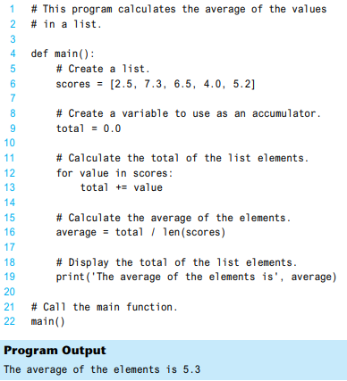
Averaging the Values in a List

Slide 23
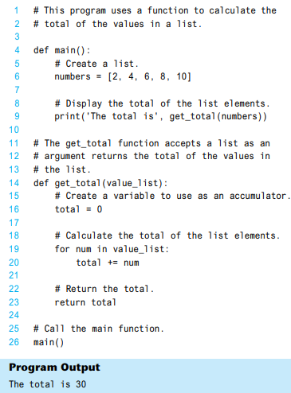
Passing a List as an Argument to a Function

Slide 24

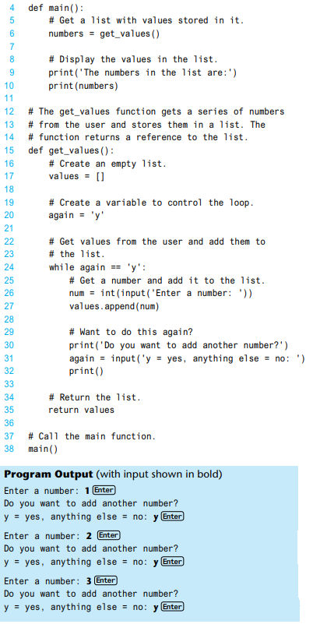
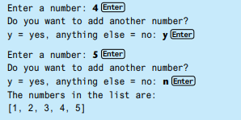
Returning a List from a Function

Slide 25
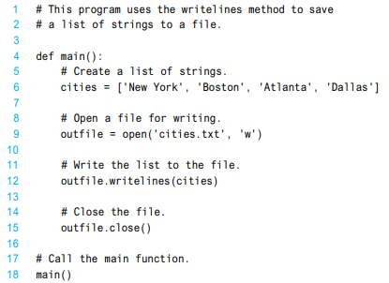


Working with Lists and Files
Writelines method
New YorkBostonAtlantaDallas
for loop

Slide 26
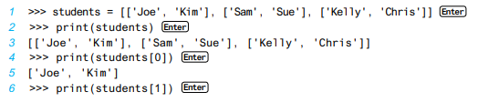

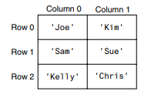
Two-Dimensional List

Slide 27
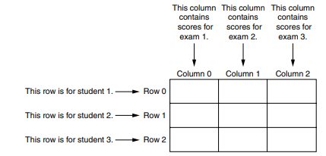
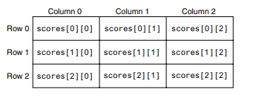

Slide 28
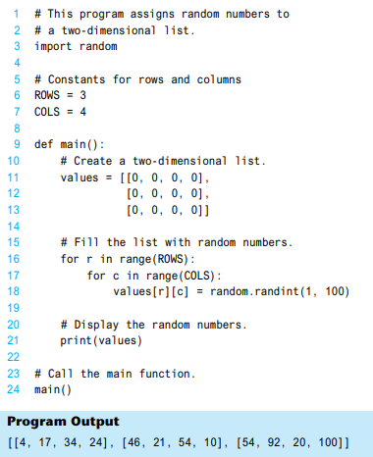


Slide 29

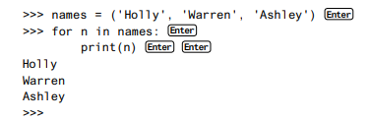
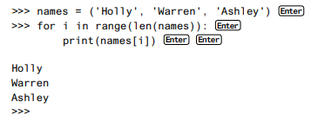
TUPLES
for loop:
Like lists, tuples support indexing, as shown in the following session:

Slide 30
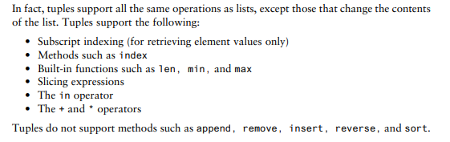
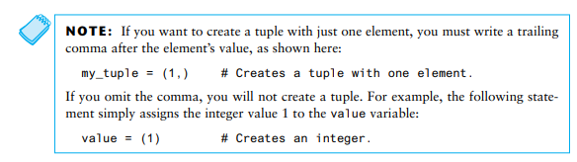

Slide 31
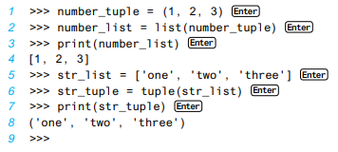
Converting Between Lists and Tuples

Slide 32
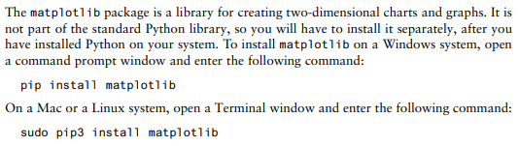
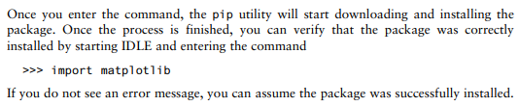

Slide 33
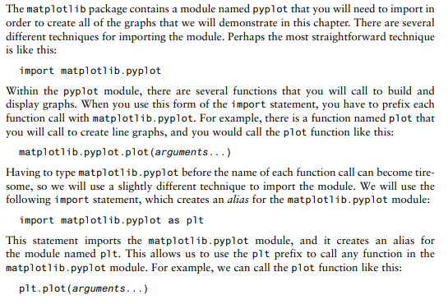
Importing the pyplot Module

Slide 34
Plotting a Line Graph
You can use plot function to create a line graph that connects a series of data points with straight lines. The line graph has a horizontal X axis and a vertical Y axis. Each data point in the graph is located at a (X, Y) coordinate.
To create a line graph, you first create two lists: one containing the X coordinates of each data point, and another containing the Y coordinates of each data point. For example, suppose we have five data points, located at the following coordinates:
(0, 0)
(1, 3)
(2, 1)
(3, 5)
(4, 2)
We would create two lists to hold the coordinates, such as the following:
x_coords = [0, 1, 2, 3, 4]
y_coords = [0, 3, 1, 5, 2]
Next, we call the plot function to create the graph, passing the lists as arguments. Here is an example:
plt.plot(x_coords, y_coords)
The plot function builds the line graph in memory, but does not display it. To display the graph, you call the show function, as shown here: plt.show()

Slide 35
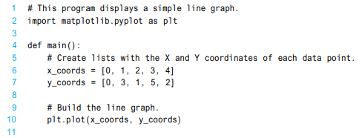

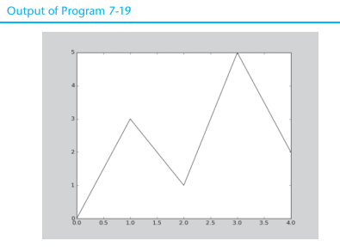
A complete example

Slide 36
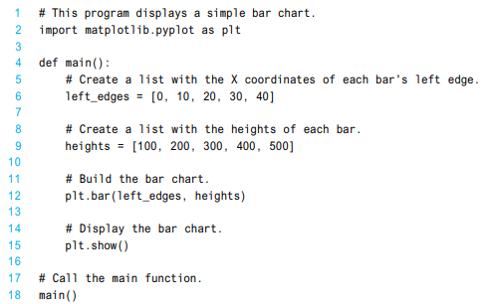
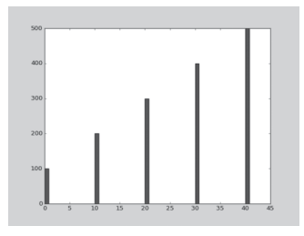

Slide 37
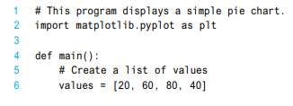
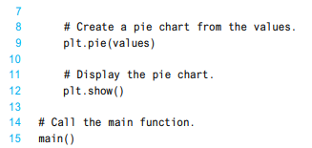
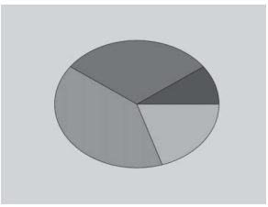
Plotting a Pie Chart

