Slide 1
INTERPOLATION AND APPROXIMATION METHODS
Interpolation

Slide 2

Interpolation is a method of finding intermediate values of a quantity from an existing discrete set of known values.
Suppose that during the experiment, when changing the input value x (x0, x1,x2,..., xn), the values of the function y=f(x) (y0, y1, y2.....yn) are obtained (Table 1).
Table 1
View of the experimental data table

Slide 3

Function interpolation is used when it is necessary to find the value of the function y(x) with the value of the argument xi belonging to the interval [x0, ..., xn], but not matching any value given in Table 1.
In many cases, the analytical expression of the function y(x) is unknown and obtainment of it from the table of its values (Table. 1) in most cases is impossible. Therefore, instead of it, they build another function that is easily calculated and has the same table of values (coincides with it at points x0, x1, x2,..., xn) as f(x), i.e.
where

Slide 4
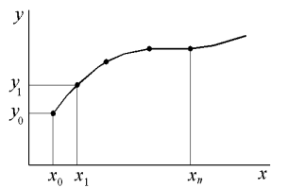
Finding an approximate function is called interpolation, and the points x0, x1, x2, ..., xn are the interpolation nodes.
The interpolating function is sought in the form of a polynomial of n degree.
For each set of points, there is only one interpolation polynomial with the power, which is no greater than n. An unambiguously defined polynomial can be represented in various forms.
Graphically, the task of interpolation is to construct such an interpolating function that would pass through all the interpolation nodes (Fig. 1).
Fig. 1. View of the interpolating function

Slide 5
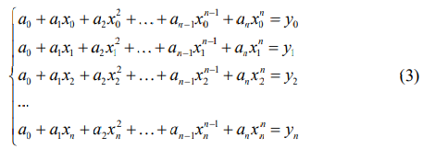
The canonical polynomial
A type of canonical polynomial in the n-th power
The choice of a polynomial in the n-th power is based on the fact that a single curve in the n-th power passes through n+1 points. Substituting (2) into (1), we obtain a system of linear algebraic equations (3)
Solving this system of linear algebraic equations, we find the coefficients of the interpolation polynomial

Slide 6

Linear interpolation
Linear interpolation is the simplest and most commonly used type of interpolation. It consists in the fact that the given points with coordinates
at i=0, 1, 2, ... n are connected by rectilinear segments, and the function y(x) can be approximated as a polyline.
The equations of each segment of the polyline are generally different. Since there are n intervals , for each of them, the equation of a straight line passing through two points is used as the equation of the interpolation polynomial: for the i-th interval, you can write the equation of a straight line passing through the points and ,

Slide 7


From here
Therefore, when using linear interpolation, firstly, need to determine the interval in which the value of the argument x falls, and then substitute it into formula (4) and find the approximate value of the function at this point.

Slide 8
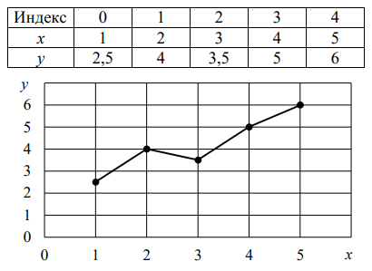
An example of linear interpolation for experimental data according to Table 2 is shown in Fig. 2.
Table 2
Experimental data table
Fig. 2. Graphical solution of linear interpolation

Slide 9

Example:
Experimental data are given (Table 3).
Table 3
Experimental data
Task:
1. Find the value of the function at x = 1 and x = 3.2.
2. Solve the problem graphically.

Slide 10
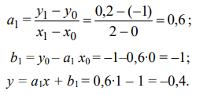
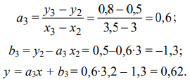
Solution:
1. The point x=1 belongs to the first local segment [0, 2], i.e. i=1 and, therefore, according to the above formulas (1, 2):
The point x=3.2 belongs to the third interval [3, 3.5], i.e. i=3 and, therefore, according to the formulas (1, 2):

Slide 11
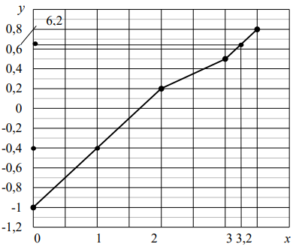
2. According to Table 3, we build a graph (Fig. 3).
Fig. 3. Graphical solution of the problem

Slide 12



Lagrange interpolation polynomial
Lagrange interpolation polynomial has the form:
where is Lagrange multiplier
Therefore

Slide 13
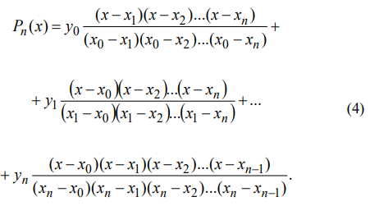
The numerator and denominator should not include the values , so as a result, it will be zero.In the expanded form, Lagrange formula can be written:

Slide 14



Example
1. Find the Lagrange interpolation polynomial for the function by selecting nodes
2. Find the values of Lagrange polynomial for the values of x:
3. Determine the absolute and relative errors of calculations.

Slide 15

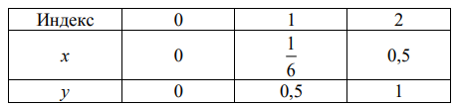
Solution:
1. Calculate the corresponding values of the function in the nodes:
(table 4).
Table 4
Data table

Slide 16
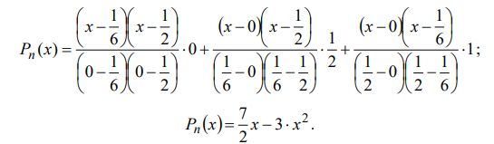

Applying formula (4), we obtain
2. Find the values of Lagrange polynomial for the values of x:

Slide 17
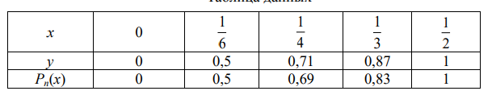
3. Determine the calculation errors.
To do this, we will find the values of the function for the given values of x by compiling the corresponding table (Table 5).
Table 5
Data table

Slide 18
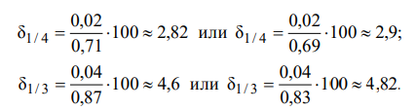
The absolute measurement error, defined as the difference between the true and measured values of a physical quantity:
The relative error is found as the ratio of the absolute error to the true value or to the measurement result:

Slide 19
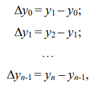
Newton's interpolation polynomial
The interpolating polynomial is searched for in the form
The construction of the polynomial is reduced to the determination of the coefficients . When writing coefficients, finite differences are used.
The finite differences of the first order will be written as:
where yi are the values of the function with the corresponding values of

Slide 20
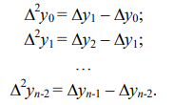
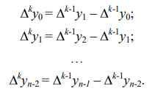


Finite differences of the second order:
Finite differences of higher orders will be found similarly:
The coefficients are found from the condition Find a0, assuming x=x0,

Slide 21

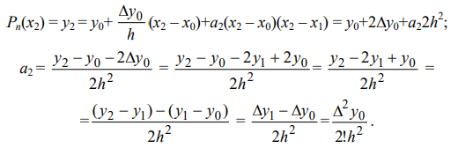

Next, substituting the values we get:
To define assuming x=x2, we obtain
The general formula for finding all coefficients has the form
where

Slide 22
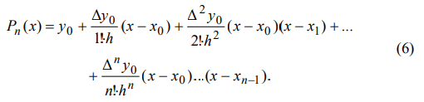
As a result, (5) will take the form
This polynomial is called the first Newton polynomial.

Slide 23

Example
A table of values of the dependence of the viscosity of water on temperature p=f(T) is given (table 6).
Table 6
Dependence of water viscosity on temperature
Construct the first Newton interpolation polynomial.
Determine the value of the polynomial for temperature T = 12 ° C.

Slide 24
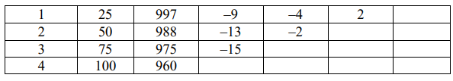
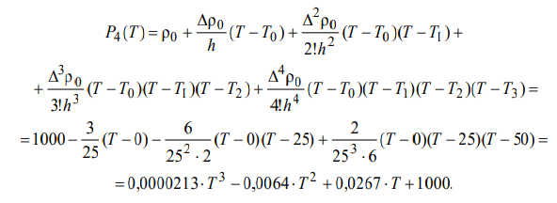
Solution:
Make a table of the finite differences of the function (Table 7).
Table 7
Table of finite differences
To construct the polynomial, we use the formula (6):
Substituting the value T = 12 ° C into the formula of the resulting polynomial, we find the density value

Slide 25



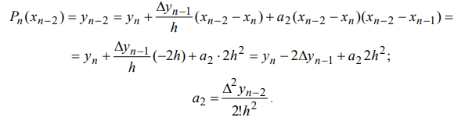
Newton's second interpolation formula
To find the values of the function at the end of the interpolation interval, the interpolation polynomial is written as
The coefficients are determined from the value Substitute x = xn to (7), find
For
For

Slide 26

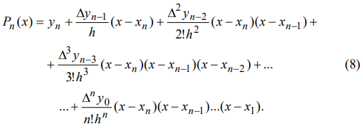
The formula for finding all the coefficients is written as:
Substituting the expressions for determining the coefficients ai into formula (7), we obtain Newton's second interpolation formula:

Slide 27
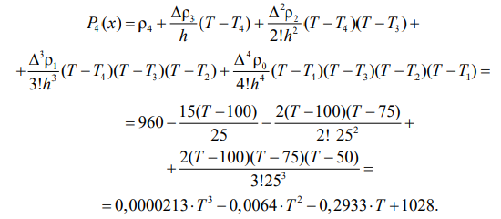
Example
A table of values is given (Table. 7)
Construct Newton’s interpolation polynomial.
Determine the value of the polynomial for temperature T = 90 ° C.
Solution
To construct the polynomial, we use the formula (8) and Table 7:
Substituting the value T = 90 ° C into the formula of the resulting polynomial, find the density value

