Slide 1
Computer mathematics Lection 1
Introduction

Slide 2
The purpose of the course is to provide students with a modern tool for solving practical, but time-consuming mathematical problems arising in both engineering and socio-economic research. Students should be aware of the goals and objectives of the theory of symbolic, graphical and numerical calculations, their role and place in solving modern problems arising in management.
As a result of studying the discipline, students must:
• to know modern computational algorithms for solving various applied problems arising from mathematical modeling of real processes and phenomena, with their subsequent implementation on a computer;
• be able to independently implement algorithms for solving mathematical problems using modern computer mathematics systems;
• possess the skills to use modern computational algorithms for solving a variety of applied problems arising from mathematical modeling of real processes and phenomena, followed by their implementation on a computer;
• demonstrate the ability to work independently with both educational and special mathematical literature, as well as with electronic educational resources, to extract and consciously apply the acquired knowledge.

Slide 3
Methods of solving mathematical problems
The following main groups of methods are used to solve mathematical problems:
Graphic
Analytical
Numerical
Graphical methods:
The basic idea is that the solution is found by geometric constructions.
Example: to find the roots of the equation f(x)=0, a graph of the function y=f(x) is plotted, the intersection points of which with the axis of the abscissa will be the desired roots.

Slide 4
Graphical visualization of calculation results:
– plotting of many functions;
– various types of axes (with linear and logarithmic scales);
– graphs of functions in coordinate systems;
– special types of graphs (array points, vector graphs, level diagrams, etc.);
– user-defined coordinate systems;
– graphs representing solutions of differential equations;
– graphs of three-dimensional surfaces with functional coloring;
– construction of objects intersecting in space;
– user's assignment of graph coloring;
– import graphs from other packages and software systems;
– animation of graphs;
– creation and playback of animation files.

Slide 5
Analytical methods:
Analytical computing systems (computer algebra) are the newest direction in the development of modern computer mathematics. Their main advantage lies in the ability to perform calculations in an analytical form and in the ability to perform arithmetic and many other calculations with almost any desired accuracy and without restrictions on the maximum (minimum) values of numbers.
Numerical methods:
This is the main tool for solving complex mathematical problems, which allows you to reduce the solution of the problem to performing a finite number of arithmetic operations on numbers, while the results are obtained in the form of numerical values.
Problems solved by systems for numerical calculations. The most common tools provided by systems for numerical calculations include:
– arithmetic and algebraic operators and functions;
– functions for working with complex numbers;
– trigonometric and hyperbolic functions;
– inverse trigonometric and hyperbolic functions;
– logical operators and functions;
– vector and matrix operators and functions;
– tools for solving systems of linear algebraic equations;
– special mathematical functions.

Slide 6
Definition:
A numerical method for solving a problem is a certain sequence of operations on numbers, that is, a computational algorithm whose language is numbers and arithmetic operations.
In computational mathematics, methods of approximate solution of mathematical problems are studied, which make it possible to reduce the solution to performing a finite number of arithmetic operations on numbers. These actions can be performed either "manually" (in modern terms, using a calculator) or using computers (usually personal computers).

Slide 7
With the advent of computers, a period of rapid development of numerical methods and their implementation into practice began. Only a computer can perform in a relatively short time the amount of calculations in millions, billions or more operations necessary to solve many modern problems.

Slide 8
Technology for solving an applied problem on a computer
Often, the problem that needs to be solved is not formulated in mathematical language. For example, the problem can be formulated in terms of physics or economics. To solve it on a computer, you first need to bring it into the form of a mathematical problem, and then program it.
The work on solving an application problem on a computer goes through the following stages:
Problem statement – includes the collection of information about the problem, the formulation of the problem condition, the definition of the final goals of solving the problem, the definition of the form of results, the description of data (their types, ranges of values, structure, etc.)
2) Mathematical formalization – at this stage, a mathematical model is built, a system of mathematical relations, formulas, equations, inequalities, etc., reflecting the essential properties of an object or phenomenon.
3) Algorithm construction – the process of solving a problem is written in the form of a sequence of elementary arithmetic and logical operations leading to the final result and called an algorithm for solving the problem. The algorithm can be represented as a flowchart.

Slide 9
4) Writing a program in a programming language – choosing a programming language, clarifying ways to organize data, writing an algorithm in the selected programming language.
5) Debugging and testing of the program – debugging refers to the process of testing the operation of the program and correcting errors detected by it. A test is a specific variant of the values of the source data for which the expected result is known.
6) Performing calculations and analyzing the results obtained – using an already developed program to obtain the desired results. The results of solving the problem are analyzed and, if necessary, the mathematical model is refined.
This sequence is called the technological chain of solving a problem on a computer

Slide 10
Due to the expansion of the use of personal computers (PCs) and the development of their software, the ideology of using computer technology to implement numerical methods is beginning to change.
Instead of programming a computational problem in a high-level programming language, it can be solved by using universal packages of applied mathematical programs in a PC, which have the necessary computational algorithms and programs built into them.

Slide 11
Computer mathematics is a set of methods and tools that provide the most comfortable and fast preparation of algorithms and programs for solving mathematical problems of any complexity, while in the vast majority of cases with a high degree of visualization of all stages of the solution.
Computer mathematics systems have become the main tool of computer mathematics. Today, computer mathematics systems are used to solve scientific, engineering, and educational problems, to visually present data and calculation results, and also as convenient mathematical reference books.
Currently, computer mathematical systems can be (rather conditionally) divided into 7 main classes:
– systems for numerical calculations;
– table processors;
– matrix systems;
– systems for statistical calculations;
– systems for special calculations;
– systems for analytical calculations (computer algebra);
– universal systems.

Slide 12
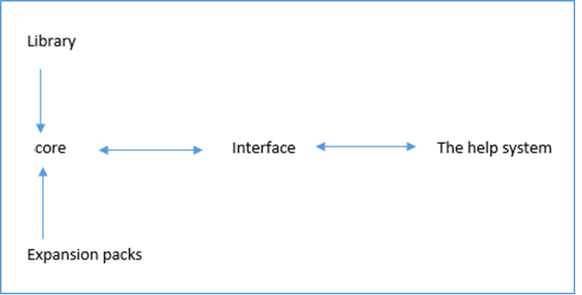
Well-known world leaders among universal computer mathematics systems are the following: Derive, Maple, Mathcad, Mathematica, Matlab. These systems have the following features:
combining analytical and numerical calculation methods;
visualization of calculation results;
application of high-level programming languages;
exchange of information between each other using various formats.
The structure of computer mathematics systems

Slide 13
Mathcad is an integrated environment for documenting and sharing the results of technical calculations. This product allows users to enter, edit and solve equations, visualize the results, and document them.
Mathcad serves as a computing, analysis and reporting tool for professionals in all fields of science and technology. It is easy to use and does not cause problems when learning.

Slide 14
An assignment for independent work
Take notes of lecture 1 materials
Watch video tutorials on working in Mathcad
https://www.youtube.com/watch?v=yaA7iG7NTx0&list=PLRhPac0z_f-HCplRNzuEjPtJZg_9hu6Nm&index=1

