Slide 1
Lecture 3
Solving nonlinear equations with one variable

Slide 2


Setting the task
An equation is given, where the function is defined and continuous in a certain interval (finite or infinite). Continuity of the first or even the second derivative is required.
Definition: Any value that converts an equation into an identity is called the root of the equation or the root (zero) of the function .

Slide 3



Definition: A number is called the root of the k-th multiplicity if, for with a function , its derivatives up to and including (k-1)th order are zero:
Definition: A single root is called a simple one.

Slide 4


Definition: Equations and are called equivalent if the sets of solutions to these equations coincide.
Definition: To solve an equation means the following:
To determine whether the equation has roots;
Determine the number of roots of the equation;
Find the values of the roots of the equation with a given accuracy.

Slide 5
We will consider the case of isolated roots, that is, for each root there is a neighborhood that does not contain other roots.
It is often difficult to find the roots, because the function is very complex and does not have explicit expressions for the roots, or the recommended algorithms are very complex. In these cases, the task can be formulated differently: find the approximate values of the roots, and then refine their approximate values to the required accuracy.
A number of numerical methods have been developed to solve the problem in this formulation.

Slide 6
The approximate finding of isolated real roots usually consists of two stages:
the definition of roots, that is, the establishment of possibly close intervals containing the root;
refinement of approximate roots

Slide 7




Separation of roots
Definition: Root separation is a procedure for finding segments on which the equation has only one solution.
Theorem: If a continuous function takes values of different signs at the ends of a segment , i.e. , then at least one root of the equation is contained inside this segment.
A root will obviously be the only one if the derivative exists and retains the sign inside .

Slide 8
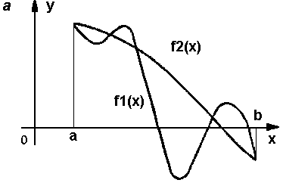
The scheme of determining the roots of the equation by the method of separating the roots

Slide 9




The process of determining the roots:
the signs of the function are determined at the boundary points of the domain of its existence
the signs of the function are determined in a number of intermediate points the choice of which depends on the nature of the function; if it turns out __________then there is a root in the interval

Slide 10
The method of half division is often used, approximately dividing this interval into 2, 4, 8, etc. parts and determining the signs of the function at the points of division.
It is useful to remember the rule that an algebraic equation of the n-th power has no more than n roots.
Separating the roots already means a rough assessment of them.
The absolute error of such an estimate does not exceed

Slide 11


Methods for clarifying approximate roots
The graphical method
Implementing this method, the function is plotted and the abscissa of the point of intersection with the axis of the abscissa is found.
You can also plot the left and right sides of an equivalent equation ___________and graphically find the abscissa of the intersection point of these graphs.

Slide 12
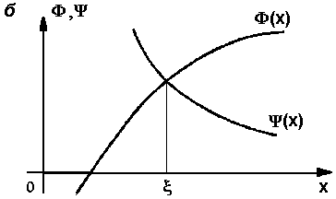

Slide 13
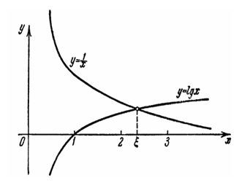

Example: Graphically solve the equation
Solution: Let's write the equation as an equality
The roots of the equation can be found as the abscissae of the intersection points of the logarithmic curve and the hyperbola
Having constructed these curves on the coordinate plane, we will approximately find the only root of the equation

Slide 14

The method of half division
The value of the function is calculated at the ends and in the middle of a given interval, i.e.
If this value is zero, then is the root of the equation. If this value is greater than or less than zero, then select the half of the interval at the ends of which has opposite signs, and repeat the specified calculation for it.
The maximum absolute error in determining the root will be
where n is the number of steps.

Slide 15
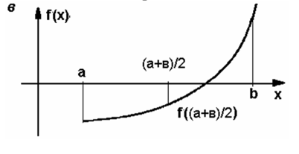
The method is recommended for deep root finding. With increasing accuracy, the amount of calculations increases greatly.

Slide 16

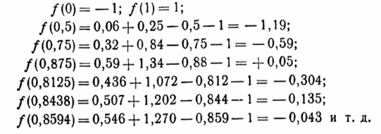

Example: Using the method of half division, clarify the root of the equation
lying on the interval
Solution: We have sequentially:
It can be accepted

