Slide 1
Lecture 2
Elements of the theory of errors

Slide 2
Absolute and relative errors
The error is the deviation of the data result from the measured value. The term is used in physics, economics and marketing. Measurement error is the sum of all errors, each of which has a reason. A specialist's assessment is considered inaccurate if this value is not specified.
The error can be estimated using:
absolute error
relative error

Slide 3
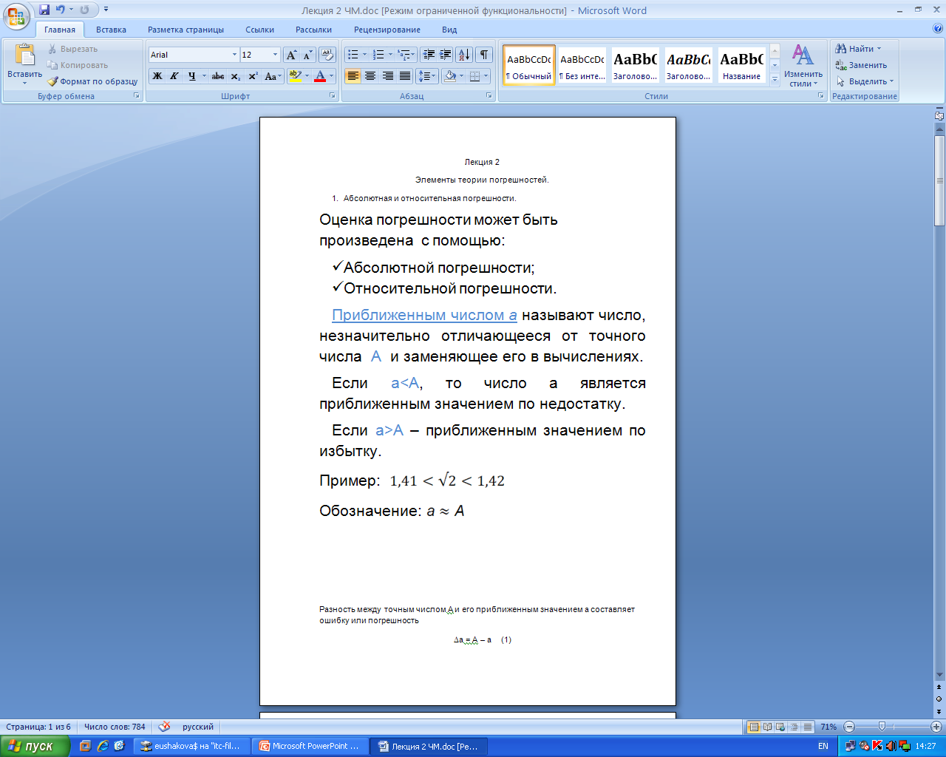
An approximate number a is a number that differs slightly from the exact number A and replaces it in calculations. If a<A, then the number a is an approximate value for the disadvantage. If a>A is an approximate loss value.
Example:
Designation:

Slide 4
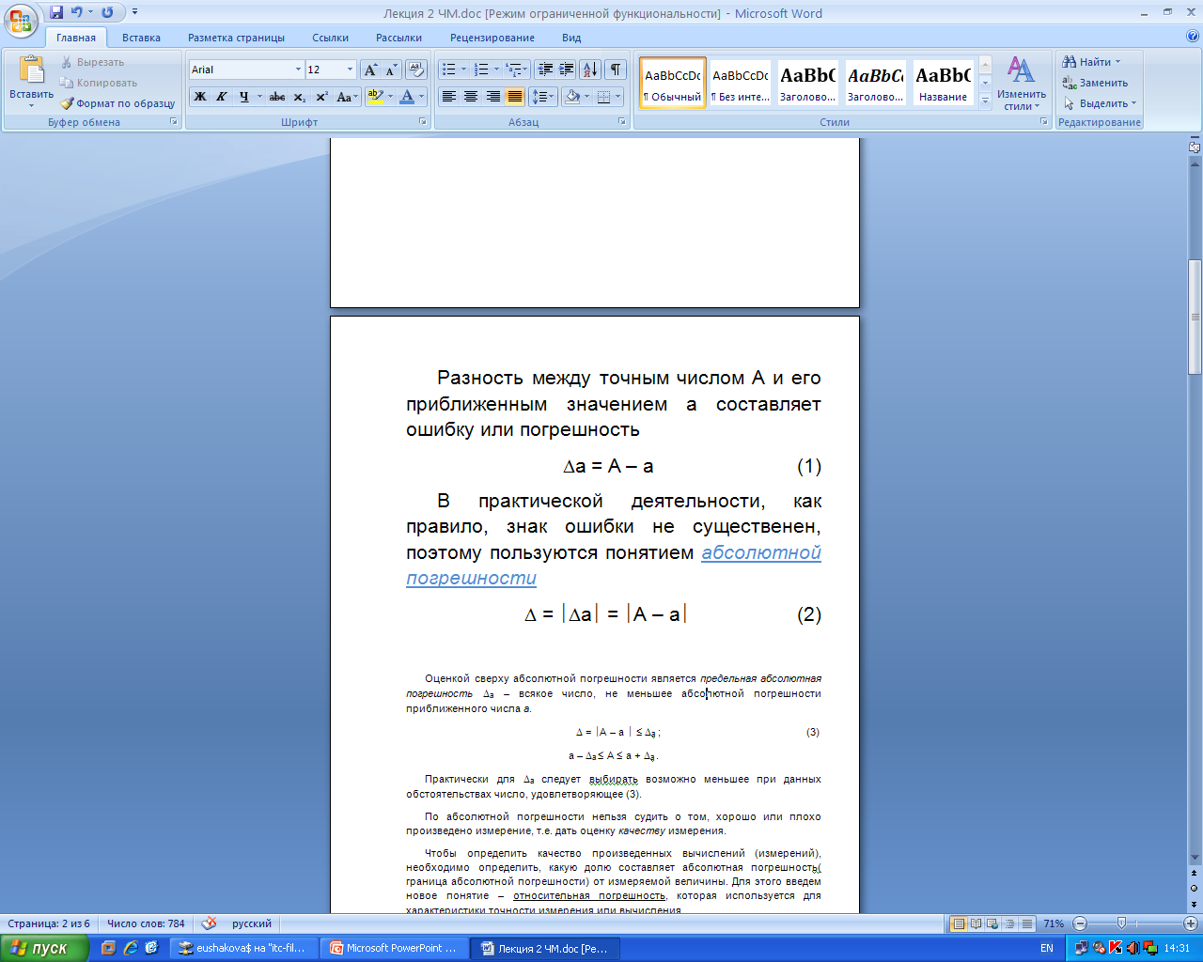
The difference between the exact number A and its approximate value a is an error.
In practice, as a rule, the error sign is not significant, therefore, the concept of absolute error is used

Slide 5
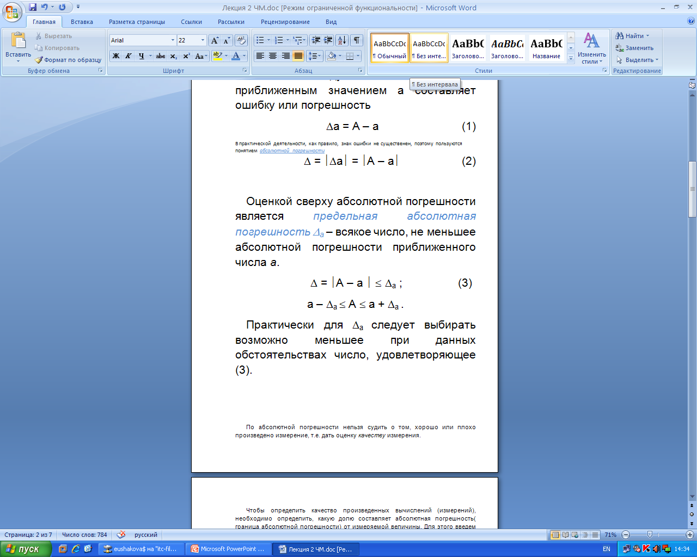
The top estimate of the absolute error is the ultimate absolute error - any number not less than the absolute error of the approximate number a.
In practice, for , the number satisfying (3) should be chosen as small as possible under the given circumstances

Slide 6
According to the absolute error, it is impossible to judge whether the measurement was carried out well or poorly, that is, to assess the quality of the measurement.
To determine the quality of the calculations (measurements) performed, it is necessary to determine what proportion of the absolute error (the limit of the absolute error) of the measured value is. To do this, we introduce a new concept - relative error, which is used to characterize the accuracy of measurement or calculation.

Slide 7
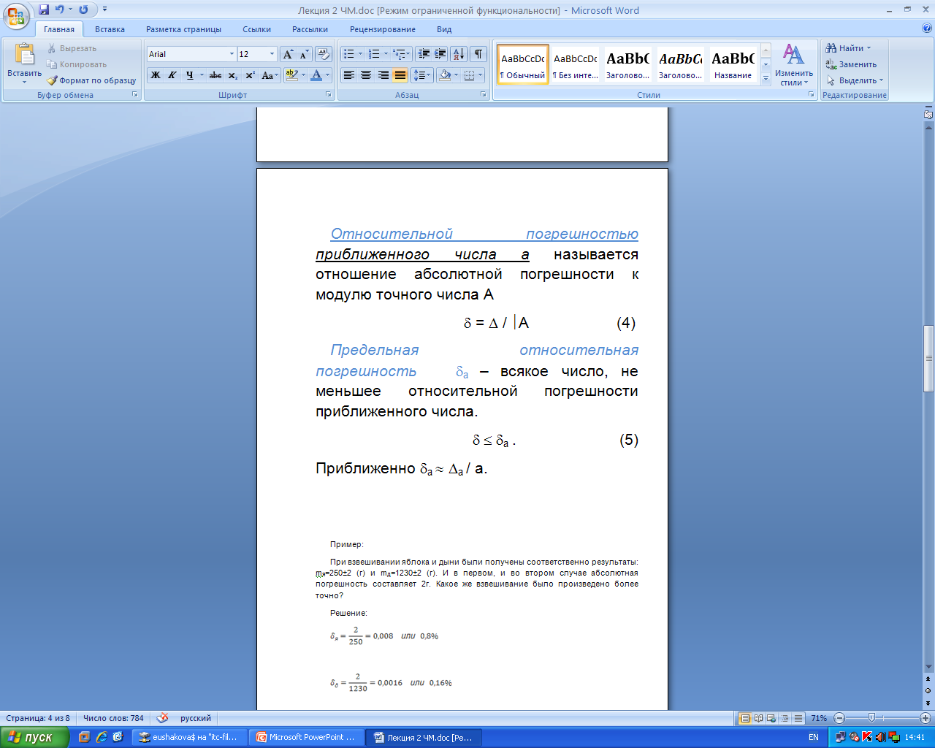
The relative error of an approximate number a is the ratio of the absolute error to the modulus of the exact number A.
The maximum relative error is any number not less than the relative error of the approximate number.
Approximately:

Slide 8
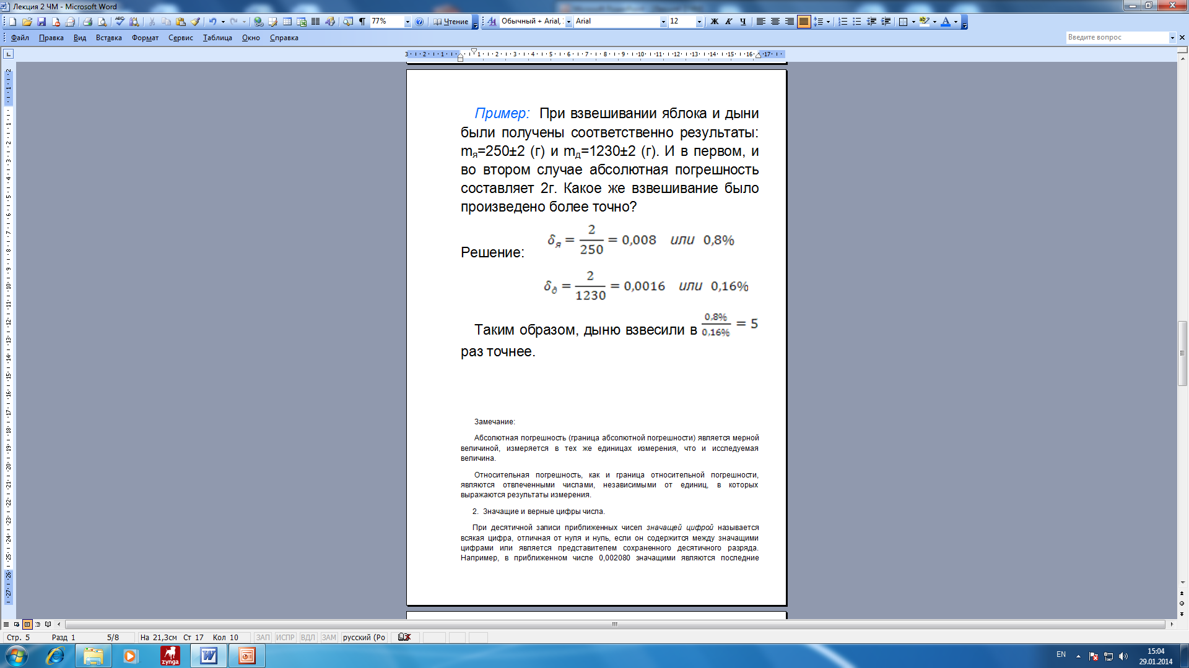
Example: When weighing an apple and a melon, the results are obtained, respectively: . In both the first and second cases, the absolute error is 2 g. Which weighing was performed more accurately?
Decision:
Thus, the melon was weighed times more accurately.

Slide 9
Note:
The absolute error (the limit of absolute error) is a measured value, measured in the same units of measurement as the value under study.
The relative error, as well as the boundary of the relative error, are abstract numbers independent of the units in which the measurement results are expressed.

Slide 10
Significant and correct digits of numbers
In decimal notation of approximate numbers, a significant digit is any digit other than zero and zero, if it is contained between significant digits or is a representative of a stored decimal digit.
For example, in the approximate number 0.002080, the last four digits are significant. The first three zeros are insignificant, they serve to establish the positions of other digits.

Slide 11
For example:
the number 0.01405 has four significant digits: 1,4,0,5;
the number 0.014050 has four significant digits: 1,4,0,5,0;
the number 1405,00 has four significant digits: 1,4,0,5,0,0.

Slide 12
The first n significant digits of an approximate number are called correct if the absolute error of this number does not exceed half of the unit of the digit expressed by the n-th significant digit, counting from left to right. Thus, the number of correct digits (or the number of correct signs) in an approximate number is closely related to its error.

Slide 13
For example, with an absolute error of 0.03, the approximate number 36.00 has three correct signs, and with an absolute error of 0.003 - four correct signs.

Slide 14
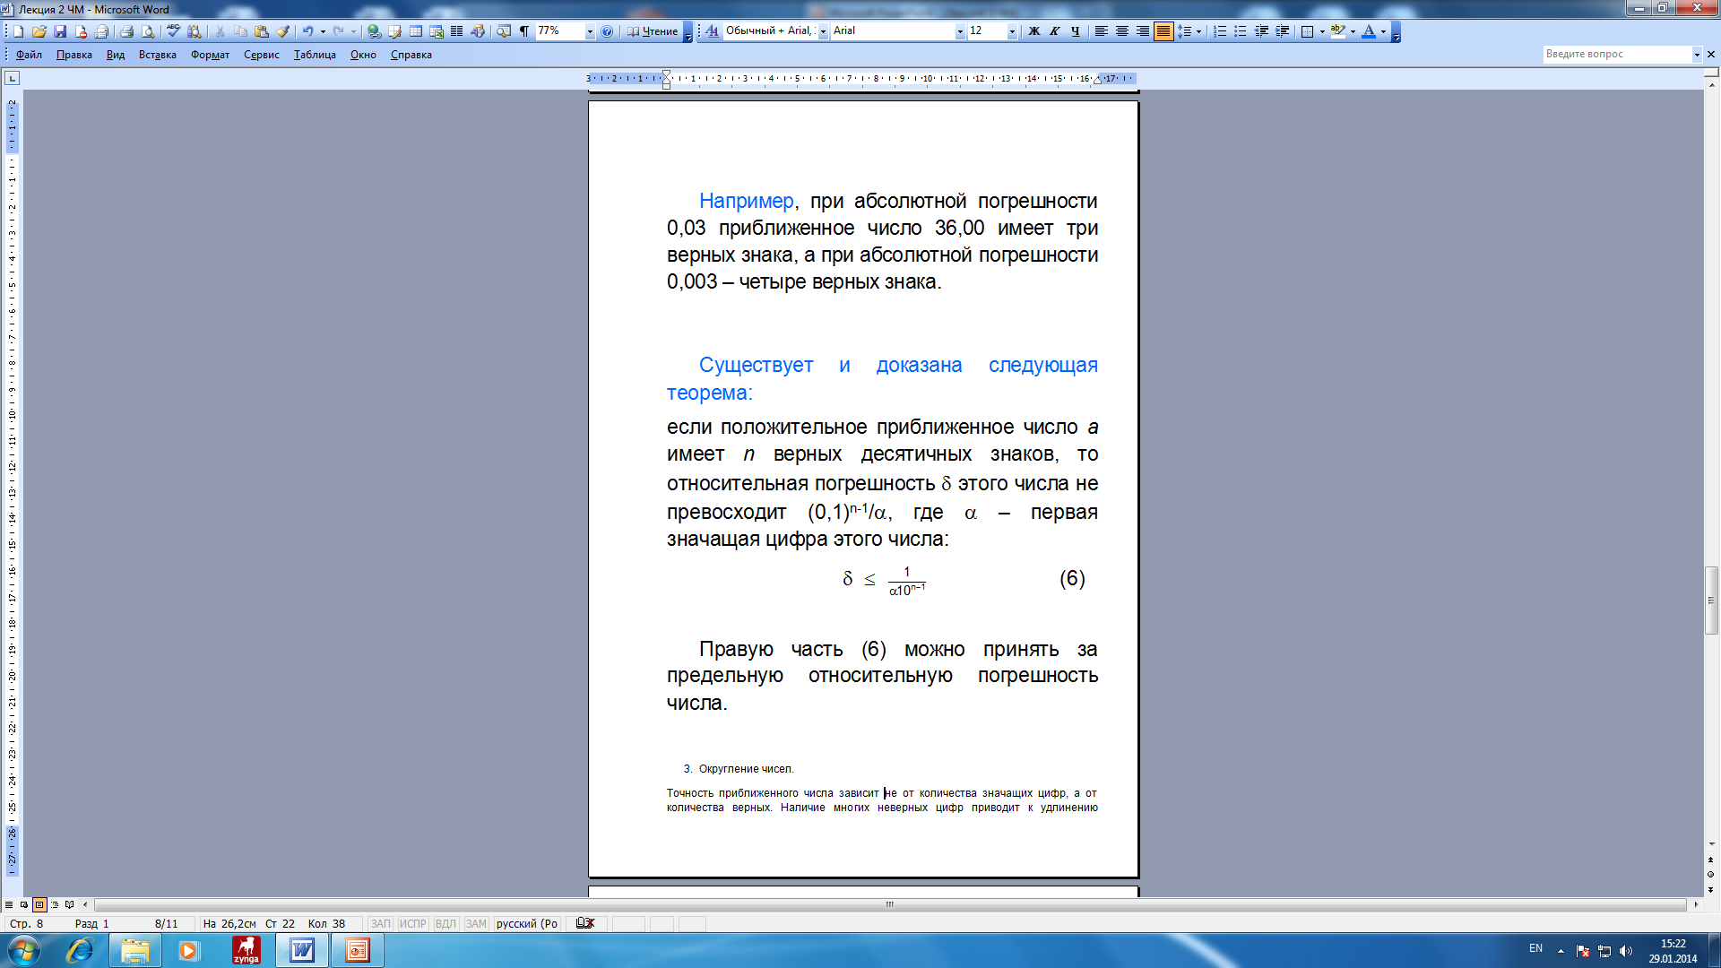
The following theorem exists and has been proved:
if the positive approximate number a has n correct decimal places, then the relative error of this number does not exceed where is the first significant digit of this number:
The right-hand side (6) can be taken as the ultimate relative error.

Slide 15
Rounding numbers
The accuracy of an approximate number does not depend on the number of significant digits, but on the number of correct ones. The presence of many incorrect digits leads to lengthening of records and an increase in calculation time.

Slide 16
To eliminate these disadvantages, researchers resort to replacing the approximate number with a number with fewer significant digits. This can be done by rounding, for example, simply discarding some of the incorrect significant digits or replacing them with zeros to preserve the digits. However, special rounding rules are used to obtain the minimum error.

Slide 17
Rounding rules. If less than half of the unit of the last stored digit is discarded during rounding, then the digits in all stored digits are left unchanged, if there are more than the specified half, then the last stored digit is increased by 1. If the discarded part is exactly equal to the specified half, then the even digit rule is applied - the last stored digit is left unchanged, if it is even, and increase by 1 if it is odd. The error of such rounding does not exceed 1/2 decimal place of the last digit left.

Slide 18
When performing approximate calculations, the number of significant digits of intermediate results should not exceed the number of correct digits by more than 1 or 2.
These rules allow you to avoid writing unnecessary digits without compromising the accuracy of calculations and save calculation time.

Slide 19
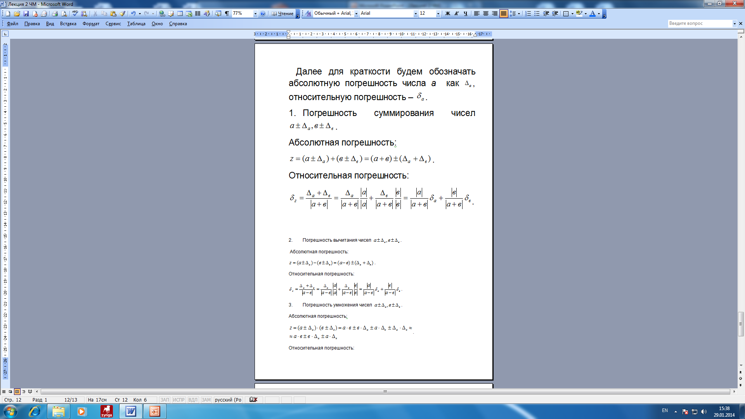
Errors of computational operations
Further, for brevity, we will denote the absolute error of the number a as , and the relative error as
1. The error of summation of numbers
The absolute error
The relative error

Slide 20
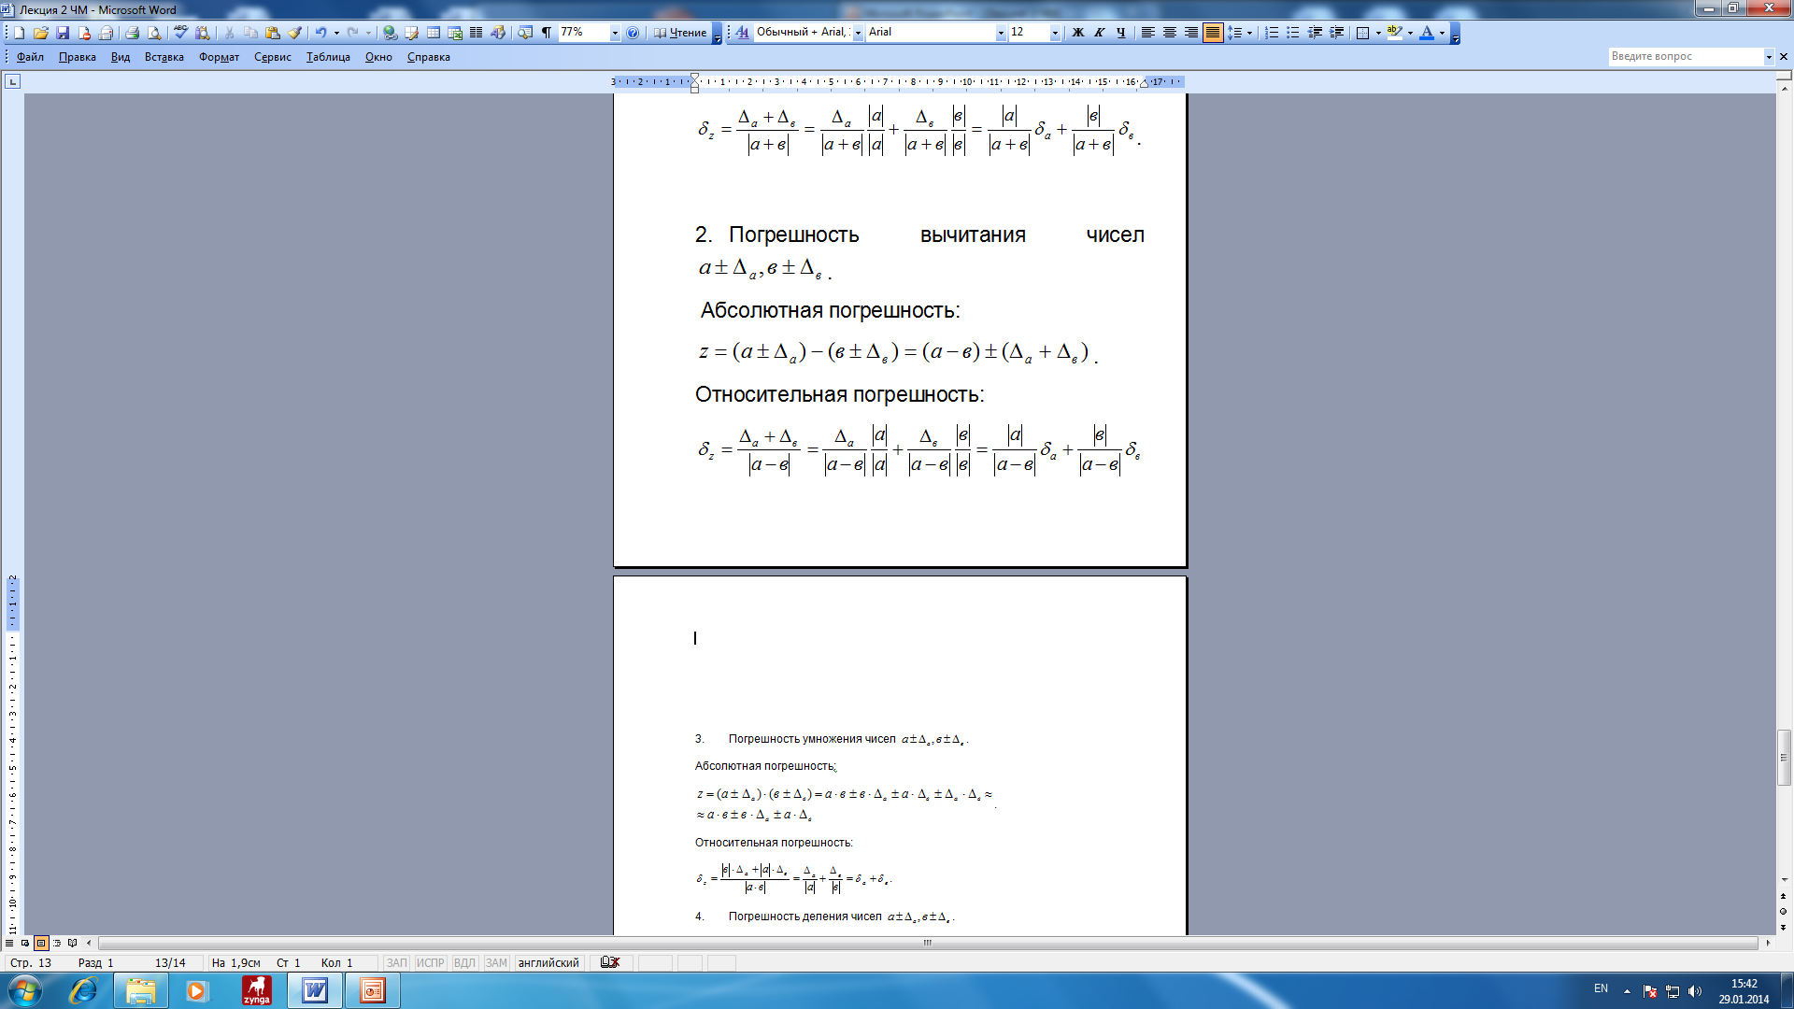
2. The error of subtracting numbers
The absolute error
The relative error

Slide 21
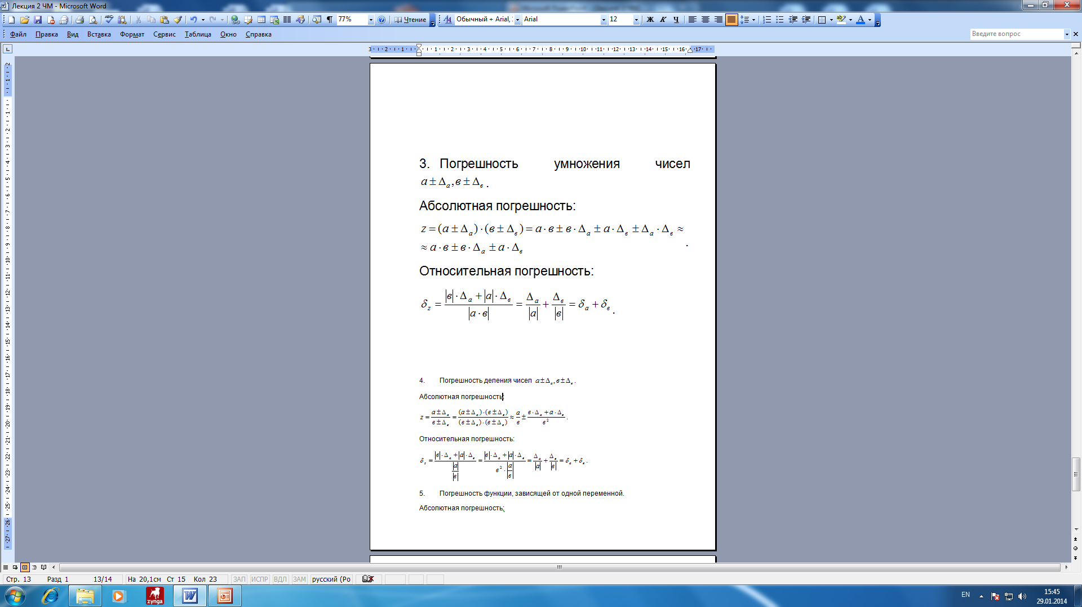
3. The error of multiplication of numbers
The absolute error
The relative error

Slide 22
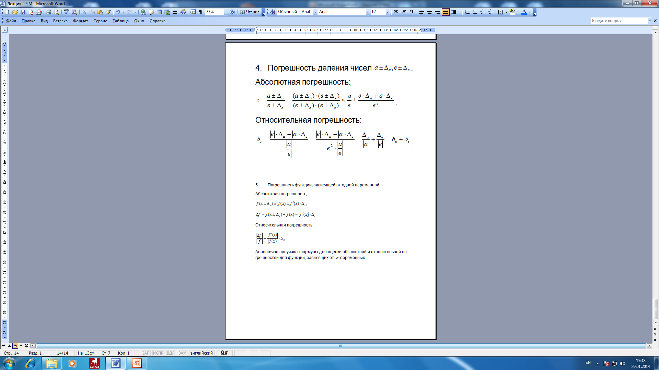
4. The error of dividing numbers
The absolute error
The relative error

Slide 23
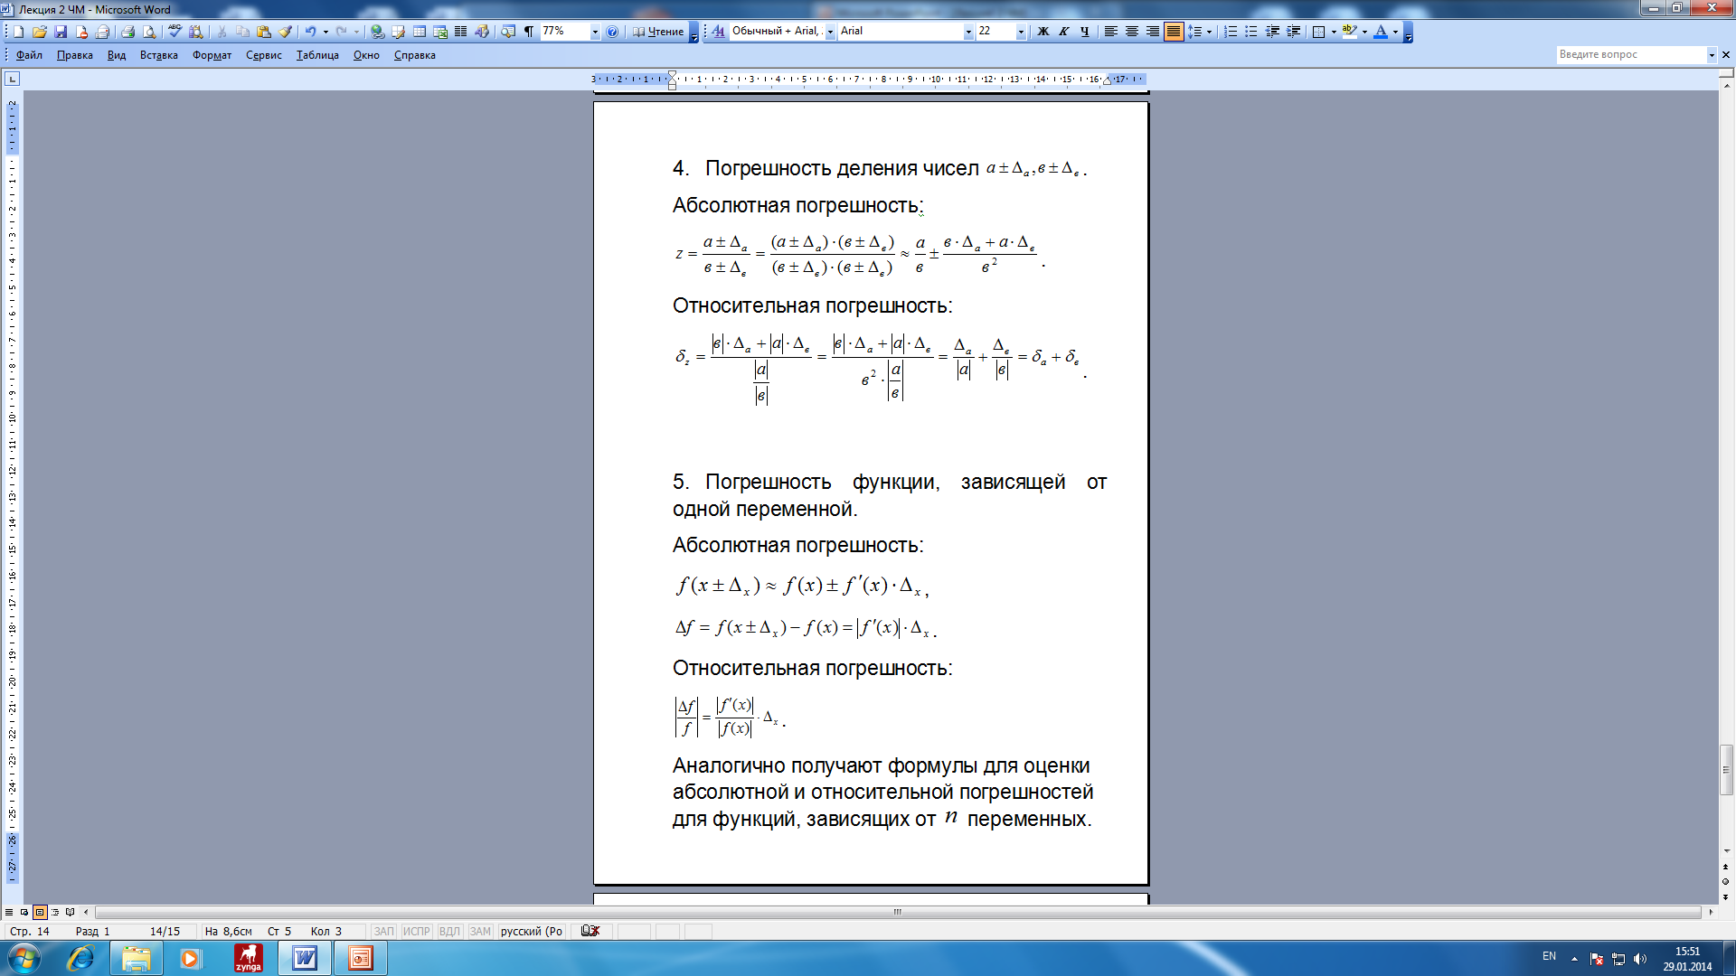
5. The error of a function depending on a single variable.
The absolute error
The relative error
Similarly, formulas are obtained for estimating the absolute and relative errors for functions depending on n variables.

