Slide 1
What Is a MongoDB?
MongoDB is an open source NoSQL database management program.
NoSQL is used as an alternative to traditional relational databases. NoSQL databases are quite useful for working with large sets of distributed data.
MongoDB is a tool that can manage document-oriented information, store or retrieve information.

Slide 2
MongoDB supports various forms of data. It is one of the many non relational database technologies that arose in the mid-2000s under the NoSQL banner -- normally, for use in big data applications and other processing jobs involving data that doesn't fit well in a rigid relational model. Instead of using tables and rows as in relational databases, the MongoDB architecture is made up of collections and documents.

Slide 3
What Is SQL
SQL (pronounced “ess-que-el”) stands for Structured Query Language.
SQL is used to communicate with a database.
According to ANSI (American National Standards Institute), it is the standard language for relational database management systems.
SQL statements are used to perform tasks such as update data on a database, or retrieve data from a database.
Some common relational database management systems that use SQL are: Oracle, Sybase, Microsoft SQL Server, Access, Ingres, etc.

Slide 4
Although most database systems use SQL, most of them also have their own additional proprietary extensions that are usually only used on their system.
However, the standard SQL commands such as “Select”, “Insert”, “Update”, “Delete”, “Create”, and “Drop” can be used to accomplish almost everything that one needs to do with a database.

Slide 5
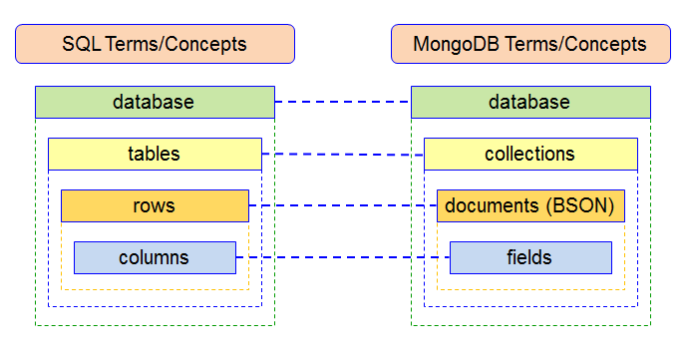
Difference Between MongoDB and MySQL
SQL databases are used to store structured data while NoSQL databases like MongoDB are used to save unstructured data.
MongoDB is used to save unstructured data in JSON format.
MongoDB does not support advanced analytics and joins like SQL databases support.

