Slide 1

Final Project: Deliverable 4
Data Structure and Object Oriented Programming
Yasmine El Hattab
GitHub link: https://github.com/yasmineel7/FinalProject.git

Slide 2
Table of contents:
Project description
requirements that the project respect
executions examples
Issues or changes during this project
Learning Outcomes

Slide 3
Project description
My project will feature a system that imitates the one used in school to keep all the information needed by the establishment to ensure its smooth operation. Thus, the students will be able to register and drop courses, the teachers will upload grades and calculate their average, and the administrator will keep track of the students' transcripts.

Slide 4
The requirements respected by the project
Firstly, since the project is suposed to let the student read and write it's own transcript, I used the main to try it with examples.

Slide 5

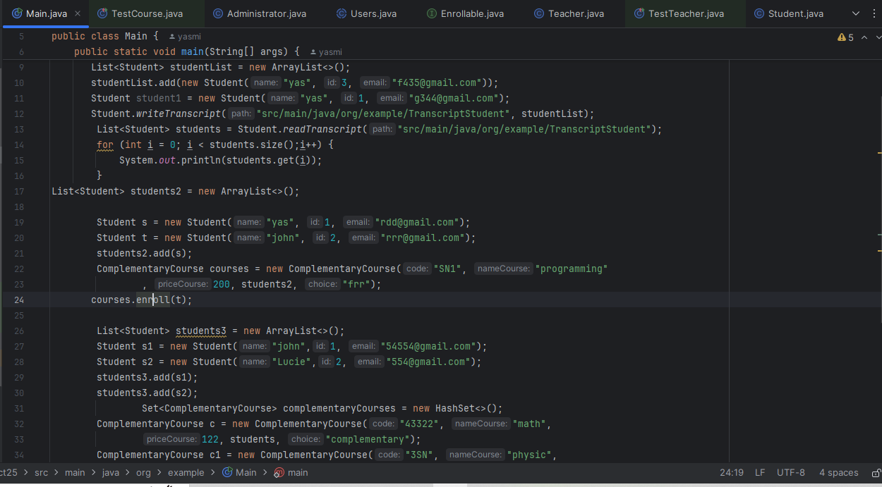
The main

Slide 6
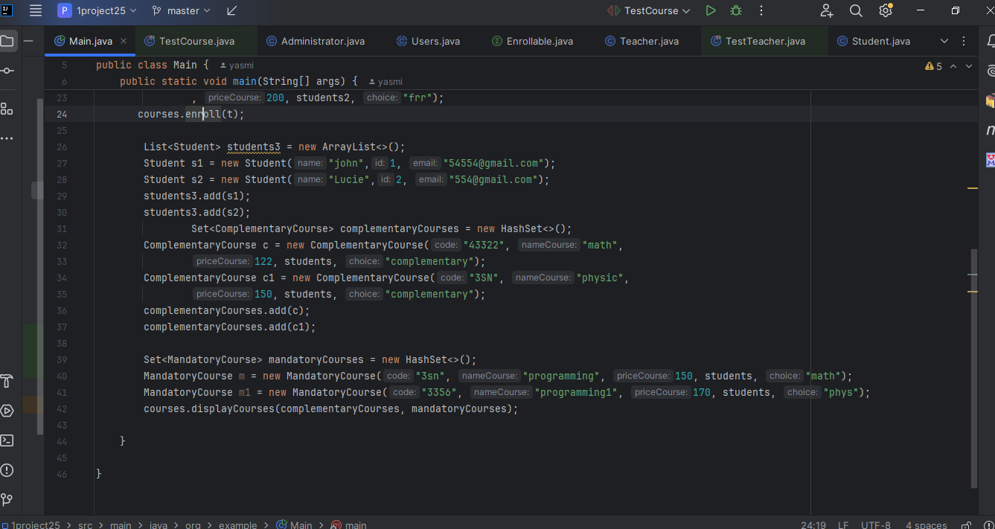

Slide 7
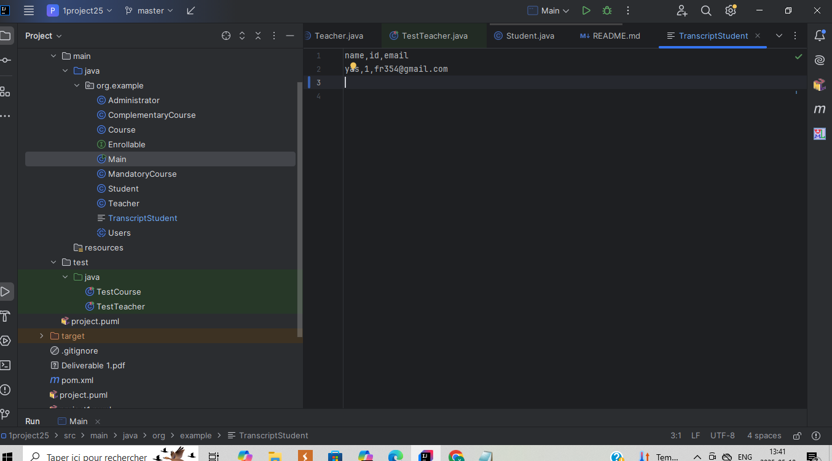
The transcriptStudent before running the main

Slide 8
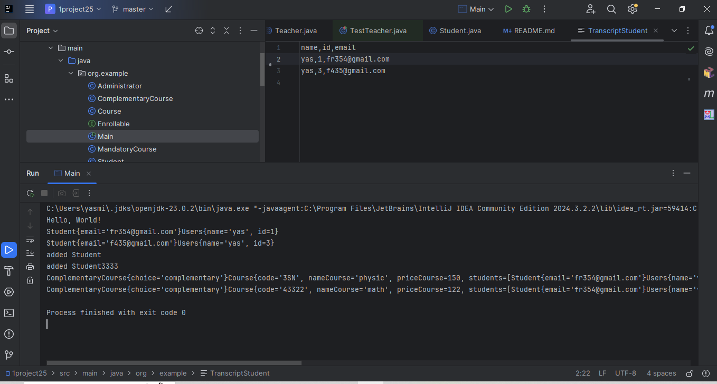
Execution of the main and its signification
What has been added to the student transcript
Display the transcript
This is the text that prove that a student has been enrolled/the second one proves that it has been added to a complementary course
The method displayCourse

Slide 9
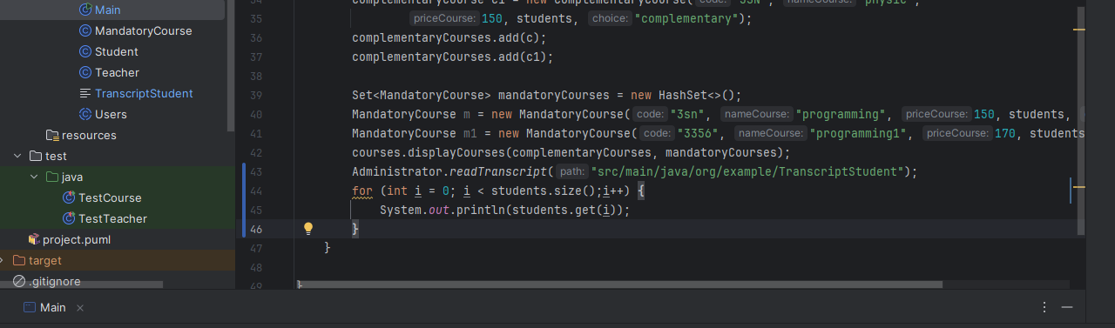
The main with the readtranscript inside the Adminstrator Class

Slide 10
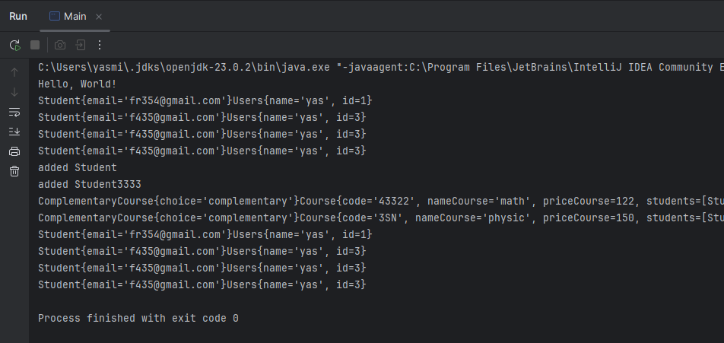
The output of the method readTranscript inside the Administrator Class
This part

Slide 11
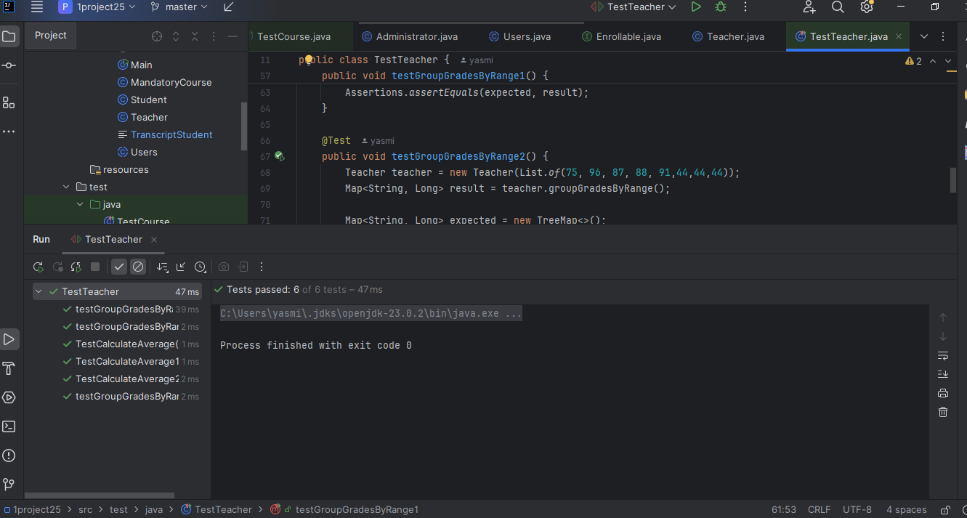
For the other methods, I used unitTesting that's the output of the TestTeacher

Slide 12
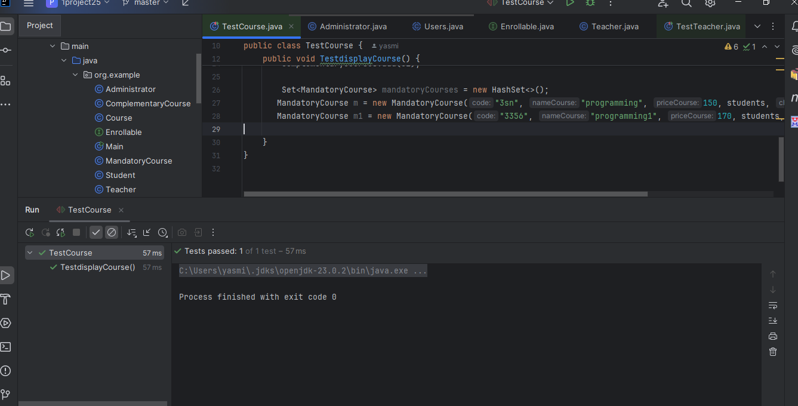
That's the test for TestCourse

Slide 13
Issues or changes during this project
I realized that some of the methods that I wanted to write in the Student class wouldn't work. That's why I decided to write them in the Course class instead. For instance, I decided to change the place of the method drop and enroll.
I also decided not to use Comparator and replace it with compareTo in the Student Class
Moreover, I decided to add a method that used stream and map to cover all the material of the semester. This method is called groupGradesByRange and is in the Teacher class.

Slide 14
Learning Outcomes
I learned how to group grades by range
I had the time to master and practice how to use TextIo with a real file. In fact, I had to use a real path and find how to make it run the way I wanted.

