Slide 1
COVID-19
In incarceration facilities

Slide 2
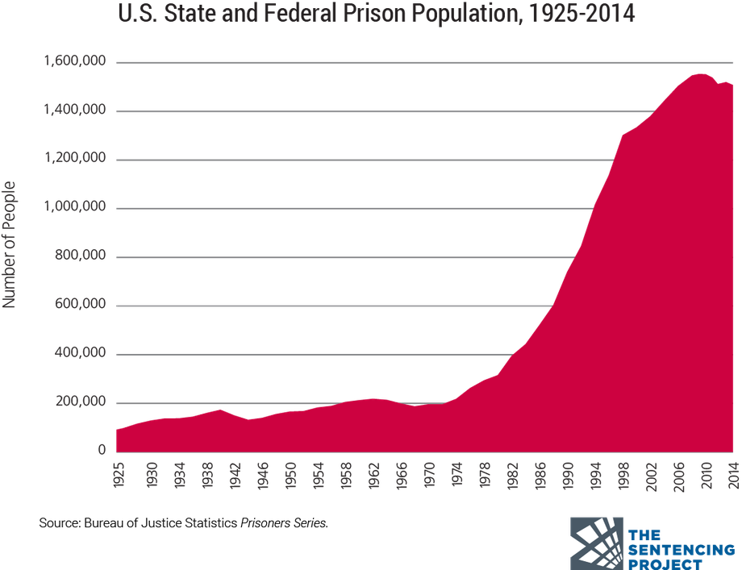
Background:
Although the US makes up about 4 percent of the world's population, it accounts for 22 percent of the world's prison population.
In 2020 the total prison population in the US was over 1.8 million people

Slide 3
Background contd:
In the United States there have been nearly 34,000,000 cases of Covid-19 and over 600,000 deaths due to the virus
As of June 2021 there were nearly 400,000 cases of Covid-19 reported among prisoners and just over 2700 deaths
Prisoners tested positive for covid at a rate over 4 times higher than the general population.

Slide 4

The Problem:
The goal of this project was to examine if there were any trends in the ways that different states were affected by COVID-19 and draw insights into what could be causing those trends.

Slide 5
THE DATA
1
Cases = Cases collected weekly Mar 20 – June 21
2
Rates = Overall total numbers, percentages and rates
3
Inmate populations collected monthly
4
Staff populations collected monthly

Slide 6
Feature engineering
The final dataset for inference consisted of
* 51 rows of data
*15 different columns
1 row per state
1 row for federal facilities
Columns added
*maximum inmate population, *maximum staff populations, *region of the country

Slide 7
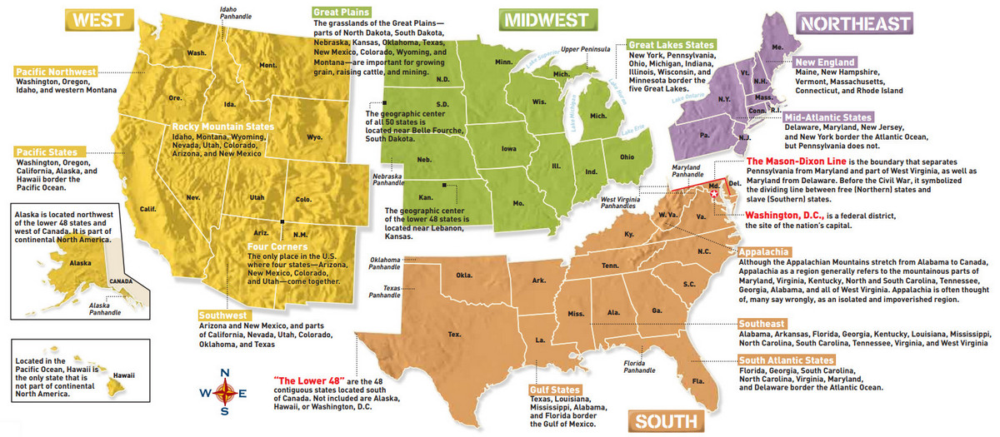

Slide 8
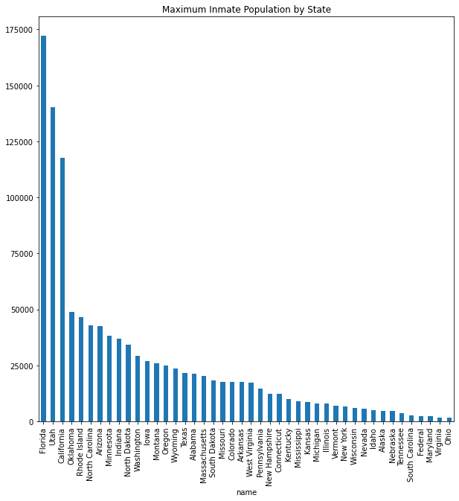
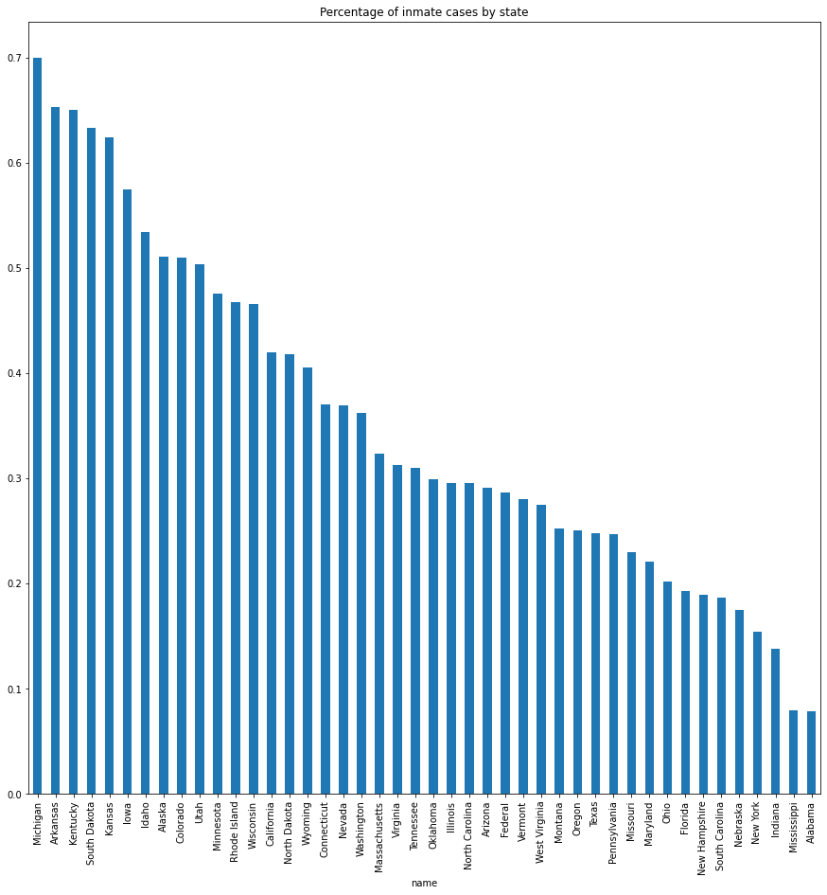
Initial findings (inmates)

Slide 9
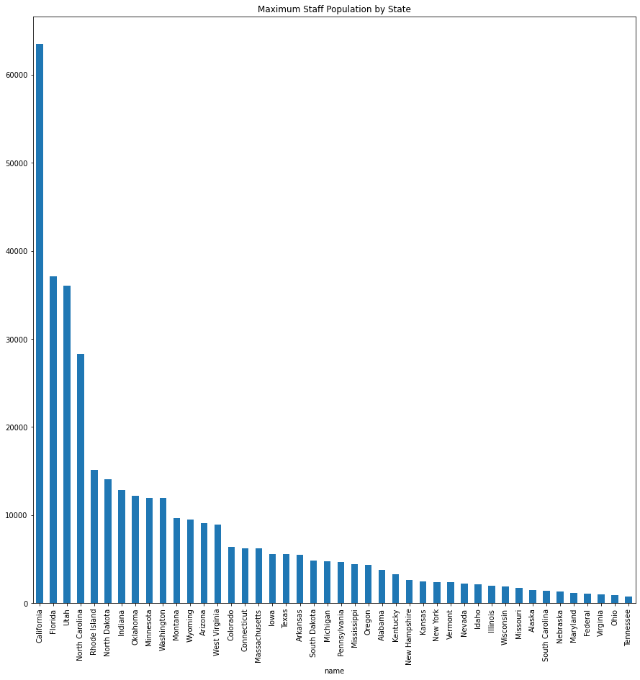
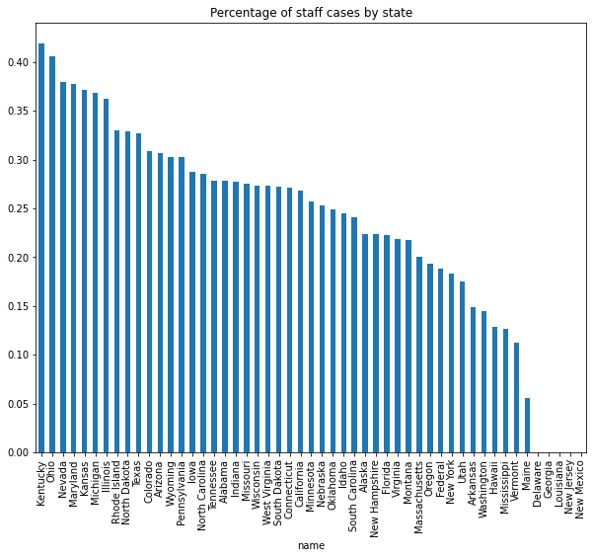
Initial findings (staff)

Slide 10
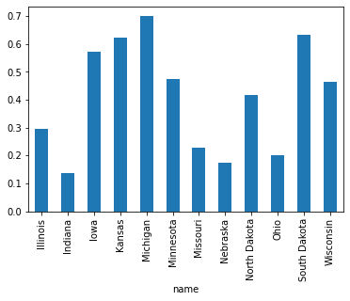
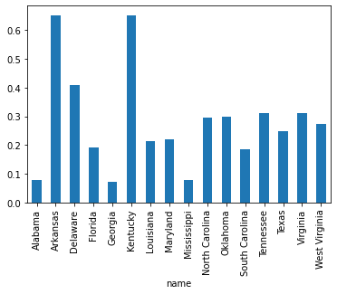
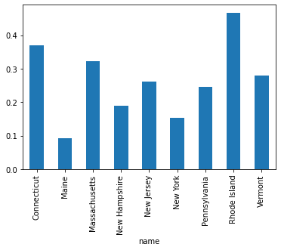
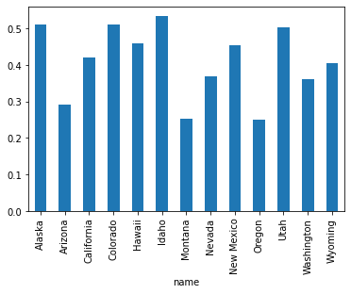
Prisoner Case Percentage by Region
Mean by region
NE - 0.264822
South- 0.280709
MW- 0.410695
West- 0.409354

Slide 11
Drawing inferences
Performed Clustering analysis to determine if the facilities could be grouped in other ways to offer insight
Kmeans, k = 2, score = .45
DBScan score = .45

Slide 12
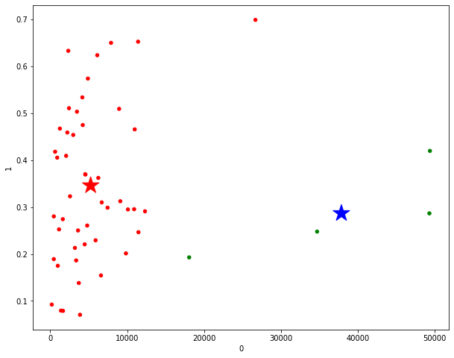
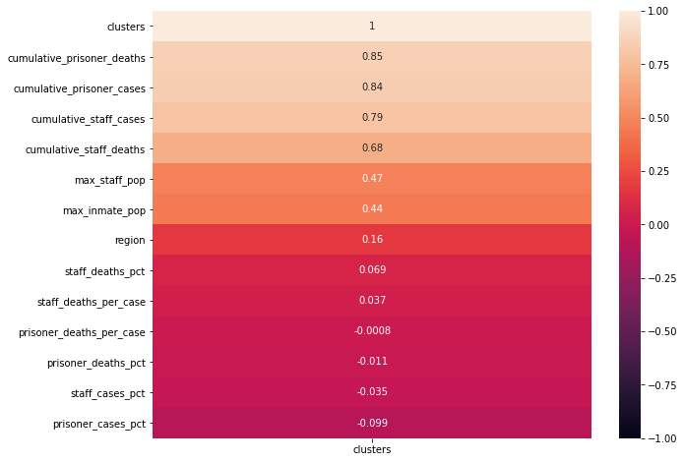
Correlation and Clusters

Slide 13
Conclusions
*Clustering results did no shot much difference in how incarceration facilities were able to control the spread of the disease
*The factors that distinguished facilities the most were their maximum populations and total number of cases. Other factors were similar among both groups
4

Slide 14
Recommendations
For Future Analysis:
- Include information of square footage of facilities
Hypothesis testing based on region
Hypothesis testing based on maximum population
Get data on other factors
Time series each state and hypothesis test the rates

