Slide 1
Parking sensors
Yasmine Khalifa
Rishit Sheth
Alex Lawson
Eamonn McCallum
Nelson Garcia

Slide 2
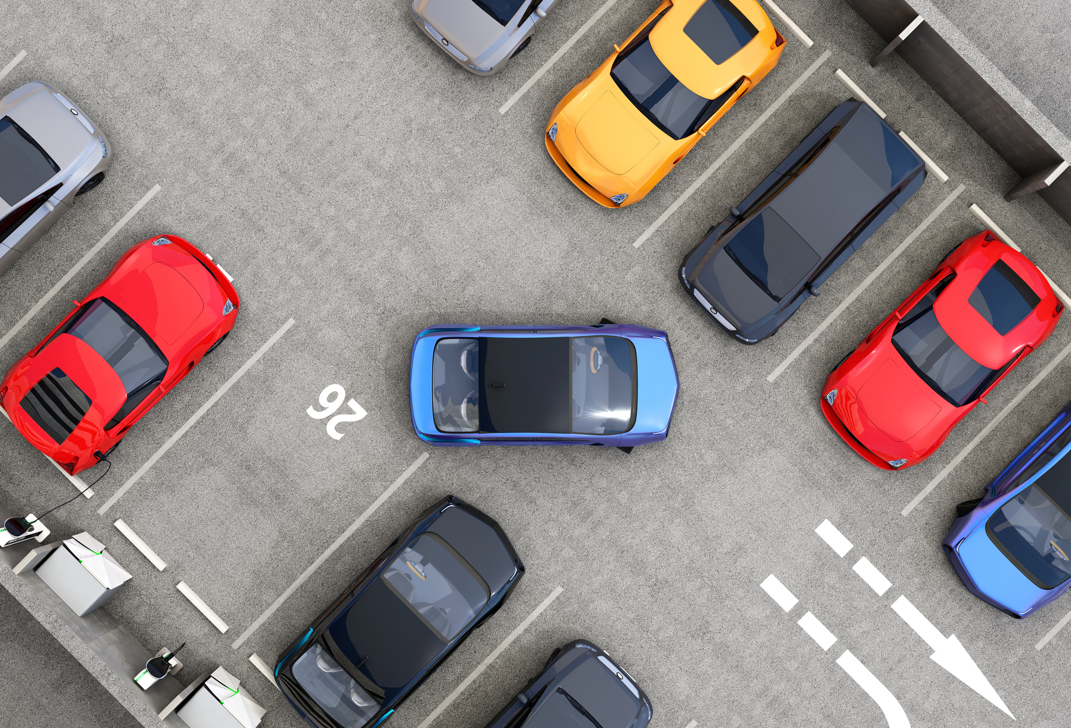
Problem
What is the status of the parking spaces?
How can one determine the fluidity of these
spaces, in terms of occupation or free space?
Which points or places can be determined as the most frequented?

Slide 3

The Data
https://data.melbourne.vic.gov.au/
Data alive
Historic data

Slide 4

Process
SQL.
SQLAlchemy
Flask
Geo-mapping
Plotly

Slide 5
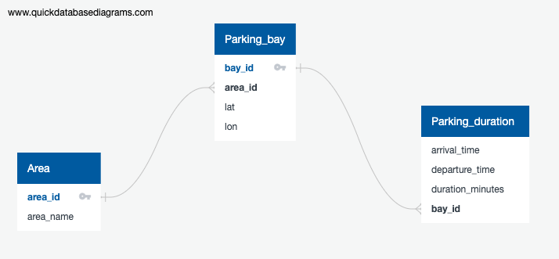
SQL.

Slide 6
Flask
Home
Map
Chart
Data base

Slide 7
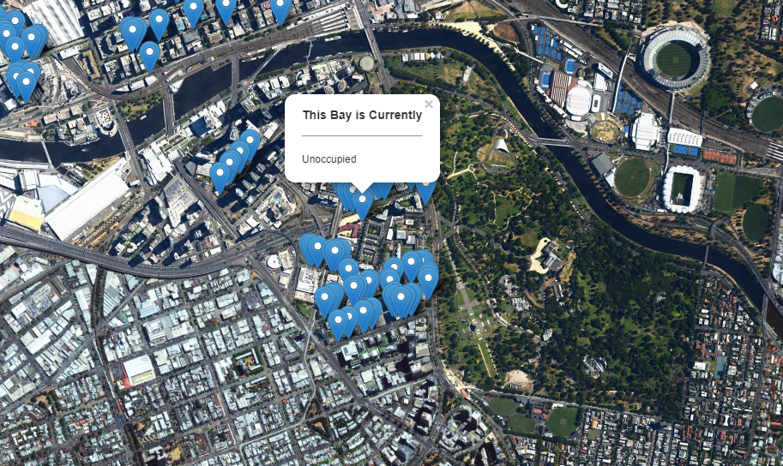
Geo-mapping
"https://data.melbourne.vic.gov.au/resource/vh2v-4nfs.geojson"

Slide 8
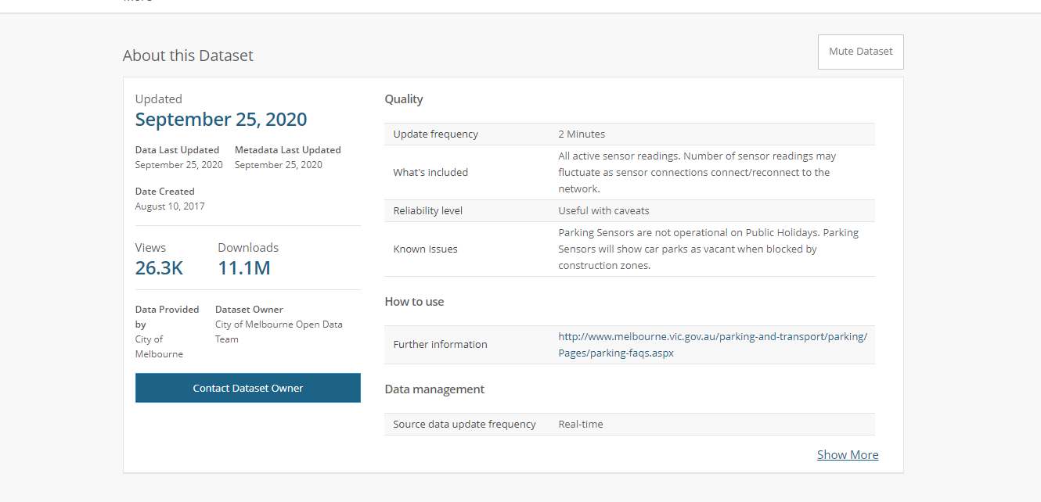
The Dataset we used: "https://data.melbourne.vic.gov.au/resource/vh2v-4nfs.geojson"

Slide 9
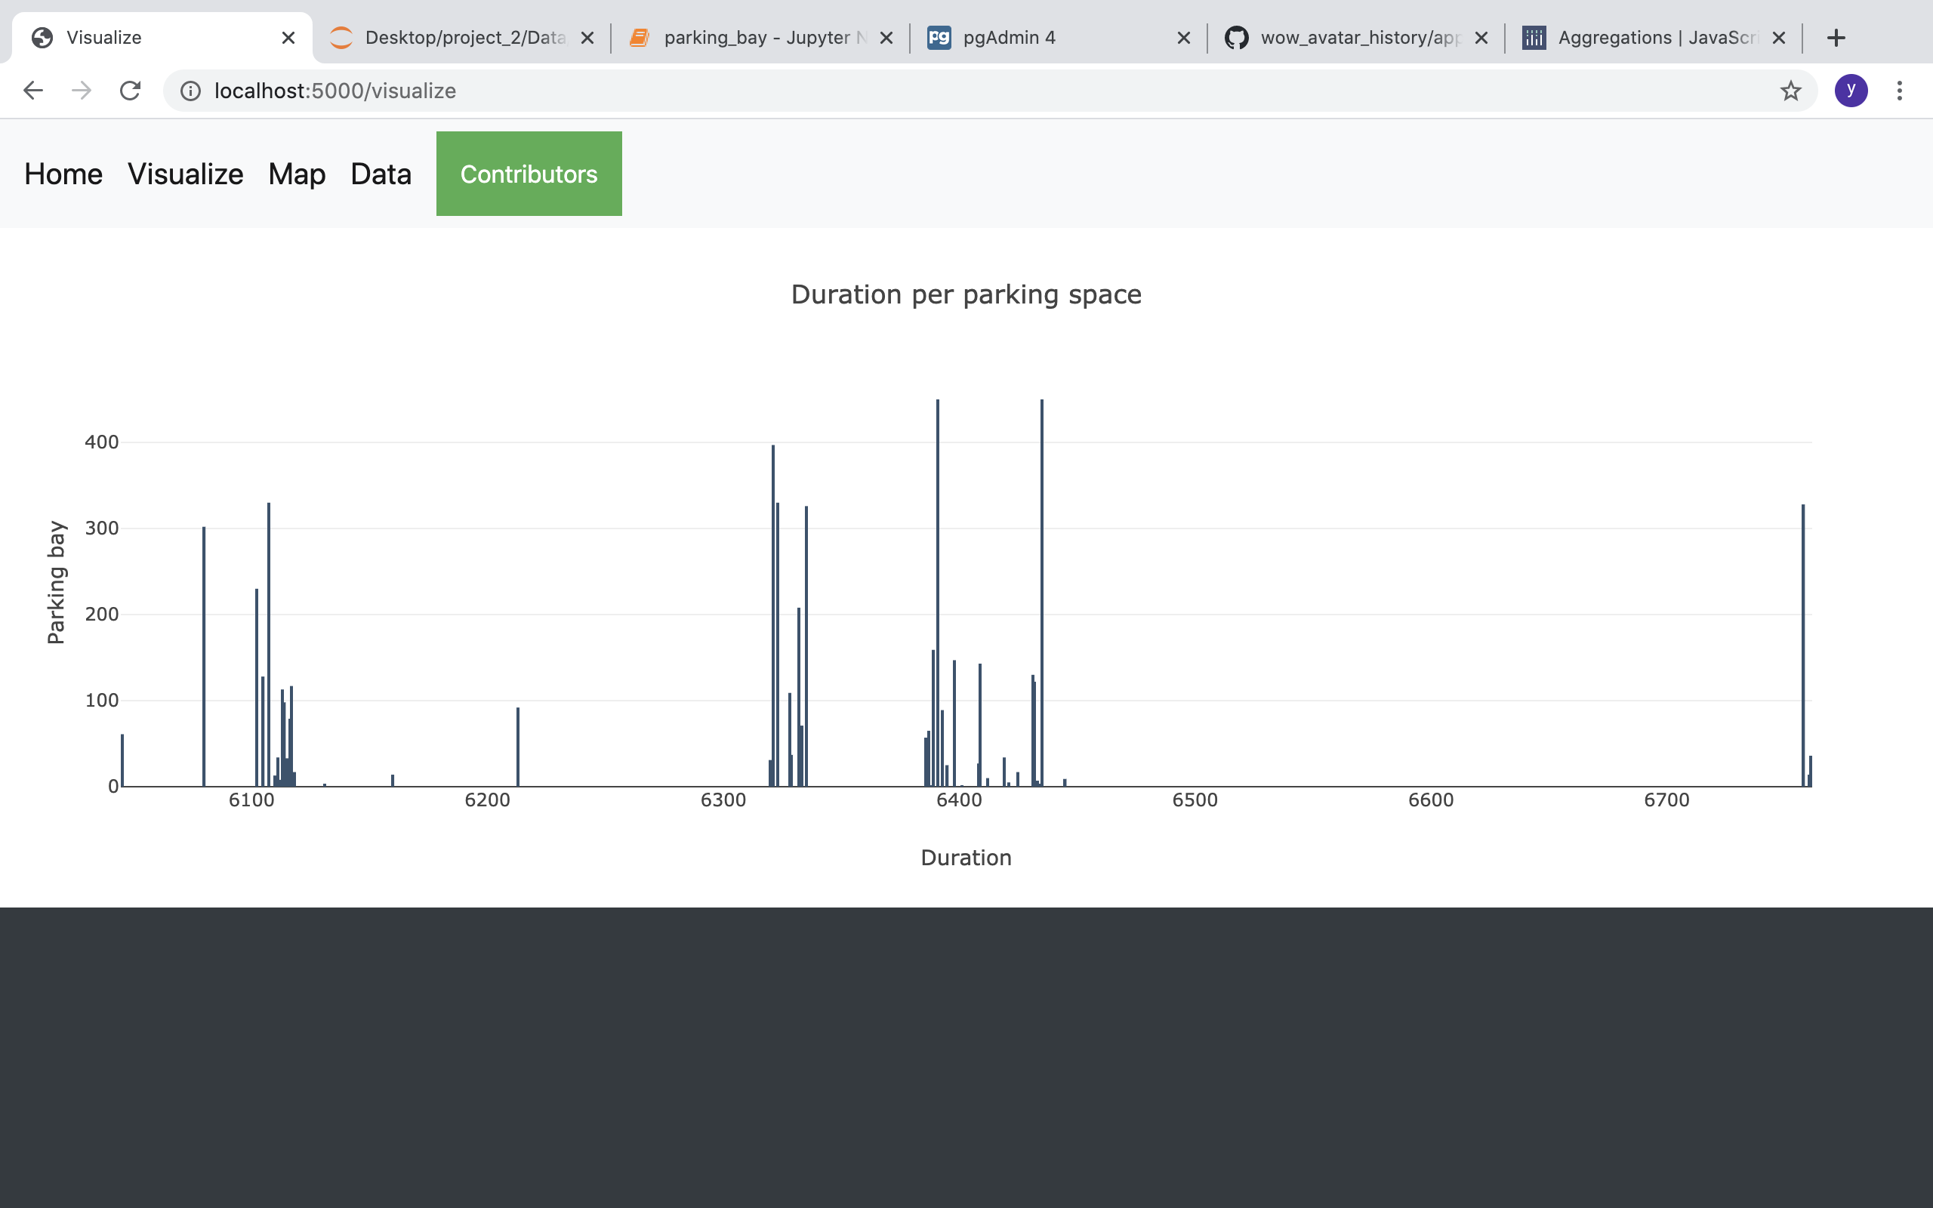
Plotly
Explore the difference between duration of car stay in Melbourne’s CBD

Slide 10
Conclusions
Challenges:
Collaboration - Most of us work full time with long hours on some days.
Lots of coding and testing
Overcomes:
Separated tasks
Made uncomplex solution

