Slide 1
Relational database management system

Slide 2
Definition
A relational database management system (RDBMS) is a collection of programs and capabilities that enable IT teams and others to create, update, administer and otherwise interact with a relational database. RDBMSes store data in the form of tables, with most commercial relational database management systems using Structured Query Language (SQL) to access the database. However, since SQL was invented after the initial development of the relational model, it is not necessary for RDBMS use.

Slide 3
Some examples
IBM
Oracle
MySQL
Microsoft SQLServer
PostgreSQL

Slide 4
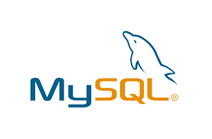
MySQL
MySQL is a relational database management system based on SQL – Structured Query Language. The application is used for a wide range of purposes, including data warehousing, e-commerce, and logging applications. The most common use for MySQL however, is for the purpose of a web database

Slide 5
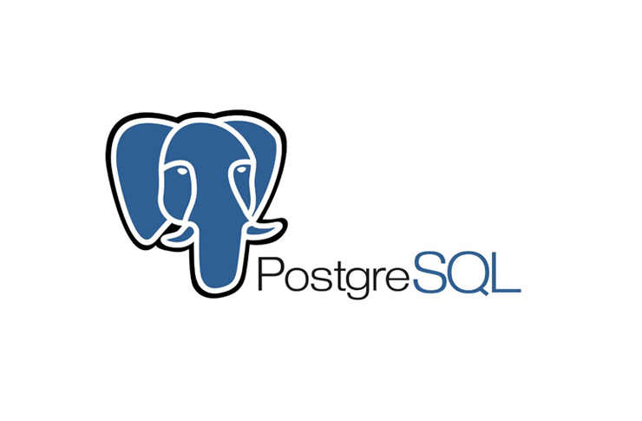
PostgreSQL
PostgreSQL also known as Postgres, is a free and open-source relational database management system (RDBMS) emphasizing extensibility and SQL compliance
PostgreSQL works according to a client/server architecture, it is thus constituted
PostgreSQL has many features making it a robust and powerful RDBMS worthy of commercial DBMSs

Slide 6
SQL SERVER
Microsoft SQL Server is a relational database management system (RDBMS) that supports a wide variety of transaction processing, business intelligence and analytics applications in corporate IT environments.
SQL Server Express is a free, entry-level version of the database, ideal for learning, as well as for building desktop applications and small servers up to 10 GB of data.

Slide 7
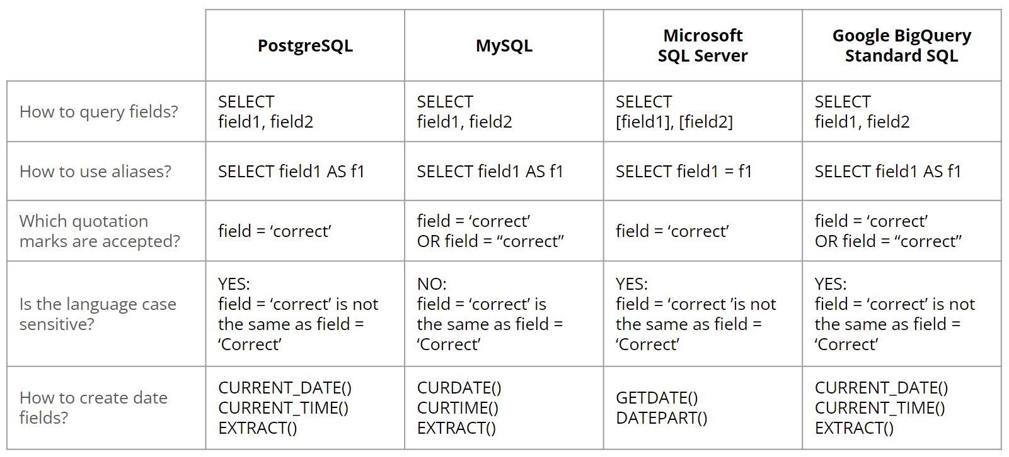
Comparison between the three RDBMS

