Slide 1
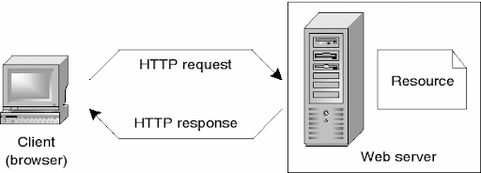
How does the web work?
The web browser connects to the web server and sends an HTTP request (via the protocol stack) for the desired web page. The web server receives the request and checks for the desired page. If the page exists, the web server sends it. If the server cannot find the requested page, it will send an HTTP 404 error message.

Slide 2
What do you need to be a web developer?
Client-side
Client-side scripting, or frontend development, refers to the end-user expertise directly. The client-side code is dead in a very applications program and is directly associated with what folks see once they visit a website. Topics like layout, fonts, colors, menus, and speak to forms are all driven by the frontend.
Server-side
Server-side scripting, or backend development, is regarding what happens behind the scenes. Backend is essentially the part of a website that the user does not really see. it’s chargeable for storing and organizing knowledge, and making certain that everything on the client-side is running swimmingly. It will do this by contacting the front. Whenever one thing happens next to the shopper – say, a user fills out a kind – the browser sends an invitation to the server-side. The server-side “responds” with relevant data within the type of frontend code that the browser will then interpret and show.

Slide 3
Database technology
Websites additionally consider info technology. The info contains all the files and content that a website must operate. It’s held in such a way that it’s straightforward to recover, organize, edit and save. The info runs on a server and most websites usually use some style of the electronic database management system (RDBMS).
In a nutshell: Frontend, backend and info technology all work along {to create|to make|to kind} and manage a completely purposeful website or application, and these 3 levels form the idea of internet development.

Slide 4
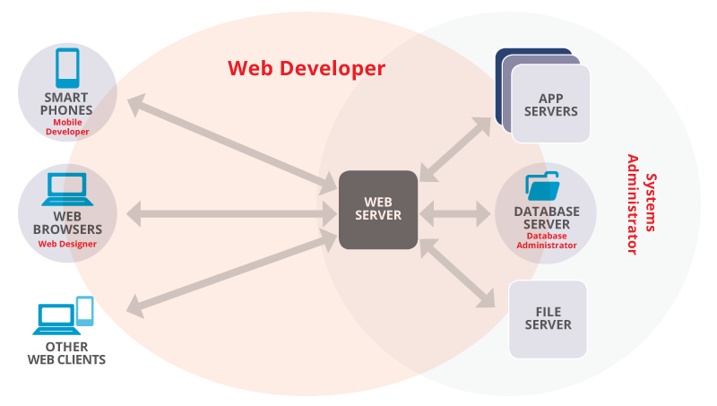
What is the role of a web developer ?
Web developers build and maintain websites. Their primary purpose is to create functional websites that give users the best experience. They take a website design and project and make it into a reality. This is why they are involved in the more technical aspects of development. They need to learn programming languages, most commonly PHP, Java, Ruby (among others), and understand how the Internet works.

Slide 5
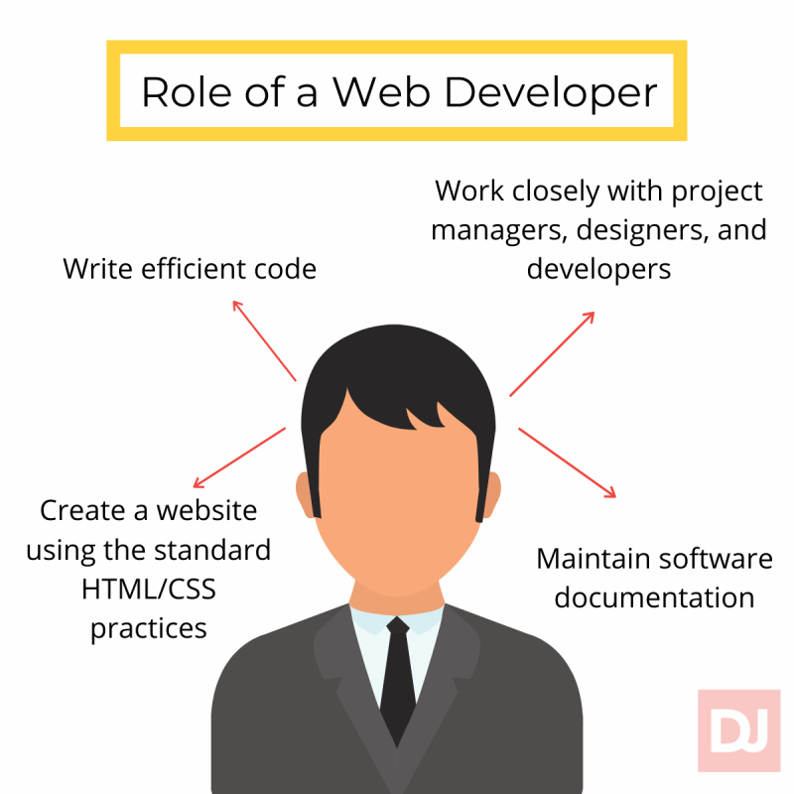
The role is responsible for designing, coding and modifying websites, from layout to function and according to a client’s specifications. Strive to create visually appealing sites that feature user-friendly design and clear navigation.

