Slide 1
Over-representation analysis in R
Yasmin Hilliam, PhD
Geisel School of Medicine at Dartmouth

Slide 2
Going beyond basic statistics in ‘omics analysis
With a pre-defined hypothesis
Without a hypothesis
Cherry-picking your favorite genes from the dataset that may support your hypothesis
Examining your data row-by-row, without being influenced by pre-existing knowledge

Slide 3
Going beyond basic statistics in ‘omics analysis
With a pre-defined hypothesis
A better approach?
Without a hypothesis
Cherry-picking your favorite genes from the dataset that may support your hypothesis
Examining your data row-by-row, without being influenced by pre-existing knowledge

Slide 4
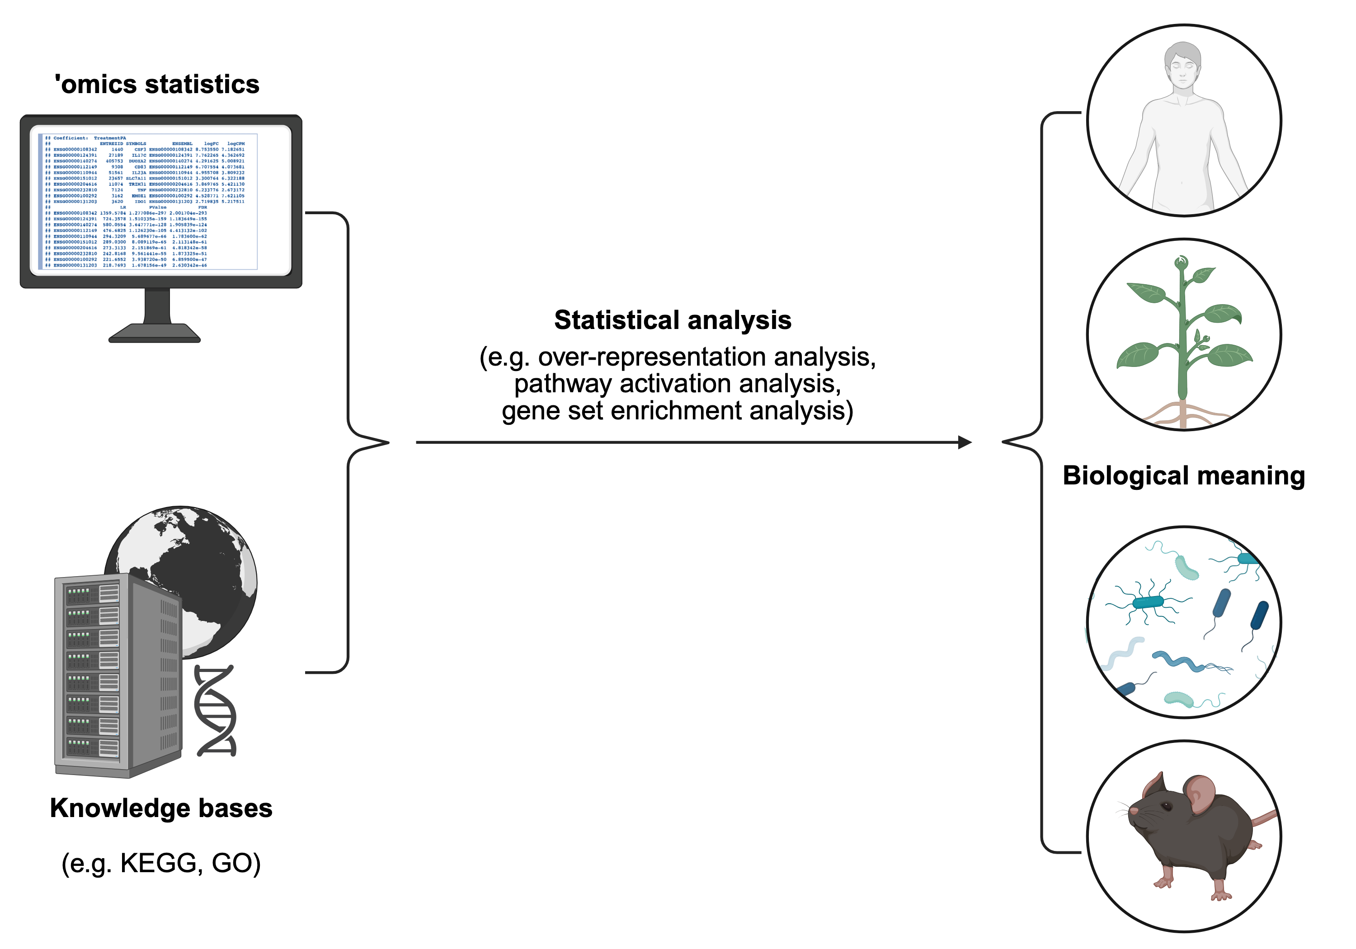
Pathway/gene set analysis
Reduces complexity from molecular to pathway level

Slide 5
Knowledge base databases
There are several databases with different curation philosophies to provide different levels of granularity for different purposes
Curators assign biological meaning to a set of genes
Gene Ontology (GO), Kyoto Encyclopedia of Genes and Genomes (KEGG), Molecular Signatures Databse (MsigDB)

Slide 6
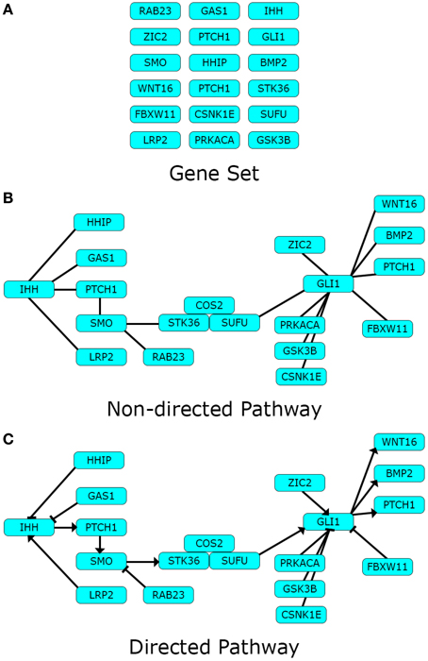
Types of databases
Miguel A García-Campos et al. (2015) PMID: 26733877

Slide 7
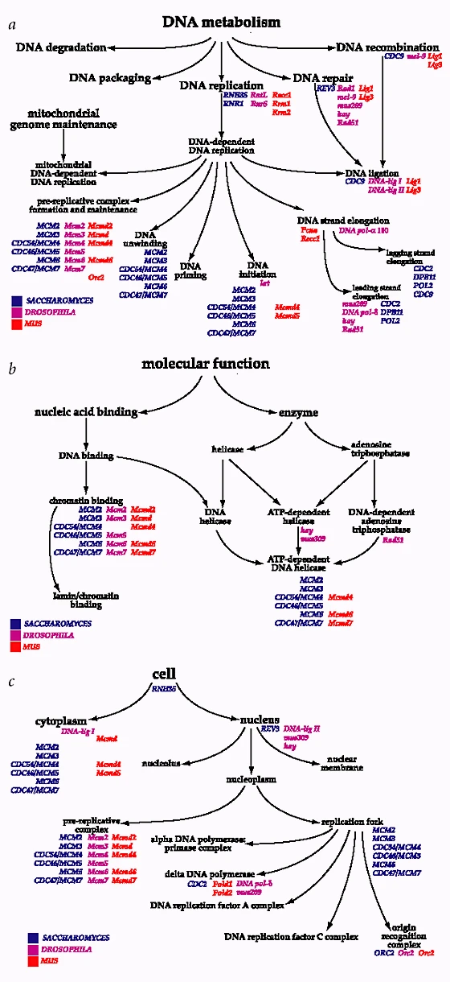
Gene ontology (GO) terms
GO terms describe our knowledge of biological domains in three aspects:
Biological processes (BP)
Michael Ashburner et al. (2000) PMID: 10802651

Slide 8
Gene ontology (GO) terms
GO terms describe our knowledge of biological domains in three aspects:
Biological processes (BP)
Molecular functions (MF)
Michael Ashburner et al. (2000) PMID: 10802651

Slide 9
Gene ontology (GO) terms
GO terms describe our knowledge of biological domains in three aspects:
Biological processes (BP)
Molecular functions (MF)
Cellular components (CC)
Michael Ashburner et al. (2000) PMID: 10802651

Slide 10
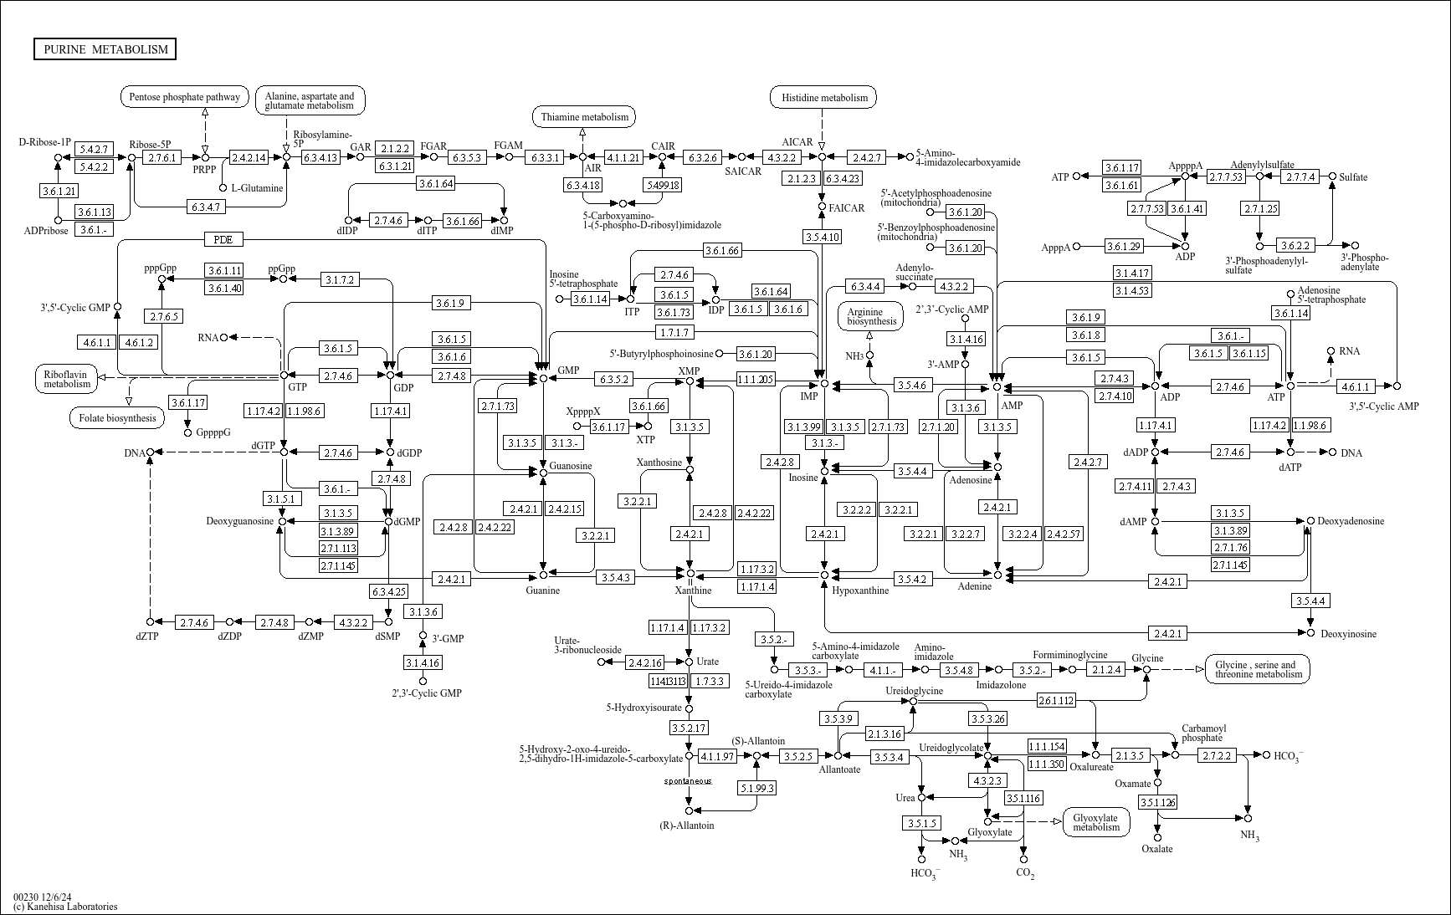
KEGG pathways
There are multiple databases in KEGG
KEGG pathways look like wiring diagrams of molecular interactions, reactions, and relations

Slide 11
Over-representation analysis
Fisher’s exact test is used to test independence of two categorical variables
Are more of our differentially expressed genes involved in a particular pathway than would be expected by chance?
When a list of differentially expressed genes contains more genes from a particular biological pathway than you would predict by chance this pathway is “enriched”

