Slide 1
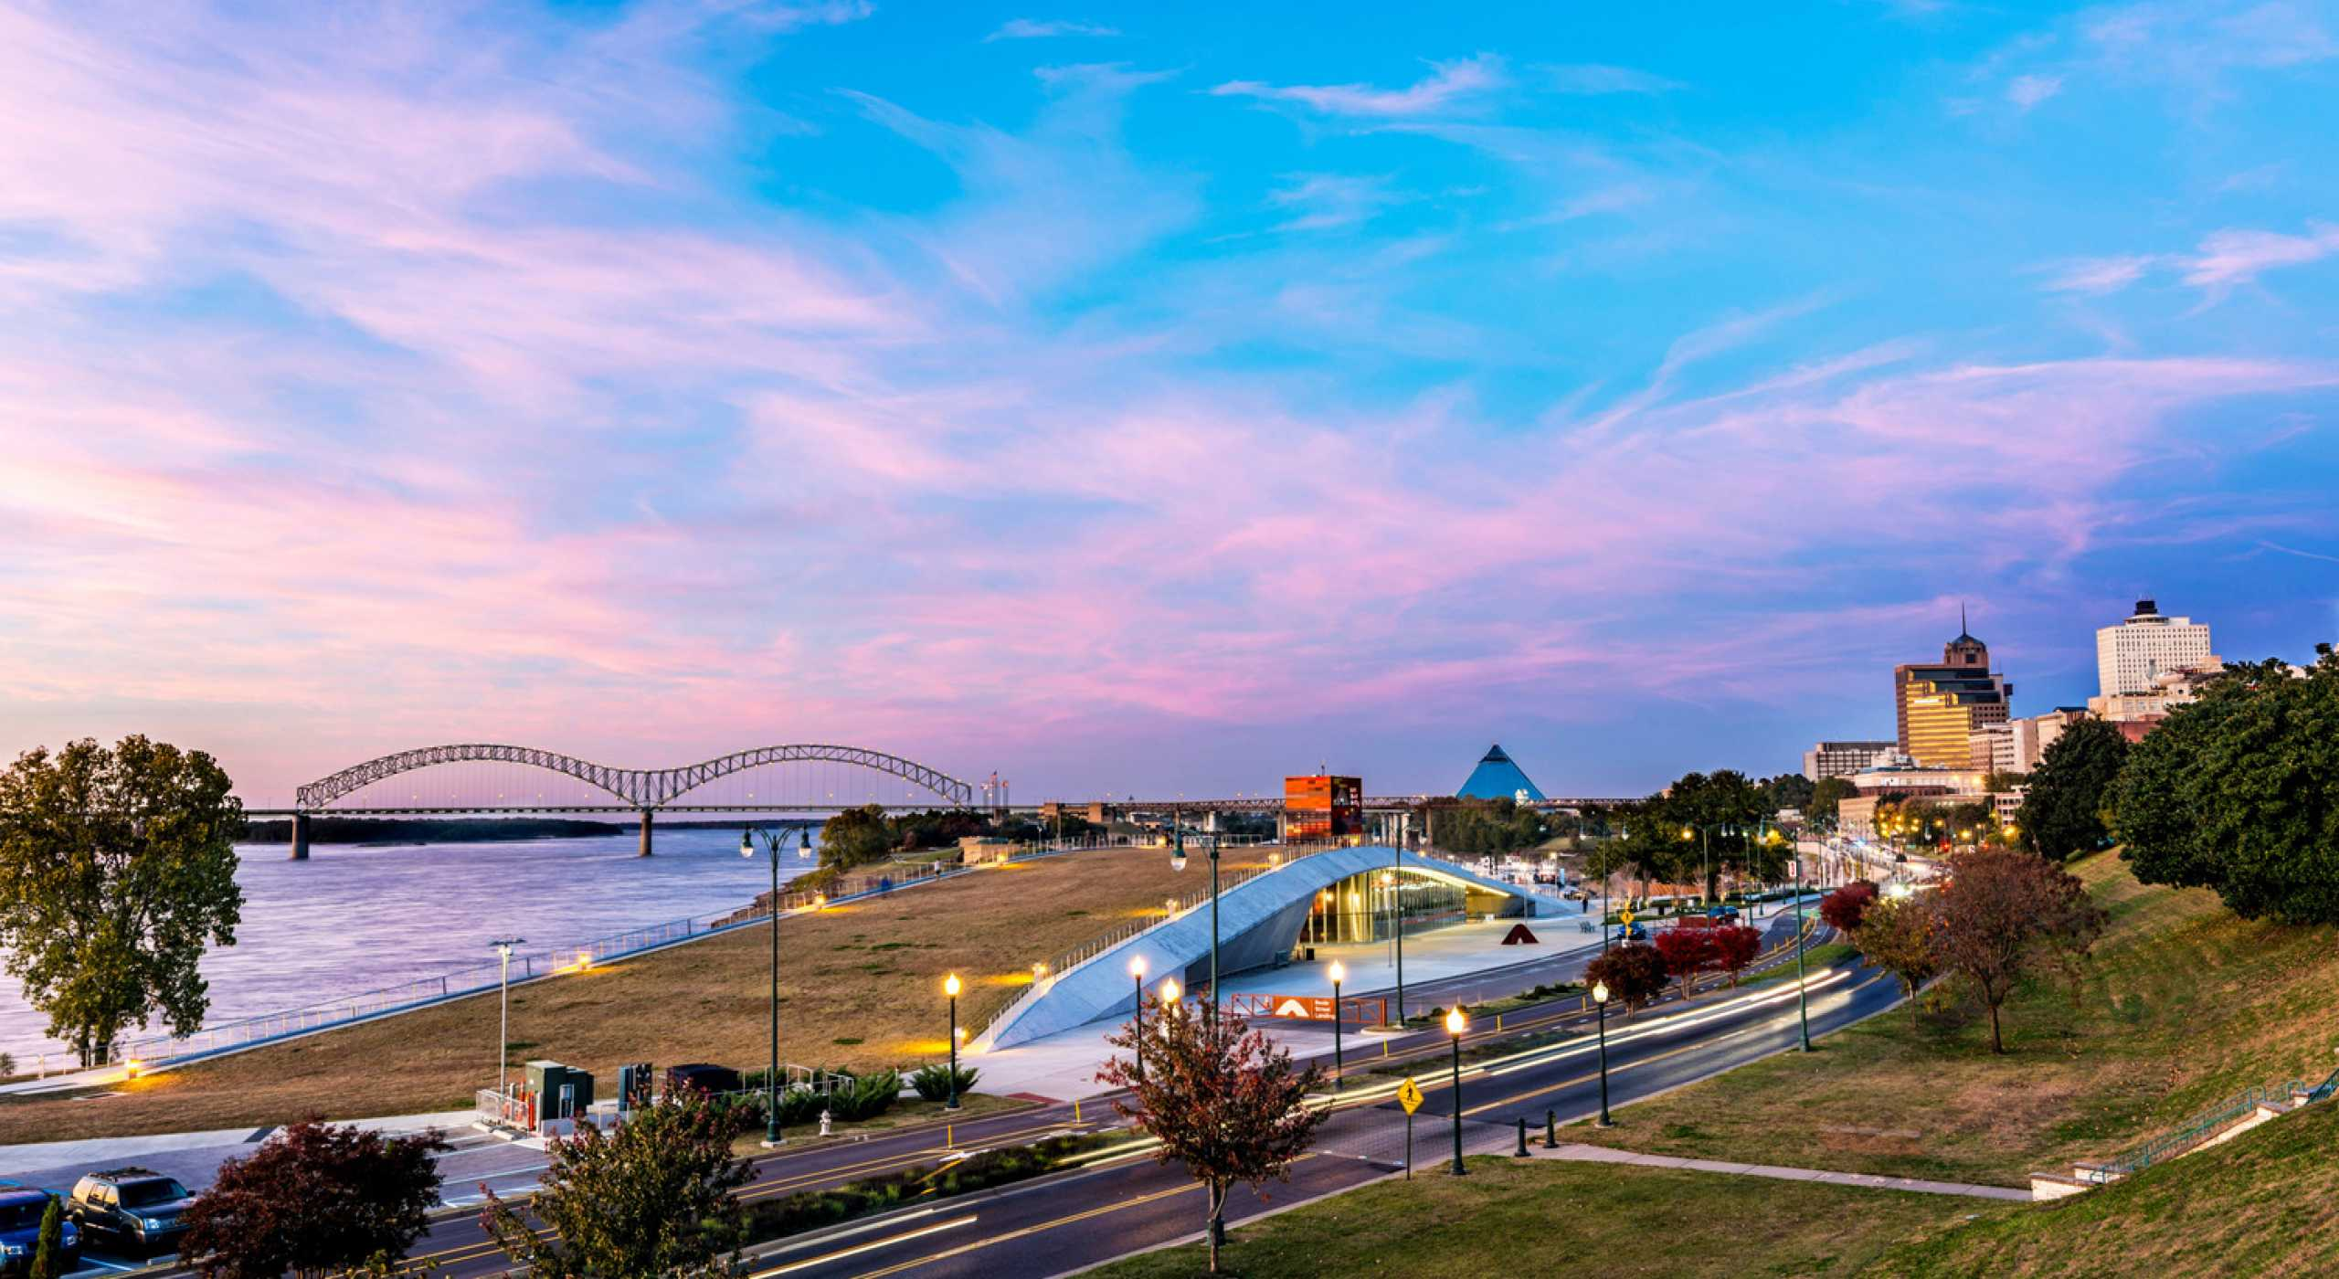
Predicting Location to Open an Indian Restaurant in Memphis, Tennessee
Submitted by: Rojoba Yasmin
August 2020

Slide 2
Business Problem:
For a successful business, the first step is to find out a proper location that is suitable to attract the customers.
Memphis is the 26th largest city in United States, and the second-most populous city in Tennessee State.
This city has a number of renowned industries such as headquarters of FedEx, AutoZone, and so on.
Memphis is a popular choice to live in for people of all race.
Goal of this project: To select the best location to open an Indian restaurant at the city of Memphis.

Slide 3
Methodology:
Data Collection
Use Foursquare API to collect location information
Data Pre-processing
Generate a data frame that consists of the necessary information only
Cluster the dataset
Use K-Means Clustering approach
Map visualization
Use Folium to visualize the dataset

Slide 4

Description of the Dataset:
Foursquare API is one of the largest open-access databases of 105+ Million data.
Foursquare API is used to search for specific type of venues or stores around a given location.
Collect the location data for the neighborhoods by using Foursquare API.

Slide 5
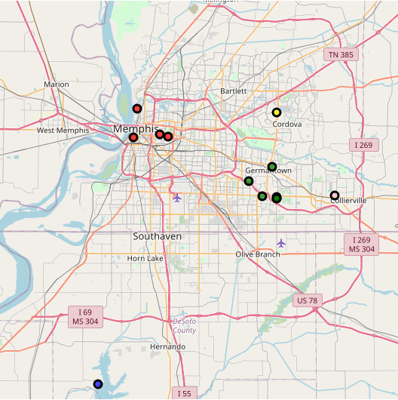
Results:
The fig shows the neighborhoods of Memphis city and the location of Indian restaurants

Slide 6
Discussion:
Location data is important to start a new business.
This project gives an example to find the location dataset, and cluster them to see the suitable place.

Slide 7
References:
Memphis, Tennessee Population 2020. (n.d.). Retrieved August 27, 2020, from https://worldpopulationreview.com/us-cities/memphis-tn-population
Foursquare Developer. (n.d.). Retrieved August 27, 2020, from https://developer.foursquare.com/

Slide 8
