Slide 1

Insurance Portfolio Analytics
Power BI Dashboard Project — Business Problem Statement & Project Report
MICROSOFT POWER BI DESKTOP
INSURANCE ANALYTICS / BI
JUNE 2026
Prepared by Boveen Pavuluri

Slide 2

The Business Problem
An insurer across 4 Indian regions manages 10,000+ policies across 5 product lines — Health, Motor, Life, Travel, and Home. Leadership relies on disconnected spreadsheets with no centralized visibility into premiums, claims, agents, or retention.
Underwriting
No loss ratio visibility — policies may be underpriced
Claims
Cannot identify which products or regions drive losses
Agents
Cannot differentiate high-performing vs. high-risk agents
Retention
Lapse rate unmonitored — customers leave without intervention

Slide 3

Proposed Solution
Build a 4-page interactive Power BI dashboard consolidating all insurance data — giving executives, operations, sales, and risk teams a single source of truth for fast, data-driven decisions.
Executive Overview
Agent Performance
Premium, claims, loss ratio, policies
Top/bottom agents and loss ranking
Claims Analysis
Risk & Retention
Approval rate, settlement days, volume
Lapse rate and regional loss heatmap
Any stakeholder can filter the entire dashboard by region, policy type, or time period.

Slide 4
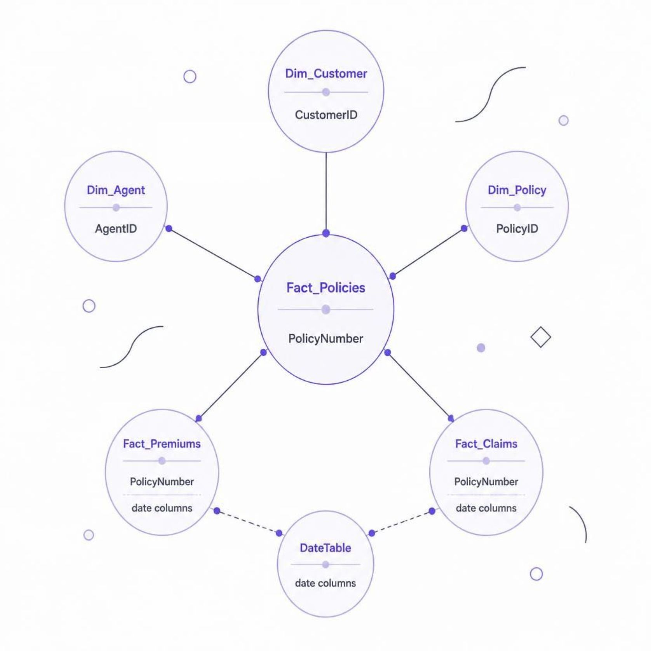
Data Model & Cleaning
Star Schema — 7 Relationships
Dataset Overview
Single Excel file with 6 sheets covering 10,000 policies, 4,000 claims, and premiums from Jan 2022 – Apr 2025.
3 Dimension tables: Customer, Agent, Policy
3 Fact tables: Policies, Premiums, Claims
Custom DateTable via DAX CALENDAR() (2022–2026)
Power Query fixes: Added headers to Dim_Agent, corrected Excel serial-number dates across 3 fact tables, added MonthSort column for chronological chart display.

Slide 5



DAX Measures
Revenue & Volume
Total Premium, Total Claims Amount, Total Policies, Active Policies, Lapsed Policies
Efficiency Ratios
Policy Lapse Rate %, Claim Approval Rate %, Loss Ratio %
Claims Performance
Total Claims Count, Approved Claims Count, Avg Settlement Days, Average Claim Amount
Agent Metrics
Claims per Agent — total claims divided by distinct agent count

Slide 6
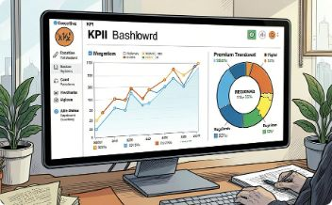
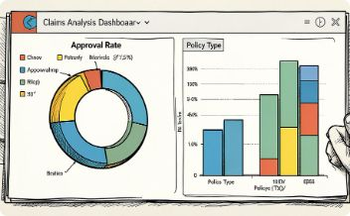
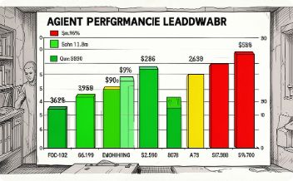
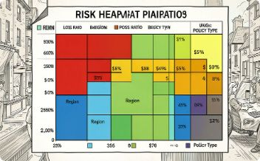
Dashboard Pages
Page 1 — Executive Overview
Page 2 — Claims Analysis
Page 3 — Agent Performance
Page 4 — Risk & Retention
KPIs, premium trend, policy type breakdown, regional distribution
Approval rate, settlement days, claims by status and policy type
Top 10 agents by premium, loss ratio ranking, risk-coded table
Lapse rate, premium vs. claims by region, loss ratio heatmap

Slide 7

Key KPIs & Critical Insights
₹567M
₹603M
Total Premium
Total Claims
106.4%
6,018
Loss Ratio
Active Policies
54.8%
25.2
Claim Approval
Avg Settlement Days
Underwriting Loss
Lapse Rate: 14.6%
Claims exceed premiums — immediate repricing needed.
1,463 customers stopped paying — targeted retention required.
Health (West): 134.8% Loss Ratio
Life (West): 87.5% — Only Profitable
Highest-risk segment — paying ₹134 per ₹100 collected.
Cross-subsidizing all other loss-making segments.
Agent Quality Gap
Premium Decline Since Mid-2024
Best agent (Shlok Banik) at 64.4% vs. worst (Oorja Ratta) at 229% loss ratio.
Peaked at ₹21M/month in April 2024, then declined sharply.

Slide 8



Tools, Technologies & Conclusion
Technology Stack
Power BI Desktop — Dashboard development & visualization
Power Query (M) — Data cleaning & transformation
DAX — Calculated measures & KPIs
Star Schema — Fact & dimension table modeling
GitHub — Portfolio hosting & version control
This project is available on GitHub with the source dataset, Power BI file, and README documentation.

