Slide 1
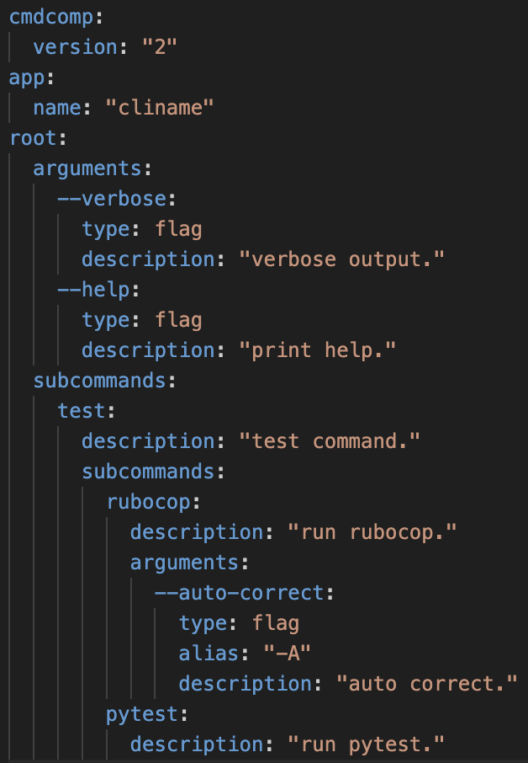
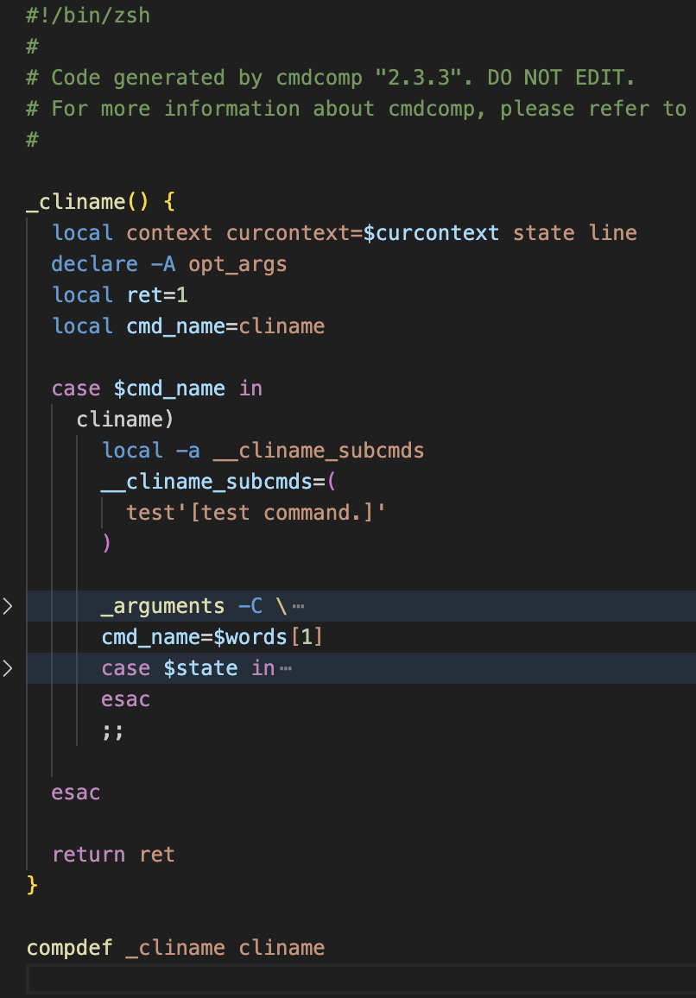
Config File
Shell Completion File
JSON
TOML
BASH
ZSH
YAML
cmdcomp

