Slide 1
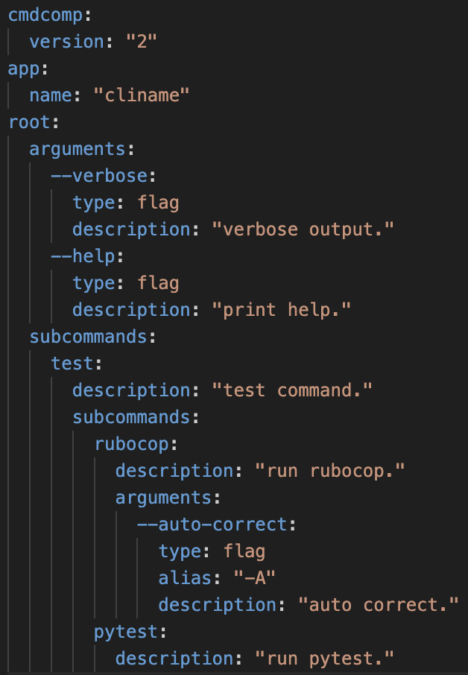
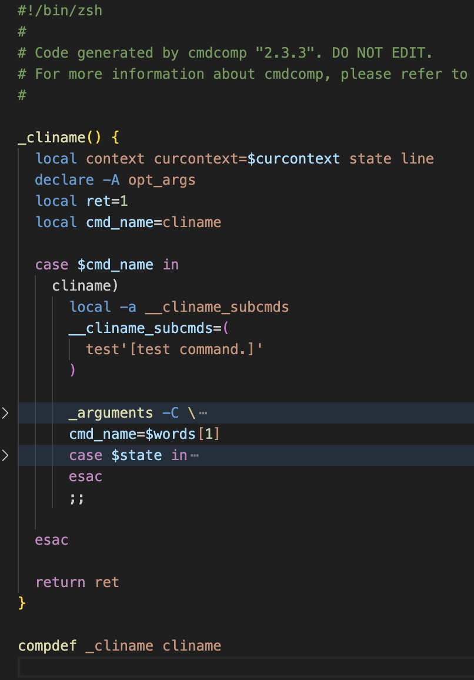
JSON
TOML
BASH
ZSH
YAML
cmdcomp

