Slide 1
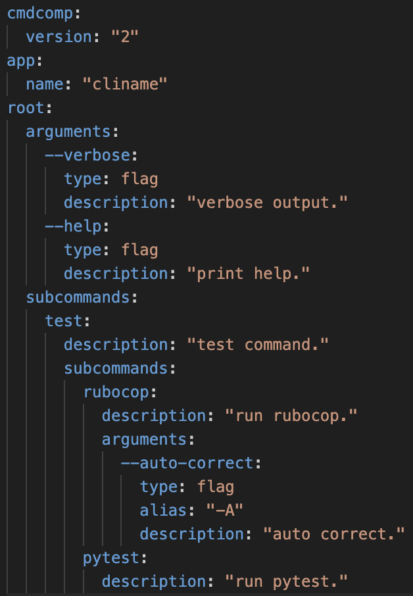
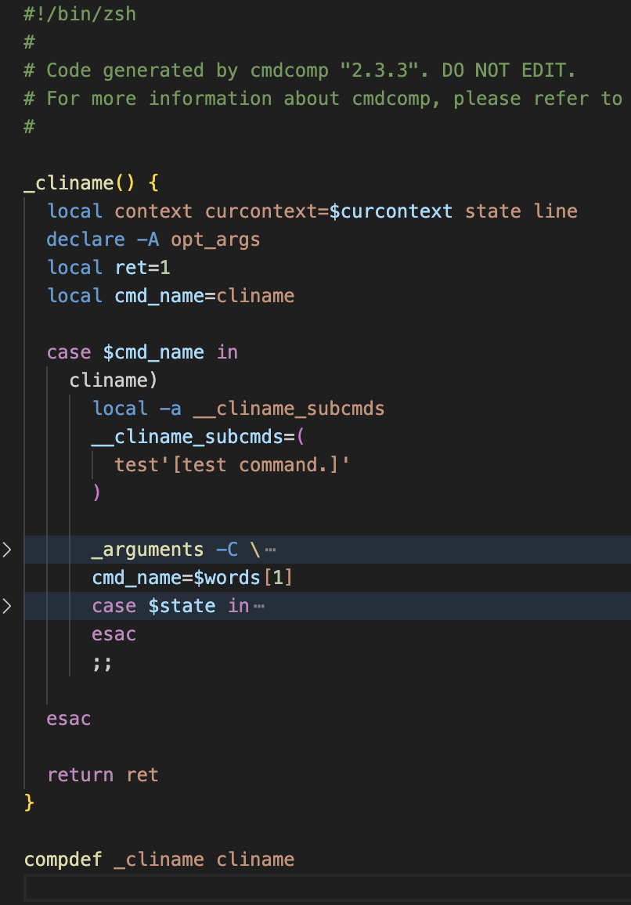
Config File
Shell Completion File
TOML
JSON
BASH
ZSH
YAML
cmdcomp

