Slide 1
SEDS482 - Training Chatbot
IYTEBot
Toprak Zeybek 323011022
Yasin Turk 323011020

Slide 2
What was our Motivation?
01
In fact, as a society, we are not particularly fond of reading. As students, we sometimes avoid reading school regulations and instead go directly to student affairs or other administrative staff to ask our questions
Notes:
As a society, we don't tend to read much. Students often skip reading school regulations and ask administrative staff instead. To reduce their workload and improve access to information, we developed a chatbot based on IYTE’s regulations.

Slide 3
Collecting and Creating Data
Training the Chatbot
Create Endpoints
UI Changes
First, we downloaded IYTE’s regulations and prepared questions based on them.
Then, using the questions we created, we trained the chatbot through transfer learning based on the GPT-2 model.
After that, we downloaded the trained model and created an endpoint using Flask to ask it questions.
After that, we made improvements to the user interface.
Notes:
We actually divided our work into four main steps:
First, we downloaded the regulations and prepared relevant questions.
Next, we trained the chatbot.
Then, we created the endpoint.
Finally, we improved the UI.

Slide 4
Dolor Sit
While creating the questions, we wrote some of them ourselves and generated others with the help of AI.
We used Flask locally to create the endpoint.
Ready for use! :)
In training, we used Python and Google Colab.
For the UI, we used HTML, CSS, and a small amount of JavaScript.

Slide 5
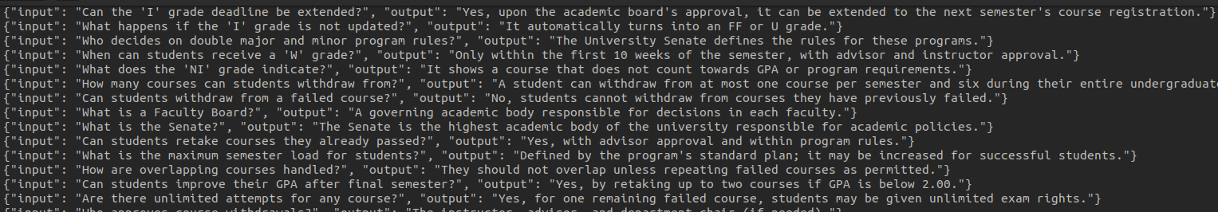
Dolor Sit
Example Records that we used in training.

Slide 6


Slide 7
THANK YOU
Yasin Turk
Toprak Zeybek

