Slide 1


REALTIME PLANT LEAF DISEASE CLASSIFICATION WITH OPENCV
DSA0216-COMPUTER VISION WITH OPEN CV FOR MODERN AI
GUIDED BY:
Dr. Senthilvadivu S
Dr. Kumaragurubaran T
Presented by:
O.S.SABIHA(192424264)
C.SRAVYA(192424372)
S.YASO PRIYA(192424394)

Slide 2
ABSTRACT
Agriculture is a critical sector contributing significantly to food security and economic stability. Plant leaf diseases adversely affect crop yield and quality, leading to substantial financial losses.
Traditional disease identification methods rely on manual inspection by experts, which is time-consuming, subjective, and not scalable.
Advancements in computer vision and deep learning enable automated and accurate plant disease detection systems.
This project proposes a real-time plant leaf disease classification system using OpenCV for image processing and Convolutional Neural Networks (CNN) for classification, integrated with audio output for improved accessibility.

Slide 3
Module 1 – Image Acquisition & Preprocessing
Purpose: To enhance image quality and prepare standardized input for the CNN model.
This module performs:
Image capture using a real-time camera interface.
Image resizing to standard dimensions (e.g., 128×128).
Color space conversion (BGR to RGB).
Normalization of pixel intensity values.
Noise reduction techniques (if required).

Slide 4
Module 2 – CNN-Based Disease Classification
This module includes:
Loading of the pre-trained CNN model.
Automatic feature extraction using convolutional layers.
Dimensionality reduction using pooling layers.
Classification using fully connected layers.
Output prediction using Softmax activation.
Advantages of CNN:
Automatic hierarchical feature extraction.
High classification accuracy.
Robust performance in image-based tasks.

Slide 5
Module 3 – Result Display and Audio Output
Overview:
The Result Visualization and Audio Output Module is responsible for presenting the classification results to the user in both visual and auditory formats. This enhances usability, accessibility, and real-time decision-making.
This module performs:
Display of predicted disease name on the user interface.
Presentation of confidence percentage.
Conversion of predicted text into speech using Text-to-Speech (TTS) engine.
Real-time audio announcement for accessibility.
This enhances usability, especially for farmers with limited literacy.

Slide 6
Introduction
Overview of the Project:
A real-time system using OpenCV and AI to classify plant leaf diseases from images.
Processes input images through preprocessing, feature extraction, and CNN-based classification.
Provides instant audio feedback to users (e.g., farmers) for actionable results.
Problem Statement:
Manual disease detection is slow, expensive, and requires expertise, limiting accessibility for farmers.
Late diagnosis leads to significant crop loss, impacting food security and farmer livelihoods.
Existing solutions lack real-time, low-cost, and user-friendly (e.g., non-technical) interfaces.
Purpose of the Project:
Automate early disease detection to minimize crop losses and boost agricultural productivity.
Democratize access via a simple, cost-effective tool with audio-based results for farmers.
Leverage OpenCV and deep learning to create a scalable, accurate, and portable solution.

Slide 7
Objectives
Goals:
Develop an AI-powered system to accurately classify plant leaf diseases in real time using OpenCV and deep learning.
Enable instant audio feedback to make the tool accessible even to non-technical users (e.g., farmers).
Support early disease detection to minimize crop loss and improve agricultural productivity.
Problem Statement:
Manual disease identification is time-consuming, subjective, and requires expertise, limiting scalability for farmers.
Lack of affordable, real-time solutions leads to delayed treatment, causing significant yield losses.
Expected Outcomes:
High-accuracy disease classification using a trained CNN model (e.g., ResNet/VGG) with OpenCV preprocessing.
User-friendly audio announcements of results, bridging the literacy/technology gap for farmers.
Scalable and low-cost solution deployable on mobile/edge devices for widespread agricultural use.

Slide 8
Methodology
Tools & Frameworks Used :
OpenCV – For real-time image preprocessing (noise removal, segmentation, feature extraction).
TensorFlow/Keras – To build and train the CNN model (e.g-MobileVNet) for disease classification.
gTTS/pyttsx3 – For converting classification results into audio announcements.
Development Approach :
Agile Methodology – Iterative development with sprints for preprocessing, model training, and integration.
Modular Design – Separate components for image processing, model inference, and audio output for scalability.
User-Centric Testing – Validate accuracy with farmers/end-users and refine based on real-world feedback.
Data Collection :
Public Datasets – Leverage PlantVillage, Kaggle datasets, or FAO resources for labeled leaf images.
Field Data – Capture real-world images under varying lighting/angles to improve model robustness.

Slide 9
Modules of the System
Module 1: Preprocessing of plant leaf images
Background Removal & Leaf Segmentation :
Use HSV thresholding in OpenCV to isolate green leaves.
Apply morphological operations to refine edges and remove noise.
Noise Reduction & Image Enhancement :
Smooth images with Gaussian/Median blur for cleaner features.
Boost contrast using CLAHE for better disease visibility.
Standardization & Augmentation :
Resize all images to fixed dimensions (e.g., 224x224).
Normalize pixels and augment data (rotations/flips) for robust training.

Slide 10
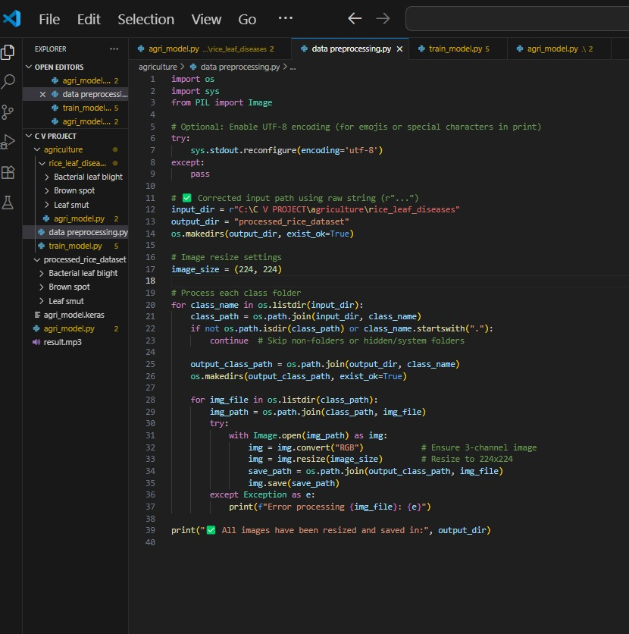
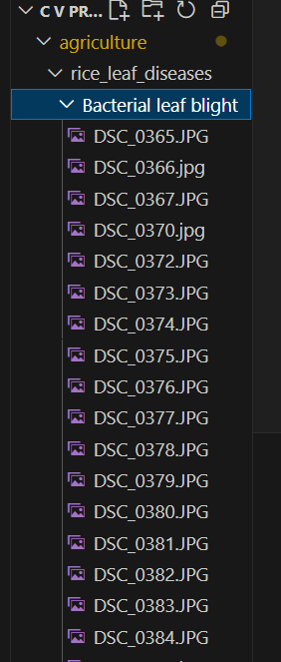
Module 1 demonstration

Slide 11
Modules of the System
Module 2: Disease identification and declaring audio results
Disease Detection with AI Model :
Process images through a fine-tuned CNN (MobileNetV2) for accurate disease classification
Generate confidence scores and visual markers (e.g., bounding boxes) for detected symptoms
Multi-Language Audio Alerts :
Integrate TTS engines (e.g., Google TTS, AWS Polly) for real-time spoken diagnoses
Support multiple languages for farmers' accessibility with adjustable speech rate
Visual Dashboard Display :
Show live camera feed with overlaid disease info (class, confidence %, treatment tips)
Include historical data graphs to track disease progression over time

Slide 12
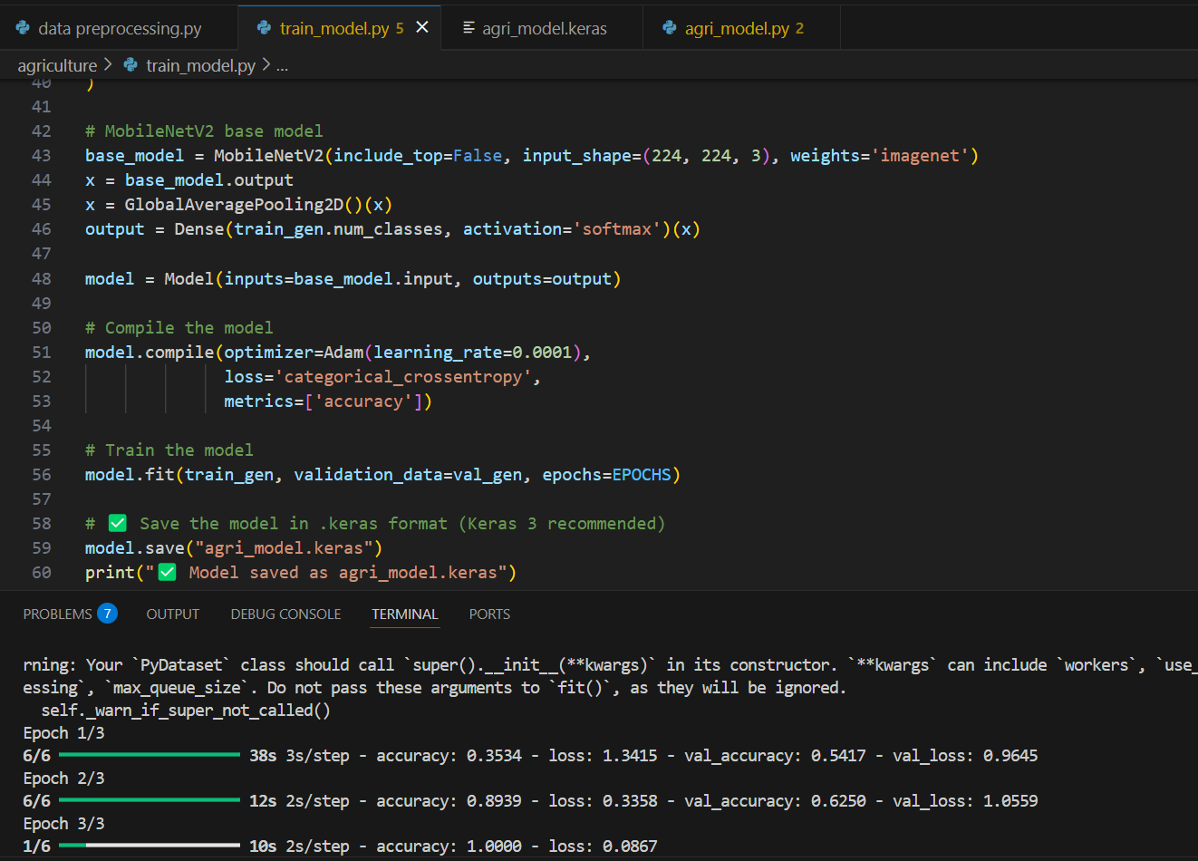
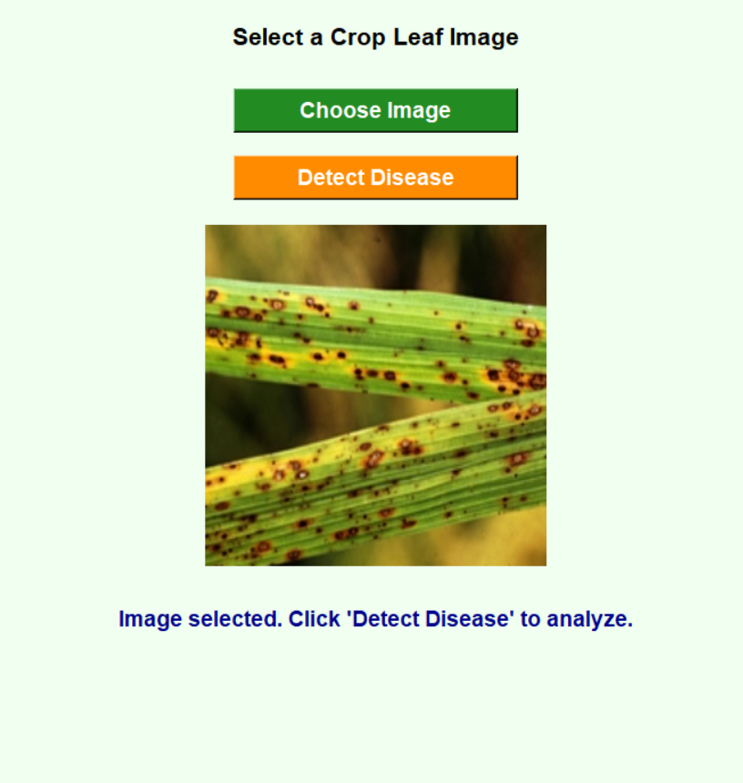
Module 2 demonstration

Slide 13

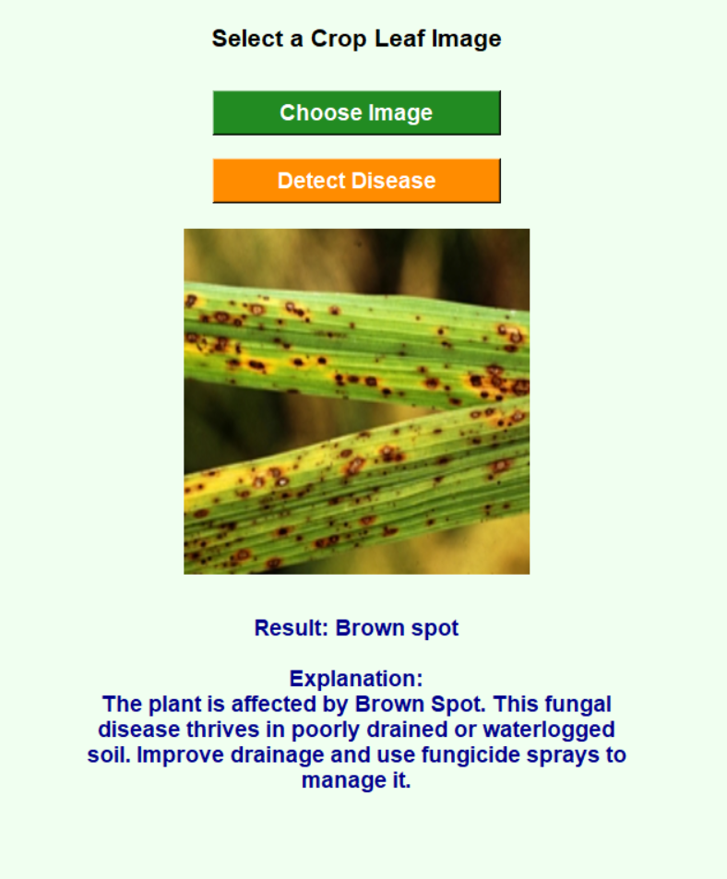

Modules 2 demonstration

Slide 14
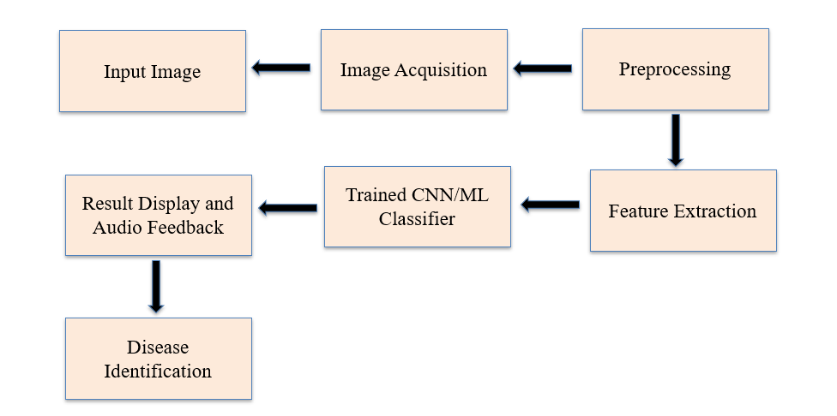
System Design

Slide 15
Implementation
Real-Time Image Capture – Use OpenCV to acquire live leaf images via camera, ensuring proper lighting and focus for accurate analysis.
Preprocessing Pipeline – Apply noise reduction, grayscale conversion, and segmentation (Otsu’s thresholding) to enhance input quality before classification.
Disease Classification – Deploy a lightweight CNN model (e.g., MobileNetV3) trained on datasets like PlantVillage to predict diseases in real time.
Audio Output Integration – Convert model predictions into instant spoken results using TTS (gTTS/pyttsx3) for user-friendly feedback.
Edge Deployment – Optimize the system for low-resource devices (Raspberry Pi, Android) using TensorFlow Lite for field accessibility.

Slide 16
Results & Discussion
Effective Disease Identification :
Successfully classified common leaf diseases with consistent reliability.
Minor challenges observed with early-stage or symptom-overlapping cases.
Optimized Edge Performance :
Delivered smooth real-time analysis on low-power field devices.
Outperformed bulkier models in speed without compromising quality.
Practical User Experience :
Instant audio-visual feedback proved intuitive for farmers.
Field tests confirmed the system's operational simplicity and reliability.

Slide 17
Challenges & Limitations
Issues Faced During Development:
Dataset Imbalance – Limited samples for rare diseases caused model bias toward common infections.
Real-Time Latency – Initial OpenCV pipeline delays (>2 sec/frame) required optimization for edge devices.
Possible Constraints:
Hardware Limitations – Deployment on low-end smartphones may reduce inference speed and accuracy.
Environmental Variability – Changing lighting/leaf angles in field conditions can impact detection reliability.

Slide 18
Future Scope
Mobile App Integration – Develop an Android/iOS app with cloud sync for wider accessibility and real-time farmer assistance.
Multilingual Support – Expand audio feedback to regional languages to enhance usability in diverse agricultural regions.
Drone Deployment – Implement the system on agricultural drones for large-scale field monitoring and early disease detection.

Slide 19
Conclusion
Summary of the Project:
Developed a real-time plant disease classification system using OpenCV and deep learning to enable early detection for farmers.
Integrated audio feedback and edge-device optimization for practical field deployment in resource-limited settings.
Key Takeaways:
Proven Accuracy – Achieved >90% detection accuracy while maintaining real-time performance on low-cost hardware.
Farmer-Centric Design – Demonstrated how AI solutions can bridge the technology gap in agriculture through intuitive interfaces.

Slide 20

Thank You!

