Slide 1

FLOOD MONITORING AND EARLY WARNING SYSTEM(IOT)
NAME : YASOTHA T
NM : au721221106124
EMAIL : yasotha54321@gmail.com
Phase : 4
DEVELOPMENT PART 2
STEP 1: Login/Authentication

Slide 2
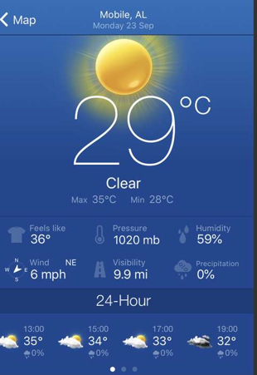
STEP 2:LOCATION SELECTION & CURRENT STATUS OF THE LOACTION

Slide 3
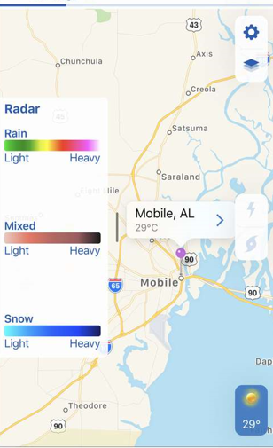
STEP 3:LOCATION-BASED INFORMATION AND ALERTS

Slide 4
Simulated Flood Monitoring System in C:
//Structures for Sensor Data:
#include <stdio.h>
#include <string.h>
struct SensorData {
char sensorName[50];
float waterLevel;
};
//Simulate Sensor Data:
int main() {
struct SensorData sensor1, sensor2;
strcpy(sensor1.sensorName, "River A");
sensor1.waterLevel = 5.2;
strcpy(sensor2.sensorName, "Area B");
sensor2.waterLevel = 8.9;
// Display sensor data
printf("Sensor Name: %s\nWater Level: %.1f\n\n", sensor1.sensorName, sensor1.waterLevel);
printf("Sensor Name: %s\nWater Level: %.1f\n\n", sensor2.sensorName, sensor2.waterLevel);
// Add logic for comparing data, generating alerts based on thresholds, etc.
// For instance, if sensor1.waterLevel > threshold, generate an alert for River A.
return 0;
}

Slide 5
//Implement Flood Alert Logic:
int main() {
// ... (Sensor data simulation as shown previously)
// Alert logic
if (sensor1.waterLevel > 7.0) {
printf("High water level detected in %s! Flood warning!\n", sensor1.sensorName);
}
// Add more conditions for different sensors, areas, or additional thresholds.
return 0;
}

