Slide 1
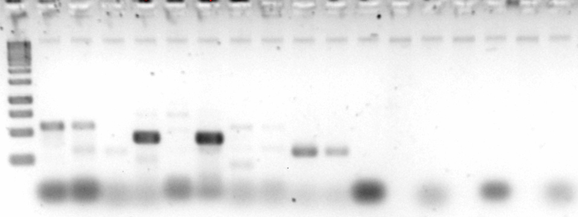
ladder
A
B
Negative controls
Primer pair A
Primer pair B
SALK_
039481
Wild type
Negative control
SALK_
039481
Wild type
Negative control

