Slide 1
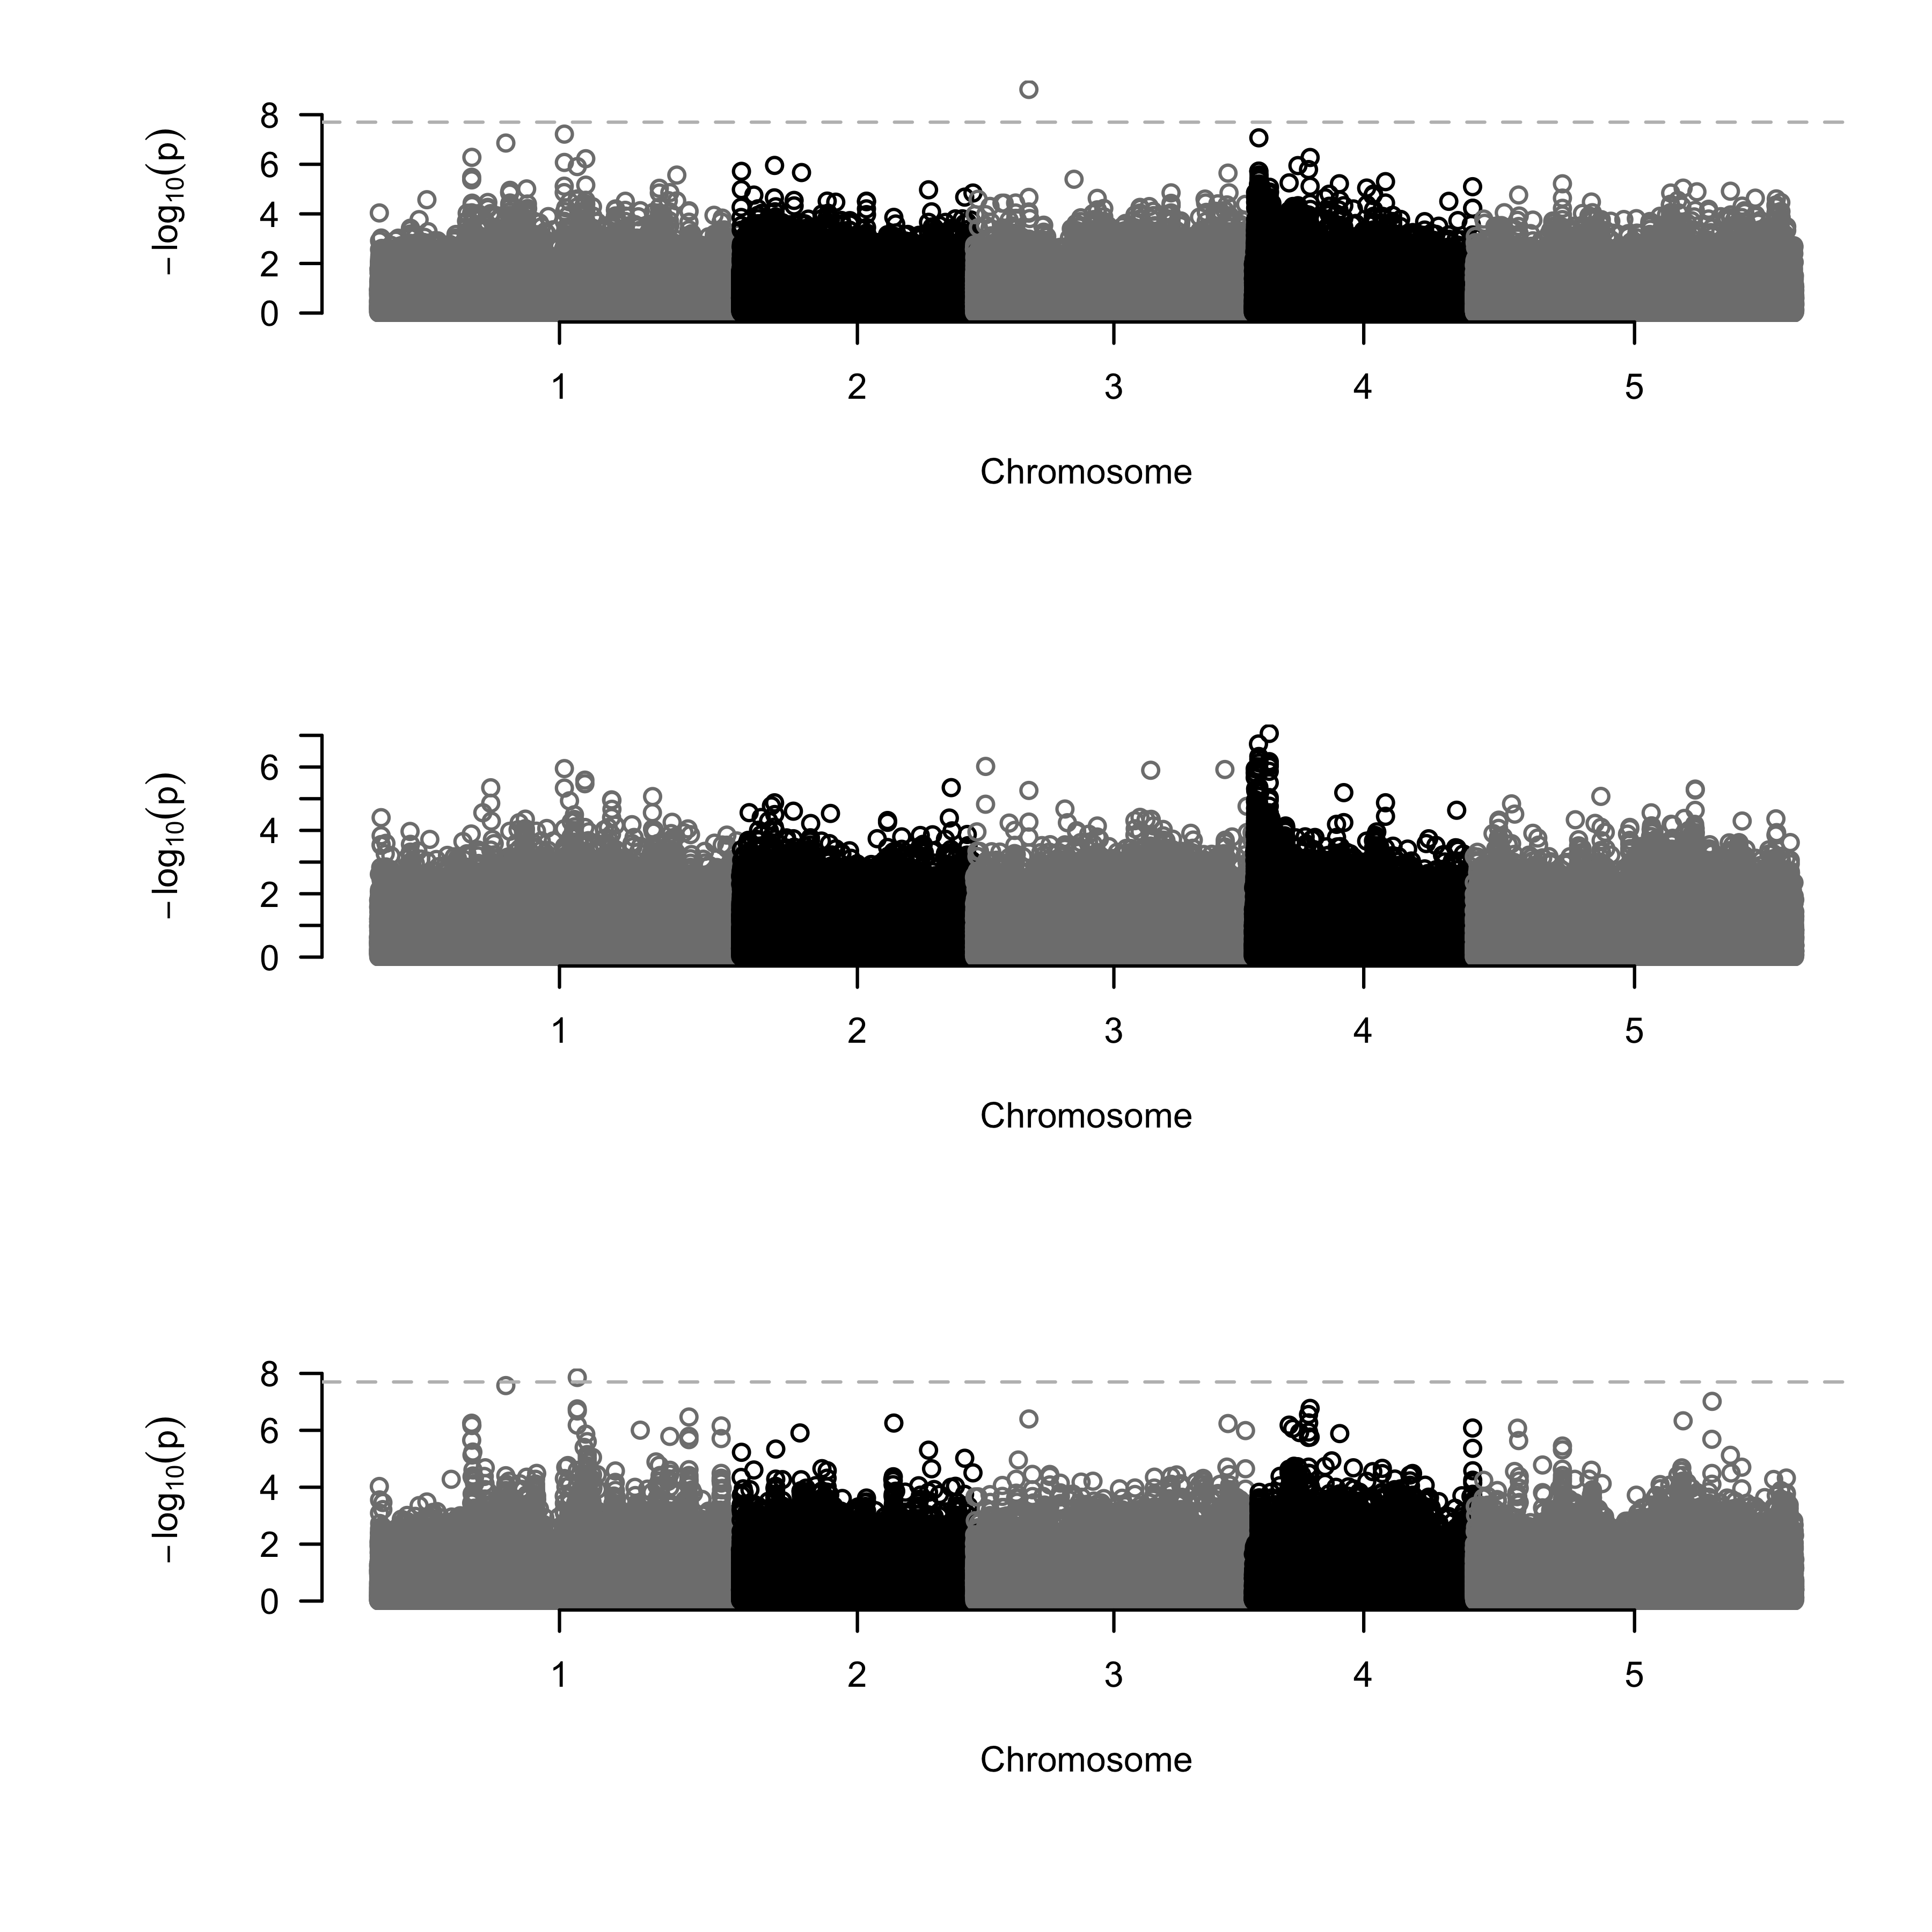
A: Genes
AT3G13880.1
AT3G13890 (MYB26)
AT3G13898 (EPFL3)
AT3G13900.1
AT3G13882 (ribosomal gene)
4574114 4579943 4585773
4579292
B: Aphid abundance
Association score
C: Bolting
Association score
D: Residuals
Association score

