Slide 1
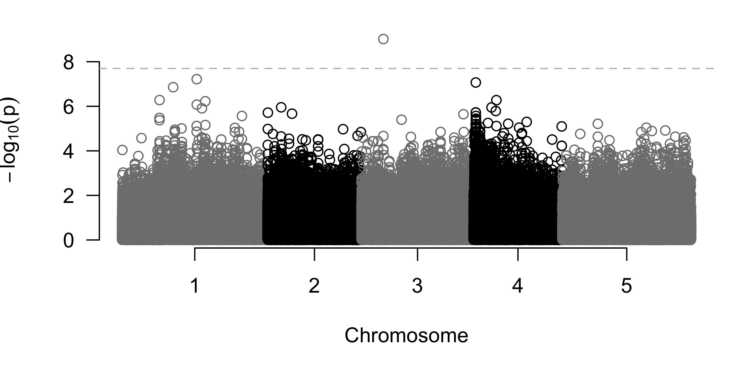
A
MYB26
EPFL3
AT3G13880.1
AT3G13890.1
AT3G13898.1
AT3G13900.1
AT3G13882.1
AT3G13890.2
AT3G13882.2
ribosomal gene
4574114 4579943 4585773
4579292
B
Association score

