Slide 1
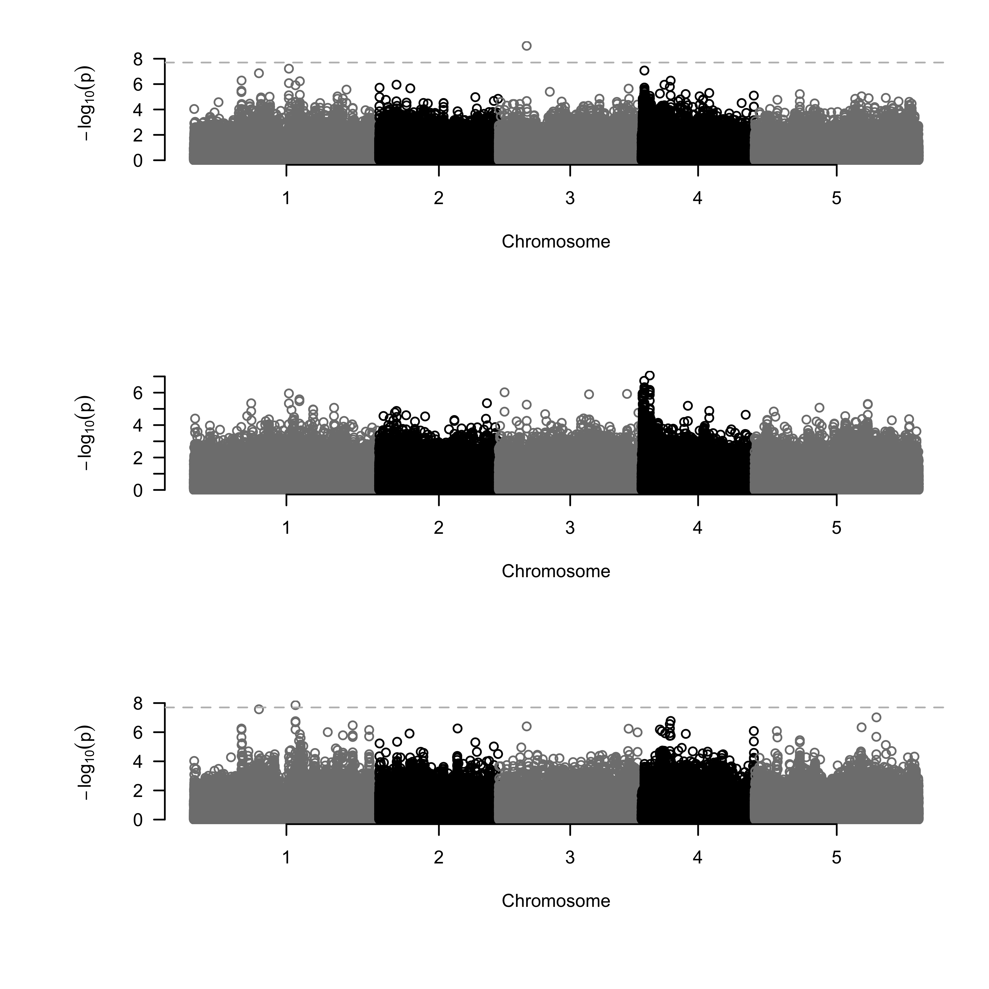
(a) Genes
AT3G13880.1
AT3G13890 (MYB26)
AT3G13898 (EPFL3)
AT3G13900.1
AT3G13882 (ribosomal gene)
4574114 4579943 4585773
4579292
(b) Aphid abundance
Association score
(c) Bolting
Association score
(d) Residuals
Association score

