Slide 1
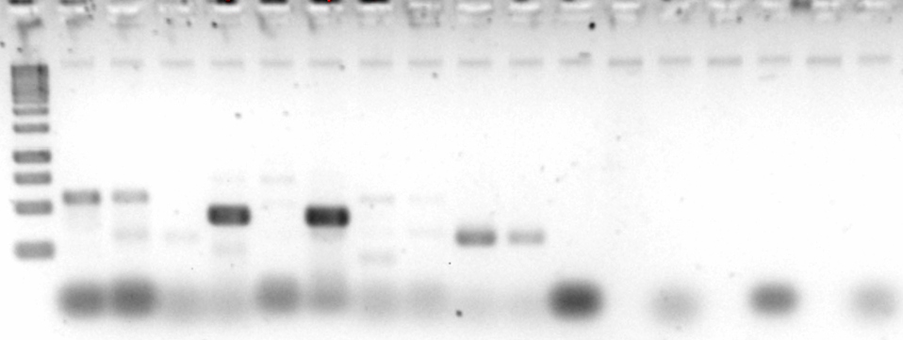
Primer pair A
Primer pair B
SALK_039481
Wild type
Negative control
SALK_039481
Wild type
Negative control

